Slide 1
The cervical spine. Normal anatomy, variants and pathology.
Dr Mandy Williams.
Cons Head and Neck Radiologist.
University Hospitals Bristol.

Slide 2
Aims
Normal anatomy- plain film/ CT/MRI.
Common normal variants.
Pathology seen on different imaging modalities.
Management/ imaging of lesions.

Slide 4
Anatomy

Slide 5
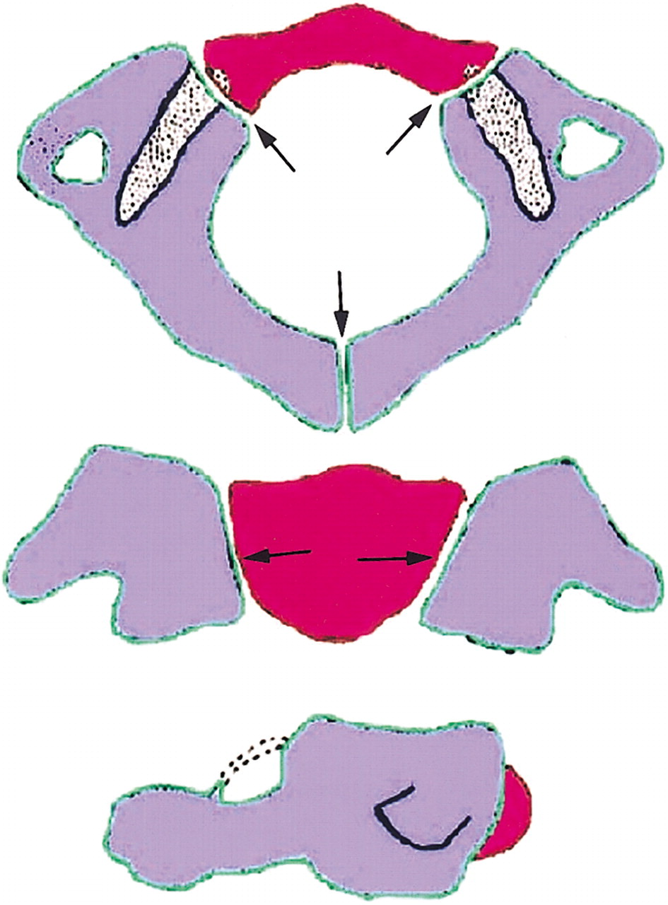
C1
Unique vertebra.
3 ossification centres
Anterior arch & 2 neural arches
Later fuse=posterior arch.

Slide 6
Ossification
Anterior arch ossified in only 20% at birth.
Posterior arch fuses around age 7. Easy mistake to call this a fracture in children.

Slide 7
C2
Most complex vertebra.
4 separate ossification centres- 2 neural arches, body and odontoid peg.
2nd ossification centre develops in the apex of the peg aged 3-6 and fuses around 12 yrs.
The body fuses with the odontoid process around 6yrs but line still seen till age 11. ? Fracture line.

Slide 8
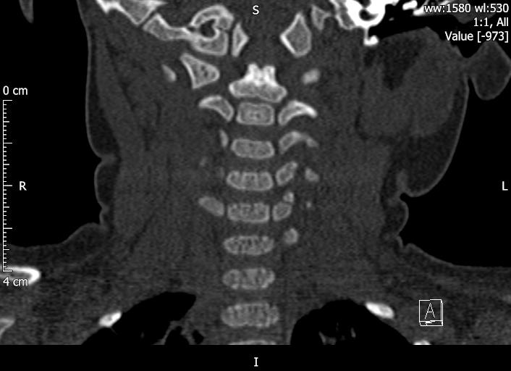
6 months

Slide 9
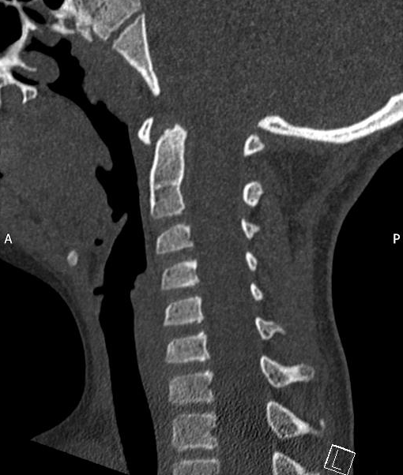
8yrs

Slide 10
C3-C7
Similar pattern of ossification.
3 ossification centres.
Body and 2 neural arches.
Neural arches fuse aged 2-3 yrs
Body fuses with posterior arch 3-6 yrs.
Can have additional secondary ossification centres at tips of transverse processes.

Slide 11
C2-C6
Transverse foramen for vertebral artery to pass.
Bifid spinous processes.

Slide 12
C7
Has transverse foramen but vertebral artery rarely passes through it.
Longer spinous process. Not bifid.
Vertebra prominens.

Slide 13
C3-7

Slide 14
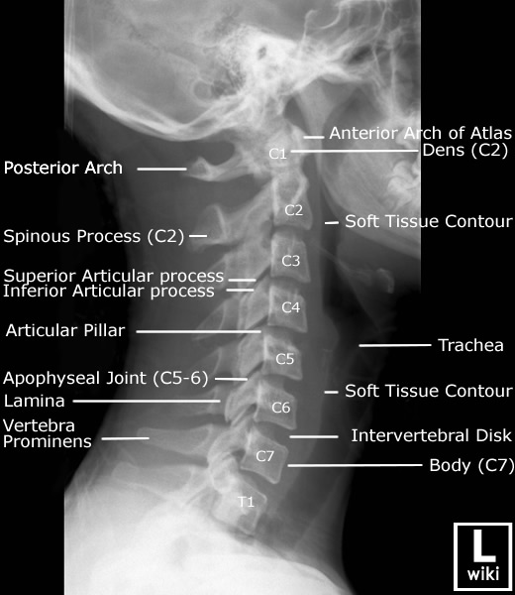
Plain film

Slide 15
Lateral cephalometry
Skull base-C5/6

Slide 20
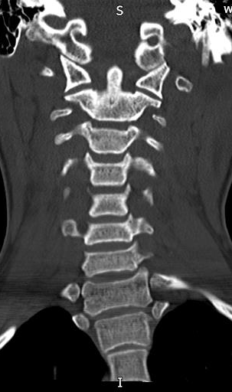
CT

Slide 21
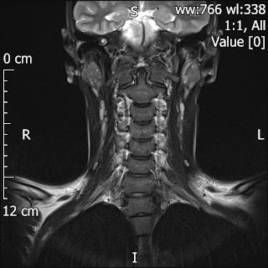

Slide 23
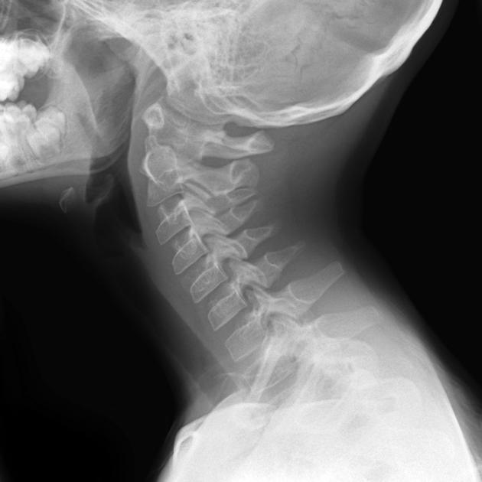
Normal variants
Os odontoidium- Dens absent/ hypoplastic or incompletely fused to C2.

Slide 24
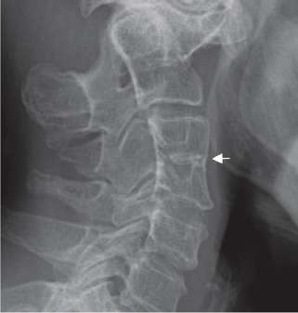
Congenital fusion
Commonly see only one level involved. Not associated with any syndrome. Asymptomatic.

Slide 25
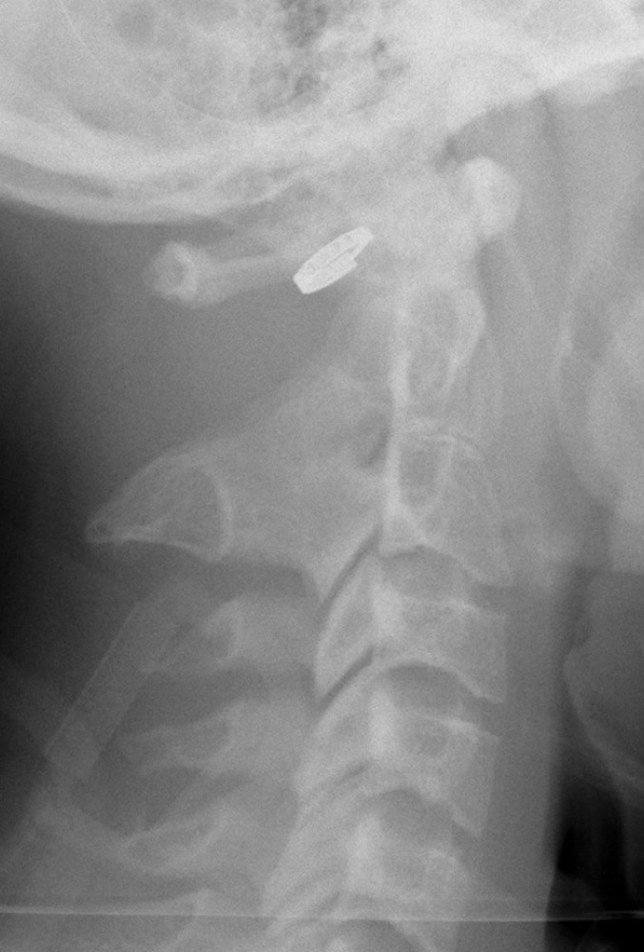
Fusion of basiocciput
Fusion of C1 to occiput (atlanto occipital fusion)
Rare variant.
Fusion of facet joints.

Slide 26
Disc pathology
Ageing
Disc prolapse
Infection.
Arthropathies

Slide 27
Acquired disorders of the Cervical spine.
Normal ageing.
.

Slide 28
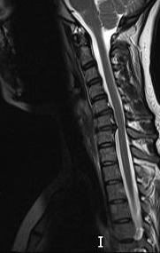
Disc pathology

Slide 29
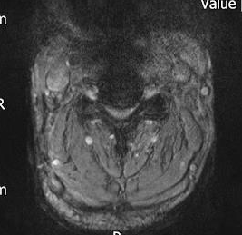
Spinal stenosis

Slide 30
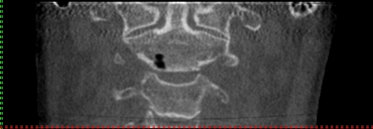
Pneumatocyst

Slide 31
Discitis
Primary infection of the intervertebral disc.
Disc loss of height and end plate destruction.
Common causes- staph aureus/ e coli / streptococcus/TB

Slide 32
Initially plain films and Ct will be normal. MRI more sensitive as picks up disc signal change before bone destruction.

Slide 33
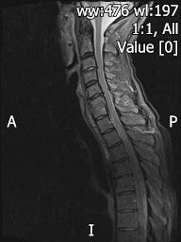

Slide 34
Destructive lesions
Most commonly metastatic in adults.
Primary bone tumours in children/ adolescents-benign and malignant.

Slide 35
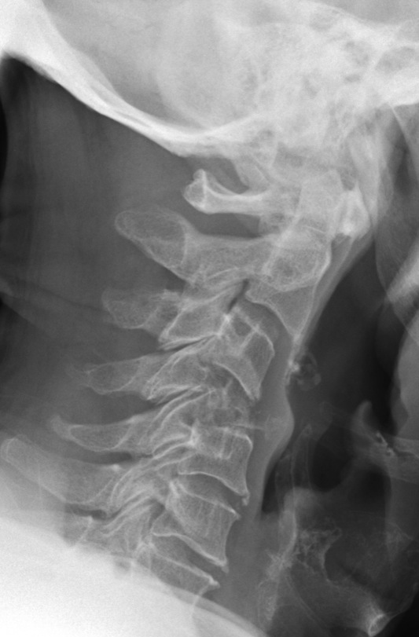

Slide 36
Aneurysmal bone cyst

Slide 37
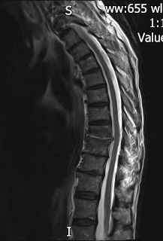

Slide 38
Fractures
Vary according to mechanism of injury.
May go straight to CT if major trauma.
If focal neurology need CT and MRI.

Slide 39
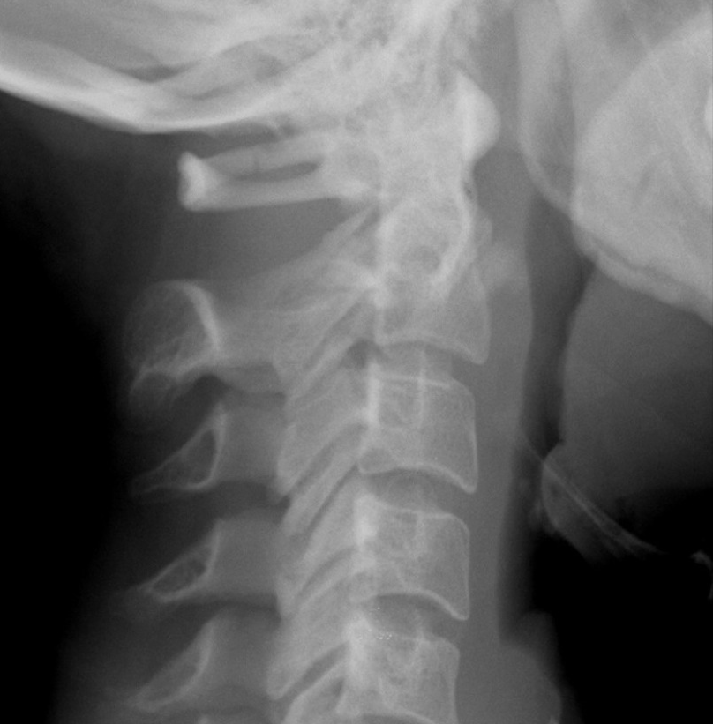
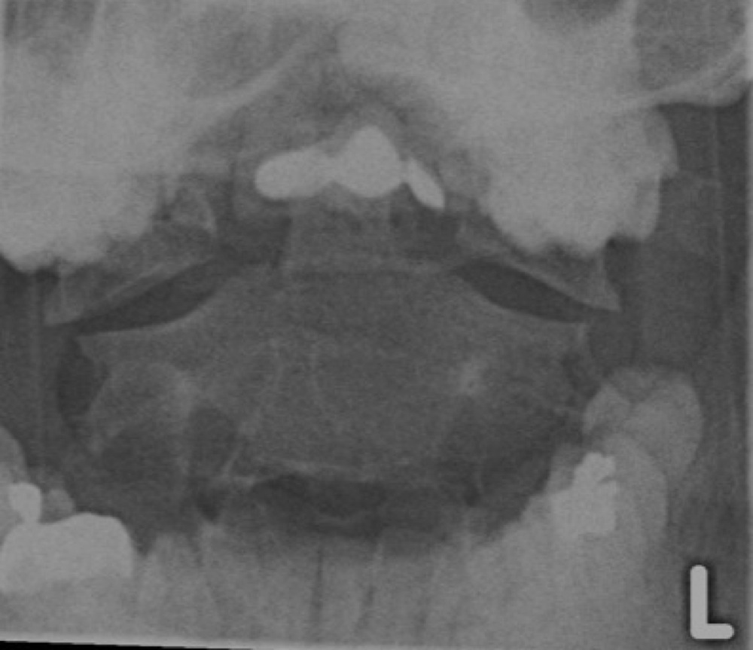
C1- Jefferson/ burst fracture
Widening of lateral masses on open mouth views.
Axial compression.

Slide 40
C2-Hangman’s

Slide 41
Peg fracture
Flexion/ extension. Can be unstable.

Slide 42
Teardrop
Forced extension.
Usually neurologically
intact

Slide 43
Burst Fracture
Axial compression.

Slide 44
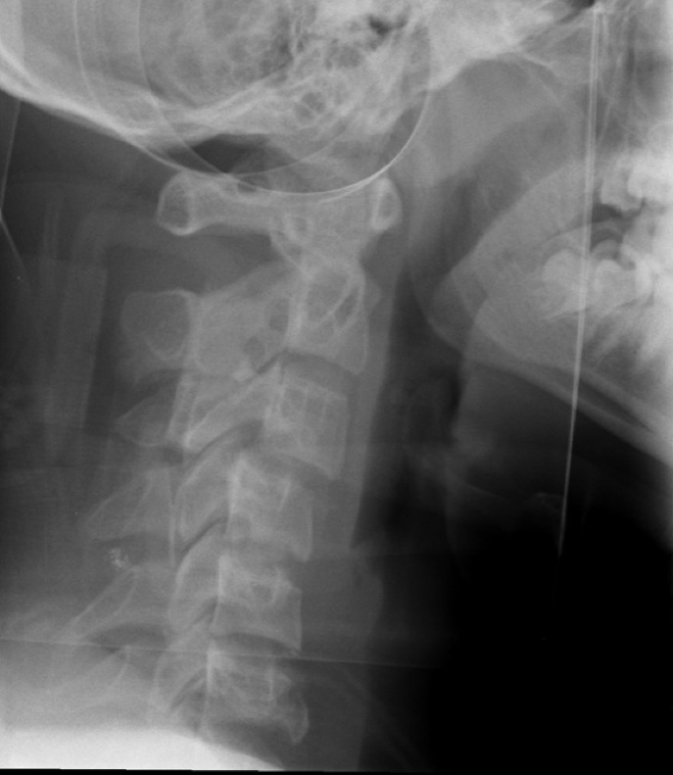
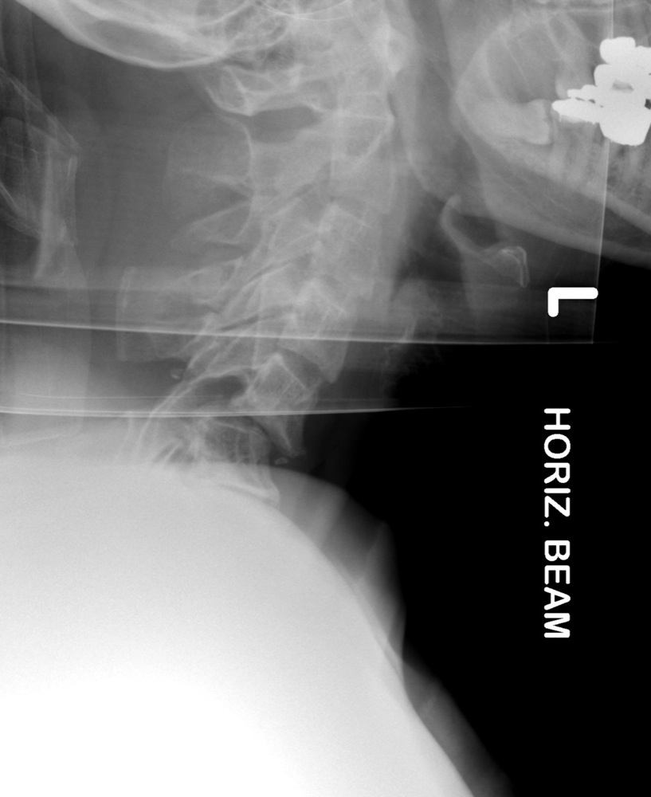
Facet joint dislocation- uni/ bilat
Flexion/ rotation/ distraction.

Slide 45
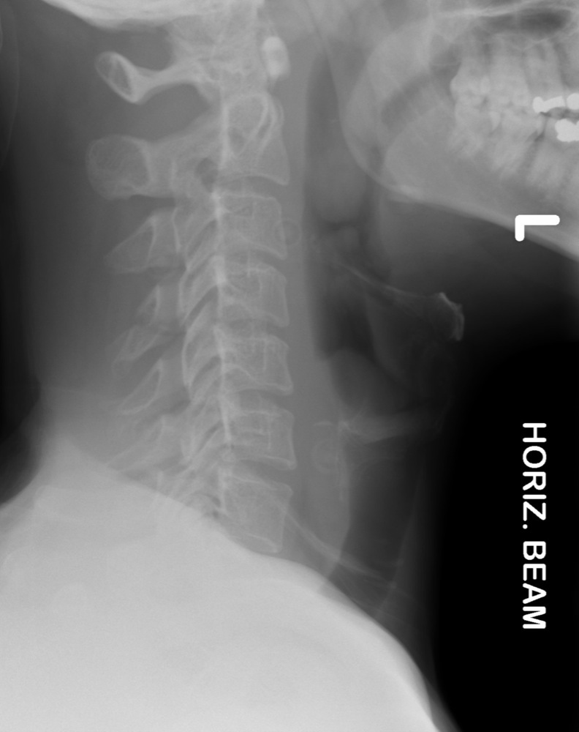
Spinous Process fractures.
Flexion of body relative to the head- avulsion injury.

Slide 47
Ankylosing spondylitis
Seronegative arthropathy.
HLA B27 positive.
Affects whole spine and SIJ.
Associated with uveitis, aortic valve insufficiency and lung fibrosis.

Slide 48
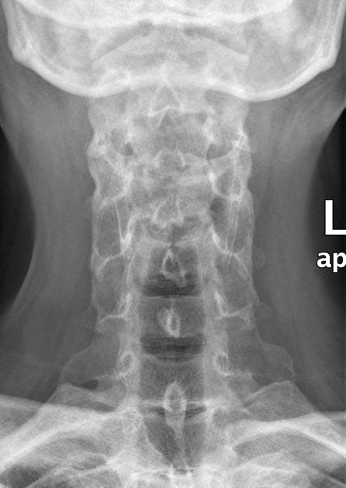

Slide 49
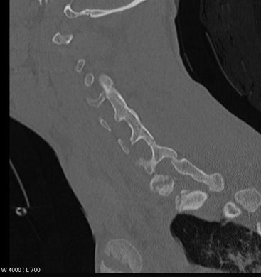
FRACTURES
More common with AS/ fusion as fixed spine

Slide 50
Atlanto axial subluxation.
Flexion extension views.
The atlanto dens distance should be under 3mm (adults) and 3.5mm (children).

Slide 51
If instability, due to ligamentous injury or congenital ligamentous laxity/ damage from inflammation. On flexion the ADI may increase.
Seen post trauma.
Downs Syndrome
Rheumatoid Arthritis.

Slide 52
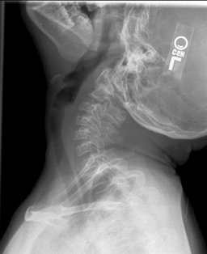

Slide 53
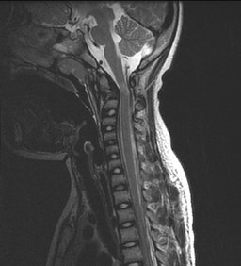

Slide 54
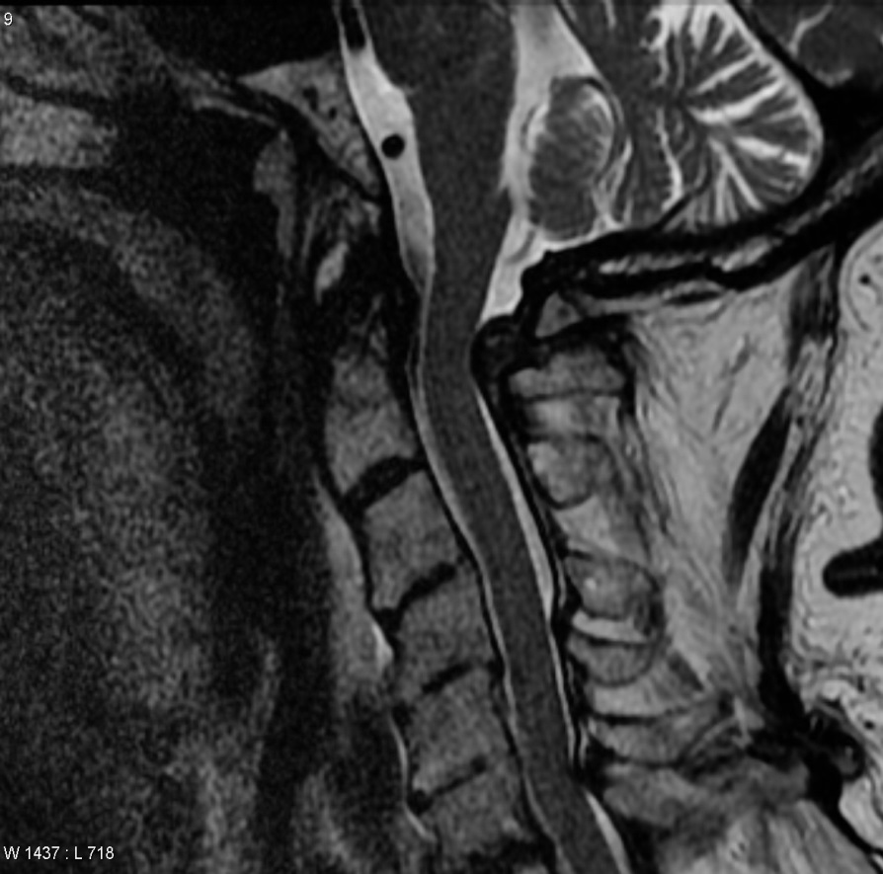
Rheumatoid arthritis

Slide 56
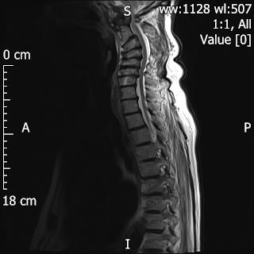
Basilar invagination.

Slide 57
Summary
Cervical spine- unique vertebra.
Common variants can be mistaken for fractures.
Pathology of the atlanto axial bones/ joints seen in inflammatory and congenital conditions and may be seen on CBCT.
MRI most useful imaging modality to asssess underlying cord/ brain stem.

