Slide 1
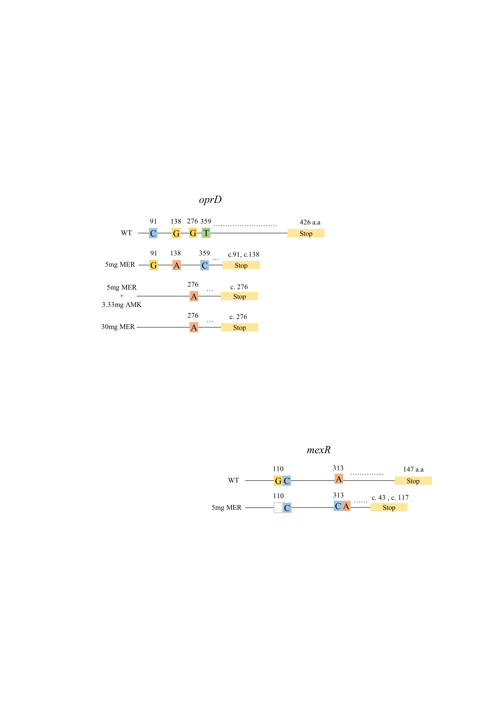
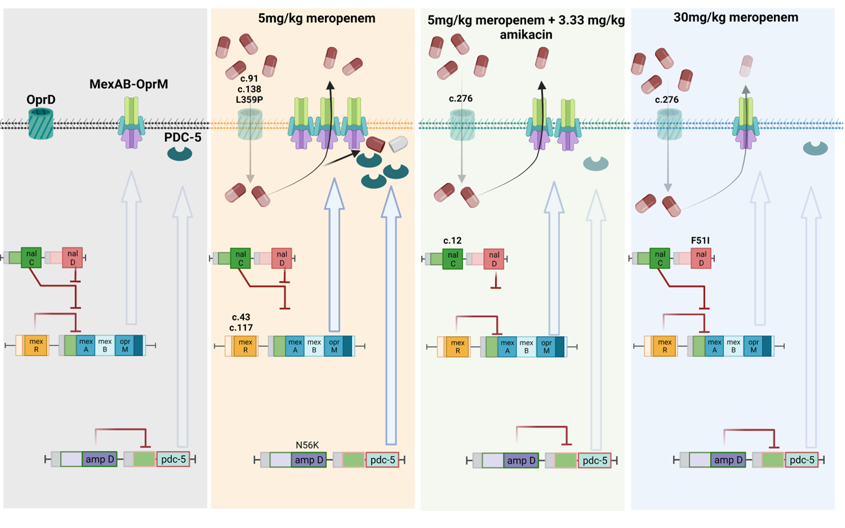
Dynamic interplay of MexAB-OprM, PDC-5 and OprD in Pseudomonas aeruginosa facilitates emergence of meropenem resistant phenotype in rabbit pneumonia model
¹Vineet Dubey, ¹Nicola Farrington,¹Adam Johnson, ¹Iona Horner, ¹Adam Stevenson, ¹William Hope
¹Antimicrobial Pharmacodynamics and Therapeutics, University of Liverpool, UK
P#012
vineet.dubey@liverpool.ac.uk
INTRODUCTION
RESULTS
Pseudomonas aeruginosa is associated with high rate of morbidity and mortality in nosocomial pneumonia. This pathogen has high propensity to develop resistance to different class of drugs, including carbapenems. However, the underlying pharmacodynamics of meropenem treatment and rise of a resistance phenotype is poorly characterised. The aim of this study was to assess the selection of different determinants of meropenem resistance as a function of drug exposure in rabbit pneumonia model.
2. Resistance gene expression analysis
METHODS
Figure 1. Normalised expression of gene pdc-5, oxa-396, mexA and oprM with respect to 16S rRNA and rpoB genes. Each dot represent a single amplicon of different biological replicates (n=6). Statistical analysis were carried out using two-tailed unpaired t test with Mann-Whitney post-test was used for comparison between two groups. P values of < 0.05 were considered statistically significant.
Rabbit Lung Infection Model
Immunocompromised White New Zealand rabbits were infected with P. aeruginosa ATCC 27853 (meropenem MIC: 1 mg/L). Animals received vehicle control, meropenem 5 mg/kg, 30 mg/kg meropenem or 5 mg/kg meropenem with 3.33 mg/kg amikacin q8h. After 96 h, lung isolates were extracted and selected on 3 mg/L meropenem Mueller Hinton agar plates
Whole Genome Sequencing
Briefly, base calling and de-multiplexing of indexed reads was performed by CASAVA version 1.8.2 (Illumina, San Diego, USA) to produce samples in FASTQ format. The raw FASTQ files were trimmed to remove Illumina adapter sequences using Cutadapt version 1.2.1. The option “-O 3” was set, so the 3' end of any reads which matched the adapter sequence over at least 3 bp was trimmed off. The reads were further trimmed to remove low quality bases, using Sickle version 1.200 with a minimum window quality score of 20. After trimming, reads shorter than 20 bp were removed.
Variant Calling
Variant detection was performed using the GATK and single nucleotide polymorphisms (SNPs) and small insertions/deletions (indels) were identified. Single-sample
Variants were filtered using the GATK VariantFiltration tool following assessment GATK filtering cut-off, i.e. In the resulting VCF files, SNPS with either QD < 2, FS > 60, MQ < 40, SOR > 3, QUAL < -12.5 or ReadPosRankSum < -8 and indels with QD < 2, FS > 200, QUAL< -20 were flagged according to the reason that they failed filtering. Filtered files were eventually annotated with SnpEff v4.2 and SNPs and Indels located in a set of genes known to be involved in P. aeruginosa chromosomal antibiotic resistance were extracted
Real-Time PCR Analysis
Total RNA (DNA free) were extracted from different treatment group lung isolates. Single cDNA were synthesized from each RNA group and was used as template for real-time PCR analysis. Relative gene expression was calculated by the ΔΔCT method using P. aeruginosa 16S rRNA as the reference gene.
Mutation Site Visualisation
Pymol and Modeller were used to highlight active motifs mutations in transcriptional repressors.
RESULTS
1. List of Mutations
3. Identification of mutation sites on AmpD, NalD, OprD and MexR
4. Dynamic interplay of Amp C, Oxa-396, MexAB-OprM
Table 1: List of mutations in P. aeruginosa isolates treated with different doses of meropenem
Figure 2. Non-synonymous substitution mapped on AmpD (AlphaFold ID: A0A3S0L9R0), NalD (Protein Data Bank ID: 5DAJ). Grey shades represents monomers and green/pink regions represents mutated residues. Mutations identified in isolates obtained from different meropenem and combination treated group in oprD and mexR genes. Number represents nucleotide location in oprD and mexR genes respectively and colour are given to each box to highlight the base type. Blank box represent deletion of nucleotide base; yellow box represents stop codon; c.t. represent amino acid location at which chain terminal occurred due to SNPs and short INDELs.
Figure 3. Schematic of molecular pathway affected by different treatment regime of meropenem and combination with amikacin in Pseudomonas aeruginosa.
Gene | Gene ID | Mutation site | Mutation | Type | Function
Isolates treated with 5mg meropenem
oprD | NP446_RS22285 | 4720604 | C-G | SNP | Porin for carbapenem influx
oprD | NP446_RS22285 | 4720745 | G-A | SNP | -
oprD | NP446_RS22285 | 4721407 | T-C | SNP | -
ampD | NP446_RS25910 | 5487757 | A-C | SNP | Transcriptional repressor of AmpC β-lactamase
mexR | NP446_RS02205 | 481104 | T-TG | INDEL | Transcriptional repressor of MexAB-oprM efflux pump
mexR | NP446_RS02205 | 481306 | GC-G | INDEL | -
Isolates treated with 5mg meropenem and 3.33mg amikacin
oprD | NP446_RS22285 | 4721161 | G-A | SNP | -
nalC | NP446_RS06070 | 1274401 | GGCGTTGCCTGCC-G | INDEL | Transcriptional repressor of MexAB-oprM efflux pump
Isolates treated with 30mg meropenem
nalD | NP446_RS07125 | 1477005 | A-T | SNP | Transcriptional repressor of MexAB-oprM efflux pump
oprD | NP446_RS22285 | 4721161 | G-A | SNP | -
spot | NP446_30990 | 6580143 | G-GATGGCC | INDEL | ppGpp accumulation in stringent condition
Most of these SNPs and INDELs were in oprD gene in all treatment groups, suggesting that loss of this outer membrane protein is the key first-step resistance mechanism in P. aeruginosa. We also observed mutations within mexR and ampD transcriptional regulators, which were limited to only 5mg/kg treatment group. MexR is known repressor of MexAB-OprM efflux pump and inactivation of ampD is associated with hyper-inducible AmpC β-lactamase expression in this pathogen. However, these mutations were not present in rabbits receiving meropenem 5 mg/kg s.c. with 3.33 mg/kg amikacin i.v. q8h combination treatment group, suggesting that the hyperactivity of MexAB-OprM and PDC-5 are adaptive response as deletion of OprD might confer a fitness cost in P. aeruginosa.
CONCLUSIONS
Our study suggests that there are well choreographed networks of adaptive resistance mechanisms to meropenem in Pseudomonas aeruginosa that include porins, efflux and AmpC β-lactamases.
The extent to which these networks are mobilised, and the ultimate pattern is drug exposure dependent. An understanding of optimal mitigation strategies (e.g., combination therapies) requires a deep understanding of these adaptive networks.

