Slide 1
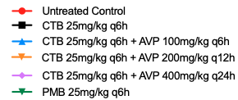
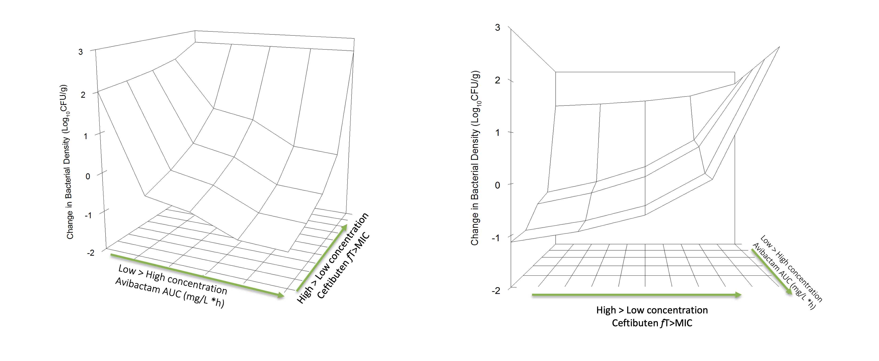
Pharmacokinetic-Pharmacodynamic assessment of oral pro-drug avibactam in combination with ceftibuten against multi-drug resistant Enterobacterales in the murine thigh infection model
¹Adam Johnson, ¹Laura McEntee ¹Nicola Farrington, ¹Iona Horner, ¹Adam Stevenson ¹Jennifer Unsworth, ¹Ana-Jimenes Valverde, ²Ruwanthi Kolamunnage-Dona, ³Sharon L Ripp, ³Gregory Stone, ¹William Hope ^{, 1}Shampa Das
¹Antimicrobial Pharmacodynamics and Therapeutics, University of Liverpool, UK
²Department of Biostatistics, Institute of Translational Medicine, University of Liverpool, member of Liverpool Health Partners, Liverpool UK
³Pfizer, Groton, CT, USA
nfarring@liverpool.ac.uk
ASM/ESCMID, 19th September 2023 P#013
INTRODUCTION
RESULTS
There is an urgent unmet medical need for oral antimicrobial agents active against ß-lactamase-producing Gram-negative bacilli. Broad-spectrum intravenous carbapenems are usually the first go to agents for treatment as current oral agents are insufficient to treat multi-drug resistant infections. A novel oral pro-drug of avibactam is being developed in combination with ceftibuten. This combination has the potential to be a useful carbapenem sparing oral agent. Preclinical pharmacokinetic and pharmacodynamic (PK-PD) studies are needed to identify the appropriate dynamically linked index and magnitude that best links drug exposure with antibacterial efficacy for multidrug resistant Enterobacterales.
3. Dose Finding Studies
4. Dose Fractionation
Figure 2 Sigmoid E_{max} model fitted to the q6h dose finding studies using strain K. pneumoniae 1466540 over two independently conducted experiments with AVP in combination with CTB. The E_{max} model was fitted to the data in ADAPT5
Figure 3. CFU/g of neutropenic mouse thighs infected with K. pneumoniae 1466540 1.5 x 10⁷ CFU/mL and treated subcutaneously with polymyxin B (PMB) or ceftibuten (CTB) or ceftibuten in combination with oral avibactam prodrug (AVP) q6h, q12h, or q24h
METHODS
Mouse Model
A murine neutropenic thigh infection model was used to characterise PK-PD of the combination across several clinical ESBL-producing Enterobacterales isolates. Neutropenia was induced with 150mg/kg cyclophosphamide on day -4 and 100 mg/kg on day -1 in male CD-1 mice weighing 25-30 grams
Initial Dose Finding Studies
Treatment started 2h post inoculation. Fixed doses of ceftibuten were administered subcutaneously (SC) and was selected to have minimal activity alone but sufficient to show effect in combination with a dose range of avibactam pro-drug, administered orally (PO). Both compounds were delivered every 6 hours (q6h) using K. pneumoniae 1466540 as the challenge strain.
Inhibitory Sigmoid E_{max} model was fitted to the dose range of avibactam
Dose Fractionation Study
Dose fractionation was conducted with a fixed backbone of ceftibuten 25mg/kg q6h SC and avibactam pro-drug total daily oral dose of 400mg/kg given as q24h, q12h or q6h using a destructive design with endpoints at 6h, 14h and 26h post-inoculation.
Differences in groups were compared using ANOVA and non-linear regression
Pharmacokinetics (PK)
For PK both ceftibuten and avibactam pro-drug were administered q6h, and PK of ceftibuten and avibactam assessed at 0.25, 0.5, 1, 2, 3, 4, and 6h post the 1st and 4th interval.
Dose fractionation and PK were conducted with K. pneumoniae 1466540.
Magnitude of the Pharmacodynamic Index
To identify magnitude, dose ranging studies were conducted with a fixed backbone of either 25 or 50mg/kg q6h ceftibuten depending on the challenge strain. Avibactam pro-drug was ranged from 50-750mg/kg q6h on the relevant ceftibuten backbone.
The E_{max} model was fitted to CTB q6h and AVP doses shown in Figure 2. E₅₀ was reported with r² of 0.88. AVP dose to use in fractionation was 400mg/kg.
All doses resulted in bacterial stasis at the end of the 24-hour experiment compared to the 2-hour post infection untreated control group. The dynamically linked index from our data suggests fAUC for avibactam and free (f) time (T)>MIC for ceftibuten can be used to account for the experimental data.
RESULTS
5. Identification of the magnitude of the pharmacodynamic index for avibactam pro-drug
1. Pharmacokinetics
Figure 4. Plot of fitted surface for avibactam and ceftibuten in combination
Figure 1 Total drug plasma concentration-time profiles for ceftibuten (CTB) and oral pro-drug avibactam (AVP)
A
B
Total drug concentration time profiles for ceftibuten, administered SC (Panel A) and avibactam, oral administration (Panel B). Sampling occurred in the 1st and 4th interval. A destructive design was used with groups of mice at each dose-timepoint being serially sacrificed. Data are mean ± standard deviation of 3 mice. PK for ceftibuten was dose proportional. The PK for avibactam was dose proportional up to a dose of 500 mg/kg q6h.
2. Minimum Inhibitory Concentrations and Molecular Mechanisms
MICs were determined in the presence of avibactam at a fixed concentration of 4 mg/L using Clinical Laboratory Standards Institute (CLSI) methodology over the course of at least 10 independently conducted experiments and the mode was then used for subsequent pharmacodynamic studies and analyses
Table 1. Broth microdilution minimum inhibitory concentrations (MICs) of the challenge strains used in the magnitude studies.
The bacterial strains used for the assessment of the pharmacodynamics of the combination of ceftibuten and avibactam pro-drug are shown in Table 1. Multiple independent dose range studies were performed, and the data transformed as surface fits (Figure 5). Murine protein binding of 91% unbound for ceftibuten and 92% unbound for avibactam were taken into consideration in the modelling and the fAUC for avibactam and fT>MIC for ceftibuten were then calculated.
Panel A and B represent the same surface plot viewed at different angles. With an increase of ceftibuten fT>MIC, avibactam exposures can be decreased to achieve bacterial stasis against all 7 bacterial species from the pooled analysis.
Isolate | Resistance mechanism | MIC (mg/L)
 |  | Ceftibuten | Ceftibuten + Avibactam (4 mg/L) | Polymyxin B
K. pneumoniae 1466540 | KPC-3; SHV-12; TEM-OSBL | 32 | 0.25 | 0.5
K. pneumoniae 1528848 | DHA-1; OXA-48; SHV-OSBL | 32 | 1 | 128
K. pneumoniae 1616810 | KPC-2; SHV-OSBL | 32 | 0.25 | 0.5
K. pneumoniae ATCC-BAA-1705 | KPC+ | 8/16 | 0.03-0.125 | 0.5-2
E. coli 1658416 | CTX-M-15 | 32 | 2 | 0.5
E. coli 1733855 | CMY-2; CTX-M-15; TEM-OSBL | 32 | 8 | 0.5
K. pneumoniae 1295932 | CTX-M-15; OXA-162; SHV-OSBL; TEM-OSBL | 32 | 0.125 | 64
E. cloacae 1677271 | Chrom AmpC | 32 | 4 | -
CONCLUSIONS
Statistical analysis from the results in the present studies suggest AUC is the relevant dynamically linked PK/PD index used to describe the pharmacodynamic driver of oral pro- drug avibactam.
PKPD modelling demonstrated stasis could be achieved with different combinations of fT>MIC targets for ceftibuten and fAUC targets for avibactam.

