Slide 1

TACKLING SENSITIVE TOPICS
Jan Jobling
21.3.24

Slide 2

‘Controversial’ v. ‘Sensitive’: is there a difference?
Dearden (1984): a topic is controversial if “contrary views can be held on it without those views being contrary to reason.”
Sensitive topics: widely held to mean topics which might evoke discomfort or emotional responses such as distress or anger
Can you think of examples for each category?

Slide 3
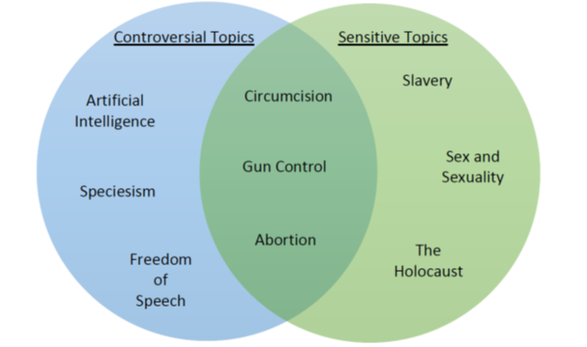
Academy for Teaching and Learning, Baylor University

Slide 4
But what if views about ‘controversial’ issues are held with passion?
Is the distinction so clear?
Significance of personal and contextual factors which may be unaware of

Slide 5

Why is it important to teach such topics?

Slide 6

Promote understanding of own position and ability to articulate both it and the basis for it
Encourage curiosity, self-reflection and critical thinking beyond existing beliefs/biases
Foster understanding of and respectful engagement with different perspectives and diversity
Navigation of dilemmas – ‘when rights clash’

Slide 7
Academic freedom and integrity
Inherent importance - e.g. issues of social, political and economic significance and antagonism
Parker (2003) on the central citizenship question of our time. ‘How can we live together justly [in ways which leave] our multiple identities recognized?’
The democratic mission of a university or other educational establishment?

Slide 8
According to Ortego-Sánchez (2022), Future Education and Democratic Hope: Rethinking Social Studies Education in Times of Change:
….. “in a United States riven by a president who has stoked violence, in an England convulsed by Brexit, and in a Northern Ireland where centuries of conflict have yielded to a fragile truce amid persistent division ….
The world is in a precarious political, environmental and moral space.”

Slide 9
What might be the barriers?

Slide 10
Fear of upsetting students
Mental health concerns
Lack of confidence in handling potentially difficult situations/disruption
Worry over potential repercussions for self and student in and beyond the classroom
Fraught political contexts and public discourse
‘Motivated reasoning’ (yours as well as theirs)
Concern about your own ‘authenticity’ in speaking on a particular topic

Slide 11
What key principles and practices might we want to establish, in balancing an open classroom with a ‘safe’ one?

Slide 12
An open and trusting ethos is important: how do we establish this?
‘Gradient of controversy’:
  Consider examples used – for example, historical or geographical distance can take some ‘heat’ out of discussions, whilst still conveying the key principles at stake
  Fictional scenarios
‘Picking’ on students is often problematic – it may be even more so with sensitive topics. How do you encourage participation?
Or do you? Are some topics best addressed didactically and factually?
What about assessed seminar participation? How might this be managed?

Slide 13
The tutor and pedagogical framework
Awareness of own positionality
    When in class, do we share this with students..? Why/Why not?
Do we seek a constructivist, egalitarian and democratic classroom? What does this involve for the tutor, and what might be the risks when teaching sensitive topics?

Slide 14
Specific Strategies: establishing the terrain
Trigger warnings/sensitivity notices
Pre-exposure through e.g. resources, so students are not ‘hijacked’ in a public context (and nor are you, through not realizing a particular topic was sensitive)
Inviting students to be in touch before a class if they have content concerns.
  Depending on context, they might seek permission not to attend or be able to leave quietly and without comment if necessary
  Trust may be required: it is usually not appropriate to ask for details!
  Where attendance is mandatory, seek advice on local policies for absence authorization.

Slide 15
The ‘civil’ seminar: establish ground-rules and expectations
Open discussion with students at the outset of a course containing typically sensitive issues
Signposting of student support systems within course materials

Slide 16
Within the class – some things to consider
Clarity on pedagogical goals for the session; this can also help keep discussions on track
  How in practice to do we keep discussions focused or move them?
Consider how best to frame questions – Drummond in Pace (2021, p.78): the difference between ‘what do you think?’ and ‘what are the issues here?’
She speaks from N. Ireland school context:
‘I personally think it’s irresponsible to rip the heart out of a child and to expose their prejudice or racism … and then twenty minutes later, send them off to French.’
Visual resources: to use or not? ‘A picture speaks a thousand words…’
Framing in public/objective not personal terms

Slide 17
Having respect for the student voice – whilst enabling that voice to be challenged, in an appropriate manner. How do we do this?
How do we foster students giving serious attention to points of view they disagree with - perhaps strongly?
Tutor ‘attunement’ – reading the room! You’ve noticed a potential issue (body language, expression etc.). What do you do?

Slide 18
References
Controversial or Sensitive Topics (no date) Academy for Teaching and Learning | Baylor University. Available at: https://www.baylor.edu/atl/index.php?id=988047 (Accessed: 9 September 2023).
Dearden, R.F. (1981) ‘Controversial Issues and the Curriculum’, Journal of Curriculum Studies, 13(1), pp. 37–44. Available at: https://doi.org/10.1080/0022027810130105.
Ortega-Sánchez, D. (2022) ‘Teaching Controversial Issues and Social Problems from an Integrated Perspective’, in D. Ortega-Sánchez (ed.) Controversial Issues and Social Problems for an Integrated Disciplinary Teaching. Cham: Springer International Publishing (Integrated Science), pp. 1–7. Available at: https://doi.org/10.1007/978-3-031-08697-7_1.
Pace, J. (2021) Hard Questions. Lanham: Rowman & Littlefield.

