Slide 2
UK Research and Innovation
We are the largest public funder of R&I in the UK
We bring together nine councils covering all sectors and disciplines
We are a public body and accountable to government
We are part of a system, working with academia, business, public sector, third sector, and international partners
For more info visit UKRI.org

Slide 3
The UKRI Portfolio
Inputs
Outputs
Impacts
In 21/22 we will invest (% of budget):
Funding 54,000 researchers and innovators and more than 300 nationally significant infrastructures
New breakthroughs and discoveries
The success of the Oxford-AstraZeneca vaccine built on decades of in-depth research, underpinned by UKRI funding.
£690m in PhD students/skills (9%)
£180m in fellowships (2%)
Supporting over 28,000 PhD students and 1,600 fellows
Attracting private investment
Our third wave of challenge-led R&D will attract £1.50 from industry for each public £1 invested over its lifetime, and more beyond.
£950m in responsive research (12%)
£530m in research targeting priorities (7%)
Delivering R&D in almost 4,000 organisations, including 3,100 of the UK’s most innovative businesses
Creating new businesses
UKRI grants have generated almost 900 spinouts since 2004, such as Oxford Nanopore, a biotech success story commercialising DNA sequencing technology now valued at £2.5bn.
£1,680m in university research (QR) (21%)
£980m in infrastructure (12%)
£850m in research institutes (11%)
Delivering government priorities such as Net Zero, public health, strategic technologies – our current investment portfolio is delivering more than £1bn in R&D relevant to AI and more than £1bn in R&D relevant to Net Zero energy solutions.
£540m in challenge-led funding (ISCF) (7%)
£530m in responsive innovation (7%)
£240m in Catapults (3%)
Unleashing innovation and economic growth
Firms participating in UKRI funded research saw their average turnover grow by c.25% faster in the six years after the grant.
Our Higher Education Innovation Fund connects university research to businesses and society, achieving a RoI of £9 per £1 invested.
£480m in international collaboration (6%)
£390m in targeted Covid-19 funding (5%)
Investing in all regions of the UK and building partnerships overseas – over one third of our grant funding includes an international partner
Improving lives across society
UKRI funded research outlining the science behind how children learn to read is transforming the way reading is taught in classrooms around the world and helping potentially millions of children improve their life chances through better literacy skills.

Slide 4
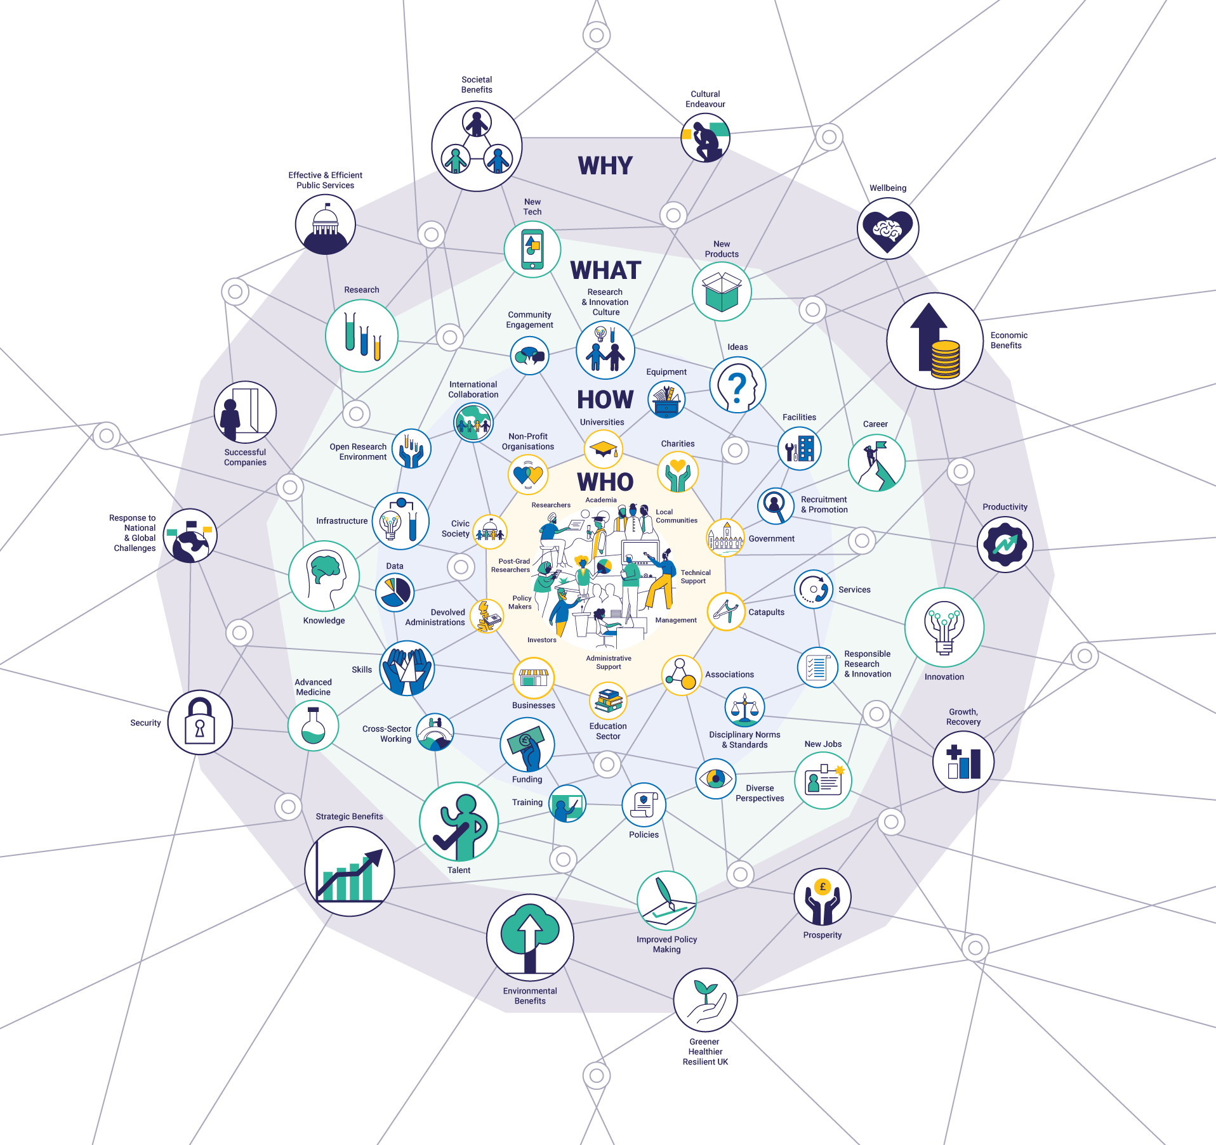
Our role as stewards of the system
Our vision is for an outstanding research and innovation system in the UK that gives everyone the opportunity to contribute and to benefit, enriching lives locally, nationally and internationally.
Our mission is to convene, catalyse and invest in close collaboration with others to build a thriving inclusive research and innovation system that connects discovery to prosperity and public good.

Slide 5
Principles
Diversity
Connectivity
Resilience
Engagement

Slide 8
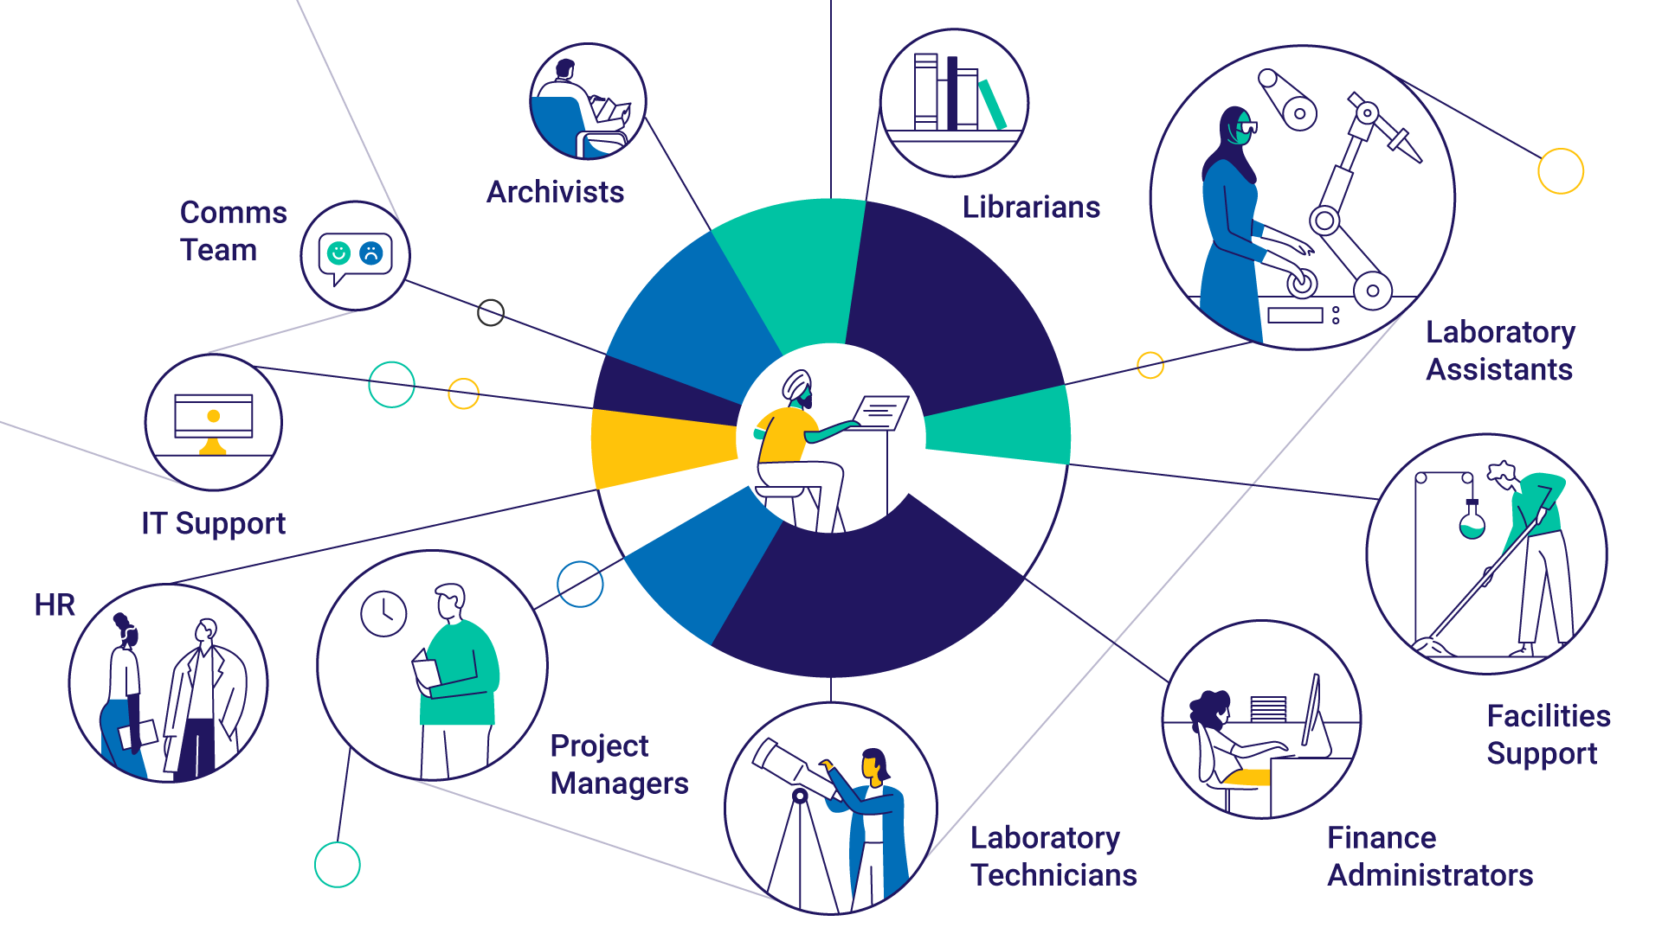

Slide 9
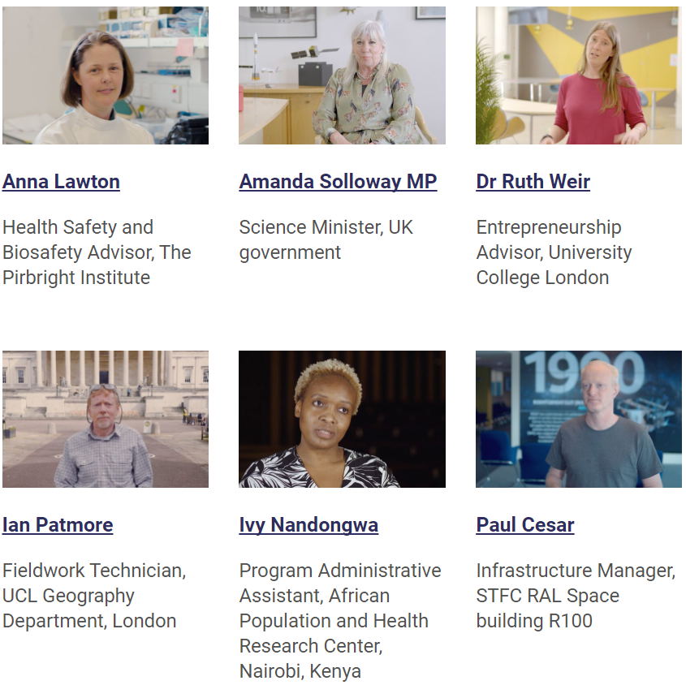
101 Jobs
R&I needs a diverse range of people to drive progress
Celebrate the essential contributions that all these people are making
Showcase the breadth of careers within the R&I system

Slide 10
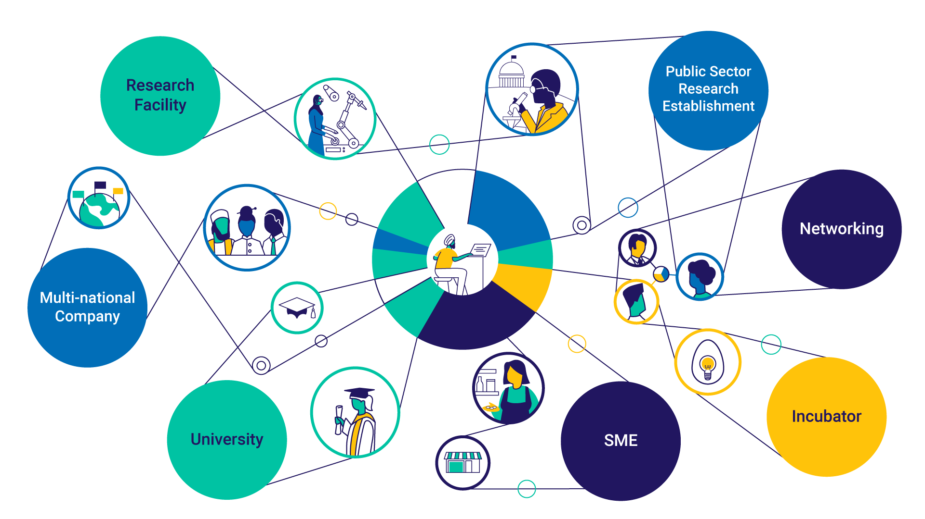

Slide 11
A Research Career?
PhD
Post-doc
Lecturer
Prof
Undergrad
Industry

Slide 12
Patent law
Policy
Investment
Practice-based experience
Prof
Management
Industry
Undergrad
Post-doc
PhD
Communication
Lecturer
MBA
KE
Entrepreneur
Teaching

Slide 13
Patent law
Policy
Investment
Practice-based experience
Prof
Management
Industry
Undergrad
Post-doc
PhD
Communication
Lecturer
MBA
KE
Entrepreneur
Teaching

Slide 14
A Research Career?
PhD
Post-doc
Lecturer
Prof
Undergrad
We are in an era of perceived hyper-competition
The rules for winning are perceived to be disproportionately focused on a small number of measures that can incentivise poor research practice
All the stakeholders view the rules for winning as out of their control

Slide 15
Combatting precarity
…. given fixed term project grants
Dual support system
Career diversity
Improved research culture
Broad success criteria

Slide 16
Patent law
Policy
Investment
Practice-based experience
Prof
Management
Industry
Undergrad
Post-doc
Communication
PhD
Lecturer
MBA
KE
Entrepreneur
Teaching

Slide 17
Research Culture and Psychological safety
An environment in which people feel safe to
Voice ideas and disagree constructively with others
Seek and provide honest feedback
Collaborate
Take risks and experiment
Admit errors
Ask for help
Psychological safety is undermined
when people feel threatened

Slide 18
Reasserting what we value
Assessment criteria define the things we value in the research system
The criteria must therefore support all the things we would like the system to deliver
The system needs to deliver these things collectively
All criteria are important, but not all criteria apply to all research or all researchers
We need to support diversity with collaboration
This simultaneously supports creativity, productivity and psychological safety

Slide 19
Different projects
We need to value the different types of research project
Basic vs. applied research
Generating data sets and technologies vs. using them to test hypotheses and explore ideas
Establishing the reproducibility and generality of existing results vs. generating completely new ones

Slide 20
Different people
Supporting researchers with very different backgrounds
Traditional research career vs. unusual route into research
Traditional academic path vs. unusual path moving between sectors
Focus on single topic and approach vs. move between disciplines and topics
Career breaks vs. no career breaks

Slide 21
Different contributions
We need to support and incentivise multiple different wider contributions to the system
Teaching
Training and mentoring the next generation of researchers
Services to the system: refereeing, committees, conferences
Policy or public engagement

Slide 22
The Résumé for Researchers (R4R)
UKRI committed to rolling this out across the sector
Narrative CV providing the opportunity to present contributions in 4 areas using diverse evidence types:
Contributions to Knowledge
Supporting people
Contributions to the research community
Engagement with wider stakeholders
This allows people with different backgrounds,
contributing in different ways to be compared
https://royalsociety.org

Slide 23
UK Govt. People and Culture Strategy
Actions include:
Develop New Deal for PGR students – UKRI-led consultation
Forum for Tackling Bullying and Harassment – encouraging sector-wide engagement
Review of peer review
Incentivise improving culture in Research Assessment

Slide 24
@UKRI_news
UK Research and Innovation
UK Research and Innovation

