Slide 1
UKRI and researcher development:
changing culture across research careers
Ellen Meek
Nik Ogryzko

Slide 2
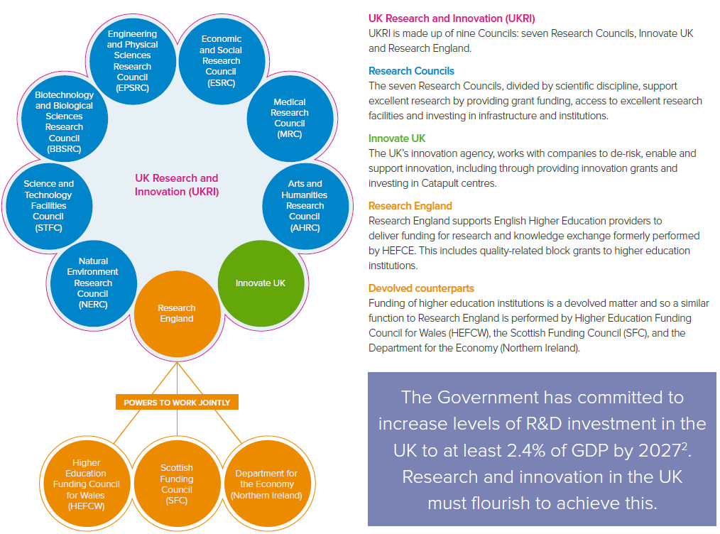
What is UKRI?
Non-departmental public body (NDPB)
Sponsored by the Department for Business, Energy and Industrial Strategy (BEIS)
UKRI Explainer (royalsociety.org)

Slide 3
What we do
UKRI convenes, catalyses and invests in close collaboration with others to build a thriving, inclusive research and innovation system. We do this through:
Our role as a funder, supporting people, ideas and infrastructure across the research and innovation system
Our role as a policy organisation, working with the community to drive positive changes in research culture
Our role as an employer of people working in research and innovation at the institutes and facilities that we manage.
As a funder supporting talent across the research and innovation landscape
By showing leadership through policy and practice.
As an employer, including the institutes and facilities it manages.
Funder
Policy Org
Employer

Slide 4
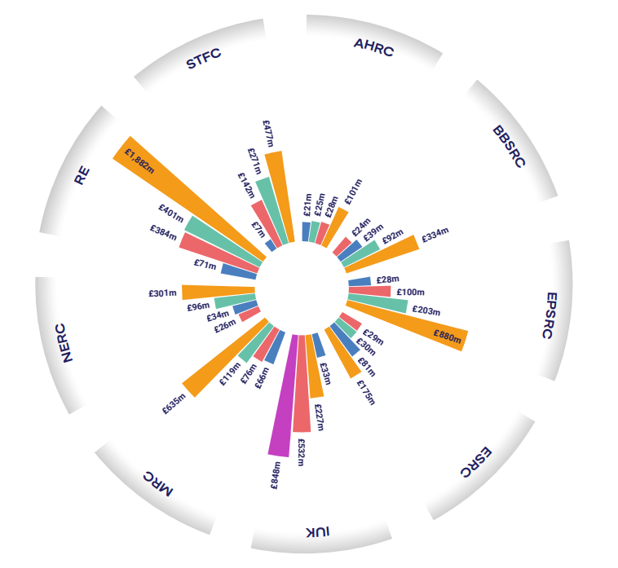
What we do: funding
UKRI funding is distributed through a range of mechanisms, including grants and Quality Related research funding (QR) to support:
Individuals
Teams
Research Organisations
Research Institutes
Business
Research Infrastructures

Slide 5
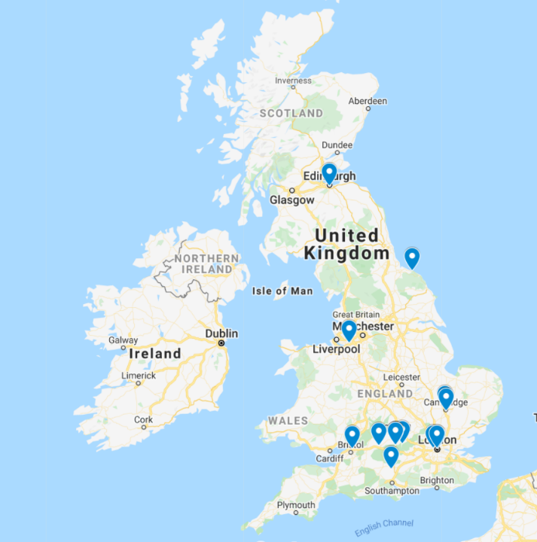
What we do: research
MRC
Laboratory of Molecular Biology (LMB)
London Institute of Medical Science (LMS)
Harwell Institute
NERC
British Antarctic Survey (BAS)
British Geological Survey (BGS)
STFC
Rutherford Appleton Laboratory
Daresbury Laboratory
Hartree Centre
UK Astronomy Technology Centre
Boulby Underground Science Facility

Slide 6
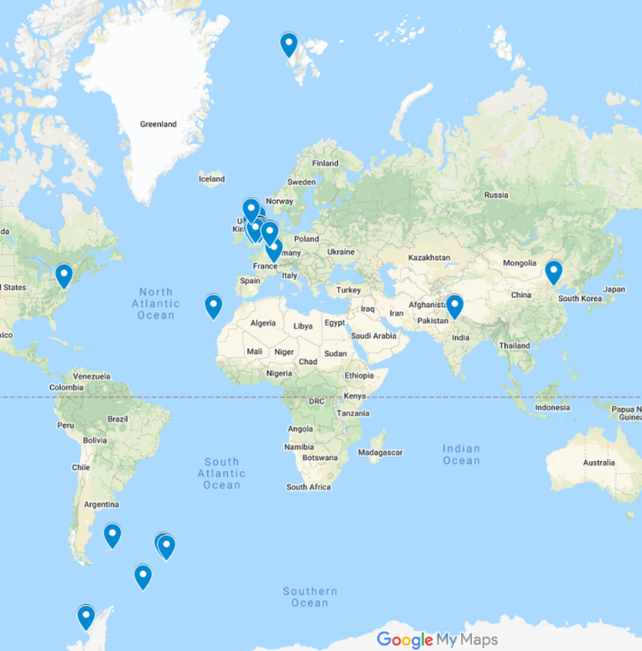
What we do: research
MRC
Laboratory of Molecular Biology (LMB)
London Institute of Medical Science (LMS)
Harwell Institute
NERC
British Antarctic Survey (BAS)
British Geological Survey (BGS)
STFC
Rutherford Appleton Laboratory
Daresbury Laboratory
Hartree Centre
UK Astronomy Technology Centre
Boulby Underground Science Facility

Slide 7
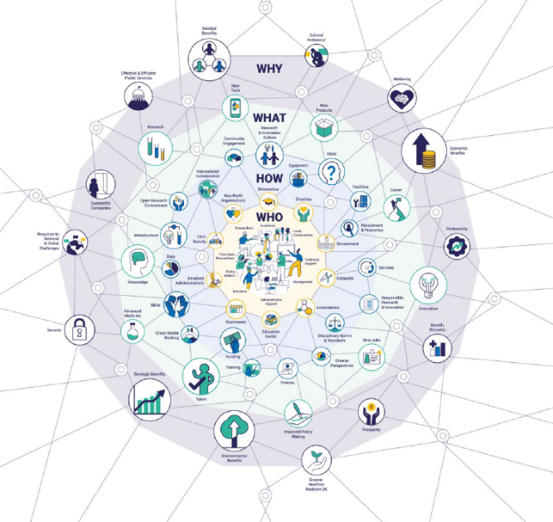
What we do: policy
Our mission is to convene, catalyse and invest in close collaboration with others to build a thriving inclusive research and innovation system that connects discovery to prosperity and public good.
Our vision is for an outstanding research and innovation system in the UK that gives everyone the opportunity to contribute and to benefit, enriching lives locally, nationally and internationally.

Slide 8
What we do: policy
UKRI aims to enable a dynamic, diverse and inclusive system of research and innovation in the UK that is an integral part of society, giving everyone the opportunity to participate and to benefit.
The success of research and innovation depends on every member of the research and innovation system, irrespective of discipline, setting or sector.
UKRI is committed to ensuring that all the people whose work contributes to research and innovation are recognised, valued and supported to realise their potential.

Slide 9
The role of UKRI Talent and Skills
Funding Policy
UKRI’s Centres Institutes and Units
Research Integrity
Open Research
UKRI Talent and Skills
Equality, Diversity and Inclusion
Communications and Engagement
Research Culture
Assurance
HR and Organisational Development
Analysis

Slide 10
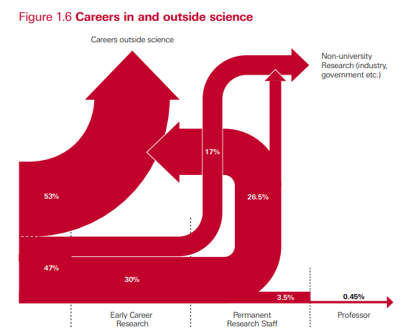
Why problems are we trying to address?
We know most PhDs and ECRs will not follow a “traditional academic career” pathway.
We know from Wellcome Trust’s “Reimagine Research” that there are problems with the culture of research.
Incentives in research are geared towards a very narrow definition of success
The Royal Society, the Scientific Century, 2010

Slide 11
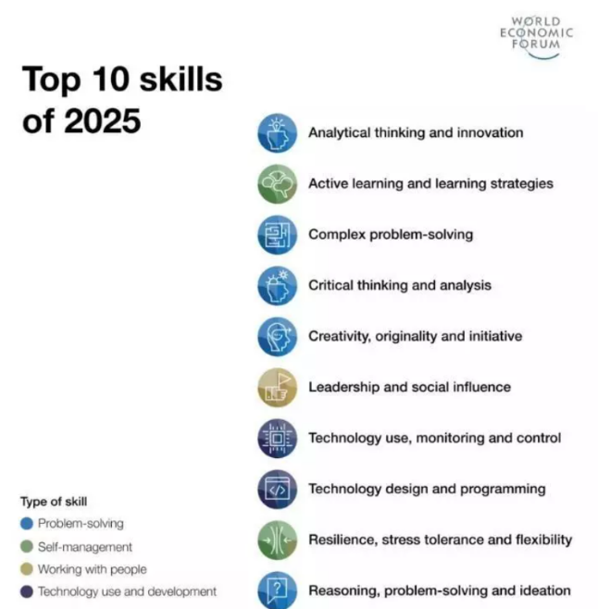
UK research and innovation skills needs
Does this look like an postdoc to you?
Future of Jobs Report 2020, World Economic Forum

Slide 12
UK research and innovation skills needs
How many researchers do we need to meet the 2.4% R&D investment target?
+ 50% UKRI Chair, Sir John Kingman 2018
+ 260,000 Science Minister Chris Skidmore 2019
More than we have now – the revised concordat, 2019
The Royal Society analysis recently published an analysis of where we are now.

Slide 13
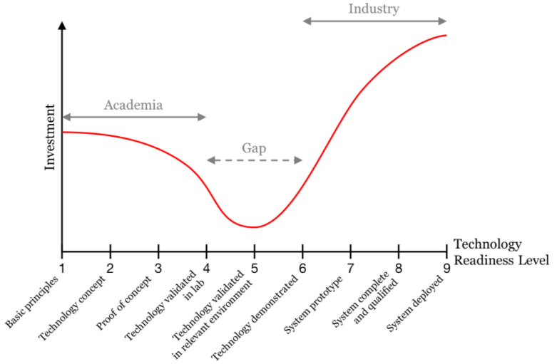
Innovation “Valley of Death”
PWC

Slide 14
Visibility of Contributions
Publications
Invited talks
Awards
and prizes
Successful grants
Leadership
Data sharing
Emergent leadership
Data preparation and curation
Management
Team working
Building collaborations
Accessibility, inclusivity, integrity initiatives
Panels & committees
Co-creation of research priorities & plans
Peer review
Mentorship & supervision
Ensuring impact & working with research users
Public Engagement
Unsuccessful grants & papers

Slide 15
Why are we using R4RI?
R4RI
Saving Applicants’ Time
Creating an inclusive process
Reducing barriers across disciplines and sectors
Responsible assessment
Creating the right incentives
Team science & collegiality
An inclusive, single format for CVs across UKRI to allow researchers to evidence a wider range of activities and contributions:
How have you contributed to the generation and flow ​of new ideas, hypotheses, tools or knowledge?
How have you contributed to research teams and the ​development of others?​
How have you contributed to the wider research ​
community?​
How have you contributed to broader society?
How will your institutional environment help to deliver the projects objectives?​

Slide 16
UKRI Pilots of Résumé for Researchers
EPSRC New Horizons and NERC Pushing the Frontiers used narrative track records
BBSRC Transformative Research Technologies, UKRI Citizen science collaboration grant, MRC-NIHR Clinical Academic Research Partnerships
UKRI Innovation Scholars: Data Science Training in Health & Bioscience, and EPSRC Open fellowships BBSRC Bioinformatics and Biological Resources Fund.
In a survey of Citizen Science applicants
65% said they were either satisfied or very satisfied with the use of a narrative CV in place of the former track record section.
71% agreed it provided more flexibility to highlight specific skills, experience and achievements relevant to delivery of the project

Slide 17
Wider incentives: REF and research funding
REF results used to calculate allocation of ca. £2 billion annual quality-related (QR) block grant funding
QR funding supports the university sector at the “whole institution” level (rather than project / academic level)
Funding can be used flexibly to support the research and knowledge exchange missions of universities
Provides stability to universities
Complements project-based funding provided by research councils and national academies

Slide 18
Future Research Assessment Programme
Programme launched by the four UK Higher Education Funding Bodies in May 2021
Aims to investigate possible approaches to the evaluation of research performance in the UK that can:
encourage and strengthen the emphasis on delivering excellent research and impact,
support a positive research culture,
while simplifying and reducing the administrative burden on the HE sector.
Overseen by the four funding bodies with advice from an international advisory group, chaired by Sir Peter Gluckman

Slide 19
Key questions
What characterises an excellent research system? What elements are required to allow UK research and researchers to thrive?
How do we develop a definition of excellence that can recognise and reward those elements we want to see in the research system?
How do we design an assessment system that drives positive behaviours and removes perverse incentives?

Slide 20
The Researcher Development Concordat
A sector wide agreement on how researchers in Higher Education Institutions and Research Institutes should be supported to develop their careers
Recognises 4 stakeholder groups:
Research funders
Research Organisations (employers)
Principal Investigators (managers)
Researchers

Slide 21
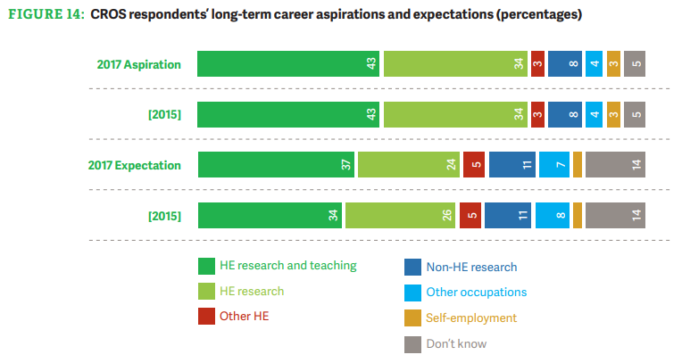
We currently prepare researchers (at all levels) for a very narrow career pathway
Vitae, 5 Steps Forward 2017

Slide 22
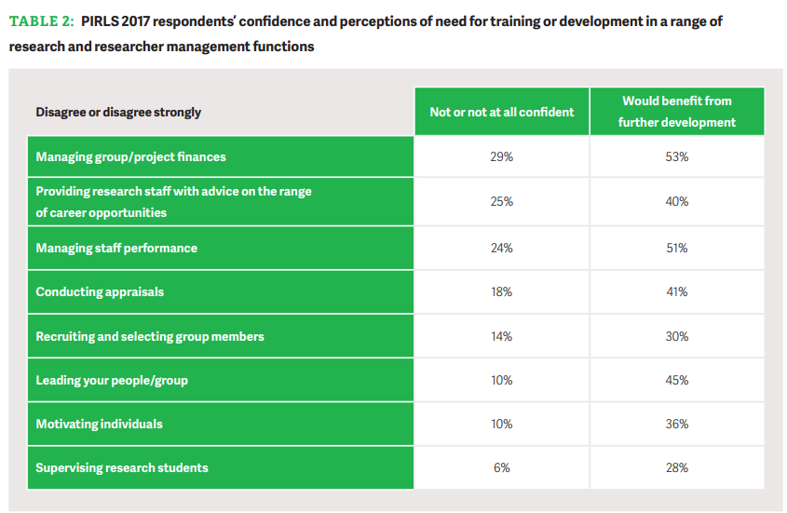
Principal Investigators have limited experience of other sectors

Slide 23
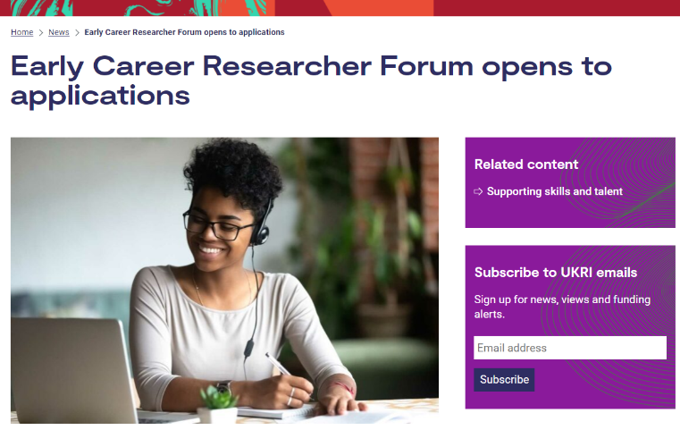
Our Concordat plan: Engaging with the community
ECRs have so far contributed to:
The R&D People and Culture Strategy
BBSRC Strategy development
BBSRC and EPSRC researcher advisory subgroups
AHRC focus groups on support for researchers
The Review of Research Bureaucracy
The Future of Research Assessment Programme
Funding service design
(upcoming) UKRI Strategy

Slide 24
Grant assessment
Intended Outcome
Grant review and assessment considers: Non-traditional career paths and equality friendly ways of working. Whether applicants have given sufficient thought to the careers of staff they aim to employ. Workload expectations of researchers
Résumé for Researchers
An inclusive, single format for CVs across UKRI to allow researchers to evidence a wider range of activities and contributions.

Slide 25
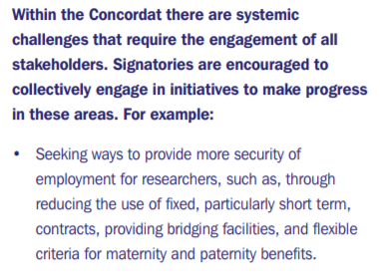
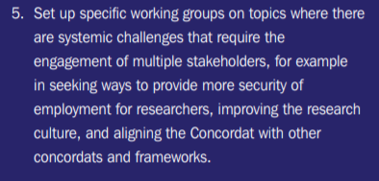
Sustainable research careers
The Concordat
UKRI concordat plan

Slide 26
Our concordat plan: sustainable research careers
Intended Outcome | Action
The new funding service is sufficiently flexible to enable research organisations to creatively meet their concordat obligations. | We will ensure that the new UKRI Funding Service Provides flexibility in the capturing of data (e.g. staff effort, working patterns) to support research organisations in their ambitions to develop bespoke career paths for their researchers.
Understanding of financial and non-financial barriers to secure employment. | We will work with Concordat Strategy Group partners to engage with research organisations to identify the barriers they face to offering more stable employment.
Evidence base of the benefits of healthy research cultures and well supported researchers to support future interventions and funding bids. | We will develop and communicate evidence concerning the economic, social and cultural benefits of, healthy research cultures and sustainable careers for researchers.
Shared vision and standards across the UK funding landscape. | We will collaborate with other funders to develop consistent narratives, expectations and comparable grant terms and conditions around how research organisations can redeploy researchers and offer more secure and sustainable employment

Slide 27
We need researchers working across the research and innovation system
We want researchers to be prepared for, and aspire to, more than academic careers.
We all have a responsibility for supporting the career development of researchers.
We need to normalise careers outside of academia, leaving is not failure.
(at any level)
This isn’t all on you, we need mobility at all levels.

Slide 28
We need researchers working across the research and innovation system
We need to make non-academic employers more attractive to researchers
We need to make researchers more attractive to non-academic employers
Better training and development (raising the baseline)
Raising awareness of how awesome postdocs are
We also need to bring these parts of the system together, to make it easier to come back

Slide 29
Next steps
Our next steps:
Progress our action plan
Ensure it remains aligned to relevant work across UKRI and the sector, including in implementing the People and Culture Strategy
How you can contribute:
Stay engaged:
Engage with the Concordat at your institution
Take opportunities to influence policy
Learn about your institutional policies and the wider system
(if you work at UKRI)
- Keep an eye out for upcoming internal webinars and ways to get engaged!

Slide 30
Thank you
Twitter:@UKRI_News
LinkedIn: UK Research and Innovation
YouTube: UK Research and Innovation

