Slide 2
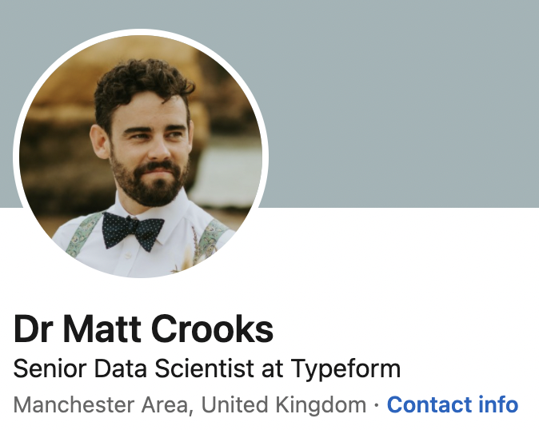
Academia
12 years at University of Manchester
MMath in 2010
Completed Maths PhD in 2014
Postdoc in Atmospheric Science until end 2017

Slide 3
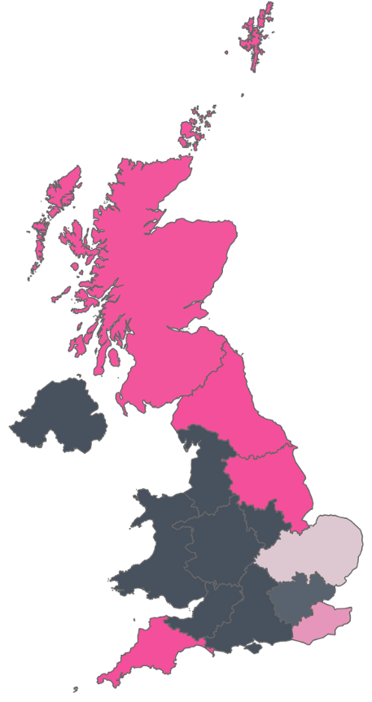
BBC Data Scientist
Predicting School Holidays from iPlayer streaming
R&D AI in Media Production
Efficient Learning

Slide 4
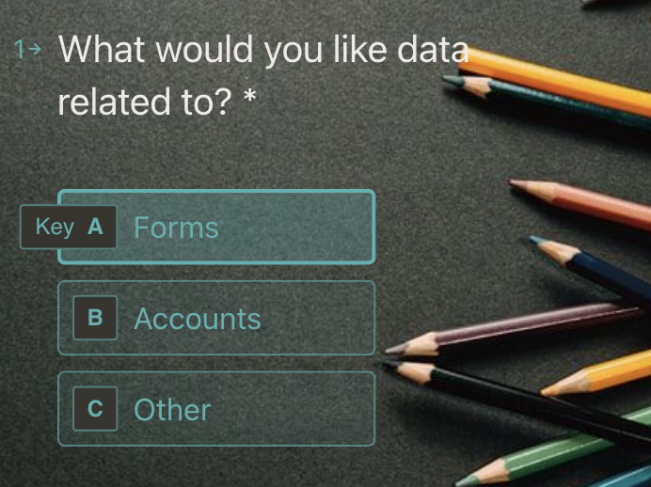
Typeform Data Scientist
AB testing
Propensity Models
Recommenders

Slide 5
Transferable Skills
Coding
Presenting/communication
Ideation/project scoping
Self-motivator

Slide 6
Recommendations
Don’t be scared or disappointed!
Prepare early - interviews are research
Don’t expect anyone to know what a postdoc is - lead with skills
Don’t take a pay cut

