Slide 1
Dr Kathryn North
Director, C-DICE, Head of ERA Skills

Slide 2



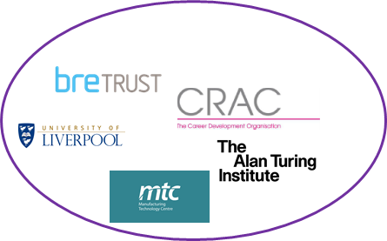


C-DICE: The Collaboration
Posdoc. Pipeline
(Infrastructure and cities)
Loughborough
Cambridge
ERA
Birmingham
Keele
Heriot-Watt
Southampton
Cranfield
Aston
(Energy research)
UKCRIC
Edinburgh
Leicester
Leeds
Sheffield
Newcastle
Warwick
Nottingham
UCL
CRAC
(Vitae)
Manchester
BGS
Bristol
Cardiff
Prosper
Alan Turing Institute
Infrastruct. Organisations
Faraday Institution
Energy-related Organisations
4 EPSRC CDTs
BRE
6 EPSRC CDTs
£276M Capital Investment
£180M Capital Investment
MTC
Twitter (@CentreDICE)
Linked-In (C-DICE)
URL: cdice.ac.uk
Notes:
Loughborough leads the ERA Skills Academy (est. 2016) and UKCRIC Skills mission
ERA_Into_the_Next_ERA_document.pdf

Slide 3
Key messages from employers
They need highly skilled people
Commercial awareness, leadership, communication skills
Pace
Key messages from postdocs – how to start the conversation/get experience in other sector?

Slide 4
C-DICE: Key components
Sustained talent pipeline
Novel net zero-carbon solutions
Training
(Cranfield)
Advanced research, leadership and innovation skills pathways.
Deep technical and industry-relevant skills development.
Drawn from partners.
Accreditation
Sandpits
(Loughborough + All)
Interdisciplinary teams solving complex, industry-derived and co-created research challenges.
‘Seedcorn’ Fund.
Impact hub
(Loughborough)
Widespread dissemination and downstream exploitation. Networking with policy-makers, business. C-DICE Fellowships.
Informing funders’ policy development.
Development pathway
(Birmingham)
Industrial placements, 'discipline/sector hopping' and secondments, Fellowships.
Notes:
Loughborough, Cranfield and Birmingham have co-created C-DICE
Each will take responsibility for a different strand of activity, whilst working cooperatively across the other strands.
Training strand - platform for accessing specialist, ad-hoc and tailored training and development for the postdoctoral researchers, sourced from among the partner HEIs and other stakeholders, and/or developed specifically for C-DICE.
Development pathway will provide bespoke opportunities over longer time spans for secondments or placements (HEIs, industry or other stakeholders like Turing), discipline hopping to work on business start-ups, with access to mentors.
Sandpit series will coalesce interdisciplinary teams around solving complex, industry-derived and co-created research challenges.
A capstone event – the C-DICE Net Zero-Carbon Energy and Infrastructure Challenge – will bring many C-DICE participants together with industry to define a new research roadmap that exploits the totality of the UKCRIC/ERA capability.
Impact strand will lead on the co-creation, dissemination, and evaluation of the programme.

Slide 5

Upcoming opportunities
Sandpits - £30k seed-corn funding
Peer-to-peer training
Placements and secondments
Dragon’s Dens
Policy Showcase

