Slide 1

Supporting the career development of researchers
How can we implement a positive research environment?
Daniel Wake, Policy Manager, Universities UK
NPDC21 Friday 24 September 2021

Slide 2
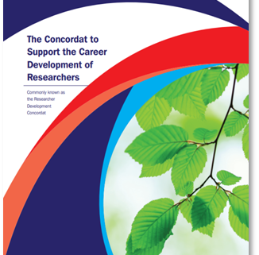
There is still much to do to create the healthy and supportive culture needed to ensure our researchers are given every opportunity to thrive and realise their potential…
Professor Julia Buckingham CBE
Chair of the Researcher Development Concordat Strategy Group and Vice-Chancellor and President of Brunel University London

Slide 3
Why do we have a Concordat?
When did the Concordat come about, and has it made a difference?

Slide 4

When did it come about?
Concordat to Provide a Framework for the Career Management of Contract Research Staff, 1996
European Charter for Researchers and Code of Conduct for the Recruitment of Researchers, 2005
Concordat to Support the Career Development of Researchers, 2008
Independent review and consultation, 2018−19

Slide 5
https://www.vitae.ac.uk/vitae-publications/culture-employment-and-development-in-academic-research-survey-cedars-aggregate-results-launched

Slide 6
Principles and stakeholders
What are the principles of the Concordat, and who is responsible for their implementation?

Slide 7
Core principles
Stakeholder groups
Environment and culture
Researchers
Excellent research requires a supportive and inclusive research culture
Employed primarily to conduct research
Managers of researchers
Employment
Having direct line management responsibility for researchers
Researchers are recruited, employed and managed under conditions that recognise their value and importance
Institutions
Professional and career
development
Universities and research institutes as employers of researchers
Professional and career development are integral to enabling researchers to develop their full potential
Funders
Providing funding for public or private research

Slide 8
Environment and culture
Institutions must
Funders must
promote good mental health and wellbeing through, e.g., effective management of workloads and people
consider how funding opportunities and policies can facilitate different patterns and ways of working
Managers of researchers must
Researchers must
promote a healthy working environment
take positive action towards maintaining their wellbeing and mental health

Slide 9
Employment
Institutions must
Funders must
seek to improve job security for researchers, e.g., through redeployment processes and greater use of open-ended contracts
support institutions to develop policies and frameworks to promote sustainable employment arrangements and enhance job security
Signatories must
produce an annual report to their governing body, which includes measures of success, an implementation plan and progress
commit to collective action on seeking ways to provide more security of employment for researchers

Slide 10
Professional and career development
Training, support and time
Institutions must
Funders must
provide opportunities and time for researchers to engage in a minimum of 10 days professional development pro rata per year, recognising that researchers will pursue careers across a wide range of employment sectors
incorporate professional development into funding calls, terms and conditions, to include a minimum of 10 days’ professional development pro rata per year
Managers of researchers must
Researchers must
allocate a minimum of 10 days pro rata per year, for their researchers to engage with professional development
take ownership of their career, including engaging in a minimum of 10 days professional development pro rata per year

Slide 11
Successful implementation
What is needed for success?

Slide 12
What is needed for success?
We all recognise our collective responsibility and accountability
Institutions ensure effective implementation at all levels, raise awareness, gather feedback, and report on progress
Funders ensure funding calls, selection processes, reporting etc., promote and support good employment practices
Managers have the skills, time and willingness to support researchers in broadest sense
Researchers are aware, proactive, and engaged in making their voices heard

Slide 13
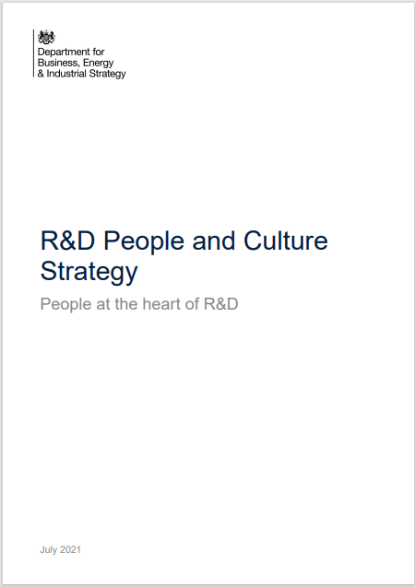
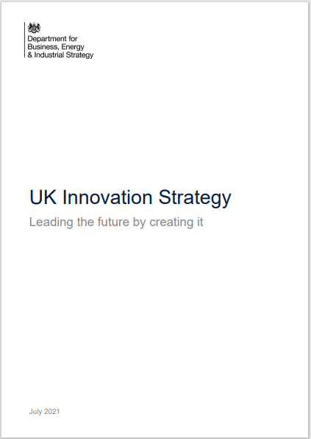

Slide 14
People
Access to R&D career and skills gaps filled
Training in EDI, well-being and mental health
Ensuring equality of opportunity between researchers
Merit based recruitment and effective inductions
Improving job security and effective re-deployment processes
Engage researchers in policy development
Access to career paths across sectors and disciplines
10 days+ of professional development for staff
Effective recognition and opportunity for success
Time to develop leadership skills / research identity
Acknowledging and support careers beyond academia
Support career diversity eg via mentors, training, secondments
Better leadership skills at all levels
Leadership and management training for managers
Line / project management training opportunities
Championing excellent people management
Access to career management advice
Time to develop leadership skills

Slide 15
Culture
An inclusive and respectful culture that attracts and retains a diversity of people
Improving job security for researchers
Promoting sustainable employment and career progression
Access to research funding at all career levels
Manager training to manage researchers effectively
Promote good mental health and wellbeing and reporting misconduct
Clear recognition and reward for excellent research and innovation
Equitable and transparent recruitment, promotion and reward
Opportunities / time for researchers to develop their identity
Appropriate credit and recognition for endeavours
Opportunities / time to develop leadership skills
Clear pathways that recognise the full range of contributions
Engagement with the public
Recognition and action as stakeholders in the wider academic community

Slide 16
Talent
Reviewing the quality of the research environment and culture, with feedback from researchers and using the outcomes to improve institutional practice
Funders ensuring requirements and selection processes offer equality of opportunity
Consideration of flexible working requests and other arrangements to support personal lives of researchers
Widening access to careers and broadening the definition of a R&D career
Merit-based recognition and reward
Stronger job security and championing transparent promotion criteria and workload allocation
UK is the most exciting place in the world for top research and innovation talent
Encourage better process and procedure to reach the aim to achieve a more attractive R&D and innovation landscape.

Slide 17
Measuring progress
How can we monitor the Concordat’s implementation?

Slide 18
Measuring progress
Culture, Employment and Development in Academic Research Survey
Reflects the Researcher Development Concordat principles
Aimed at all staff engaged in research
Runs every two years hosted by institutions: April - June 2021
UK aggregate results and benchmarking of institutional results
https://www.vitae.ac.uk/impact-and-evaluation/cedars

Slide 19
Committing to the Concordat
Raise visibility and champion its Principles
Identify a senior manager champion
Researchers formally represented in developing and monitoring implementation
Undertake a gap analysis to compare their policies and practice
Draw up and publish an action plan within a year of signing the Concordat
Gathering the views of researchers to inform and improve the organisation’s approach and progress
Produce an annual report to their governing body or equivalent authority

Slide 20
Concordat governance
Researcher Development Concordat Strategy Group
Annual reporting
A ‘living’ document
Sharing best practice
Major reviews

Slide 22




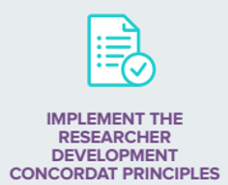
Thank you
If you have questions about the Researcher Development Concordat, please contact
CDRsecretariat@universitiesuk.ac.uk

