Slide 1
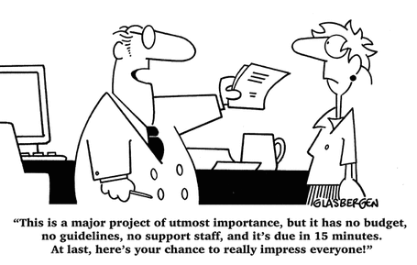

Slide 4
Vision – Scope and Boundaries
Values – Define ‘good’
Reprioritization – What will we NOT do?
“Shape change;
Volume constant”

Slide 7
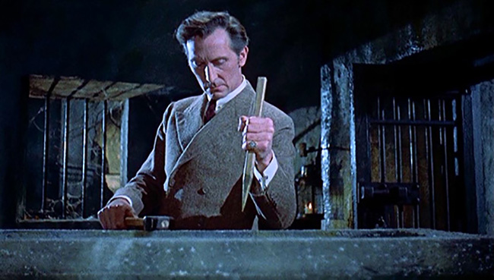
1) Share the Big Picture – Purpose, Values and Impacts

Slide 8
CLARITY OF SHARED PURPOSE
CLARITY OF PROCESS
CLARITY OF ACTION

Slide 9
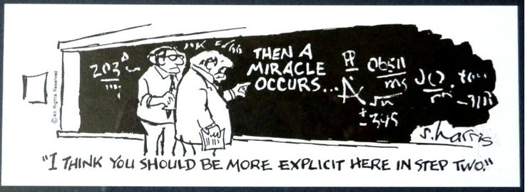

Slide 10
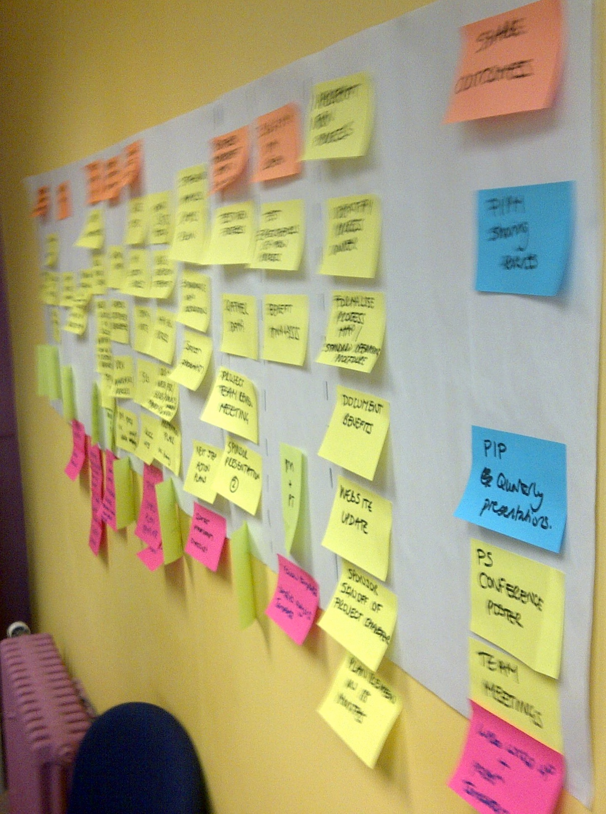
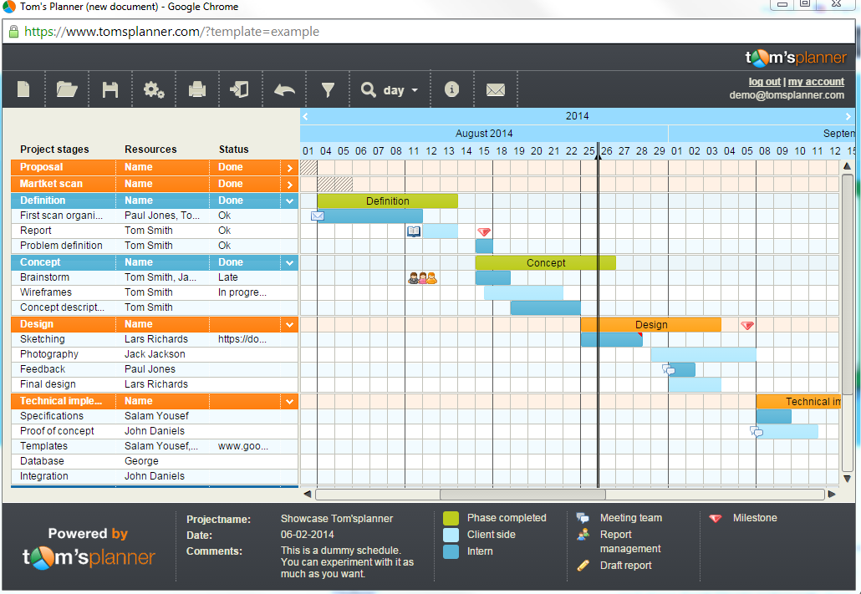
2) Agile and Explicit – Visible, Current and Flexible Plan

Slide 11
Divergence of Thought
Convergence of Action
?
!
Possibilities
Implementation and Realism

Slide 12
3) Sustainable Soft Landing Pads
PLANNING
Often The Reality
EXECUTION
CLOSE OUT
INITIATION
Impression of Cost / Effort
The ideal
Time

Slide 13
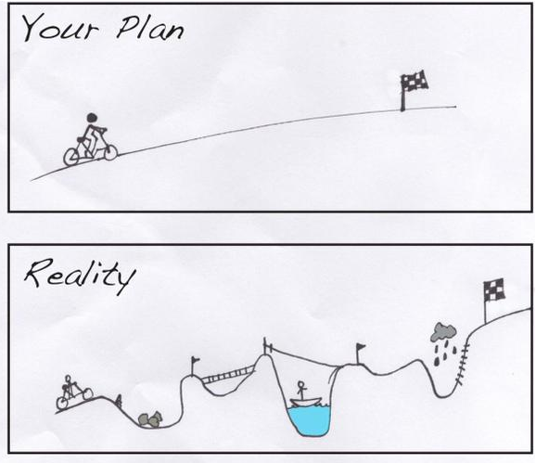
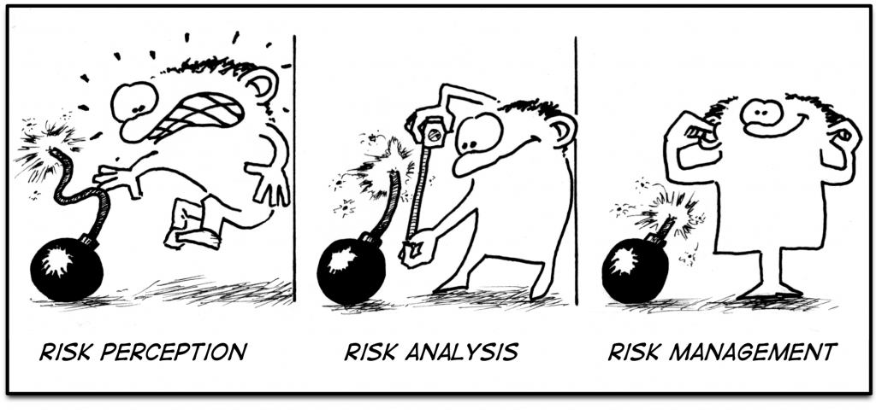
4) Pre-Mortem – Research IS Risk

Slide 14
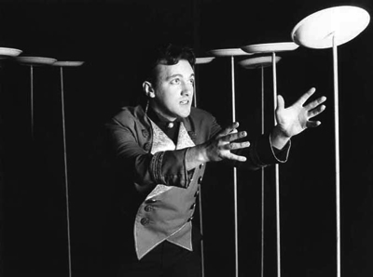
5) Human Factors – (They’re not automatons…)
Capable or incapable? / Willing or unwilling?
Remit? Career development?
Newness? Growth towards independence from you?
Requisite authority to match responsibility
Freedom within a framework (Why? / How? / What?)
What actual evidence do you need to see in order to TRUST them?

Slide 16
steve@hutchinsontraining.com
Project leadership pro-forma ? Get in touch.

