Slide 1
Inner Realities: Stronger Connections and Successful Futures
By Roddy Bray
antidotecafe.com

Slide 2
Positive Feelings

Slide 3
Negative Feelings

Slide 7
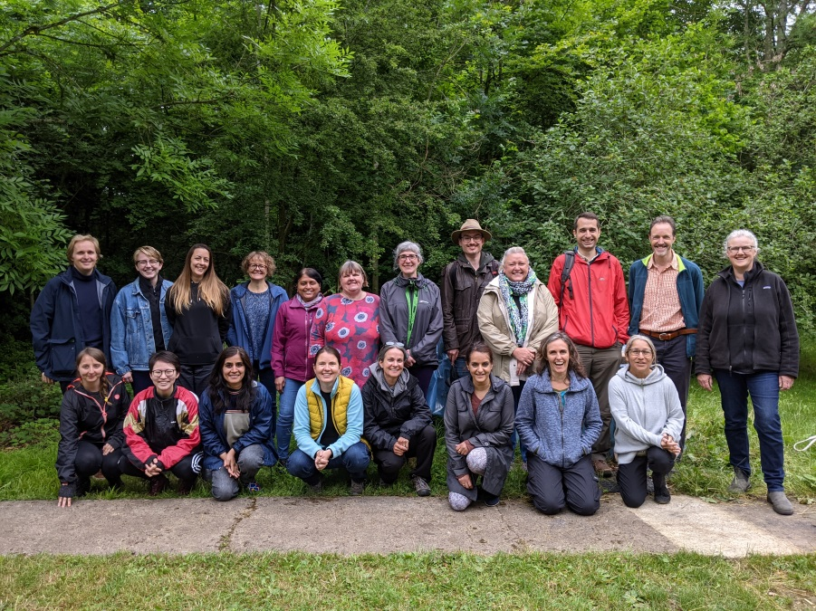

Slide 8
Roddy Bray
thrive@antidotecafe.com
Antidote Notes
monthly blogpost: antidotecafe.substack.com

