Slide 1

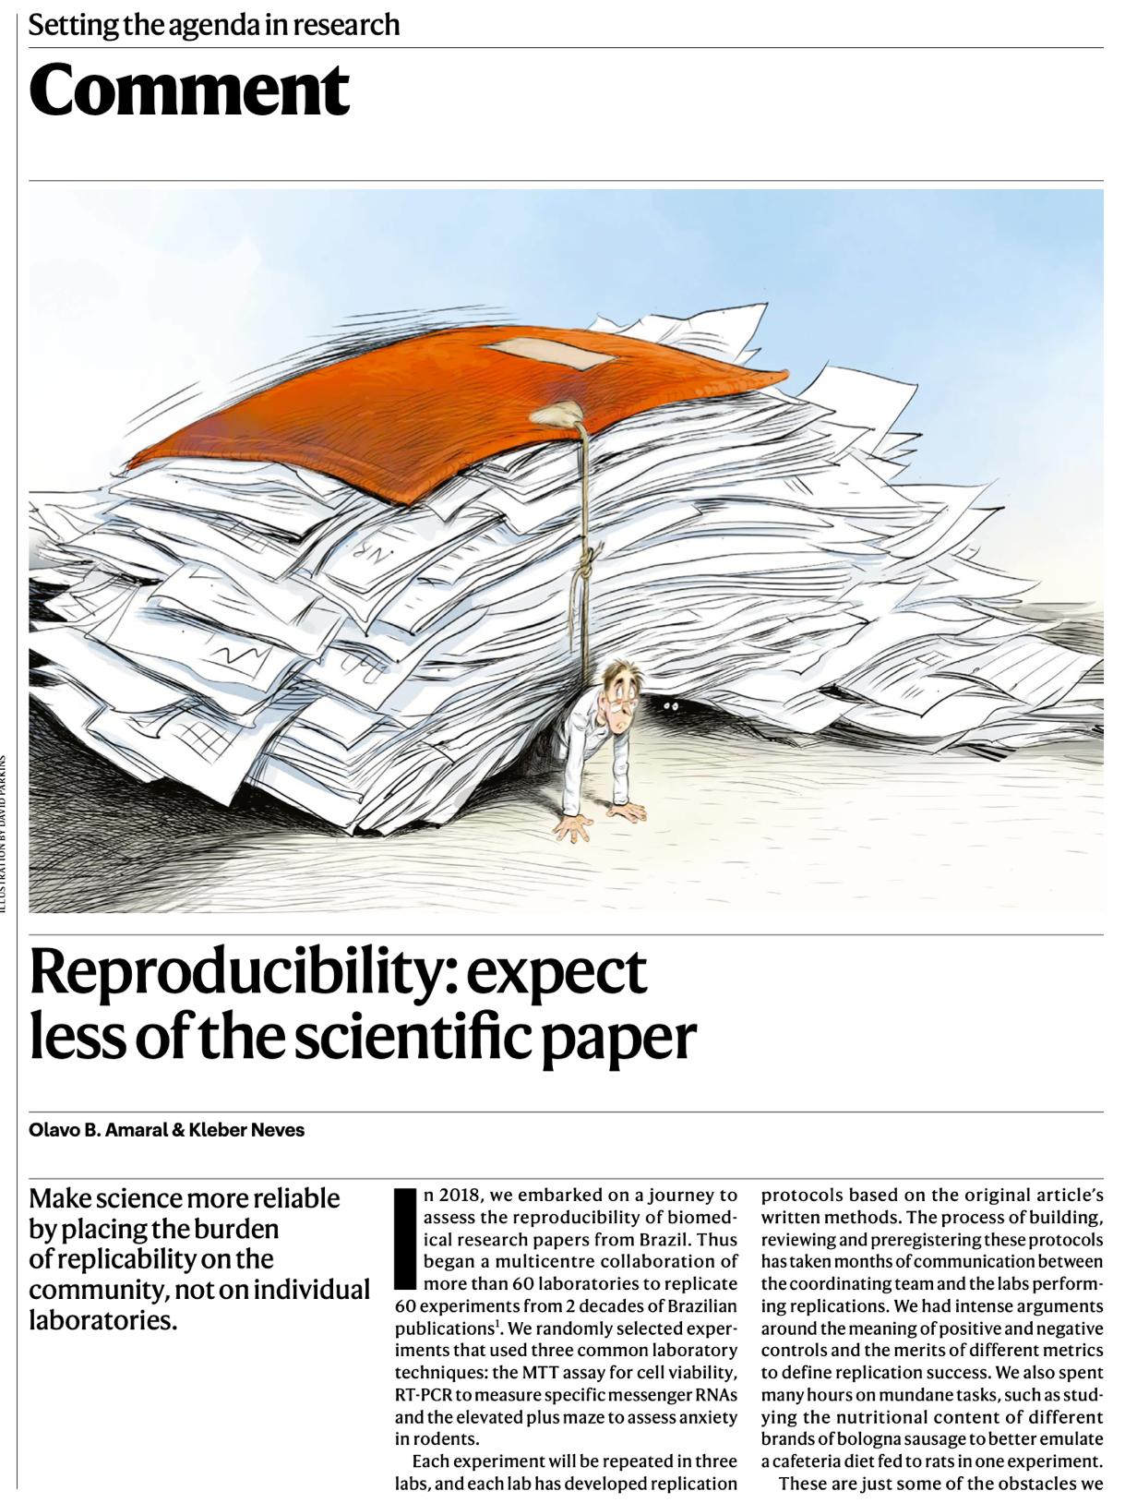
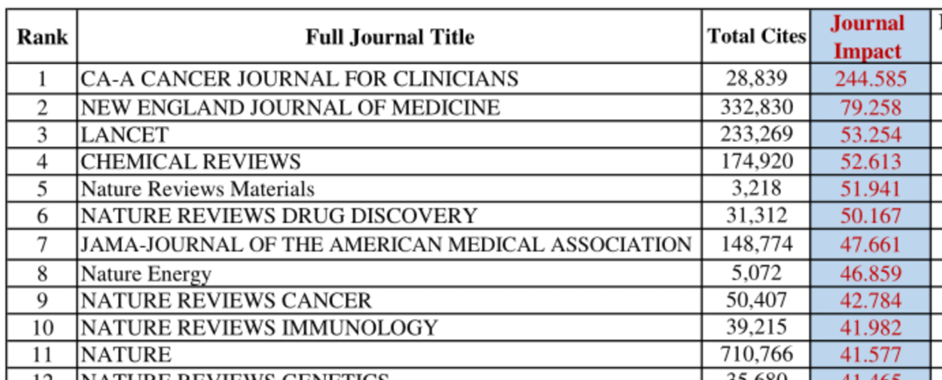
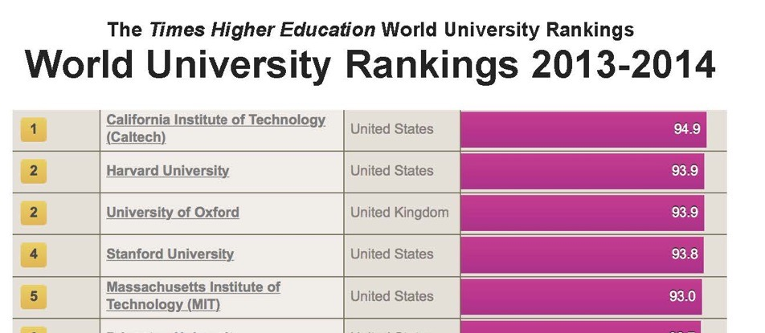
Why is DORA needed?
Impact factors and university rankings have become normalised
Evaluation based on journal metrics reduces productivity
  Chase for Journal Impact Factors slows publication
  Positive bias in the literature (no place for sharing negative results)
Metric-driven hyper-competition in which only the result matters:
  devalues other important academic activities – and academics
  focuses on the ‘what’, not the ‘how’ or ‘who’
  incentivises fraud
  undermines reliability & public trust
Prof. Stephen Curry
https://www.nature.com/articles/d41586-021-02486-7

Slide 2
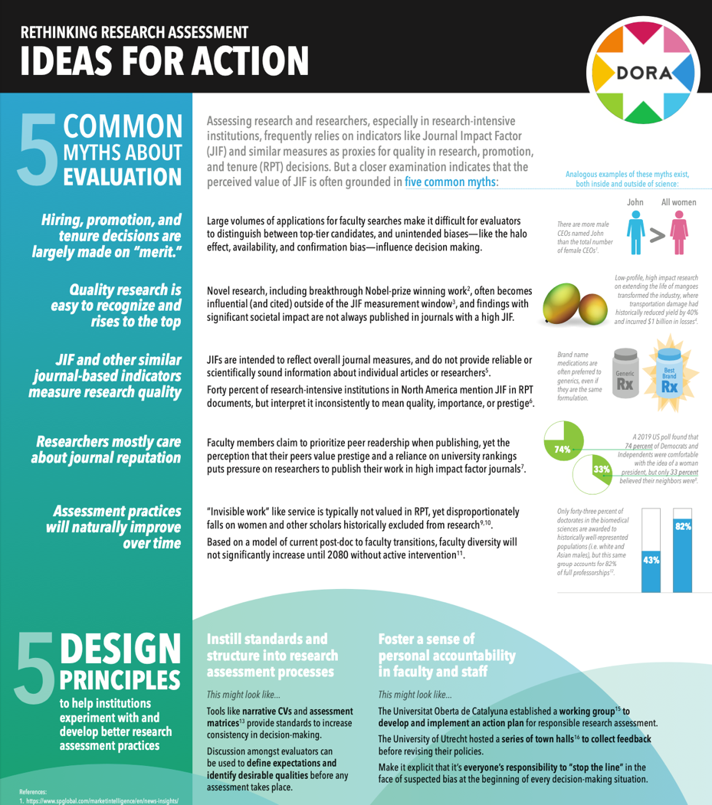
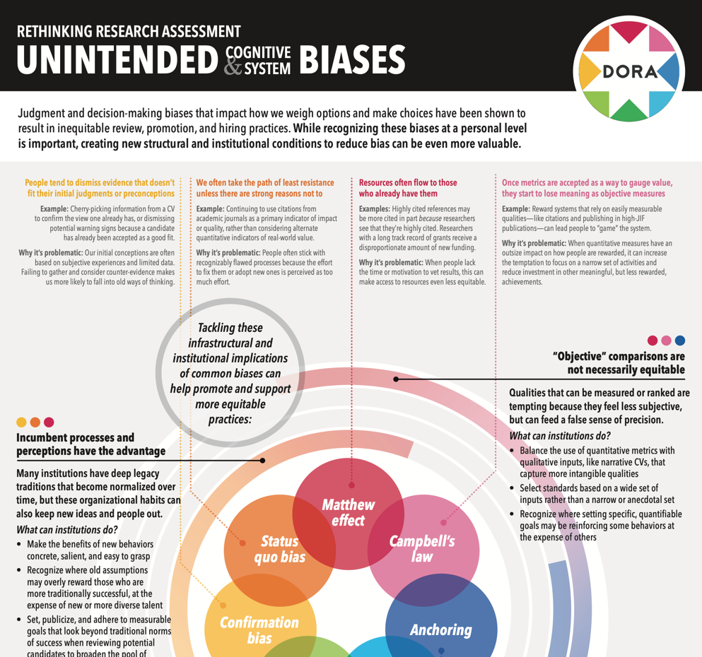
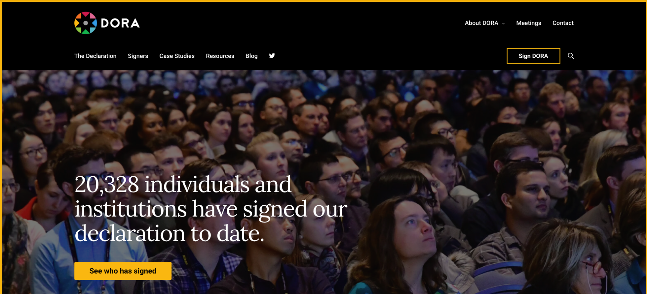
DORA: the organisation
        sfdora.org
        Launched in 2013
        >18,000 individuals and >2,300 organisations have signed
        Since 2017: significant new financial support
          2.2 members of staff (plus an intern)
          International steering group & a global advisory board (all volunteers)
Prof. Stephen Curry
          Recruit more signatories
          Extend the global and
          disciplinary impact of DORA
          Develop and promote best practice in research assessment
Notes:
As well as being a published declaration, DORA is a campaigning organisation.
Have been much more active since 2017 when injection of cash from these supporters allowed us to have a small but permanent staff - the most important member of which is Anna, our programme director
At the time, we also reconstituted the steering group and formed a global advisory board.

Slide 3
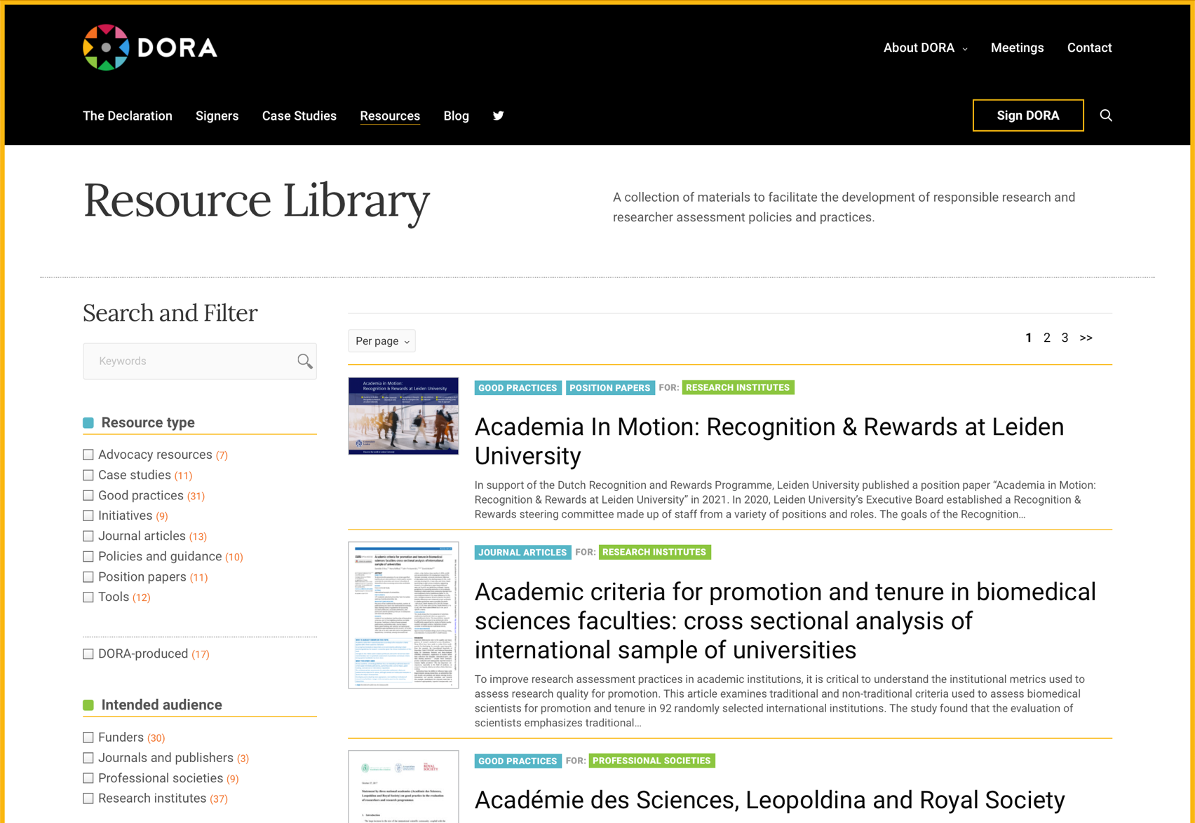
What is DORA doing to change research assessment?
Prof. Stephen Curry
          Speaking and writing about the need for responsible research assessment
          Organising meetings/workshops
          Collaborating on policy development (e.g. Wellcome, GRC)
          Developing and promoting new tools and practices:
            Collaborating on narrative CVs
            SHAPE tool for institutional self-evaluation
            Discovering, curating and promoting good practice
              e.g. Case studies of research assessment reform
            Project TARA (funded by Arcadia) – a dashboard to track institutional change
https://sfdora.org/resource-library/

Slide 4
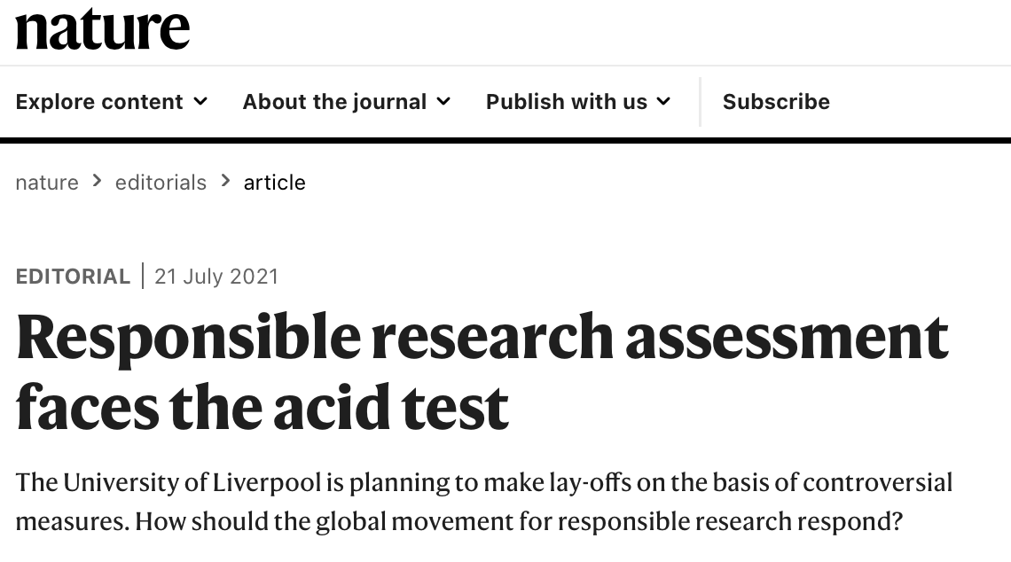
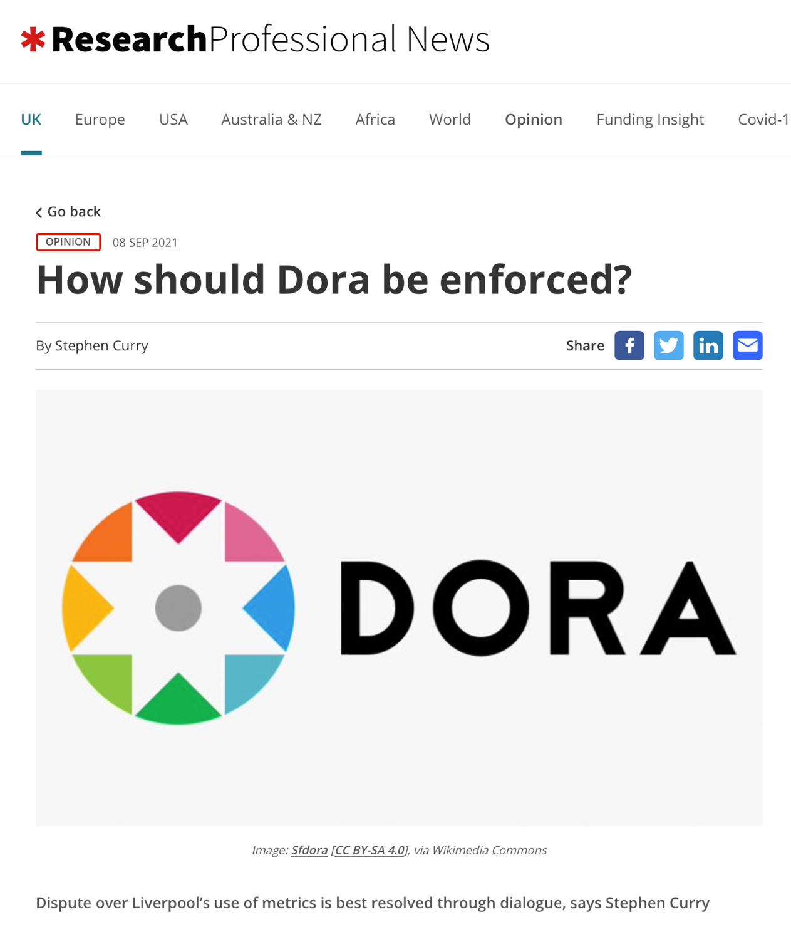
Does DORA work?
Prof. Stephen Curry
https://www.nature.com/articles/d41586-021-01991-z
https://www.researchprofessionalnews.com/rr-news-uk-views-of-the-uk-2021-9-how-should-dora-be-enforced/

