Slide 1
The Talented Dr Postdoc: A Skills Celebration
Eamon Dubaissi and Hellen Parra Florez
Research Staff Developers

Slide 2
Agenda
Introduction to Prosper
What is a postdoc? showreel
Interactive session – Unpacking your skills using examples from real job ads
Feedback and wrap-up

Slide 3
About Prosper
Prosper is a new approach to career development that unlocks postdocs’ potential to thrive in multiple career pathways.
The ultimate goal is to open up the huge talent pool that exists within the postdoctoral research community, to the benefit of postdocs themselves, Principal Investigators, employers and the wider UK economy.
Prosper is led by the University of Liverpool, working alongside our partners at the University of Manchester and Lancaster University, and is funded by the UKRI RED fund.

Slide 4
We’re working directly with employers from the public, private and third sectors to understand exactly what they need from their workforce, and applying these insights to equip postdocs with the relevant skills, mindsets and attributes to meet these needs.

Slide 5
We’re collaborating with PIs, providing best practice models and networking opportunities, allowing them to support their postdocs as they explore new possibilities.

Slide 6
We understand the diversity that exists within the UK postdoc population.
Creating a model that reflects this diversity.
We’re working to ensure our resources, and access to them, support this aim.

Slide 7
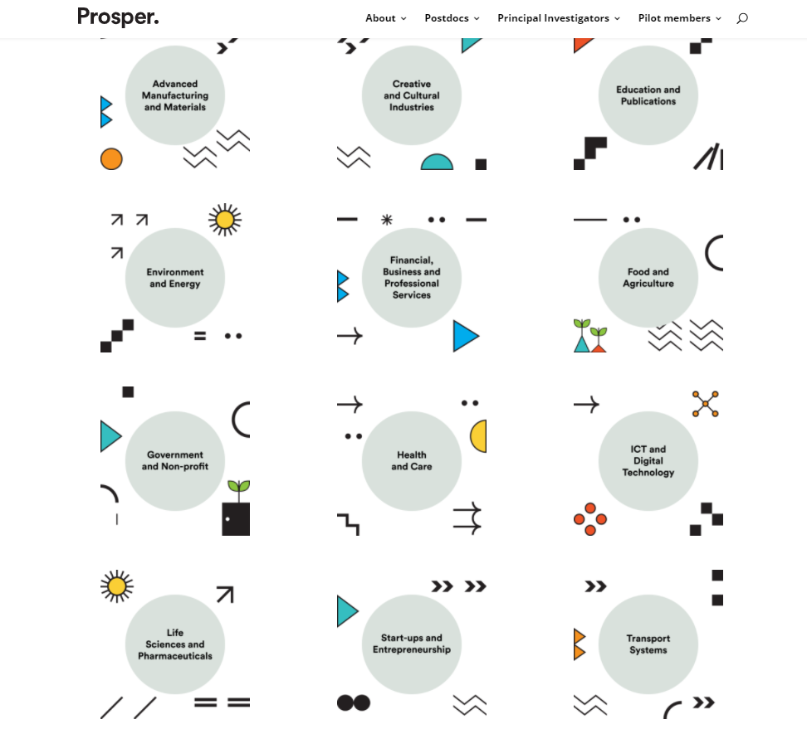
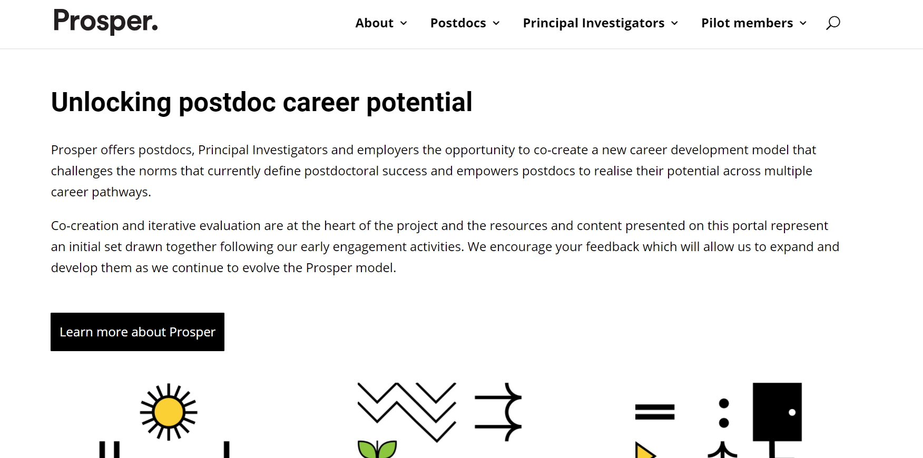
Prosper Portal – development phase leading to nationwide rollout from March 2023
Notes:
- General Advice: Skills assessment, CV guidance, use of LinkedIn, networking tips + Specific Advice: Career clusters – types of employers, roles, skills looking for

Slide 8
Agenda
Introduction
What is a postdoc? showreel
Interactive session – Unpacking your skills using examples from real job ads
Feedback and wrap-up

Slide 9
Agenda
Introduction
What is a postdoc? showreel
Interactive session – Unpacking your skills using examples from real job ads
Feedback and wrap-up

Slide 10
Examples from real job adverts
Creative consultant, Healthcare company
Account Manager, Data Specialist
Research Assistant Manager, Management Consultancy Firm
Policy Research and Academic Engagement Manager, Non-profit national innovation centre
Actual job titles taken from four different job adverts in September 2021

Slide 11
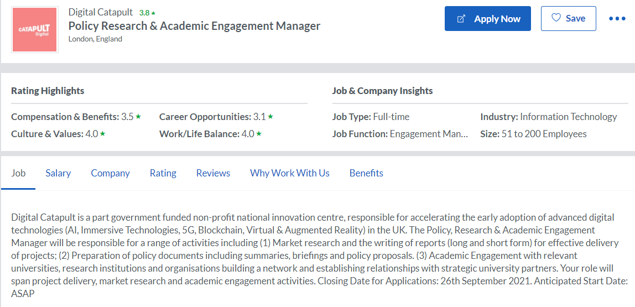
Examples from real job adverts

Slide 12
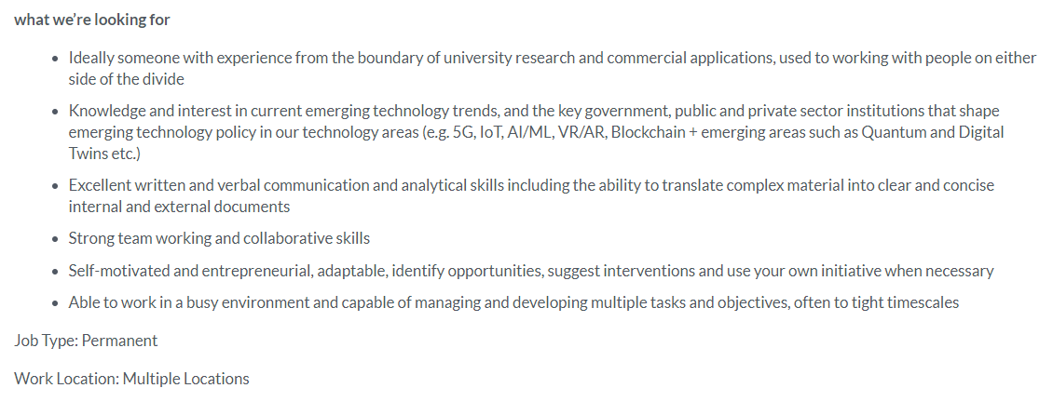
Examples from real job adverts

Slide 13
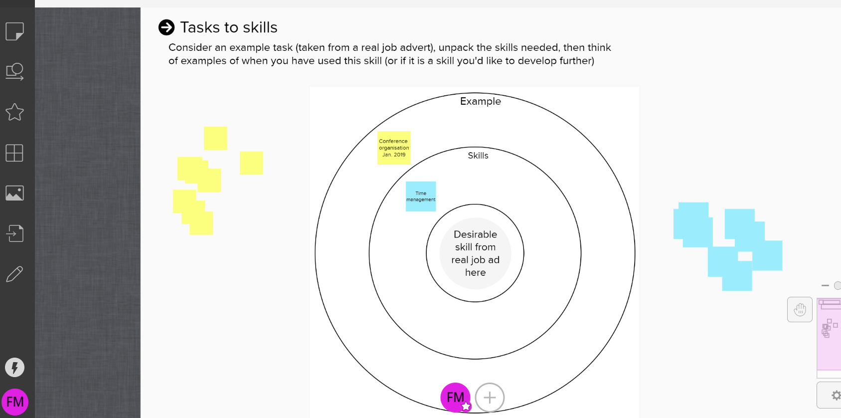
Interactive task
Notes:
Shortly you’ll be put into breakout groups and in those groups go across to Mural with a facilitator from the Prosper team. You’ll see a screen that looks something like this. You’re facilitator is there to assist you in this task but just a couple of things it’s worth noting, if you click on a sticky note you can then type on it, if you click on a sticky note and then double click into a blank area you’ll make a new sticky note, you can move the sticky notes by clicking and dragging them.If you make a mistake undo by using Ctrl+Z

Slide 14
Agenda
Introduction
What is a postdoc? showreel
Interactive session – Unpacking your skills using examples from real job ads
Feedback and wrap-up

Slide 15
Want to delve deeper into your skills?
For STEM disciplines why not try my IDP
https://myidp.sciencecareers.org/
For Arts, Humanities and Social Sciences try Imagine PhD
https://www.imaginephd.com/

Slide 16
Thank you.
Get in touch:
prosper.postdoc@liverpool.ac.uk
@ProsperPostdoc
https://www.kumospace.com/npdc21

