Slide 1
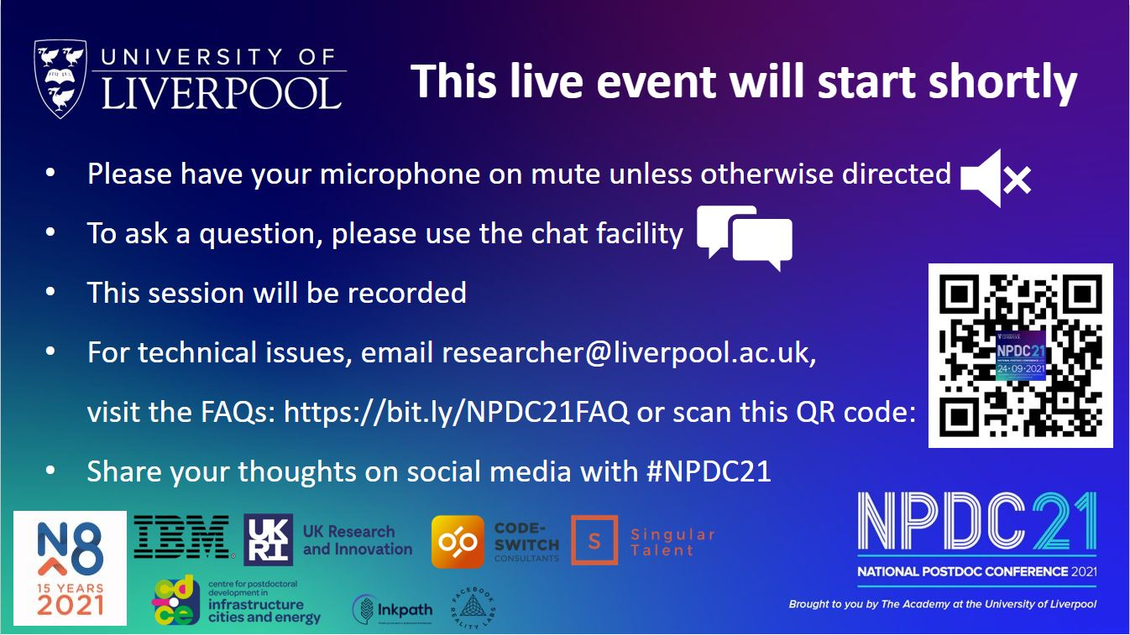

Slide 3



Self-assessment tools: Knowing me, knowing what to do
Dr Fiona McBride, Research Staff Developer

Slide 4

Session outcomes
What is self-assessment
Understand why self-assessment is important
Try out a self-assessment task
Reflect on the findings and plan how to use them
Notes:
In this session we will introduce the basics of what self-assessment is, why you’d want to use it, who makes use of self-assessment tools, and how to make the best use of your findings.

Slide 5
Poll
Q: Do you expect to be happy in your career?

Slide 6
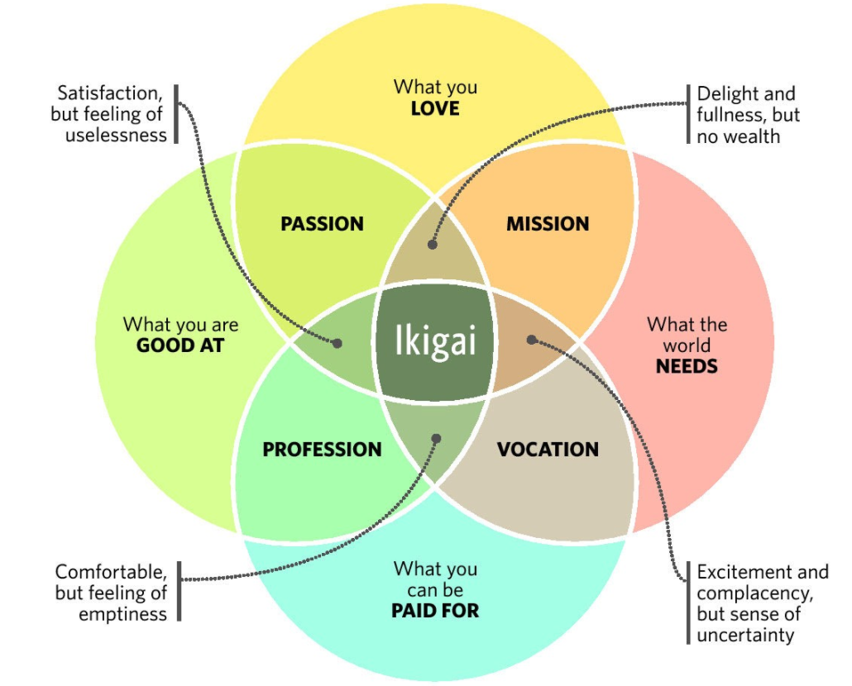
Ikigai – a Japanese have a word which encapsulates the concept of a fulfilling life- a reason for being rather than simply a job.
Definition from https://thecareercatalyst.co.uk/ikigai-how-to-decide-if-a-job-is-right-for-you/
Image from https://medium.com/org-hacking/when-do-you-feel-ikigai-35e310269cb9

Slide 7
Or put another way…
‘All work is a deal
between what you want out of life
and what an employer
wants out of you.’
From ‘How to get a job you love’ by John Lees, p.47

Slide 8
Self-assessment – what is it and why bother?

Slide 9
It’s a bit like finding a partner
Taken from https://www.findmypast.co.uk/blog/discoveries/lonely-hearts-ads, Chester Chronicle, 30/08/1816 and Bath Chronicle and Weekly Gazette, 02/05/1850
‘Wanted – A young lady, about 17 or 21 years of age, as a wife; she must be well acquainted with the necessary accomplishments of such; she must understand washing and ironing, baking bread, making good coffee, roasting beef, veal etc, boning a fowl, broiling a fish, making tarts, plum-puddings and desserts of all kinds, preserving fruits and pickles, expert with the needle, keeping a clean and snug house; must know reading, writing and arithmetic; never been in the habit of attending the ball-rooms; she must have been taught true and genuine principles of religion, and a member in a church of good standing. She must not be addicted to making too free use of her tongue, such as repeating any report that is injurious to her neighbour; or using taunting language to any person about her house, Any Lady finding herself in possession of the above accomplishments will be please address to ALPHONSO.’
Personal attributes
Skills
Social aspect/interactions with others
Hobbies
Person qualities/values
Acceptable point of compromise
‘N.B. He is bald, but will wear a wig if the lady wishes’

Slide 10
It’s a bit like finding a partner
Taken from https://www.findmypast.co.uk/blog/discoveries/lonely-hearts-ads, Chester Chronicle, 30/08/1816 and Bath Chronicle and Weekly Gazette, 02/05/1850
‘Wanted – A young lady, about 17 or 21 years of age, as a wife; she must be well acquainted with the necessary accomplishments of such; she must understand washing and ironing, baking bread, making good coffee, roasting beef, veal etc, boning a fowl, broiling a fish, making tarts, plum-puddings and desserts of all kinds, preserving fruits and pickles, expert with the needle, keeping a clean and snug house; must know reading, writing and arithmetic; never been in the habit of attending the ball-rooms; she must have been taught true and genuine principles of religion, and a member in a church of good standing. She must not be addicted to making too free use of her tongue, such as repeating any report that is injurious to her neighbour; or using taunting language to any person about her house, Any Lady finding herself in possession of the above accomplishments will be please address to ALPHONSO.’
Personal attributes
Skills
Social aspect/interactions with others
Hobbies
Person qualities/values
Acceptable point of compromise
‘N.B. He is bald, but will wear a wig if the lady wishes’

Slide 11
It’s a bit like finding a partner
Taken from https://www.findmypast.co.uk/blog/discoveries/lonely-hearts-ads, Chester Chronicle, 30/08/1816 and Bath Chronicle and Weekly Gazette, 02/05/1850
‘Wanted – A young lady, about 17 or 21 years of age, as a wife; she must be well acquainted with the necessary accomplishments of such; she must understand washing and ironing, baking bread, making good coffee, roasting beef, veal etc, boning a fowl, broiling a fish, making tarts, plum-puddings and desserts of all kinds, preserving fruits and pickles, expert with the needle, keeping a clean and snug house; must know reading, writing and arithmetic; never been in the habit of attending the ball-rooms; she must have been taught true and genuine principles of religion, and a member in a church of good standing. She must not be addicted to making too free use of her tongue, such as repeating any report that is injurious to her neighbour; or using taunting language to any person about her house, Any Lady finding herself in possession of the above accomplishments will be please address to ALPHONSO.’
Personal attributes
Skills
Social aspect/interactions with others
Hobbies
Person qualities/values
Acceptable point of compromise
‘N.B. He is bald, but will wear a wig if the lady wishes’

Slide 12
It’s a bit like finding a partner
Taken from https://www.findmypast.co.uk/blog/discoveries/lonely-hearts-ads, Chester Chronicle, 30/08/1816 and Bath Chronicle and Weekly Gazette, 02/05/1850
‘Wanted – A young lady, about 17 or 21 years of age, as a wife; she must be well acquainted with the necessary accomplishments of such; she must understand washing and ironing, baking bread, making good coffee, roasting beef, veal etc, boning a fowl, broiling a fish, making tarts, plum-puddings and desserts of all kinds, preserving fruits and pickles, expert with the needle, keeping a clean and snug house; must know reading, writing and arithmetic; never been in the habit of attending the ball-rooms; she must have been taught true and genuine principles of religion, and a member in a church of good standing. She must not be addicted to making too free use of her tongue, such as repeating any report that is injurious to her neighbour; or using taunting language to any person about her house, Any Lady finding herself in possession of the above accomplishments will be please address to ALPHONSO.’
Personal attributes
Skills
Social aspect/interactions with others
Hobbies
Person qualities/values
Acceptable point of compromise
‘N.B. He is bald, but will wear a wig if the lady wishes’

Slide 13
It’s a bit like finding a partner
Taken from https://www.findmypast.co.uk/blog/discoveries/lonely-hearts-ads, Chester Chronicle, 30/08/1816 and Bath Chronicle and Weekly Gazette, 02/05/1850
‘Wanted – A young lady, about 17 or 21 years of age, as a wife; she must be well acquainted with the necessary accomplishments of such; she must understand washing and ironing, baking bread, making good coffee, roasting beef, veal etc, boning a fowl, broiling a fish, making tarts, plum-puddings and desserts of all kinds, preserving fruits and pickles, expert with the needle, keeping a clean and snug house; must know reading, writing and arithmetic; never been in the habit of attending the ball-rooms; she must have been taught true and genuine principles of religion, and a member in a church of good standing. She must not be addicted to making too free use of her tongue, such as repeating any report that is injurious to her neighbour; or using taunting language to any person about her house, Any Lady finding herself in possession of the above accomplishments will be please address to ALPHONSO.’
Personal attributes
Skills
Social aspect/interactions with others
Hobbies
Person qualities/values
Acceptable point of compromise
‘N.B. He is bald, but will wear a wig if the lady wishes’

Slide 14
‘identifying personal values, skills, and strengths requires introspection. This can be a new or uncomfortable experience […] But keep in mind that the benefits of self-awareness will better help you in your career search, and these self-assessment techniques are tried and true’.
Lundsteen, N. (2017) ‘Taking a Personal Inventory: Assessing Your Skills, Strengths, Interests and Values’, in Evans, T.M., Lundsteen, N., and Vanderford, N.L. ReSearch: A Career Guide for Scientists. London: Academic Press, pp. 73-86.

Slide 15
Changing the question
From | ‘What job/s can I get?’
To | ‘What jobs are a good fit for me, for what I’m both good at doing and like to do?’

Slide 16
Why bother? To get clarity
UoL Research Staff Conference 2019
Prosper Snapshot Survey
“What might prevent you from exploring job options beyond academia?”

Slide 17
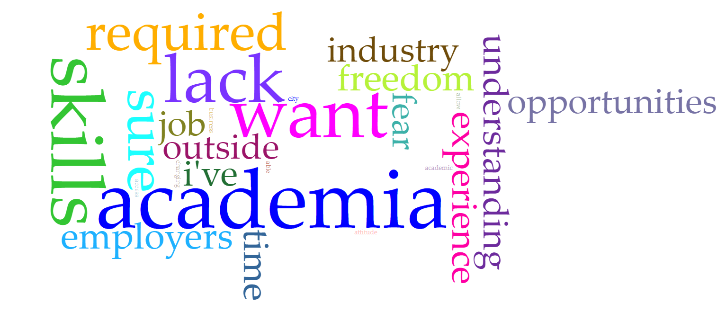
“What might prevent you from exploring job options beyond academia?”
“lack of confidence about skills I have”

Slide 18
“What might prevent you from exploring job options beyond academia?”
“lack of confidence about skills I have”
“lack of knowledge/understanding of what I can do”

Slide 19
Self-assessment – what’s the risk if I don’t bother doing it?

Slide 20
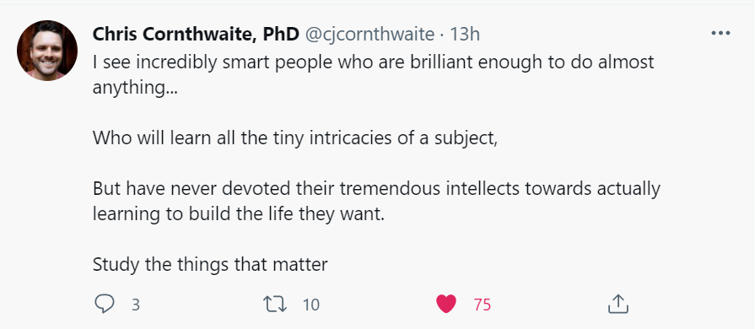
From Twitter, 07/07/2021

Slide 21
Tempting to go straight for specifics
What careers use people like me?
What have other postdocs/PhDs done besides research from my discipline?
What industries use my specific research skills?
Adapted from P S Fiske, 2001,‘Put your science to work: the take-charge career guide for scientists’ John Wiley and Sons, p.37

Slide 22
Excerpt from ‘Shark’s fin and Sichuan pepper a sweet-sour memoir of eating in China’ by Fuchsia Dunlop, p.29-30 published by Ebury press (first published 2008) 2019
‘By the age of eleven I already wanted to be a chef. But the conveyor belt of my education took me further away from food.
Students who get good grades at school are not encouraged to run away and work in restaurants. I remember one middle-school teacher laughing at me, incredulous, when I told him of my ambition. So I carried on passing exams, working hard and doing what was expected of me.
It was in China, thousands of miles away from home and almost completely cut off from my past, that I was able to do what I really wanted. Finally, I was able to admit to myself that I was no socio-economic analyst, not even really a journalist, but a cook. It was in the kitchen, chopping vegetables, mixing a dough in my hands or seasoning a soup, that I felt most completely myself. Growing up in Oxford, studying in Cambridge, working in London, I had been propped up by a string of academic and professional credentials that had seemed to define me in the eyes of other people. But in China none of that mattered.’

Slide 23
Taken from P S Fiske, 2001,‘Put your science to work: the take-charge career guide for scientists’ John Wiley and Sons, p.40
‘The most common mistake that people make in their career decisions is to do something because they’re “good at it”. It’s a story I hear all the time. Someone will say to me, “I’m an engineer, but I don’t like it.” Why did you become an engineer? “I was good at science and math, so people told me I should be an engineer.” Did you ever like engineering? “No, but it was easy.”.’

Slide 24
Delay going straight for specifics
What careers use people like me?
What have other postdocs/PhDs done besides research from my discipline?
What industries use my specific research skills?
Why am I looking for a change?
What am I dissatisfied with in my current occupation?
What do I really enjoy doing?
Adapted from P S Fiske, 2001,‘Put your science to work: the take-charge career guide for scientists’ John Wiley and Sons, p.37

Slide 25
Who uses self-assessment tools?

Slide 26
Employers
‘We do a lot of work to build competency in [team work], encouraging a process of self-analysis and self-reflection in order for people to understand what sort of person they are, why they might be aligned with some people and have conflict with others. We need people who understand how teams operate and what makes a high performing team.’
- An R&D director for a large multinational company
Notes:
Several employer partners we’ve spoken to mention self-assessment tools either as part of the recruitment process or as part of in-house development. Very large companies sometimes create their own self-assessment tool which all employees undertake to ensure that they’re in the right part of the company and working towards what they really want.

Slide 27
Former postdocs who’ve found fulfilling careers
‘A massive part of [my career planning] has always been thinking about tying together two things: understanding what my strengths are and combining that with understanding what I’m actually enjoying or not enjoying about the job; and helping that to map out what my aspirations and plans are. You have to be proactive and have some kind of self-awareness’.
Dr Kate Whelan, former postdoc now co-founder and COO of Notch Communications

Slide 28
Former postdocs who’ve found fulfilling careers
‘By getting clear on your vision, purpose, mission, values and natural talents and capabilities, the next breadcrumb steps will become obvious. You will know deeply where you can add value in a way that lights you up.’
Dr Hannah Roberts, former biotechnology postdoc turned career coach.

Slide 29
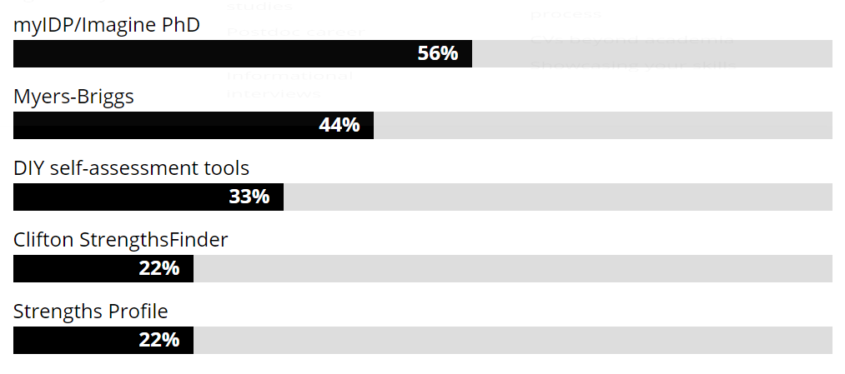
Universities with their postdocs
The University of Oxford
Ghent University
University of Leeds
Glasgow University
University of Warwick
Harvard University
Stanford University
Columbia University
Yale University
Data correct from their publicly accessible websites May 2020.

Slide 30
Have a go!

Slide 31
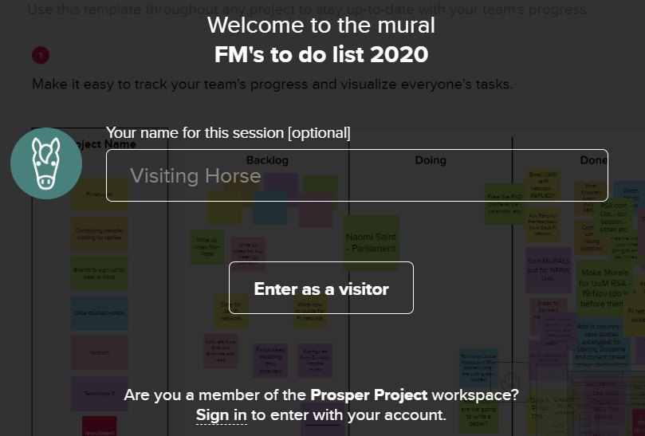
Mural
Name of Mural here
Notes:
Shortly we’ll put a link to Mural in the chat. You’ll see a screen that looks something like this, just click the Enter as a visitor button, don’t bother typing a name in.

Slide 32
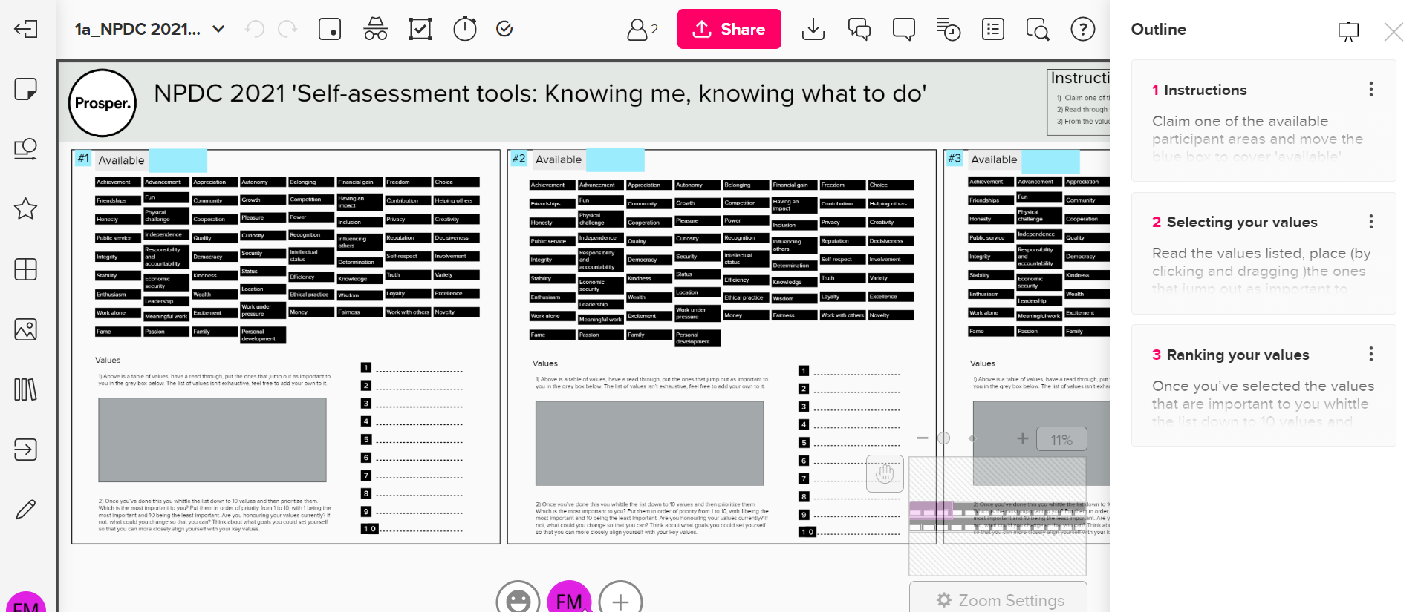
Mural
Notes:
You’ll then see a screen that looks something like this. Your facilitator is there to assist you in this task but just a couple of things it’s worth noting, if you click on a sticky note you can then type on it, if you double click into a blank area you’ll make a new sticky note, you can move the sticky notes by clicking and dragging them. If you make a mistake undo by using Ctrl+Z. Each group has a choice of 3 questions, discuss which one you’d like to tackle. You can then navigate using either the Outline (on the right hand side of the screen) or dragging the pink box near the bottom right of the screen to the area of the mural you’d like to go to. The breakout rooms are 25 mins in duration, please nominate a spokes person from your room to feedback (max 5 mins per room) when we all come back together at the end.

Slide 33
Next steps

Slide 34
Reflect on your findings and set goals
Using a self-assessment tool isn’t the end of the exercise
Reflect on your findings
Use these to set goals
Goals should be Specific, Measurable, Attainable, Relevant and Time-based.

Slide 35
What next?
Read our blog post, ‘Self-assessment tools: knowing me, knowing what to do’ https://www.liverpool.ac.uk/researcher/prosper/blog/prosper/self-assessment-tools/
Pick a self-assessment tool and try it out.
Reflect on the findings. - You thought you were an introvert, but your findings suggest otherwise? Have a think about the output of the self-assessment tool you used.
Ask a friend. – Not sure where your strengths lie? Try asking a friend, family member or colleague, or why not all three?
Find a buddy.– Find a buddy who’s also interested in learning more about themselves, discuss what you’ve been finding out about yourself via self-assessment tools with them.
Apply your findings.– Now you’ve got a clearer idea of what’s important to you, use this to help develop your career. Look for opportunities to try things out in your role or beyond it.

Slide 36
From https://theprofessorisin.com/2017/09/04/careering-toward-authenticity-postac-post-by-karen-cardozo/
‘we must reframe the concept of a career—not as a singular outcome, but as a lifelong practice of recalibration that allows you to stay in your sweet spot, where you can freely contribute your unique gifts to the world.’
Notes:
Remember it’s a process!

Slide 37
Thank you for you time!
For more information, visit: liv.ac.uk/prosperproject
Get in touch: prosper.postdoc@liverpool.ac.uk
Follow us on Twitter: @ProsperPostdoc
Visit the Prosper Portal: https://prosper.liverpool.ac.uk

Slide 38
