Slide 1
Radical Collaboration on the Living with Machines project
Ruth Ahnert, Federico Nanni, Daniel Wilson
The Alan Turing Institute

Slide 2
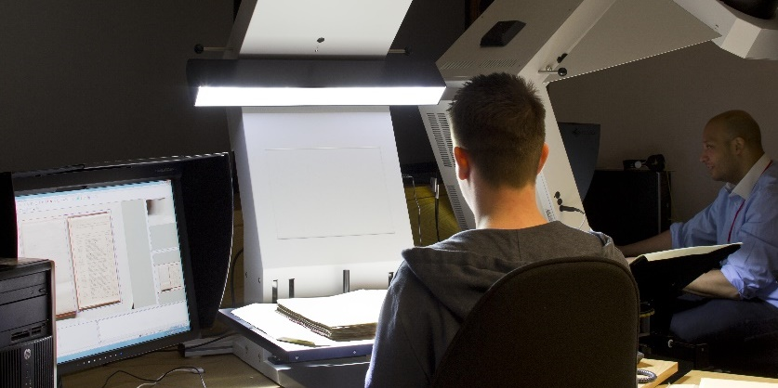


The BL and The Alan Turing Institute
The British Library has digitised millions of pages from its collections.
The national institute for data science and artificial intelligence, The Alan Turing Institute, offers the expertise to harness this data to answer research questions at scale.

Slide 3
a data-driven history project/ a history-focused data science project.
The untapped depth of digital archives means that there is still much to learn about the human, social, and cultural consequences of the coming of the machine age (c.1780-1920).

Slide 4
Objectives
We aim to:
provide computational means of marshalling at scale the UK’s growing number of digitised historical texts, and documents;
develop innovative computational models, tools, code, and infrastructure that will be transferable to other research projects;
facilitate new historical findings about the effects of mechanisation on the lives of ordinary people;
deliver the above through radical collaboration.

Slide 5


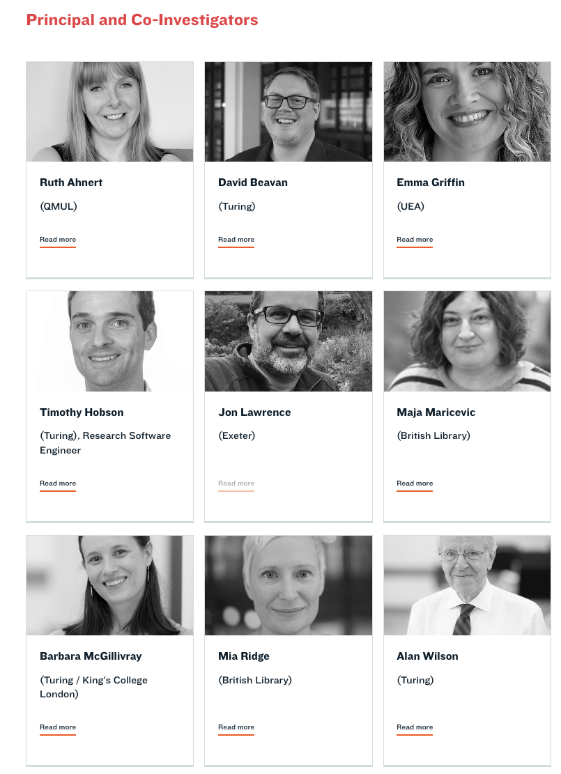
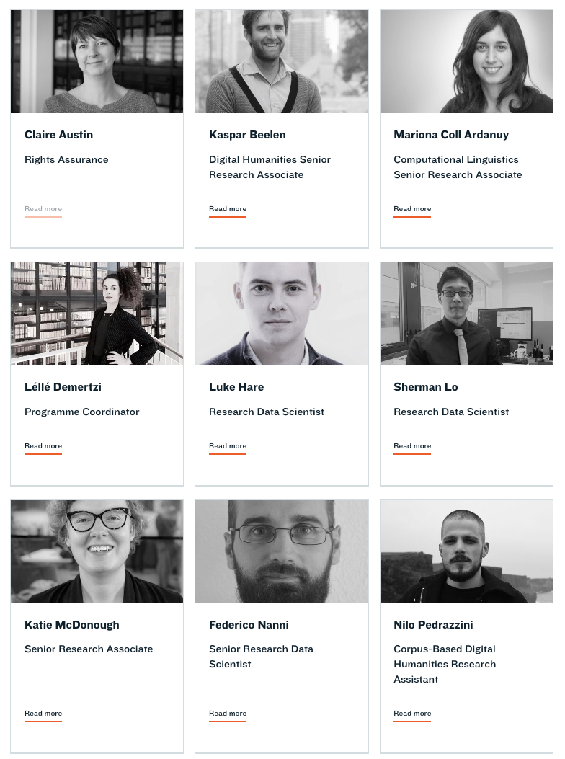
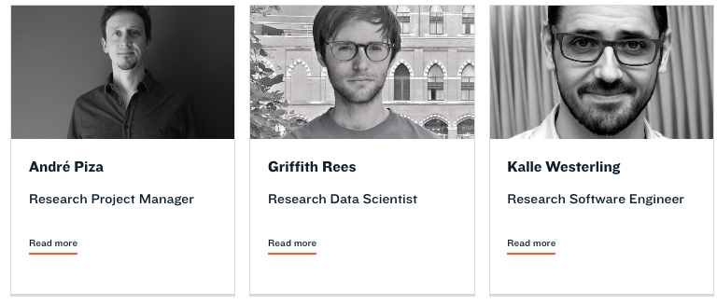
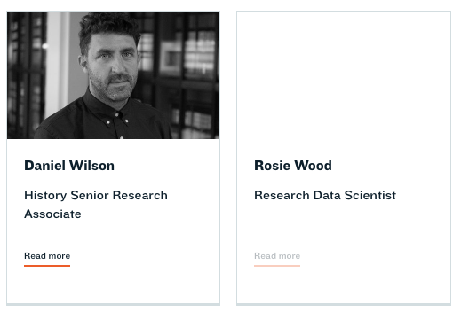
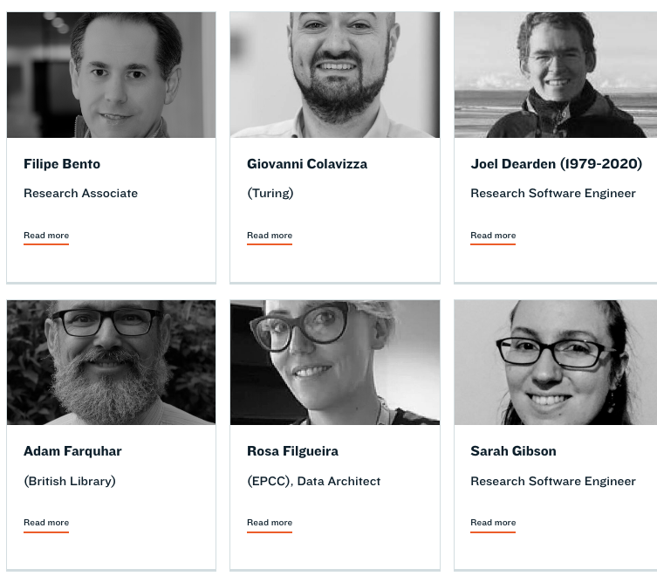
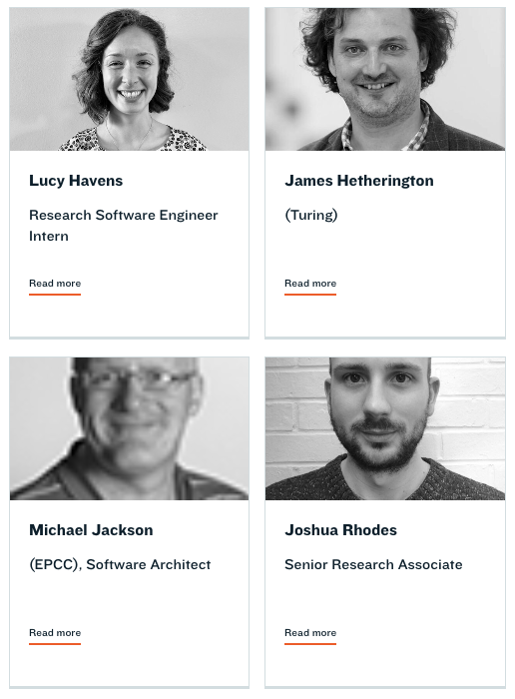
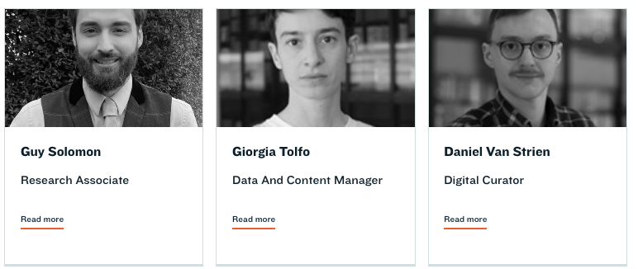
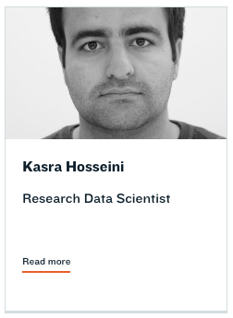

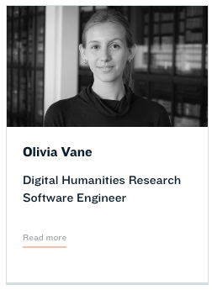
The Living with Machines Team

Slide 6
Challenges
Beginning from a standing start
  No pilot projects
  Almost no prior inter-team collaborations
  Some team members with no collaborative experience
  Data not yet acquired or ingested
  Infrastructure not in place
Different professional and disciplinary norms:
  Expectations and definitions of success
  Research processes
  Publication and dissemination cultures.

Slide 7
The Project Charter
Increasing numbers of models for this practice: Scholars Lab, Colored Conventions Project, Stan Ruecker and Milena Radzikowska etc.
Aim:
  to create shared vision so that people knew what they were signing up for
  lists a set of informal policies or values that we commit to abiding by, but also revisiting and revising where they are not working or require nuancing.
Version 1: written by PI and Co-Is for hiring
Version 2: revised once team on board
Plan to revisit at intervals (Pandemic!)

Slide 8
How to brainstorm ideas together
HypGen: hypothesis generation group
IdeasLab
NLP reading group
Computer vision for digital heritage interest group
Humanities & data science discussion group

Slide 9
How to embed best RSE practices
Offering git-flow overviews
Being available for informal support (Code & Coffe)
Having milestones independent from conference deadlines
Having regular stand-up meetings
Coding together and reviewing each other’s code (a lot)

Slide 10
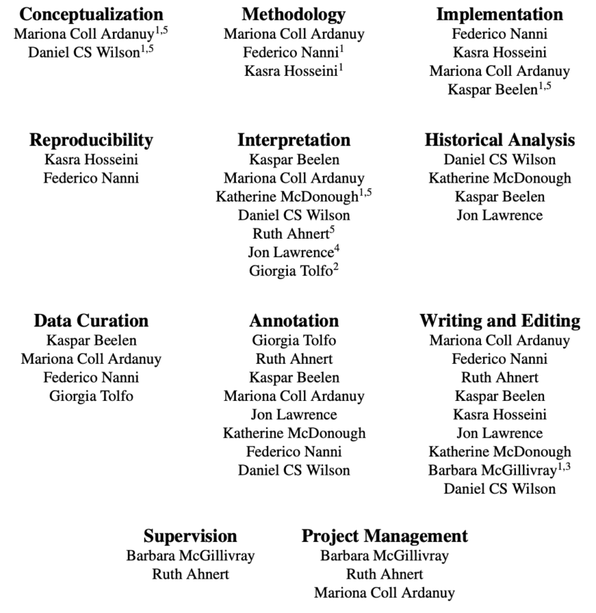
How to recognise all contributions
To know more: https://livingwithmachines.ac.uk/highlighting-authors-contributions-and-interdisciplinary-collaborations-in-living-with-machines/

