Slide 1
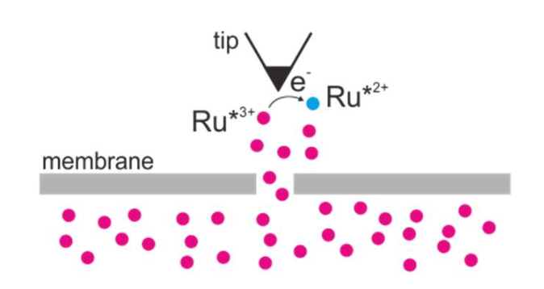
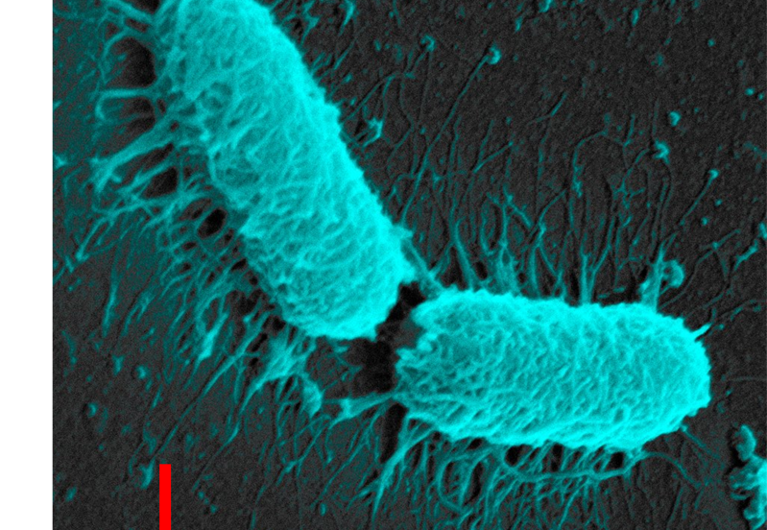
Microbial Induced Electrochemistry at the Local Site and Single Cell Level
3.5 year PhD Position available Oct 2024
Fe³⁺
Fe²⁺
Microbial induced corrosion via local electrochemical processes initiated by bacteria is a serious economic problem that costs an estimated $113 Bn p.a worldwide.
Local electrochemical processes drive such corrosion via direct metal-to-bioorganism charge transfer, electron shuttle phenomena, or electrochemical processes mediated by chemicals produced by bacteria. The project will adopt a combined surface spectroscopy, scanning probe microscopy, local electrochemistry and bio-imaging approach to understand the origin and mechanism of microbial corrosion.
The PhD will include:
interdisciplinary science
advanced nano-fabrication, nano-imaging and spectroscopic techniques
The student will register at the University of Liverpool and enrol in NBIC’s Doctoral Training Centre which trains inter-disciplinary PhD researchers at the Interface of Physical and Life Sciences.
Provide high level training and mentorship in research and entrepreneurship
Join a National Network of leading Research Groups in the UK
Join a community of leading companies in the UK
Applications are encouraged from highly motivated candidates who have, or expect to have, at least a 2:1 degree or equivalent in Chemistry, Physics, Biophysics, Materials Science, Microbiology or Engineering. Applications should be made as soon as possible .Candidates will be evaluated as applications are received and the position will be filled if a suitable candidate is identified. The project start date is 01/10/2024
Informal enquiries are also encouraged and should be addressed to Lucy Jones (Lucy.Jones2@liverpool.ac.uk)
Combining advanced fabrication and probing techniques to track electrochemistry at the local level.
Supervisory team:
Professor R Raval,
Dr A Vezzoli,
Department of Chemistry, University of Liverpool.
Professor Pat Unwin
Department of Chemistry, University of Warwick.

