Slide 1
Engage@liverpool
Professor Michael Mair
Dr Billie-Gina Thomason
Hayley Meloy
engage@liverpool.ac.uk

Slide 2
engage@liverpool
Engage@Liverpool is a cross-faculty research methods, methodology and advanced training initiative within the University of Liverpool.
Aim is to promote methodological excellence and innovation in research
Work with partners providing research methods and advanced training at 3 different levels
Institutional level
Regional level (Methods North West and Doctoral Training Partnerships0
National and International Level (National Centre for Research Methods
We have a weekly newsletter – engage@liverpool.ac.uk

Slide 3
Methods North West
Methods North West is made up of 5 partner institutions including:
University of Liverpool
University of Manchester
Keele University
University of Lancaster
University of Central Lancashire
Various Methods Lunch Sessions: Methods North West | Events

Slide 4
Funding Opportunities with Mnw
Methods Labs
Up to £2000
Collaborative partnerships with PGRs / Academics across institutions
Open brief with a methodology focus
Collaborative Innovation Grants
Up to £6000
New research methods or refining, re-inventing or finding novel ways to apply existing methods is of interest

Slide 5
National Centre for Research Methods
University of Liverpool became an NCRM partner institution in 2020
Short Courses
University of Liverpool have hosted over 30 separate events
Methods Fair – September 2025
Research Methods Rendezvous
Explore puzzles and concerns, and begin to transform the into important, feasible and impactful research.
Free learning resources

Slide 6
Engage@Liverpool
Since Spring 2011, Engage@Liverpool have been involved in:
Over 300 events featuring 100s of speakers from 30+ departments across the university.
Master classes, workshops, day-schools, symposia and conferences for students and academics regionally, nationally and internationally.
Support for research networks/themes in the University of Liverpool (and beyond).
30 separate short courses commissioned for the NCRM, and have contributed to several sets of online resources and an ‘innovation collection’ published on investigative methods

Slide 7
Methodological Innovation and Development Award Scheme (MIDAS)
Research-focused workshops/events emphasising methodological and intellectual innovation;
Practice- or impact-focused workshops/events seeking to engage people, communities and organisations;
Short-course and advanced methods training workshop development.

Slide 8
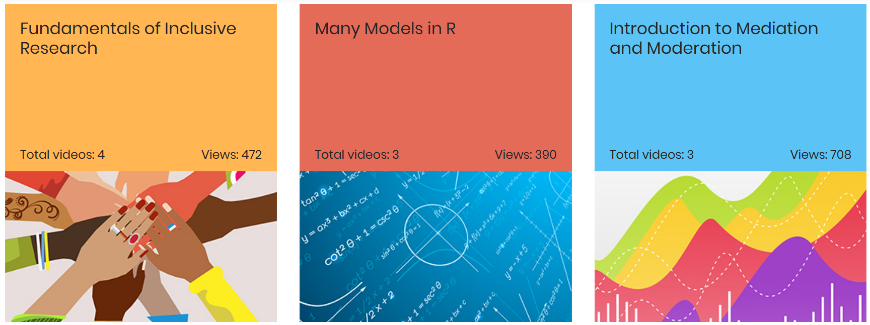
Examples of Engage@Liverpool Support
Dr Kim Ozano and Dr Laura Dean, Participatory Action Research (PAR): Equitable Partnerships and Engaged Research
Dr Laura Radcliffe and Dr Leighann Spencer, Qualitative Diary Methods
Dr Nicole Vitellone, publication The Social Life of Creative Methods: Filmmaking, Fabulation and Recovery

Slide 9
Questions?
engage@liverpool.ac.uk

