Slide 1
Why Study a PhD at Liverpool & Making your Research Proposal Stand out!
Georgina Endfield FBA
Professor of Environmental History and
Associate Pro-Vice Chancellor for Research Environment and Postgraduate Research
Notes:
Here to offer a an overview of the nuts and bolts of applying for a research degree and what you can expect in terms of support from the University
We are one of the UK’s leading research universities and, as a member of the prestigious Russell Group, we have a global reach and influence that reflects our academic heritage

Slide 2
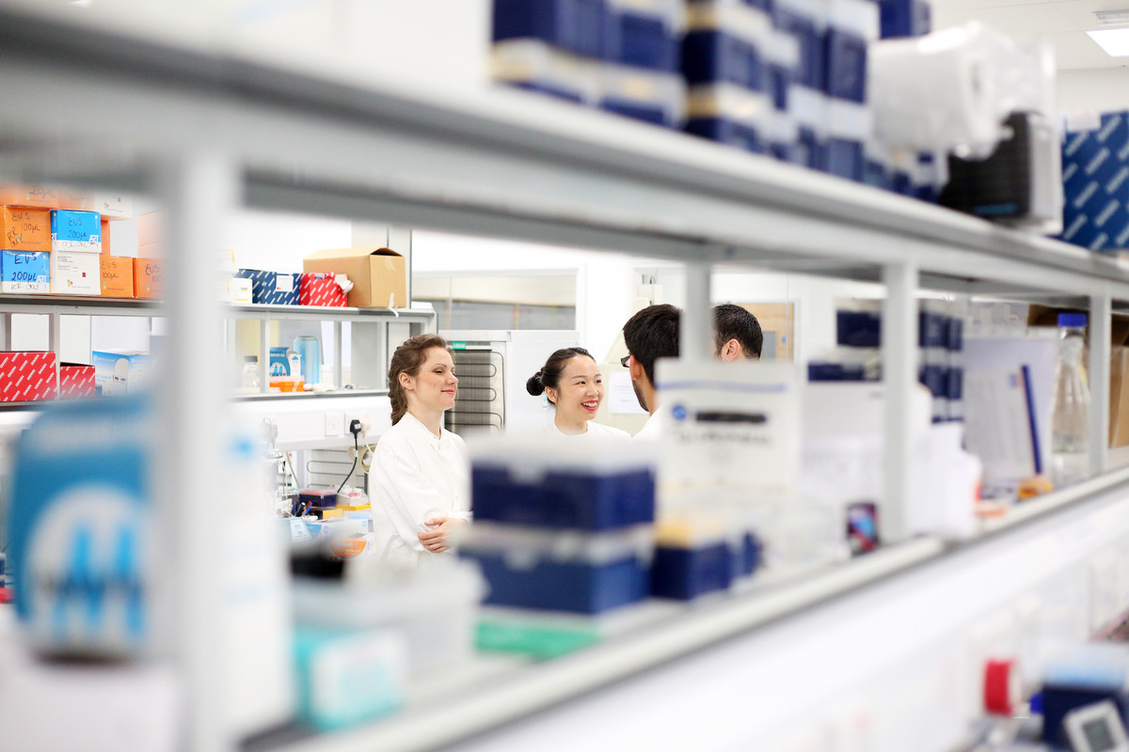
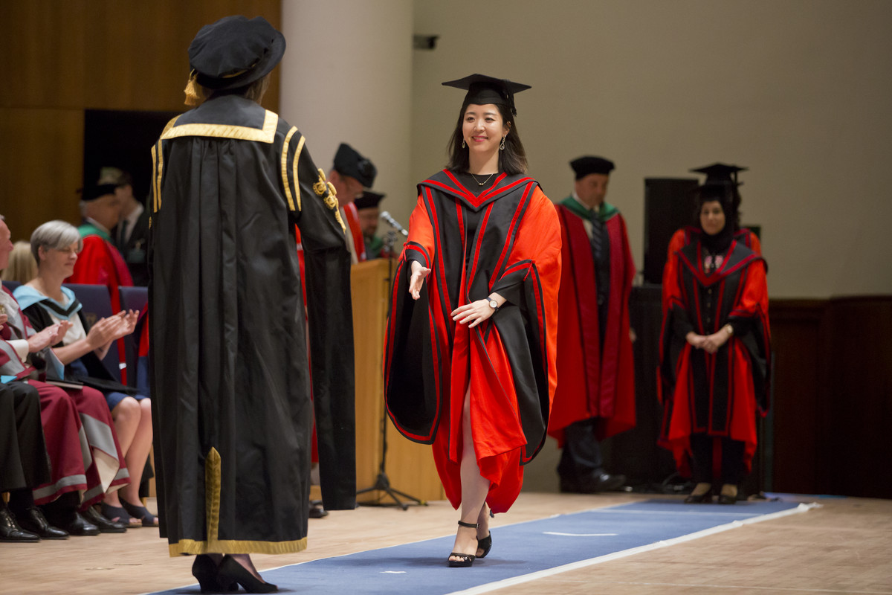
Postgraduate Research
https://www.youtube.com/watch?v=xH3txuJtBrY

Slide 3
Is postgraduate research for you?

Slide 4
Why do you want to do a PhD?
Do you have a passion for the subject and a love of knowledge?
Can you work on a single topic for a sustained period of time?
Do you consider this the natural next step in your career?
Do you need a PhD for your chosen career? Or can you gain the relevant skills through experience?
Do you want to develop in a context where the ideas are generated, through debate, discussions, reading, writing, conferences, seminars etc.?
a PhD hones reading, writing, synthesis and teaching skills - not always possible in the workplace
Adds an achievement as a string to your bow ….but don’t do it for the ‘Dr. bit’!

Slide 5
Different routes into your PhD
Pre-determined project-based PhD or ‘open’ PhD
Calls for PhD applications for projects/working topics that are already developed (often already funded).
Or you could choose a topic, develop a proposal and apply to someone / somewhere to study (funding then a key consideration)

Slide 6
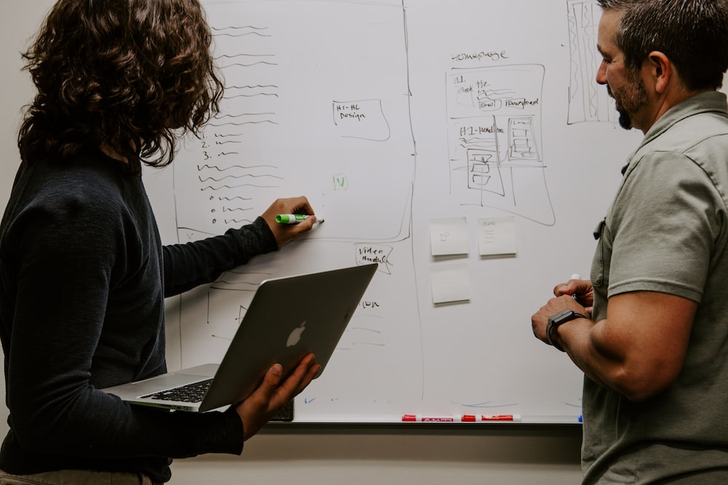
Pre-determined project
Is this the project for you?
Is the context right for the proposed research
(place/facilities/supervisor etc.)?
Are you the right person for the project?
Who you choose to work with and where you choose to work will have a significant influence on your PhD experience.
Notes:
When applying for a PhD, many people think about whether or not a particular institution will accept them onto a PhD programme- important for you to consider if the project, institution, research group and supervisor are right for you.
Who you choose to work with and where you choose to work will have a significant influence on your PhD experience.

Slide 7
Writing your own proposal
You design a research project and set the central issues or questions that you intend to address.
A research proposal is normally required for self-funded PhDs (where you develop your own idea for a thesis)
Important to identify the right place and the right supervisors/s
Consider opportunities for co-design with potential supervisor

Slide 8
Writing your own proposal: the (important) basics
What makes your proposal or project significant to your field?
How does your proposal challenge and improve knowledge ?
Why is your research important and original? Novelty is important
Will your research change ‘something’ in the real world? Does it have impact? If so, what and who for?
How can the institution/ University/ research group help support you and your research?
Why are you an ideal candidate for this PhD programme?

Slide 9
Writing your own proposal: overview
What it should include:
2,000-3,000 words
A title –tentative; can be revised over the course of your research
An abstract – a concise statement of your intended research (quite hard to do this!)
Context - a brief overview of the general area of study within which your proposed research falls,
Research questions - central aims/ objectives and questions that will guide your research
Research methods - outline of how you are going to conduct your research, (for example, visiting particular libraries or archives, field work or interviews; lab based methodological approaches or tests)
Research significance - demonstrate the originality of your intended research and its potential impact
A bibliography

Slide 10
Writing your own proposal: the synopsis
Write a brief abstract/ synopsis
A brief overview to convey how your information aligns with the discipline.
Use your abstract as an opportunity to:
Provide new information and show your knowledge in your field
Connect with the values and goals of the university
Give details about your research might affect areas like politics, society and culture

Slide 11
Writing your own proposal: aim and objectives
Highlight your aims and objectives
Explain the aim and objectives of your research and give details about how you plan to approach it.
Your aims/ objectives should be clear on how you will:
address a gap in studies
propose, challenge or disprove a concept
test or study a theory/ way of working
make a novel contribution

Slide 12
Writing your own proposal: main body
Main body: provides a context for the project.
Identify: knowledge gaps in the discipline/s you want to work in and how you can add value
Contextualise: how does your work relate to other scholars' work?
Fit: how does your research relate to the experience and skills of the proposed University/ supervisors?
Impact and Contribution: what contribution is your work making to the discipline/s and what difference will your work make to society, economy, environment, cultural life?

Slide 13
Writing your own proposal: YOU!
Why are YOU the best person for the work you propose?
What do you bring to the project?
Your track record/ previous experience, skills, ability and previous work
Your enthusiasm and passion (this is key!)
Your commitment, determination and resilience

Slide 14
Writing your own proposal: review
Final draft?
Read it aloud to yourself- this REALLY helps
Critical friend
Follow the ‘3Cs’ rule:
CLEAR: is what you have written intelligible and clearly articulated?
CONCISE: have you written your proposal in a succinct/ focussed way?
COHERENT: does your proposal link together well so that it tells the reader a short story about what you want to do, why you want to do it and how you will do it?

Slide 17
Belief and resilience
May not always work out straight away
Ask why
Proposal?
Place/host of proposed research?
Right supervisor/team?
Facilities?
Take advice
Be flexible and be prepared to adjust
Don’t give up! Resilience and perseverance pay off!

Slide 18
pret@liverpool.ac.uk
Our central enquiries team can help with all your queries about becoming a student on 0151 794 5927
Thank you
“”

