Slide 1
What is Postgraduate Research & Why Study a PhD at Liverpool?
Steve Bickerstaff
Director of Postgraduate Researcher Experience
19th February 2025
Notes:
Here to offer a an overview of the nuts and bolts of applying for a research degree and what you can expect in terms of support from the University

Slide 2
Five key takeaway facts about the University of Liverpool
Founded in 1881 – The University of Liverpool was established as a university college and gained its Royal Charter in 1903, making it one of the UK’s prestigious red brick universities. We are members of Russell Group
Global Ranking – It consistently ranks among the top universities in the world. In the 2024 QS World University Rankings, it was placed =176th.
Student Population – Liverpool has a diverse community of around 29,000 students, including 7,700 international students from over 140 countries.
XJTLU Partnership – It co-founded Xi’an Jiaotong-Liverpool University (XJTLU) in 2006, a unique UK-China partnership and the largest transnational university in China.
The University has 10 Nobel Prize winners, primarily in science and medicine. It’s also known for cutting-edge research, in relation to the city’s maritime heritage and international slavery
Notes:
The Liverpool Doctoral College is the home for all doctoral training and development across the University.
We support all postgraduate researchers across the University to thrive in their doctoral programme with our dedicated team of esteemed supervisors, professional services staff an
d student peers ensuring our students succeed in their studies.
The LDC provides:
Networking opportunities
Placement opportunities
Personalised training and development opportunities

Slide 3
Research & Doctoral Students Numbers
91% of the University's research has been rated as world-leading (4)* or *internationally excellent (3)**, underscoring its significant contributions to various academic fields
94% of the University's research impact is considered 'outstanding' or 'very considerable,' highlighting the tangible benefits of its research on society, culture, and the economy
2370 working towards a PhD who are research active
•Faculty of Health and Life Sciences – 1022
•Faculty of Humanities and Social Sciences – 572
•Faculty of Science and Engineering – 776
Notes:
The Liverpool Doctoral College is the home for all doctoral training and development across the University.
We support all postgraduate researchers across the University to thrive in their doctoral programme with our dedicated team of esteemed supervisors, professional services staff an
d student peers ensuring our students succeed in their studies.
The LDC provides:
Networking opportunities
Placement opportunities
Personalised training and development opportunities

Slide 4
The Postgraduate Researcher Experience
Innovative, choice-led doctoral training
PGRs are central to the commitment to advancing knowledge and addressing global challenges through high-quality research
Focus on employability and entrepreneurship
Support for a thriving global PGR community
PGR Laptop Scheme: All PhD Students receive a new laptop at the start of Y1 for the duration of their studies
Notes:
The Liverpool Doctoral College is the home for all doctoral training and development across the University.
We support all postgraduate researchers across the University to thrive in their doctoral programme with our dedicated team of esteemed supervisors, professional services staff an
d student peers ensuring our students succeed in their studies.
The LDC provides:
Networking opportunities
Placement opportunities
Personalised training and development opportunities

Slide 5
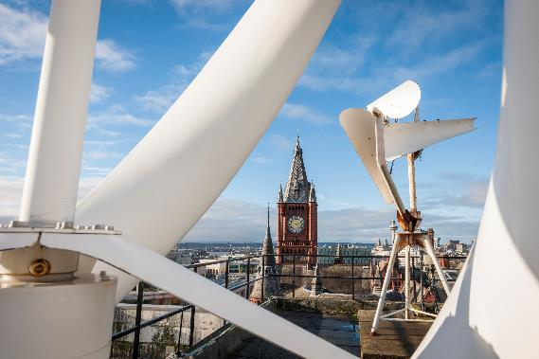
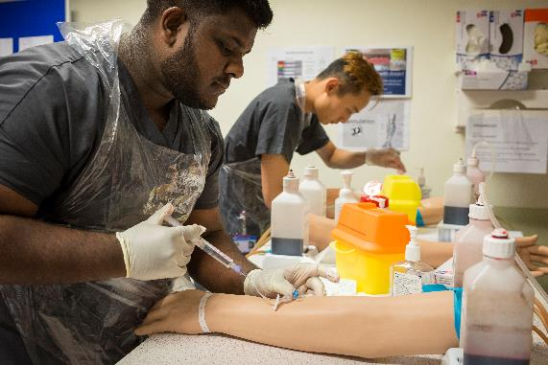
What is Postgraduate Research?
Notes:
Aim to use high-quality, professional images throughout your presentation. Avoid using clip art imagery, amateur photography or small photographs that are difficult to make out.

Slide 6
Doctoral Programmes
There are several kinds of PGR Programme
PhD – the ‘classic’ doctoral research degree
MD – a doctoral research degree for doctors
MPhil – a research masters
MRes – a research masters with taught elements
Professional doctorate – research & professional training
Notes:
The University is recognised as having one of England’s highest success rates in supervising students through to their doctoral award, by the Higher Education Funding Council for England ( now ( Office for Students. We highly value the active role our postgraduate researchers play in contributing to our success and supporting our research programmes, which attract £115 million a year in external grants.

Slide 7
Time and Place
These depend on the particular programme
A full-time PhD will take 3-4 years
A part-time PhD will take 5-6 years
A full-time MPhil will take 1-2 years
Location of work: off-site & split-site PhD available
Notes:
To delete/replace pictures within the template, right click on the image and choose either ‘cut’ or ‘change picture’ from the drop down menu.

Slide 10
Is a PhD for you?
A PhD is
An intensive research training and intellectual challenge
A gateway to the world of research (inside or outside academia)
A valuable asset in the wider world of work
Ask yourself
Have you got a thirst for (creating) knowledge and a passion for your subject?
What training do you want and what are your ambitions?
Notes:
Do you have the determination and resilience.
What do you want to achieve with your PhD.

Slide 11
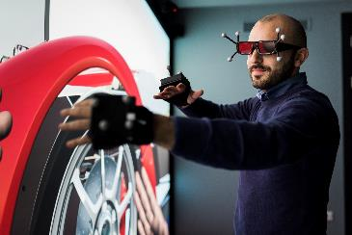
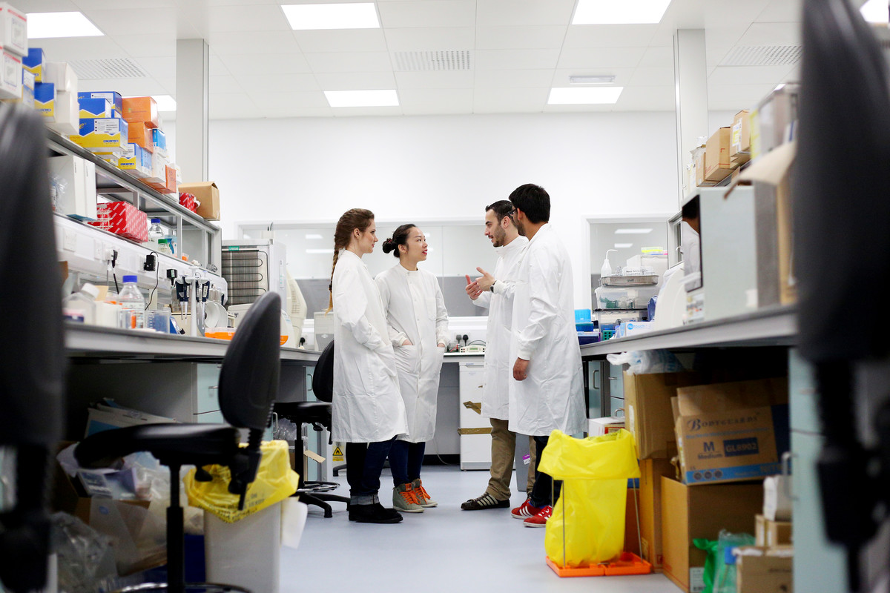
Finance and Funding
Notes:
Aim to use high-quality, professional images throughout your presentation. Avoid using clip art imagery, amateur photography or small photographs that are difficult to make out.

Slide 12
Costs of PGR Programmes
UK tuition fees set by UK Research & Innovation (UKRI): full-time £5,003 or part-time £2,502– Fee rate for 25/26
*Overseas Student tuition fees: full-time £31,250 (‘laboratory’) or £24,600 (non-lab)
Research support fees, if any, are project-specific
Living expenses: UKRI National Minimum Doctoral Stipend set at £20,780
Notes:
NB: These are indicative rates for 2024 entry. University is looking to incentivise

Slide 13
Funding for PGR Programmes
Various funding possibilities
Funding opportunities:
internal university funding
Research Council studentship schemes, and similar
Self-funded research, including part-time work
Postgraduate Doctoral loans £28,673 if your course starts on or after 1 August 2023
Notes:
To delete/replace pictures within the template, right click on the image and choose either ‘cut’ or ‘change picture’ from the drop down menu.

Slide 14
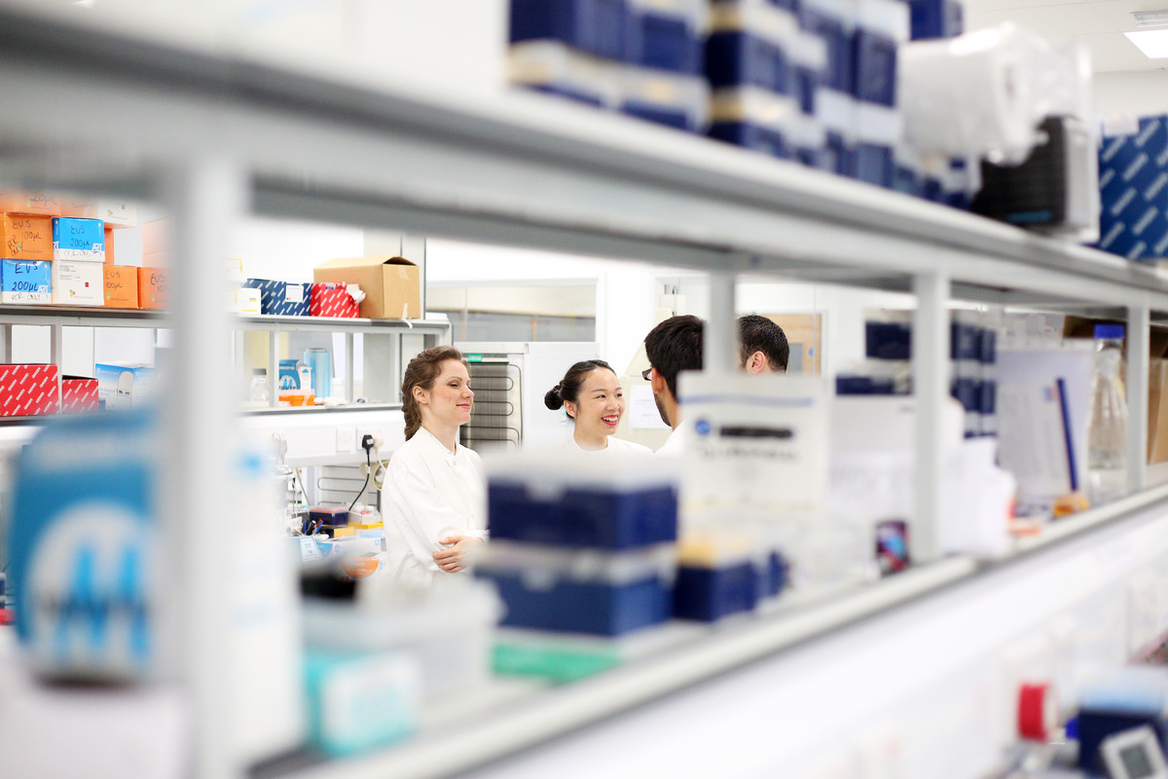
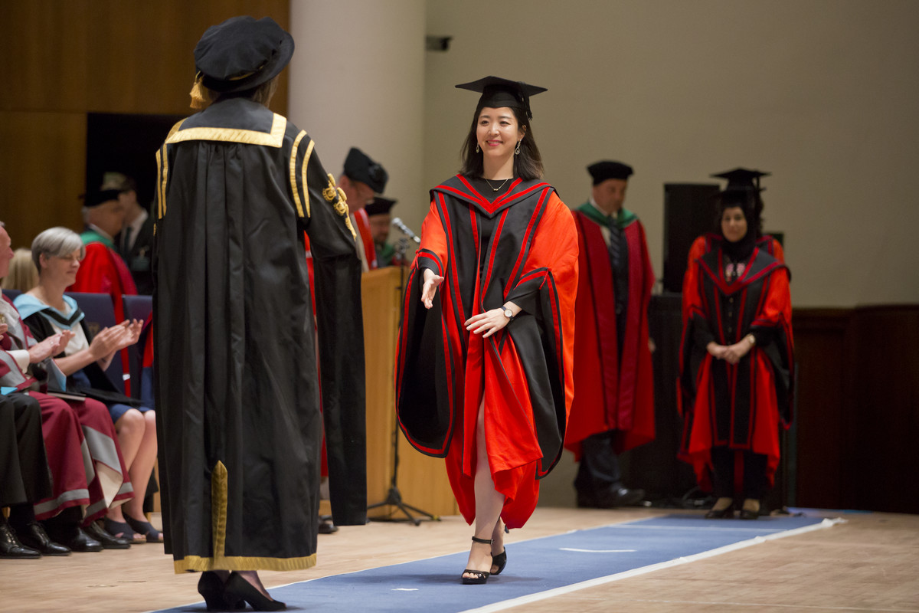
Applying for a Postgraduate Research Programme
Notes:
Aim to use high-quality, professional images throughout your presentation. Avoid using clip art imagery, amateur photography or small photographs that are difficult to make out.

Slide 15
Entry qualifications for PGR programmes
Entry qualifications depend somewhat on the area
Normally at least 2.i at undergraduate level
In Sciences, progression to a PhD is often possible without a Masters, although an MSc or MRes is often recommended and may be required
In the Humanities and Social Sciences a Masters qualification (at the level of merit) is usually required
Notes:
Important to choose carefully and do research., not just here at Liverpool but if you choose to do a PhD anywhere

Slide 16
Where to study?
Depends somewhat on the subject area
Research ‘fit’ is essential: supervisory expertise; a research project that interests you; resources
In Social Sciences and in Arts and Humanities the key elements are identifying an area of interest and drafting a research proposal
In the Sciences it is more common to apply for particular research projects, often part of larger programmes of work in a laboratory or team

Slide 17
Identifying a PhD supervisor
Depends somewhat on the subject area
Do your research: what are the research specialisms of the department to which you are applying?
In Social Science and in Arts and Humanities, where providing a research proposal is often an essential part of the application process, contact a potential supervisor to discuss viability of your proposed project
In the Sciences, check projects advertised on departmental websites and FindAPhD
Notes:
To delete/replace pictures within the template, right click on the image and choose either ‘cut’ or ‘change picture’ from the drop down menu.

Slide 18
How to apply
Before you apply you will need
School or college transcripts/certificates
University transcripts & degree certificates
English language certificates (EU/International only)
Two academic references
Personal statement
Research proposal (for some programmes)
Notes:
To delete/replace pictures within the template, right click on the image and choose either ‘cut’ or ‘change picture’ from the drop down menu.

Slide 19
Personal Statement
Your Personal Statement should show:
Why you are interested in the particular research project
What you enjoyed about any research you have already done (e.g. undergraduate dissertation)
Your longer-term plans
Whether you intend to find your own funding
Notes:
To delete/replace pictures within the template, right click on the image and choose either ‘cut’ or ‘change picture’ from the drop down menu.

Slide 20
Research Proposal
Where appropriate, a good Research Proposal should
Clearly define the topic that you’re interested in and show that you understand your research area: context, previous work
Show that you have started to develop an original and interesting research question
Demonstrate that you understand how to conduct research: methodology; theoretical frameworks
Outline the kind of work which will be done: laboratory; fieldwork; archive; literary corpus; case study; clinical trial ….
Be professional: good English, well-structured, suitable headings

Slide 21
When to apply
Dependent on the details of funding
A PhD programme can, in theory, start at any point of the academic year
However, applications for funding do usually have specific deadlines (often Autumn/Spring)
Notes:
To delete/replace pictures within the template, right click on the image and choose either ‘cut’ or ‘change picture’ from the drop down menu.

Slide 22
pret@liverpool.ac.uk
Our central enquiries team can help with all your queries about becoming a student on 0151 794 5927
Thank you
“”
Notes:
If you’re using quotes, it can be effective to increase the font size for maximum impact. If you don’t need a title box, simply right click on it and select ‘delete’.

