Slide 1
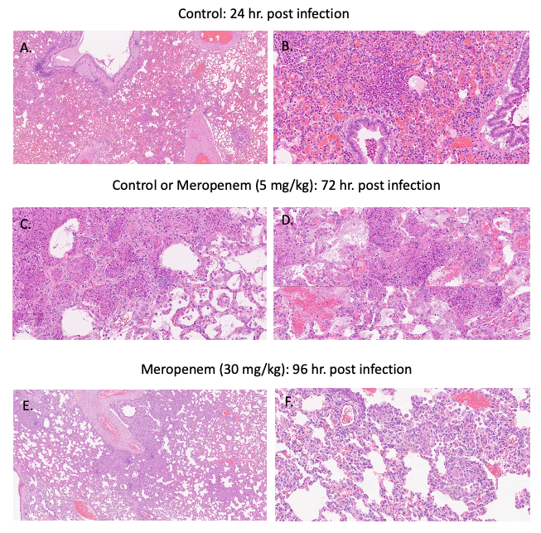
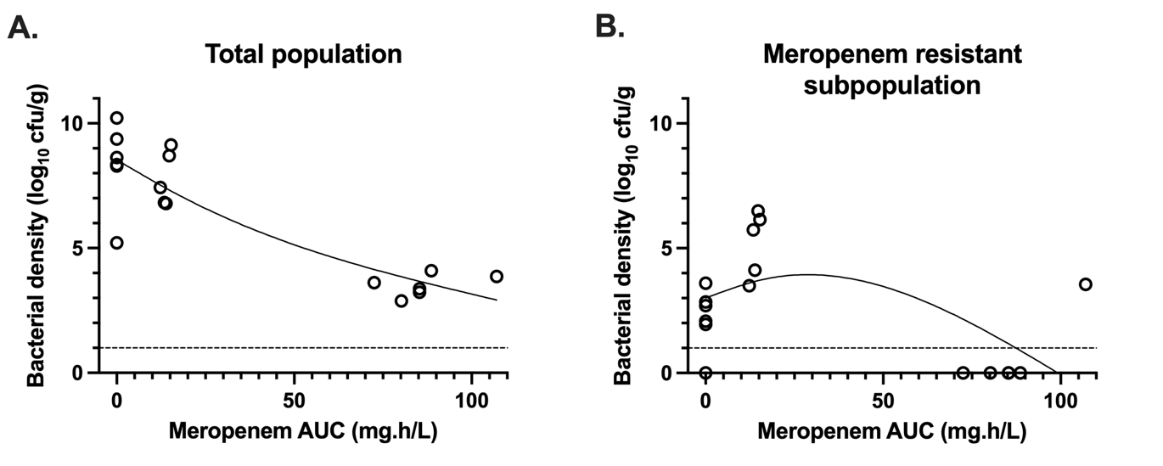
Development of a Rabbit Model of Nosocomial Pneumonia to Combat Emergence of Resistance
¹N Farrington, ¹C Darlow, ¹ V Dubey, ¹A Johnson, ¹I Horner, ¹A Stevenson, ²J Swartz, ¹J Unsworth, ¹W Hope
¹Antimicrobial Pharmacodynamics and Therapeutics, University of Liverpool, UK
²Charles River Laboratories, Reno, NV, USA
INTRODUCTION
METHODS
Nosocomial/Hospital acquired pneumonia (HAP) is a leading cause of morbidity and mortality, commonly caused by Pseudomonas aeruginosa with relatively few active antibiotics available for treatment. Meropenem is a commonly used therapeutic agent, although emergent resistance occurs during treatment.
Current model systems used for developing new antimicrobials for pneumonia have several limitations. Here, we describe a new rabbit pneumonia model allowing antibacterial activity and the emergence of resistance to occur. We used this model to characterise the pharmacokinetics and pharmacodynamics of meropenem alone and in combination with amikacin.
Challenge strain P.aeruginosa ATCC 27853 was used throughout
A 96h experimental model of nosocomial pneumonia was developed in NZW rabbits, allowing a clinically relevant background immunosuppression and pathogenesis to be recapitulated.
Cytosar-U was administered daily as an immunosuppressant. P.aeruginosa was inoculated intratracheally, resulting in a progressive bronchopneumonia, which was universally lethal beyond 96h without treatment.
Meropenem and/or amikacin were administered q8h parenterally starting 24h post infection. Blood and lung samples were taken for PK and PD analysis respectively.
A satellite study was performed to collect and fix lung samples for histopathological analysis.
A PK-PD mathematical model was fitted to the PK/PD data using Pmetrics.
RESULTS
Histopathology
Histopathological analysis showed progressive bronchopneumonia with severity of infection increasing in a time-dependent fashion. Meropenem 30mg/kg q8h was effective at limiting pulmonary inflammation, tissue damage, and bacterial growth at 96h post-infection.
Figure 1: Representative histopathological sections of rabbit lung at 24h post infection (i.e., at time of treatment start) stained with HE, representing well established bacterial bronchopneumonia (Panels A & B), at 72h post infection, fulminant inflammation and infection in control and meropenem treated rabbits (Panels C & D, respectively), and 96h post-infection resolving inflammation, infection, and tissue injury in a rabbit treated with meropenem 30mg/kg s.c q8h.
Pharmacodynamics of meropenem monotherapy
Rabbits received vehicle control, meropenem 5mg/kg s.c. q8h, or meropenem 30mg/kg s.c. q8h 24 hours following inoculation (Figure 2). There was a dose-dependent reduction in bacterial density (Figure 3A). The emergence of meropenem resistant bacteria increased in rabbits receiving meropenem 5mg/kg q8h compared to the no treatment controls. However, the emergence of resistance was suppressed to below the limit of detection in rabbits receiving meropenem 30mg/kg q8h s.c. (Figure 3B), with an apparent inverted-U relationship between meropenem dose and emergence of meropenem resistance.
Figure 2 – (A-C) Pharmacodynamics of untreated controls (A) meropenem 5mg/kg q8h (B) and
30mg/kg q8h (C) s.c. assessed using the bacterial density per gram of lung tissue. Filled circles depict
total bacterial counts; open squares depict resistant bacterial counts.
2A
2B
2C
3A
3B
Figure 3 – End-experiment Total population (A) and Meropenem-Resistant subpopulation (B) bacterial densities in lung tissue by exposure of meropenem (determined from individual Bayesian posteriors from the PKPD modelling over the 24h period following first administration).
Pharmacodynamics of combination therapy
A further cohort of rabbits received amikacin 3.33mg/kg q8h i.v. or 5mg/kg i.v. q8h in combination with meropenem 5mg/kg s.c. q8h. Although this had minimal additional effect on the total bacterial population, the emergence of a meropenem-resistant population was suppressed compared to monotherapy
Figure 4 –Pharmacodynamics of meropenem 5mg/kg q8h s.c. as monotherapy (A) or in combination with amikacin 3.33 mg/kg q8h i.v.; (B) or 5 mg/kg q8h i.v.; and (C), assessed using the bacterial density in lung tissue. Filled circles depict total bacterial counts; open squares depict resistant bacterial counts. Treatment was initiated at 24h post inoculation. The solid black lines are LOWESS curves fitted to the total and resistant bacterial densities in each cohort of rabbits. The dashed line indicates the limit of detection.
Conclusions
We have developed and characterised a novel rabbit infection model of HAP that simultaneously assesses antibacterial killing and the emergence of resistance
For meropenem, we have demonstrated the risk of resistance emergence during therapy and identified two mitigating strategies:
    Regimen intensification
    Use of combination therapy
This platform will allow pre-clinical assessment of emergent resistance risk during treatment of HAP for other antimicrobials and to allow construction of clinical regimens that mitigate this risk
Acknowledgements
This work was funded by the UKRI Strength in Places Fund (grant reference 36348).

