Slide 1
Year 5 Course Update: The GP Student Assistant
Dr K J Harrison
GP Theme Lead
GP Recruitment and Engagement Lead

Slide 2
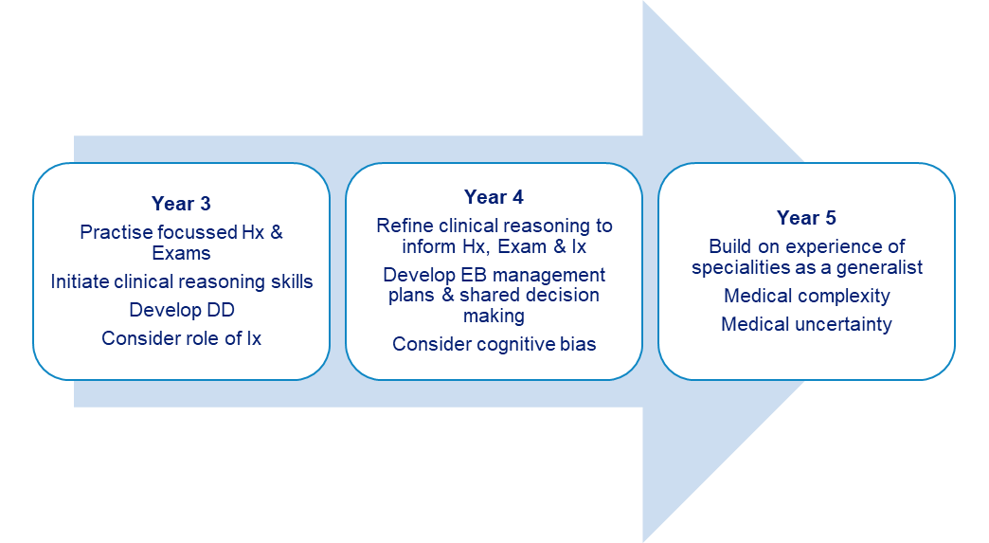
Aims of the Year 5 Course (‘Preparing for Practice’)
Bringing together clinical and management skills developed in Y3&4

Slide 3
Aims of the Year 5 Course (‘Preparing for Practice’)
Focus during Year 5 is on ‘acute’ management during their hospital placements.
In the GP placement we aim to explore:
Complexity and Uncertainty
MUS
Admission avoidance and prevention
Acute illness and admission.
The patient journey through healthcare

Slide 4
Th GP Student Assistant
Encourage student to become part of the team
Mandatory experiences aimed at delivering authentic experiences
Try to involve them in your same day access and on call for part of the week
Aiming for students leading on 9- 12 consultations per week per pair
They cannot work unsupervised.

Slide 5
Placement Overview
4 week GP placement
7 session per week in practice. Half day for self-study and one day CCT teaching in University (Friday)
Three educational supervisor meetings over the four-week placement.
ES meetings must be held individually and not in pairs.
Four mandatory experiences to cover during the four-week placement.

Slide 6
Handbook information on requirements.
The handbooks can be found via Liverpool Educators Online (LEO) www.liverpool.ac.uk/medicine/Liverpool-educators-online
Liverpool Educators Online Website
Notes:
Spend some time showing them the handbook

Slide 7
Induction.
Ideally this should take place on the first day of placement.
Provide students with a contact email and phone number to use in case of emergency or sickness.
Induction requirements can be found via the LEO website.
Induction Requirements

Slide 8
Timetable Cont....
The GMC strongly recommend all students to have a timetable whilst on placement. It is important they know where they are meant to be and who is responsible for supervising them
Timetables can be done on a weekly basis
Print/email to the students
The timetable is flexible (apart from CCT) to suit the practice situation providing students fulfil the requirements in the four-week placement

Slide 9
Example Timetable.
 | Monday | Tuesday | Wednesday | Thursday | Friday
Morning | Induction (week 1 only) Observation GP (KJH Room 6) | Student Led Clinic (hot desk or independently) (SM Room 4) | Student Led Clinic Emergency Surgery (hot desk or independently) (KJH Room 6) | Student Led Clinic (hot desk or independently) ES Meeting (SM Room 4) | CCT
Afternoon | Admin Session Mandatory Experiences ES Meeting (KJH Room 6) | Observation GP/NC (DW Room 2/SM Room 4) | Study Leave | Supporting On Call GP (JH Room 1/SB Room 4) | CCT
Notes:
Timetables are really important for students – they are asked to provide evaluation on if they are provided with one and GMC advises this.
Ideally a week at a time with named GP supervising each session
Aim for about 12 patients per week that the students lead on.

Slide 10
Leading on Consultation
Students must ‘lead on consultation’ with 9-12 patients per week (on average) as a pair.
This can be achieved by students having their own clinics, if room is available, or by ‘hot desking’ with the tutor if not.
If hot desking it may be appropriate for you to ‘step out’ while the student takes the history to provide an opportunity for more independent consulting.
Guidance on how to structure such clinics is included in the Handbook and on LEO

Slide 11
Patient Access to Medical Records
Important students are advised that patients can now view what they are writing in the electronic medical record.
The UK Council for Communication in Undergraduate Medical Education (UKCCC) have produced a guide for students writing in patient GP records.
Please share the ‘Do and Don’t’ guide with students and ask them to read it during their first ES meeting or Induction (whichever is first)

Slide 12
Mandatory Experiences - CANVAS link
Year 5 Mandatory Experiences
1 | Involvement in the Initial Triage of patients
2 | Write a referral/admission letter for a patient with whom the student has either led a consultation or observed in a GP consultation.
3 | Manage a small caseload of hospital clinic and discharge letters, reviewing patients as required, including medication reviews
4 | Manage a small caseload of investigation results, reviewing patients as required
A debrief should follow the mandatory experiences and can happen straight after or at the weekly meeting with the Educational Supervisor

Slide 13
Mandatory Experiences
For each experience we ask you to debrief with the student afterwards.
This can be done immediately after or during your weekly ES meeting.
Check the student has completed a ‘student declaration form’ for this experience at end of placement meeting.
We are now asking our students to reflect on the experience in their declaration form. To help with we ask the students to consider the following questions when reflecting on each ME:
What went well?
How could it have been done better?
How did it make you feel?
What have you learned and/or what if anything will you do differently?

Slide 14
Educational Supervision
The GP Tutor is the Educational Supervisor for the student’s time in GP
Three meetings over the course of the 4-week placement (individually)
Access their portfolio via Pebblepad (see next slide for demonstration)
Review of their progress so far with their Acute Care Reports (ACRs), Observed Examinations (OEs) and Directly Observed Procedural Skills (DOPS).
General review of any issues that may have arisen e.g. punctuality, professionalism, well-being. Refer to the University if concerns
Complete the weekly meeting template in Pebblepad

Slide 15
Pebblepad.
Please email mbchbep@liverpool.ac.uk if you have not already got access to Pebblepad. This will give you access to the students’ portfolio.
Pebble Pad Demonstration

Slide 16
Eportfolio Requirements Y5 GP
First Educational Supervisor (ES) meeting | All fields completed by Student Doctor and Educational Supervisor in the e-portfolio.
Observed Examinations | Recommended number 3 Minimum number 2
Acute Case Reports | Recommended number 8 Minimum number 2
Directly Observed Procedural Skills | Demonstration of progress only (no minimum numbers for placement)
Mandatory Experiences | Student Doctor declaration in their e-portfolio that they have completed all 4 experiences. (See Mandatory Experiences section)
End of placement Educational Supervisor (ES) meeting | All fields completed by Student Doctor and Educational Supervisor in the e-portfolio.
Notes:
O/E and ACR signed off by doctors please. DOPS can be signed off by person competent to undertake the skill being assessed.
We have changed the end of placement descriptors for 23/24. This will be covered in the sharing concerns presentation

Slide 17
Absence Reporting
GMC & University policies recently updated
‘Participation in Learning’ must be evidenced for progression to the next year (alongside examinations and engagement with study)
Essential that school is informed if a student is absent or if they miss part of the day, even if it has been pre-arranged or for illness.
Please email yr5gp@liverpool.ac.uk to inform us of any student absences.
Notes:
80% attendance to pass the year

Slide 18
Feedback
Feedback is very important to the students during their time in GP and helps with reflective learning
Please give feedback throughout the placement, when appropriate, and at the Educational Supervisor meetings
It can be helpful to highlight to the students when you are giving them feedback (so they recognise that is what it is!!!)

Slide 19
Questions?..... https://teams.microsoft.com/l/meetup-join/19%3ameeting_OWMyNTgyYmUtOTA0YS00MmI2LTgxMTUtM2ExNDM4MjllNzU0%40thread.v2/0?context=%7b%22Tid%22%3a%2253255131-b129-4010-86e1-474bfd7e8076%22%2c%22Oid%22%3a%22aeab7d3b-b02f-4f2c-aa8d-60ee6c99f9d8%22%7d

Slide 20
Thank you.
Contact your Year Lead if you find any digital content difficult or impossible to use.

