Slide 1
Year 4 Course Update: Broadening Expertise: Managing Patients in Primary Care.
2023-2024
Dr Stephanie Woodcock.
General Practitioner and Community Clinical Teacher.

Slide 2
My experience of Year 4 Student Doctors in practice…...

Slide 3
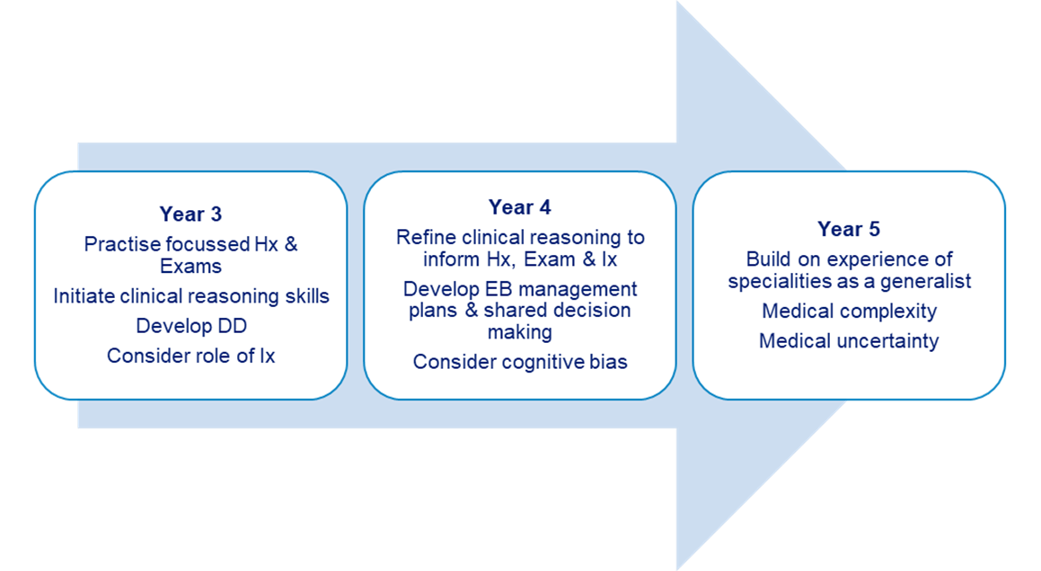
Aims of the Year 4 Course
Building on skills developed in Year 3

Slide 4
Focus of the Year 4 GP
Patient contact and supervised clinical experience
Further development of assessment skills including consultation and examination skills.
Integrating differential diagnosis into assessment process
Production of management skills
Experience wide range of both acute and chronic illness presentations
Knowledge of the variety of General Practice

Slide 5
Placement Overview
4 week GP placement.
7 sessions per week in practice. Half a day for self-study and one day at the University for Community Clinical Teaching (Tuesday, North Wales Thursday)
Students placed in pairs.
One Educational Supervisor meeting per week per student. This must be held individually and not in a pair.
Four mandatory experiences to cover during their 4 weeks in GP.

Slide 6
Handbook information on requirements.
The handbooks can be found via Liverpool Educators Online (LEO) www.liverpool.ac.uk/medicine/Liverpool-educators-online
Liverpool Educators Online Website

Slide 7
Induction.
Ideally this should take place on the first day of placement.
Provide students with a contact email and phone number to use in case of emergency or sickness.
Induction requirements can be found via the LEO website.
Induction Requirements

Slide 8
GP Sessions.
Both observed and student led. These must be supervised by a GP.
Aim for 9-12 student led consultations per week.(see later slide)
Observation of allied health care professionals is included in the seven sessions per week. This can involve observation of Pharmacists, Nurses, ANPs, HCA’s, Paramedics, Midwives etc.

Slide 9
Timetable
The GMC strongly recommend all students to have a timetable whilst on placement. It is important they know where they are meant to be and who is responsible for supervising them.
Timetables can be done on a weekly basis
Print/email to the students
The timetable is flexible (apart from CCT) to suit the practice situation, as long as students fulfil the requirements in the four-week placement

Slide 10
Example Timetable.
 | Monday | Tuesday | Wednesday | Thursday | Friday
Morning | Induction Observation GP (Dr A) | CCT | Consulting (hot desk or independently) (Dr B) Educational Supervisor Meeting (Dr A) | Consulting (hot desk or independently) (Dr A) | Consulting (hot desk or independently) (Dr B)
Afternoon | Observing Allied Health Professional (Nurse A) | CCT | Study Leave | Observing GP (Dr C) | Observing GP (Dr C)

Slide 11
Leading on Consultation
Students must ‘lead on consultation’ with 9-12 patients per week (on average) as a pair.
This can be achieved by students having their own clinics, if room is available, or by ‘hot desking’ with the tutor if not.
If hot desking it may be appropriate for you to ‘step out’ while the student takes the history to provide an opportunity for more independent consulting.
Guidance on how to structure such clinics is included in the Handbook and on LEO

Slide 12
Patient Access to Medical Records
Important students are advised that patients can now view what they are writing in the electronic medical record.
The UK Council for Communication in Undergraduate Medical Education (UKCCC) have produced a guide for students writing in patient GP records.
Please share the ‘Do and Don’t’ guide with students and ask them to read it during their first ES meeting or Induction (whichever is first)

Slide 13
Mandatory Experiences.
These should be encountered on their placement,
Review of a palliative care patient followed by a debrief with a GP in the form of a CBD (HV, remote consultation, case review, GSF meeting
Review of a care home patient and debrief with a GP in the form of a CBD (HV, MDT, Virtual WR, case review)
Review and discussion of investigation results
Attendance at a practice* or locality meeting followed by a debrief with GP
*Not GSF meeting if this has been used for the first mandatory experience
Student Canvas

Slide 14
For each experience we ask you to debrief with the student afterwards.
This can be done immediately after or during your weekly ES meeting.
Check the student has completed a ‘student declaration form’ for this experience at end of placement meeting.
We are now asking our students to reflect on the experience in their declaration form. To help with we ask the students to consider the following questions when reflecting on each ME:
  What went well?
  How could it have been done better?
  How did it make you feel?
  What have you learned and/or what if anything will you do differently?

Slide 15
Educational Supervision
The GP Tutor is the Educational Supervisor for the student’s time in GP
One meeting a week individually with each student.
Access their portfolio via Pebblepad (see next slide for demonstration).
Review of their progress so far with their Case Presentation and Discussions (CPADs), Observed Examinations (OEs) and Directly Observed Procedural Skills (DOPS).
General review of any issues that may have arisen e.g. punctuality, professionalism, wellbeing. Refer to the University if concerns
Complete the weekly meeting template in Pebblepad

Slide 16
Pebblepad.
Please email mbchbep@liverpool.ac.uk if you have not already got access to Pebblepad. This will give you access to the student’s portfolio.
Pebble Pad Demonstration

Slide 17
Eportfolio Requirements Year 4 GP.
Activity | Recommended | Minimum
Case Presentation and Discussion (CPAD) | 10 | 5
Observed Examination (OE) | 3 | 2
Directly Observed Procedural Skill (DOPS) | Progression only | Progression only
Mandatory Experience | 4 | 4
ES Meeting | Completed | Completed

Slide 18
Absence Reporting
GMC & University policies recently updated
‘Participation in Learning’ must be evidenced for progression to the next year (alongside examinations and engagement with study)
Essential that school is informed if a student is absent or if they miss part of the day, even if it has been pre-arranged or for illness.
Please email yr4gp@liverpool.ac.uk to inform us of any student absences.

Slide 19
Feedback
Feedback is very important to the students during their time in GP and helps with reflective learning
Please give feedback throughout the placement, when appropriate, and at the Educational Supervisor meetings
It can be helpful to highlight to the students when you are giving them feedback, so they recognise this is what is happening
Tutor workshop at the University will cover feedback in more detail

Slide 20
Questions?.....

Slide 21
Thank you.
Email contacts for any queries can be found in the GP Handbook on LEO

