Slide 1
Year 3 Course Update: Becoming a Practitioner
Dr Rebecca Chambers
GP/Community Clinical Teacher

Slide 2
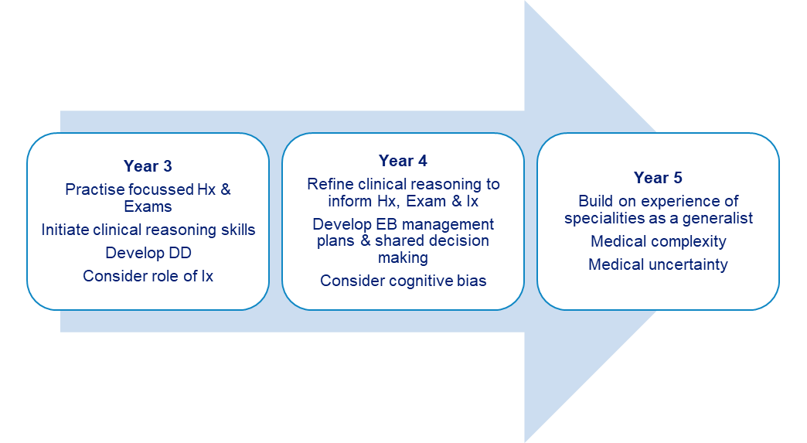
Aims of the Year 3 Placement
‘Becoming a practitioner’

Slide 3
Aims of the Year 3 Placement
The focus of the Year 3 GP placement is on patient contact and supervised clinical experience
Students should see a wide range of both acute and chronic illness presentations.
Support students to develop good consultation and examination skills and gain knowledge of the variety within general practice
This is the first year of clinical placements for the students

Slide 4
Placement Overview
4 week GP placement
7 session per week in practice. Half day for self-study and one day CCT teaching in University (Thursday)
Four educational supervisor meetings over the four week placement.
ES meetings must be held individually and not in pairs.
Four mandatory experiences to cover during the 4 week placement.

Slide 5
Handbook information on requirements.
The handbooks can be found via Liverpool Educators Online (LEO) www.liverpool.ac.uk/medicine/Liverpool-educators-online
Liverpool Educators Online Website

Slide 6
Induction.
Ideally this should take place on the first day of placement.
Provide students with a contact email and phone number to use in case of emergency or sickness.
Induction requirements can be found via the LEO website.
Induction Requirements

Slide 7
Timetable Cont....
The GMC strongly recommend all students to have a timetable whilst on placement. It is important they know where they are meant to be and who is responsible for supervising them
Timetables can be done on a weekly basis
Print/email to the students
The timetable is flexible (apart from CCT) to suit the practice situation providing students fulfil the requirements in the four week placement

Slide 8
Example Timetable.
 | Monday | Tuesday | Wednesday | Thursday | Friday
Morning | Induction (week 1 only) Observation GP (KJH) | Student Led Clinic (hot desk or independently) (SM) | Student Led Clinic (hot desk or independently) (KJH) | CCT | Student Led Clinic (hot desk or independently) ES Meeting (SM)
Afternoon | Observation GP/NC ES Meeting (KJH) | Observation GP/NC (DW/SM) | Personal Study | CCT | Observation GP (JH/SB)
Notes:
Timetables are really important for students – they are asked to provide evaluation on if they are provided with one and GMC advises this.
Ideally a week at a time with named GP supervising each session
Aim for about 12 patients per week that the students lead on.

Slide 9
Leading on Consultation
Students must ‘lead on consultation’ with 9-12 patients per week (on average) as a pair.
This can be achieved by students having their own clinics, if room is available, or by ‘hot desking’ with the tutor if not.
If hot desking it may be appropriate for you to ‘step out’ while the student takes the history to provide an opportunity for more independent consulting.
Guidance on how to structure such clinics is included in the Handbook and on LEO

Slide 10
Patient Access to Medical Records
Important students are advised that patients can now view what they are writing in the electronic medical record.
The UK Council for Communication in Undergraduate Medical Education (UKCCC) have produced a guide for students writing in patient GP records.
Please share the ‘Do and Don’t’ guide with students and ask them to read it during their first ES meeting or Induction (whichever is first)

Slide 11
Mandatory Experiences
Each Mandatory Experience is outlined in more detail on the CANVAS GP Placement area.This area is not accessible to GP Tutors, but students can access this remotely for supporting information.
Observe a 6-week Baby Check (student should then arrange a later follow-up with the family as either a phone call or seeing them in practice) We suggest this is done as early as possible during the placement.
At least 1 Home Visit with a GP (student should then arrange a later follow-up as either a phone call or visit).
2 x Chronic Disease Reviews (any clinician), 2 different of any of Asthma/COPD/CV Disease/Diabetes.
Lead a Consultation with a patient with a long-term condition causing a physical disability. Students will need to liaise with you early in the placement to arrange this.

Slide 12
Mandatory Experiences
For each experience we ask you to debrief with the student afterwards.
This can be done immediately after or during your weekly ES meeting.
Check the student has completed a ‘student declaration form’ for this experience at end of placement meeting.
We are now asking our students to reflect on the experience in their declaration form. To help with we ask the students to consider the following questions when reflecting on each ME:
What went well?
How could it have been done better?
How did it make you feel?
What have you learned and/or what if anything will you do differently?

Slide 13
Educational Supervision
The GP Tutor is the Educational Supervisor for the student’s time in GP
One meeting per week over the course of the 4 week placement (individually)
Access their portfolio via Pebblepad (see next slide for demonstration)
Review of their progress so far with their Case Presentation and Discussions (CPADs), Observed Examinations (OEs) and Directly Observed Procedural Skills (DOPS).
General review of any issues that may have arisen e.g. punctuality, professionalism, well being. Refer to the University if concerns
Complete the weekly meeting template in Pebblepad

Slide 14
Pebblepad.
Please email mbchbep@liverpool.ac.uk if you have not already got access to Pebblepad. This will give you access to the students portfolio.
Pebble Pad Demonstration

Slide 15
Eportfolio Requirements Y3 GP
First Educational Supervisor (ES) meeting | All fields completed by Student Doctor and Educational Supervisor in the e-portfolio.
Observed Examinations | Recommended number 3 Minimum number 2
Case Presentation and Discussion | Recommended number 10 Minimum number 5
Directly Observed Procedural Skills | Demonstration of progress only (no minimum numbers for placement)
Mandatory Experiences | Student Doctor declaration in their e-portfolio that they have completed all 4 experiences.
End of placement Educational Supervisor (ES) meeting | All fields completed by Student Doctor and Educational Supervisor in the e-portfolio.

Slide 16
Absence Reporting
GMC & University policies recently updated
‘Participation in Learning’ must be evidenced for progression to the next year (alongside examinations and engagement with study)
Essential that school is informed if a student is absent or if they miss part of the day, even if it has been pre-arranged or for illness.
Please email yr3gp@liverpool.ac.uk to inform us of any student absences.
Notes:
80% attendance to pass the year

Slide 17
Feedback
Feedback is very important to the students during their time in GP and helps with reflective learning
Please give feedback throughout the placement, when appropriate, and at the Educational Supervisor meetings
It can be helpful to highlight to the students when you are giving them feedback (so they recognise that is what it is!!!)

Slide 18
Questions?.....

Slide 19
Thank you.
Contact your Year Lead if you find any digital content difficult or impossible to use.

