Slide 1
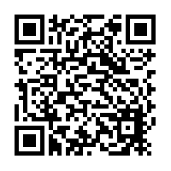
Sharing Concerns. The student in difficulty.
LEO liverpool.ac.uk/medicine/liverpool-educators-online
Dr KJ Harrison.
GP Theme Lead.
September 2023.

Slide 2
Learning outcomes.
To identify what a “student in difficulty” is.
To be aware of the wellbeing, academic and professionalism difficulties that students experience.
To be aware of strategies for GP tutors to support students.
To know how to share concerns with the School of Medicine (SoM).
To be aware of the support systems in place at the SoM.

Slide 3
Medical School guidance.

Slide 4
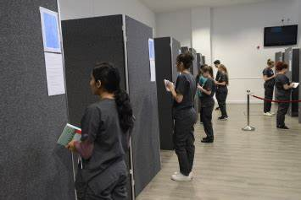
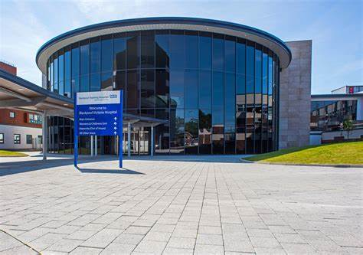
What are the main wellbeing issues experienced by students?

Slide 5
Student services.
SoM student wellbeing service: self-referral or by tutor.
Appointment with wellbeing advisor.
Wellbeing team meets regularly with Year teams.
“Transfer of Information (ToI)” plan allows sharing of information with placements.
Central University wellbeing and counselling services.
Disability support plans.
GP, TalkLiverpool, others.

Slide 6
Use of SoM Wellbeing service.
Use of SoM wellbeing service

Slide 7
Professionalism concerns.
Lack of engagement
Neglect of administrative tasks
Misuse of Alcohol/drugs
Failure to act appropriately regarding own health
Dishonesty e.g. cheating, plagiarism
Social media Mis-use
Challenging behaviour
Breach of confidentiality
Failure to obtain consent
Outcome related to level of the concern e.g. tariff points awarded, meeting with year director, referral to HCC or FTP.
Notes:
Health and Conduct Committee
Fitness to Practice

Slide 8
What to do if you have concerns?
Address concerns early (don’t leave until the end of the placement).
Speak to the student directly yourself.
Be factual/specific and provide examples.
Consider seeking opinions and examples from colleagues.
Ask the students to share their thoughts/concerns, and how they feel the issue(s) could be remedied.
Where appropriate provide feedback on how to improve performance, timeframes and how this will be monitored.
All absences should be reported.

Slide 9
If you continue to have concerns……..
For wellbeing or safety concerns complete a Sharing Concerns form
For professionalism concerns complete a Professionalism Form
These forms can also be accessed via:
LEO
E-portfolio
GP Tutor handbook
Tell the student what you are doing.

Slide 10
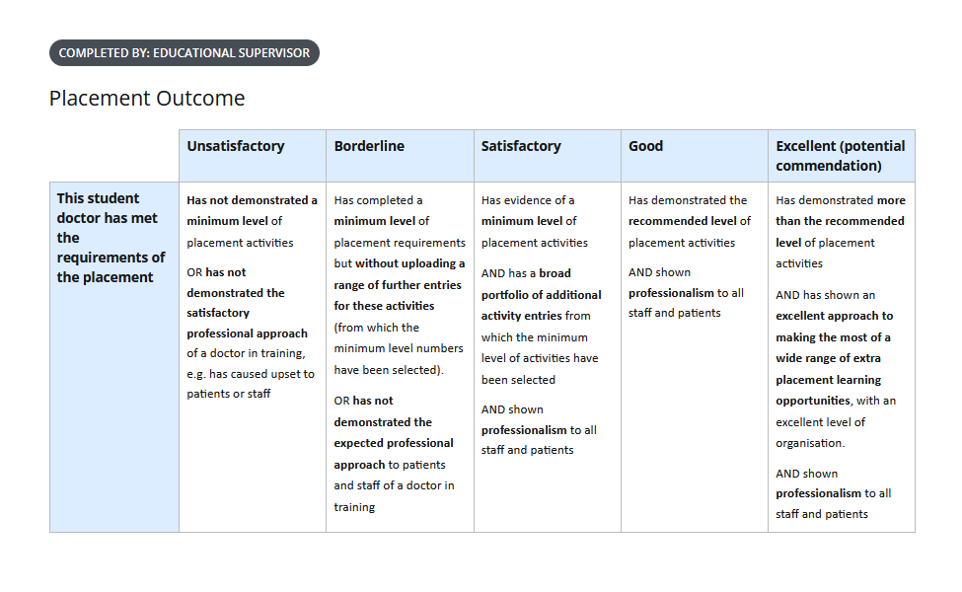
If you ‘fail’ a student for the placement
Use the eportfolio to log Academic concerns and documents actions you have taken to address this during the placement.
If you are giving a student a ‘fail’ grade for their placement, you must complete either a Sharing Concerns form or Professionalism Form
This allows the school to identify students who have failed placements earlier than the, twice-yearly, progression review meetings and put remediation in place.
Tell the student what you are doing.
These forms can also be accessed via:
LEO
E-portfolio
GP Tutor handbook

Slide 11
Student academic issues.
Often difficult to assess confidently with the first couple of students.
Students expected to improve as they move through the academic year.
Academic performance is assessed by:
Educational Supervisor (you): review of the E-portfolio and end of placement evaluation.
Academic Advisor: 2 formal meetings per year.
Progression Review.
Assessments for Learning (AFL)
Assessments for Progression (AFP): Clinical, AKT and E-portfolio, Attendance
Academic performance strongly linked to attendance and engagement.

Slide 12
Progression review.
Twice yearly panel meeting e.g. Dec/May.
Each individual students’ progress considered: attendance, e-portfolio engagement, AA comments, professionalism forms, performance in AFLs, deadlines
Outcomes include: meeting with year director, progress review panel meeting.
Academic support for students with poor performance in AFLs.
Progressive review only takes place twice yearly, so remember to highlight any problems early.

Slide 13
E-portfolio
Change for 23/24 in placement outcome descriptors.
More clarity in marking descriptors.
Be aware of link between engagement with CPADs/OEs/ and professionalism and the grade that is appropriate

Slide 14
Thank you and any questions? https://liverpool.onlinesurveys.ac.uk/gp-tutor-update-2023-evaluation-copy

