Slide 1
“What should student doctors expect, and what would they like, from their GP placements?”
Dr David Smith
Deputy Director of Quality – Community Placements

Slide 2
Introduction
The clinical model at many GP practices has changed
Primary Care Networks – hub & spoke working
Covid-19 pandemic – total triage, remote consultations
Practices are bursting at the seams
Additional workforce (ARRS, postgraduate trainees)
Recruitment and retention crisis for GPs to supervise them
Student doctors are reflecting on this in their feedback
Feedback about GP placements is overwhelmingly positive

Slide 3
Introduction
In light of these changes...
What should students continue to expect from their GP placements?
What do students like most and what do they like least?
How can practices showcase their clinical & placement model & why might this be helpful?
How can we utilise the diversity of GP placement experiences to encourage more students to consider a career in GP?
Student feedback is just one tool to monitor placement quality
What student doctors prefer is not always what they need

Slide 4
What should students expect?
Induction – NB reporting concerns
3.5 days each week at the practice for 4 weeks (0.5 days each week for personal learning, 1 day for University CCT)
Student activities
Lead ~12 consultations per week, supervised by a GP
Observe surgeries with GPs & other healthcare professionals
Mandatory experiences followed by a debrief x4
Individual weekly* GP tutor meetings with portfolio completion

Slide 5
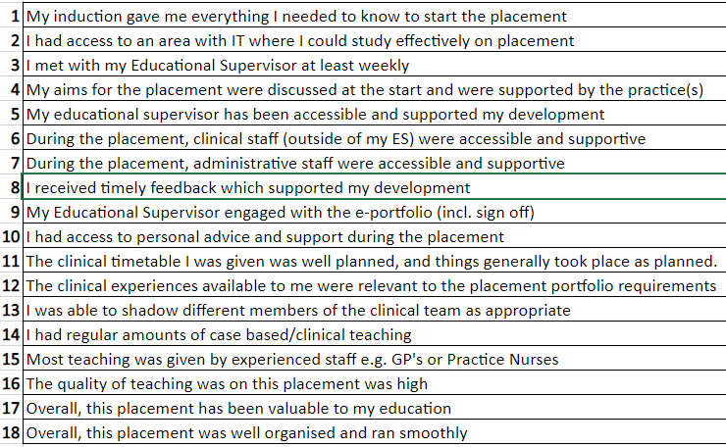
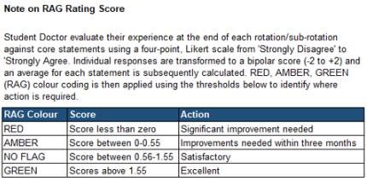
Quantitative feedback

Slide 6
Qualitative feedback
“Wonderful placement”
“Everything was amazing”
“One of the best placements”
“No areas for improvement”
“Extremely welcoming”
“Encouraging & supportive”
“High quality teaching”
“Organised incredibly well”
“A great environment to learn”
“Felt like part of the team”
“Thoroughly enjoyable”
“I have nothing but praise”
“Couldn’t fault it at all”
“I loved this placement”

Slide 7
Qualitative feedback
“I am very grateful for Dr A for going above and beyond in order to support my teaching and to ensure my experience is as great as possible”
“Dr B was incredible and changed my perspective on GP”
“Our practice manager was absolutely amazing and made sure we were looked after.”
“The reception and admin team were all incredible, made me feel so safe and welcome”

Slide 8
What do students like most?
A written timetable sent in advance of the placement
Spending the majority of their time with substantive GPs
Including regular contact with their GP tutor
Exposure to as many GPs as possible who are keen to teach
Student led clinics with their own patient list & room
No difficulty achieving mandatory requirements
Flexibility, with the opportunity to experience all of GP
Being made to feel welcome

Slide 9
What do students like least?
Limited understanding of the requirements
More time observing than doing
Telephone consultations – less chance to examine
Working in pairs – when there appears to be an alternative
Repetitive experiences
Service provision in place of education
Little time or space for self-study – particularly close to exams

Slide 10
How might practices respond?
Some of this may be challenging or even impossible
Timetables may need to change
GPs are in increasingly short supply
Room space is at a premium
Availability of experiences varies
One of the strengths of GP is its diversity & innovation
Share your clinical model at the induction
Emphasise the positives this brings to your placement

Slide 11
How might practices respond?
Sign up for the year group that is the best fit for your practice
Be mindful of your own capacity, block by block
Set specific objectives when students are spending time with other healthcare professionals
Reflect on cases & experiences at every opportunity
Get the students involved in anything & everything
Students like to be useful but ensure there is a ‘win-win’

Slide 12
Equality or diversity?
Having three identical GP placements is of limited value
Each placement needs to build on the previous
Year 3 = Assessing patients
Year 4 = Diagnosing & managing patients
Year 5 = The GP assistant
Help students appreciate the benefits of experiencing 3 different practices – especially if they might want to be a GP
Positive feedback does not necessarily produce better doctors but it might help us to produce more GPs

Slide 13
How is the School responding?
This workshop
Working to ensure student expectations are realistic
Reviewing the placement handbooks for practices & students
Reviewing the pre-placement primers for students
Reviewing the end-of-block feedback questions
Providing training to students in constructive feedback
Considering making student feedback mandatory

Slide 14
Thank you.
If you have any questions or comments relating to this workshop, please email:
quality.mbchb@liverpool.ac.uk

