Slide 1
Quality Team Update for GP Tutors Autumn 2023
Dr Anna Ballinger
Director of Quality

Slide 2
Quality Team Update for GP Tutors Autumn 2023
Dr David Smith
Deputy Director of Quality – Community Placements

Slide 3
Introduction
The clinical model at many GP practices has changed
Primary Care Networks – hub & spoke working
Covid-19 pandemic – total triage, remote consultations
Practices are bursting at the seams
Additional workforce (ARRS, postgraduate trainees)
Recruitment and retention crisis for GPs to supervise them
Student doctors are reflecting on this in their feedback
Feedback about GP placements is overwhelmingly positive

Slide 4
Qualitative feedback
“Wonderful placement”
“Everything was amazing”
“One of the best placements”
“No areas for improvement”
“Extremely welcoming”
“Encouraging & supportive”
“High quality teaching”
“Organised incredibly well”
“A great environment to learn”
“Felt like part of the team”
“Thoroughly enjoyable”
“I have nothing but praise”
“Couldn’t fault it at all”
“I loved this placement”

Slide 5
Qualitative feedback
“I am very grateful for Dr A for going above and beyond in order to support my teaching and to ensure my experience is as great as possible”
“Dr B was incredible and changed my perspective on GP”
“Our practice manager was absolutely amazing and made sure we were looked after.”
“The reception and admin team were all incredible, made me feel so safe and welcome”

Slide 6
What do students like most?
A written timetable sent in advance of the placement
Spending the majority of their time with substantive GPs
Including regular contact with their GP tutor
Exposure to as many GPs as possible who are keen to teach
Student led clinics with their own patient list & room
No difficulty achieving mandatory requirements
Flexibility, with the opportunity to experience all of GP
Being made to feel welcome

Slide 7
What do students like least?
Limited understanding of the requirements
More time observing than doing
Telephone consultations – less chance to examine
Working in pairs – when there appears to be an alternative
Repetitive experiences
Service provision in place of education
Little time or space for self-study – particularly close to exams

Slide 8
How is the Quality Team responding?
Working to ensure student expectations are realistic
Providing training to students in constructive feedback
Changes to student feedback evaluation
Reviewing the end-of-block feedback questions
Making student feedback more mandatory
Changes to the commendation/ recognition process
Changes to streamline the annual data review/ quality visit process to reduce the time burden for practices

Slide 9
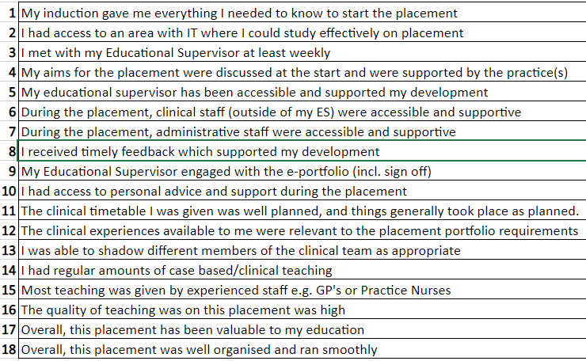
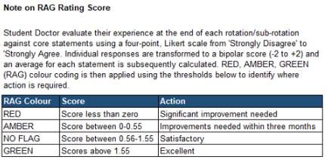
Quantitative feedback
Some of the current questions are aspirational rather than reflecting GP block requirements

Slide 10
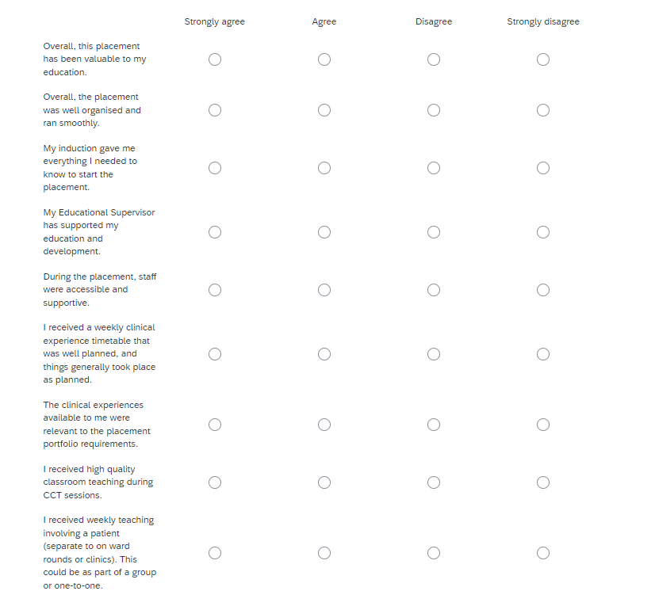
New quantitative feedback

Slide 11
New quantitative feedback
I had the opportunity to discuss and receive teaching on cases that I led on or observed in clinics.

Slide 12
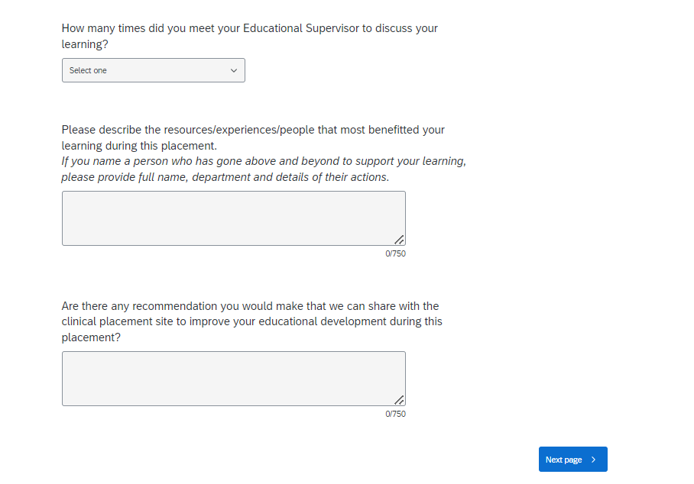
New qualitative feedback

Slide 13
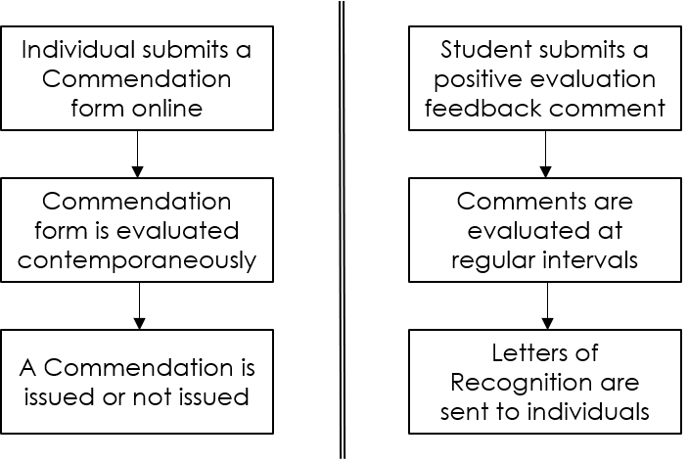
Commendations & recognitions

Slide 14
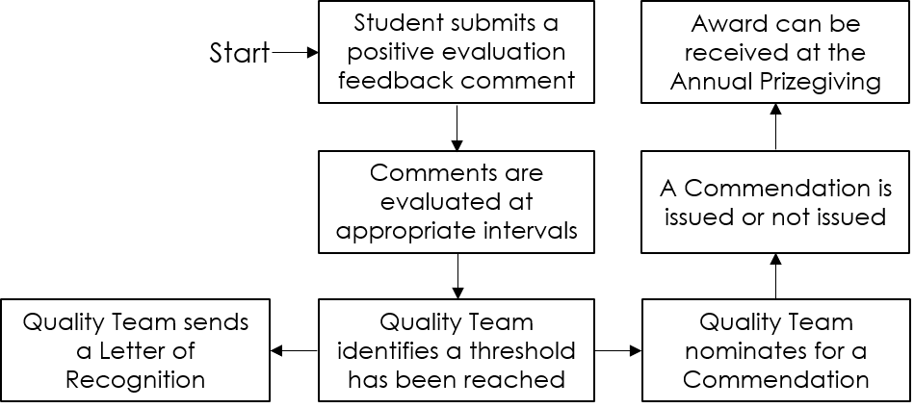
New commendations process

Slide 15
Annual data review (ADR) & quality visits
At the end of each academic year, we email the placement feedback & ask practices to complete an ADR questionnaire
Practices are signed off & receive a certificate
Deputy Director & Quality Manager perform a quality visit every 3-5 years
Promote good practice, develop relationships & provide support
Self-assessment questionnaire sent in advance
via MS Teams
– this now
matches the ADR so is not required if the ADR is up to date

Slide 16
Thank you.
If you have any questions or comments relating to this update, please email:
quality.mbchb@liverpool.ac.uk

