Slide 1
Role Modelling in GP Placements
Dr Duncan Rogers
CCT
GP Partner Vista Road Surgery, Newton-le-Willows

Slide 2
Aim
Introductions
What is a role model
Current situation
Evidence of impact of GP placements on promoting General Practice
Group discussion
  Good examples
  Bad examples
  Barriers

Slide 3
Intros…..

Slide 4
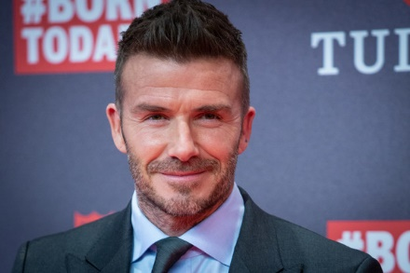
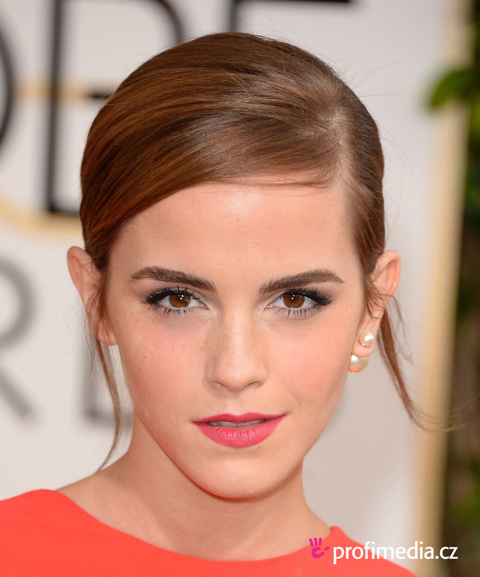
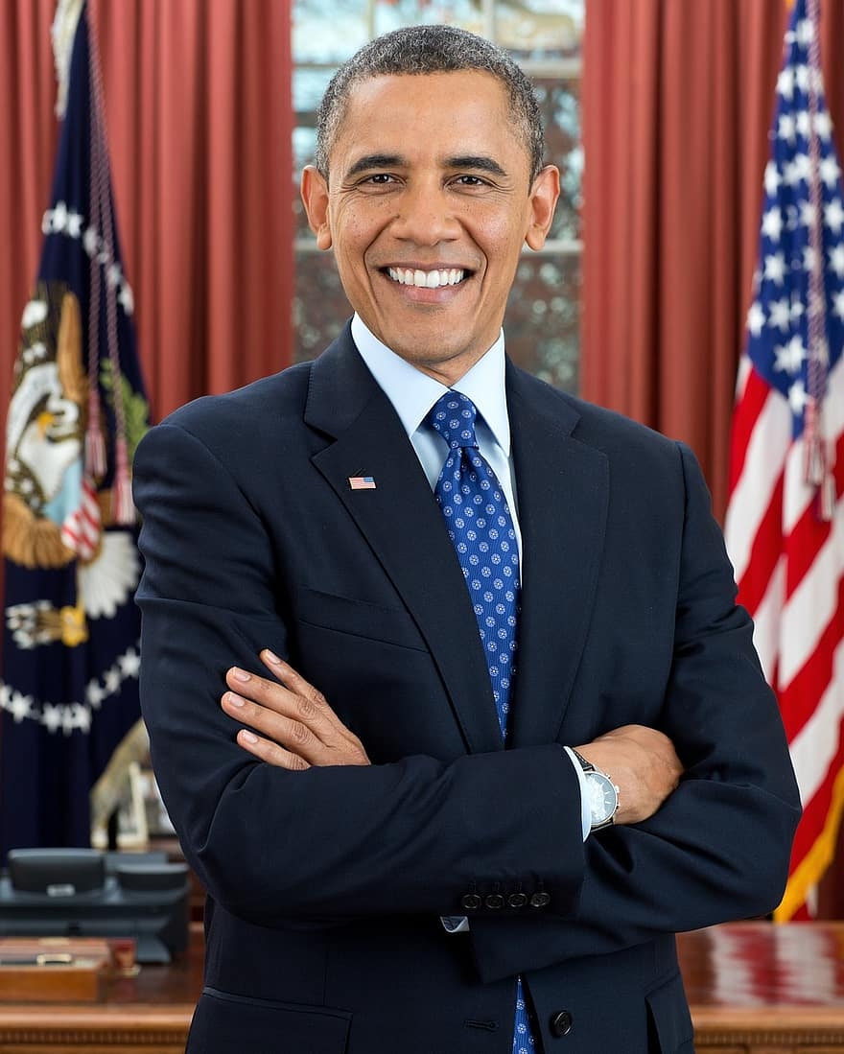
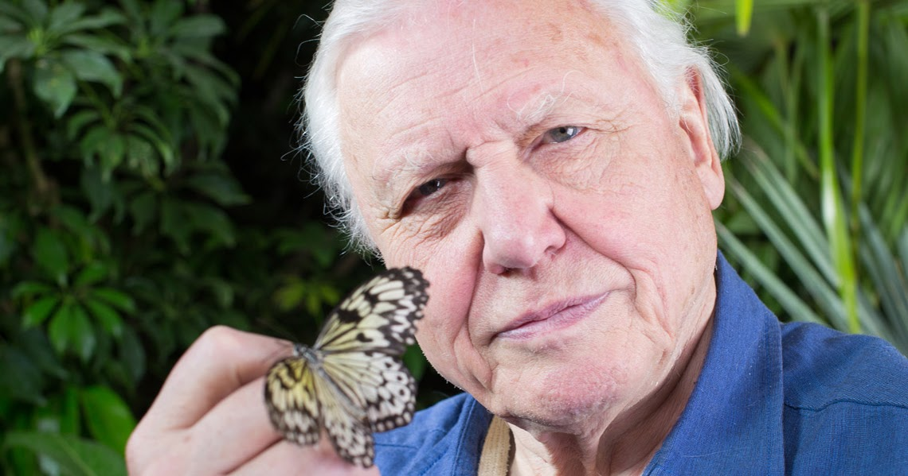
Quick Quiz
Rank | Name | Occupation | Gender | % of Vote
1 | Richard Branson | British Entrepreneur | M | 6.6860
2 | David Beckham | English Footballer | M | 5.4506
3 | Alan Sugar | British Entrepreneur | M | 4.4331
4 | Bill Gates | AmericanEntrepreneur | M | 4.2878
5 | Barack Obama | Former US President | M | 2.8343
6 | JK Rowling | British author | F | 2.4709
7 | David Attenbrough | British broadcaster and natural historian | M | 2.3256
8 | Holly Willoughby | English television presenter | F | 1.6715
9 | Michelle Obama | American lawyer | F | 1.5262
10 | Emma Watson | British actress | F | 1.3808

Slide 5
What is a role model?
People we admire for the way they act, for their professionalism, and whose behaviour is considered as a standard of excellence to aspire to” (Passi 2013)
“Teaching by example and influencing students in an unintentional, unaware, informal episodic manner” (Burgess 2015)
“A process in which faculty members demonstrate clinical skills, model and articulate expert thought processes and manifest positive professional characteristics” (Irby 1986)

Slide 6
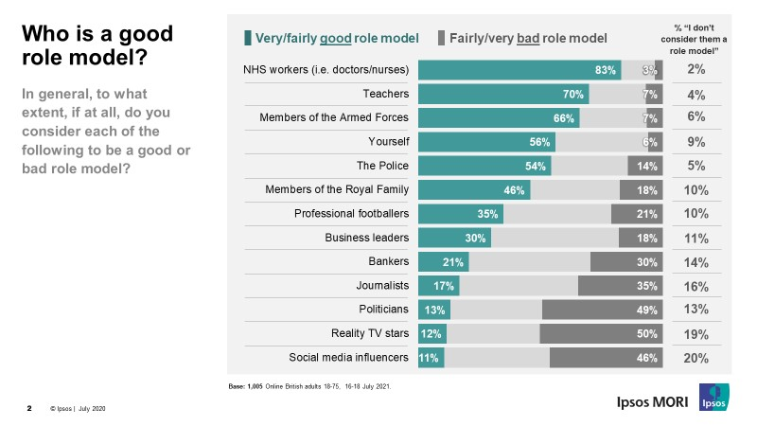
Apparently we are already good role models…
https://www.ipsos.com/sites/default/files/inline-images/Chart%201_26.jpg

Slide 7
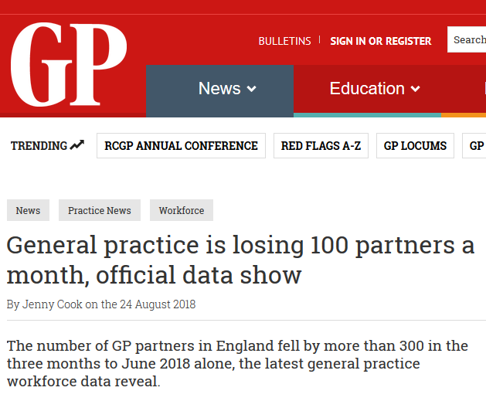
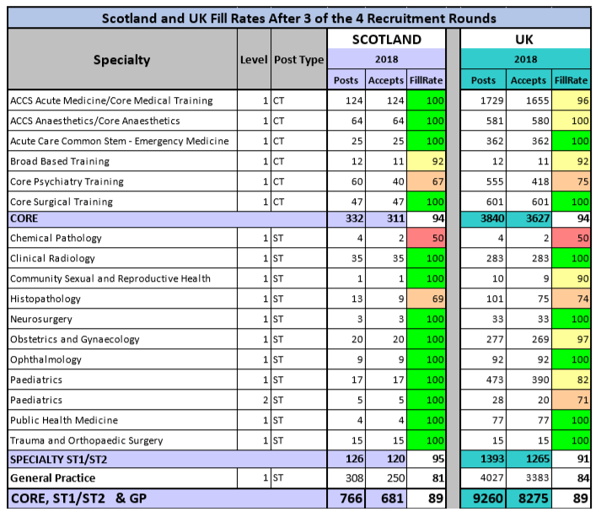
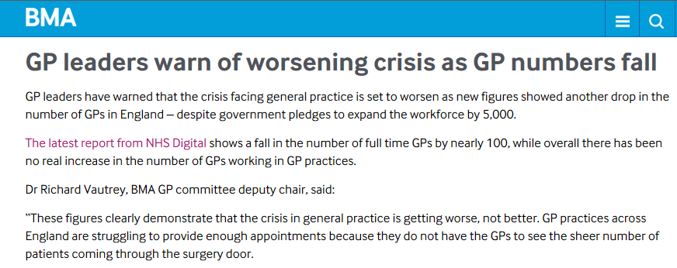
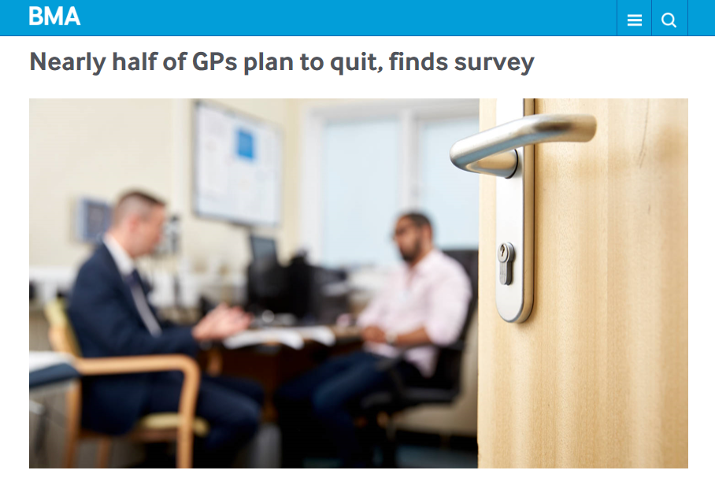

Why are GP role models important..
http://www.scotmt.scot.nhs.uk/recruitment/recruitment-statistics.aspx
Notes:
DAVE
Across the UK, 3,383 out of 4,027 general practice training posts available have been filled after 3 of 4 rounds of recruitment - representing an overall fill rate of 84%.
In England 3,019 of a 3,250 target for the year. This means that in England 93% of posts that will be available in 2018 have already been filled.
In Scotland 81% of GP training posts made available to date for 2018 have been filled
HOWEVER
With overall GP numbers stagnating, and record numbers nearing retirement, it is difficult to see how the Government’s pledge to increase the number of GPs by 5,000 by 2020
General practice in Scotland is currently facing significant difficulties in recruitment and retention, with around one in four practices reporting vacancies

Slide 8
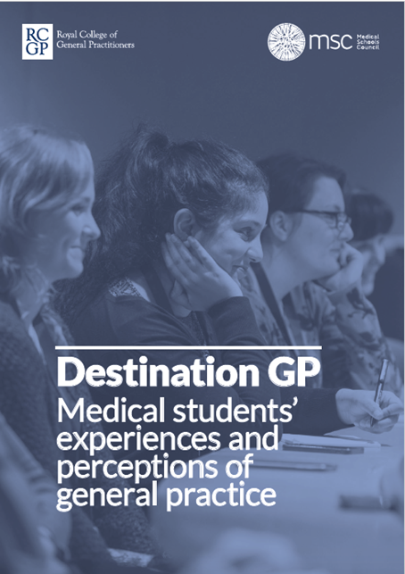
Why are GP role models important..
‘Positive and enthusiastic GP role models should be identified and made visible across all medical schools.’ By choice - not by chance
“The GP I was with on placement did not seem enthused about his job and was detailing the negative parts of being a GP, especially the differences in pay.” Destination GP

Slide 9
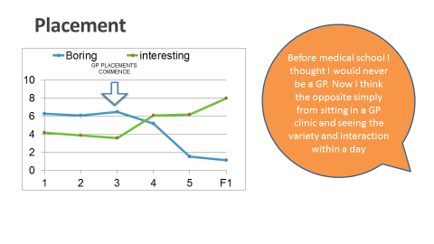
What do the students think…

Slide 10
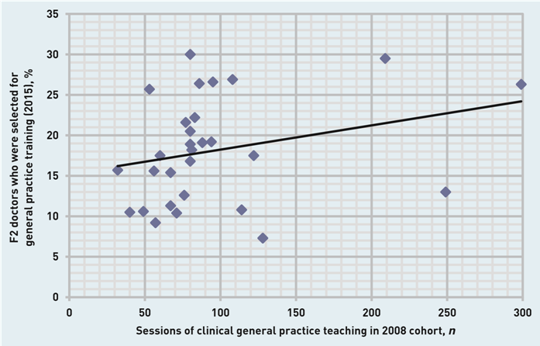
GP Placements matter!

Slide 11
Negative views of GP
Own examples in practice..
GP could be a ‘plan B’(5)
‘Consultants would say [...] you would be wasted as a GP.’ (5)

Slide 12
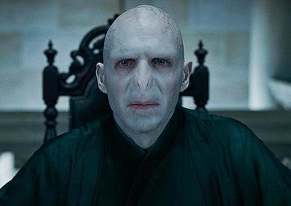
What makes a Bad Role Model in Practice..?

Slide 13
What makes a Bad Role Model in Practice..?
  Unprofessional behaviour
  Criticising other professions/their own profession
  Poor clinical credibility
  Lack of engagement in student placement

Slide 14
Group activity
Examples of a good GP Tutor role model?
What can we do promote General Practice?
What are the barriers and how can we overcome these?

Slide 15
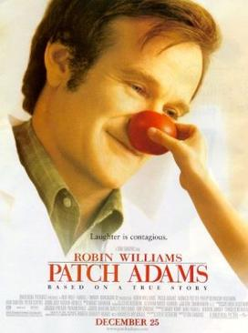
Good examples
Engaged in student placement
Professional
Enjoyment in Job
Being patient centred
Good clinical care
Recognising our role as role models

Slide 16
Promoting Team GP!
Good GP Student placement (see other workshops!!)
Best way of selling GP is by being a GP in front of them..
Honesty
Home visits…unique to GP
Patient follow up providing a sense of achievement i.e. rebooking with students in 2 weeks
Diversity of role- Minor Ops, Baby Clinic, Frailty ward round…
Part of the team, lunch etc

Slide 17
Barriers and how to overcome them.
Consider asking students about their perceptions of GP and then challenge them throughout the placement with examples
  Complexity vs coughs and colds
If there are aspects they are not enjoying maybe change elements of the placement to find things they enjoy
  May prefer more acute management so could get involved with on-call duties
  More or less mental health
  More Chronic disease
Burnout/stress- if you don’t enjoy the job are you in the right place to give advice
Explaining how you deal with stress in the work

Slide 18
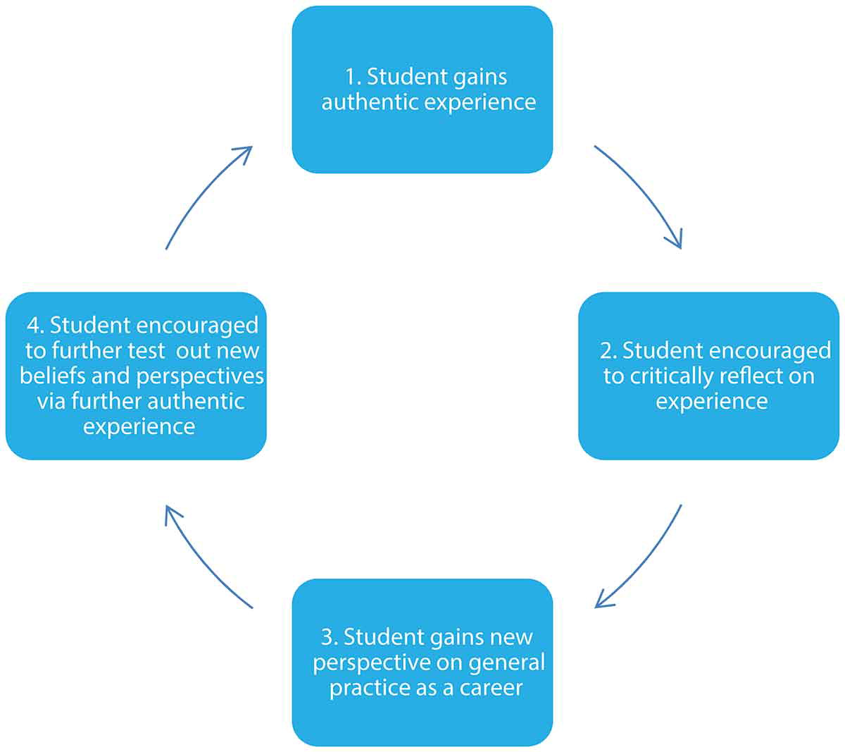
Adapted Kolb’s reflective learning cycle for informed career decisions.

Slide 19
Summary
GP Tutors have a really important role in affecting students career choices
Consider asking students about career aspirations and challenge any misconceptions
Use placements to highlight benefits of GP
Be realistic!

Slide 20
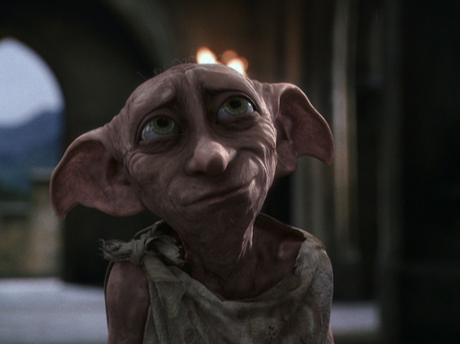
Thank you!
Any questions

Slide 21
References
https://cloutnews.com/celebrity-role-models-revealed/
https://www.ipsos.com/sites/default/files/inline-images/Chart%201_26.jpg
https://www.rcgp.org.uk/getmedia/d756d8ff-a520-498d-8c34-870608d6d846/RCGP-destination-GP-nov-2017.pdf
Anna Beth Caley & Anne-Marie Chilton (2020) Promoting general practice as a career to medical students; a qualitative study of the approaches of undergraduate GP tutors, Education for Primary Care, 31:4, 210-217, DOI: 10.1080/14739879.2020.1734970
Exposure of undergraduates to authentic GP teaching and subsequent entry to GP training: a quantitative study of UK medical schools.Hugh Alberti, Hannah L Randles, Alex Harding and Robert K McKinleyBritish Journal of General Practice 2017; 67 (657): e248-e252. DOI: https://doi.org/10.3399/bjgp17X68988
How we can all be the David Attenboroughs of the GP world: Role modelling in medical training. Sophie McArthur - 5th year Medical Student Sabrina Carinci - 5th year Medical Student,Dr Anna Ballinger - GP, Community Clinical Tutor, Deputy Director of Quality, Dr David Longford - GP Partner, Theme Lead for General Practiceall from School of Medicine, University of Liverpool

Slide 22
Thank you.
Contact your Year Lead if you find any digital content difficult or impossible to use.

