Slide 1
Workshop 2: How to Provide Useful Feedback and How to ‘standard set’ in Practice
Dr Caroline Allison
Dr KJ Harrison
GP/CCT

Slide 2
Learning outcomes
Tips on giving good feedback.
Bench marking students – how to know at which level of knowledge or skill a student should reach for each year group.
Orientation of LEO online resource for tutors.
Opportunities for experience in UOL School of Medicine undergraduate education – CCT/OSCE/CCP.

Slide 3
LEO (Liverpool Educators Online)
Notes:
Title link – open to show tutors navigation of the page

Slide 4
MBChB Overview area
MBChB Overview area

Slide 5
Giving Good Feedback

Slide 6
“Good teaching is more a giving of right questions than a giving of right answers”
Josef Albers (1888-1976) Artist & Teacher

Slide 7
Aim of Session
What is feedback?
Why is feedback important?
What gets in the way of giving feedback?
What happens if we don’t give feedback?
Feedback ‘Theory’
Practical advice
Discussing your experiences and concerns

Slide 8
What is feedback?

Slide 9
What REALLY is feedback?
Providing information with the intention to narrow the gap between actual and desired performance.
'Specific information about the comparison between a trainee's observed performance and a standard, given with the intent to improve the trainee's performance.‘
Can be informal or formal – we ask GP tutors to provide both!!

Slide 10
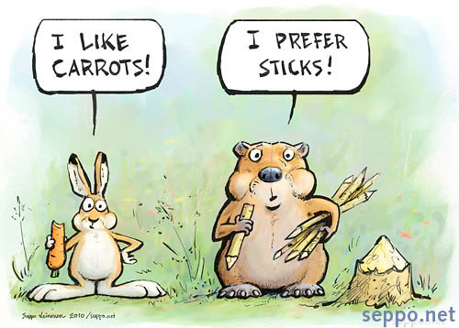
Why do we give feedback?
To reinforce good practice
To correct poor practice
To help identify ways to improve practice
To enhance clinical performance
To motivate students for their future learning
Getting students to work towards specific, personalised goals can foster a sense of accountability.

Slide 11
What gets in the way?
Lack of training in how to give feedback?
Fear of being overly critical or causing offence
Not wanting to embarrass students in front of patients or colleagues
Student defensiveness
Clinical obligations
Previous personal experience of feedback
Benchmarking – where to “set the bar”

Slide 12
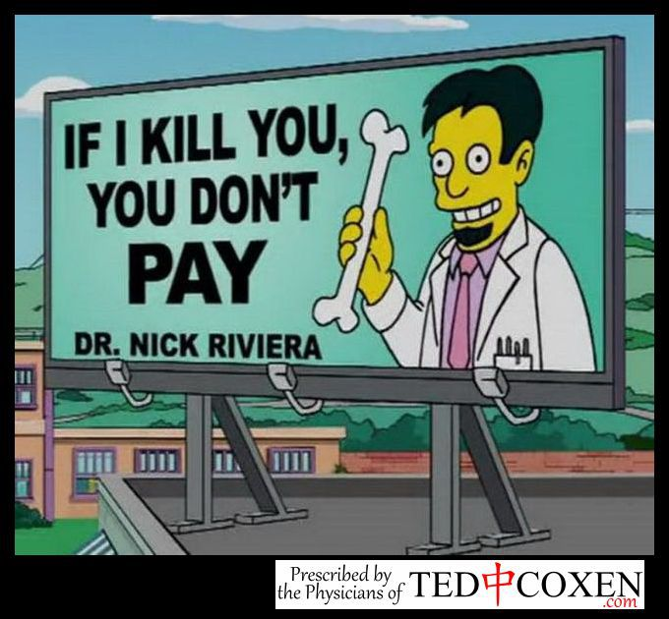
What happens without feedback?
Don’t improve performance
Students rely on hearsay or body language
They learn via trial and error!
We get poor feedback from students and drop in NSS rankings!

Slide 13
Feedback Theory
Many models on how to give good feedback
Some are more complicated than others!
All have pros and cons
We are all aiming to give CONSTRUCTIVE feedback both informally and formally

Slide 14
The Feedback Sandwich
Reinforcment statement
Corrective statement
Reinforcement statement

Slide 15
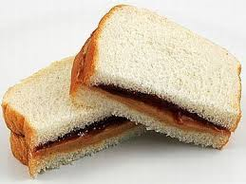
The Feedback Sandwich
Easy to remember!
Students ignore positive comments
Avoid the word …….‘but’
Often leaves inadequate time to discuss areas for improvement
One way transmission of information rather than a conversation about performance.

Slide 16
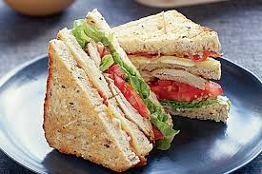
The Pendleton Model
Check the learner is ready for feedback
---------------------
An action plan for improvement is made feedback
The learner states what was done well
The observer states what was done well
The learner states what could be improved
The observer states how it could be improved

Slide 17
The Pendleton Model
Allows for a more detailed review of performance
Encourages learner to recognising what should be maintained or developed in their own performance
Can feel artificial and a bit forced
Lends itself to discussion after the event – helpful in clinical practice

Slide 18
Reflective Feedback Conversation
Frames the feedback as a conversation
Learners are responsible for self-assessing and participating in a plan for improvement
Feedback, rather than being a one-way transmission, is a dialogue.
Invite self-assessment
Provide actionable guidance
Describe relevant, observable behaviours to include constructive compliments and constructive correction

Slide 19
Reflective Feedback Conversation

Slide 20
Practical Advice
Establish feedback as a normal everyday component of the placement
Be non-judgemental
Offer feedback on the problem not the person
Ensure students are clear about the criteria against which their performance will be assessed

Slide 21
Practical Advice
Be specific - ‘Great job, well done!’ while charming is not helpful!
Base it upon what you directly observe e.g. ‘I noticed’, ‘I observed’, ‘When you were doing x, I could see that y’
Offer feedback at the time or the event or shortly after
Limit feedback to one or two items only (little and often!)

Slide 22
Practical Advice
Always deliberately seek the learners own perception of their performance and ideas for improvement
Focus on solutions and summarise at the end so everyone is clear on the outcome

Slide 23
Experiences or concerns?

Slide 24
Benchmarking – where to set the bar
How do we know “where to set the bar”?
Experience with students helps
In order to know where to pitch expectations for ability of students, we need to consider the course structure including teaching throughout the year
LOs from handbook on LEO are also helpful to establish experience/learning pre and post placement

Slide 25
Teaching throughout the years
CBL tutorials – during placements
Safe Prescribing tutorials – on placement (Pharmacist led)
Clinical skills tutorials – university and placement based sessions
Communication for clinical practice
CCT – once weekly during the GP block and weekly during academic weeks. Primary case based medicine in small groups

Slide 26
Year 3 aims– Becoming a Practitioner
Focus on the understanding of core clinical concepts
Transition year mostly on clinical placement (4 week blocks)
Medicine A – cardiovascular, respiratory, dermatology
Medicine B – gastroenterology, Diabetes, ID
Surgery A – upper an lower GI, breast
Surgery B – trauma and orthopaedics, vascular
Paediatrics – the normal child
O+G - the normal pregnancy
Primary care

Slide 27
In year 3…
Students should start to use clinical reasoning processes
Become more skilled in history-taking and examination
Begin to formulate a clinical diagnosis, investigations and management plan.
Incorporate patients’ ideas, concerns and expectations
Consider biological, social and psychological factors into a shared management plan
Provide explanations and information in a way patient can understand

Slide 28
Year 3 GP LOs snapshot (pg 5)

Slide 29
Year 4 aims – Broadening Expertise
Specialist and challenging clinical practice
Medicine C - Geriatrics, renal, rheumatology
Medicine D – Palliative care and oncology
Surgery C – ENT, plastics and ophthalmology
Neurology
O+G
Paediatrics including paediatric psychiatry
Psychiatry
Primary care

Slide 30
In year 4…
Students should be improving their clinical reasoning skills
Gaining skills in focused history taking
More effective in case presentation and discussion skills
Formulating differential diagnoses and management plans
More lateral thinking rather than learning lists
Acquiring nuanced clinical acumen eg responding to patient cues, hidden agenda, patients’ perceptions and health beliefs, etc

Slide 31
Year 4 GP Los snapshot

Slide 32
Year 5 aims – Preparing for Practice
Acute Medicine (Medicine E)
Acute Surgery (Surgery D)
Critical and Intensive Care
Emergency Medicine
Acute Primary Care (General Practice C)
SAMP (Selective in Advanced Clinical Practice)
Apprenticeship

Slide 33
In year 5…
Students should demonstrate proficiency in clinical reasoning skills
Emergency presentations, appropriate referrals and admission avoidance
Consultations should demonstrate a patient centred approach with shared decision making incorporating ICE
Medically unexplained symptoms, uncertainty and health seeking behaviour
Safeguarding

Slide 34
Practitioner health, resilience and when to seek help
Economy of healthcare and NHS structure
Integrated care and its importance in safe patient journey
Written correspondence: discharge letters and referrals
Safe prescribing including polypharmacy and multimorbidity
Clinical governance and QA activities

Slide 35
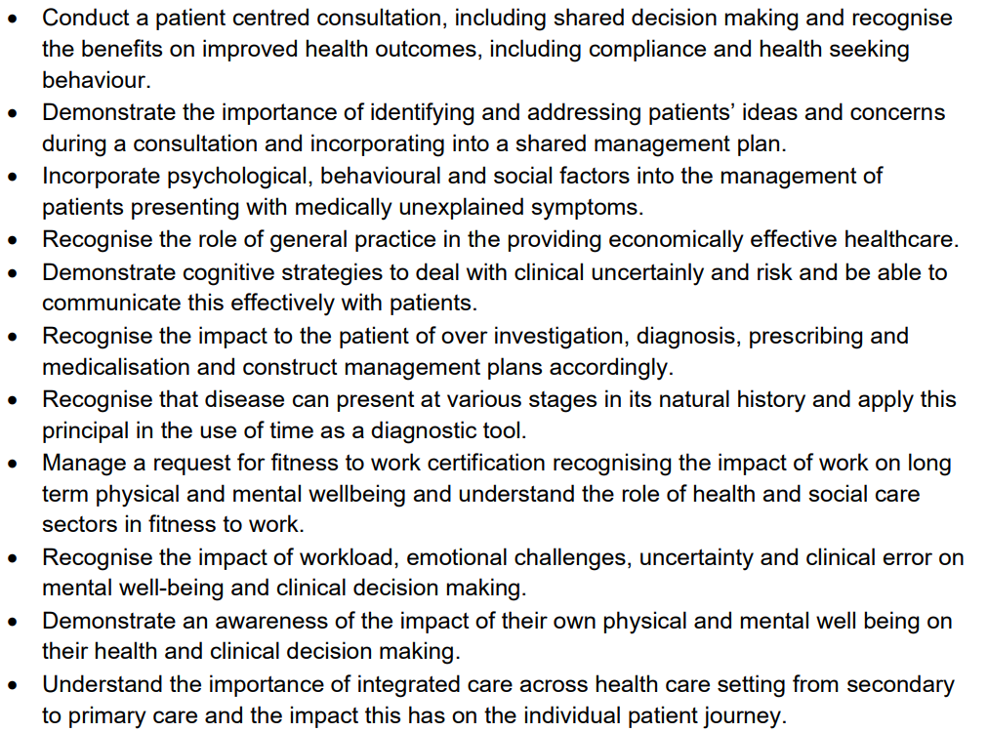
Year 5 LO snapshot

Slide 36
In conclusion…
Every student is different and will have individual learning needs
Feedback should be based on performance and learning needs these bearing in mind the stage of training
The standard/benchmark by year 5 is to be a safe F1 doctor
In years 3 and 4, interpretation of ability is a little more tricky, depending on time of year and placements so far
It gets easier with time!

Slide 37
UoL Teaching Opportunities
Communication in Clinical Practice
CCP
Clinical Skills/OSCE Examining
OSCE
Community Clinical Teaching
gprecruit@liverpool.ac.uk

Slide 38
Useful LEO areas to note
GP online resource tool
Induction checklist
Course overview
Course requirements (including educational supervisor page link to eportfolio guide)
Home visit policy
Mandatory experiences (with links to GP handbook)
Learning outcomes
Absence reporting
Clinical skills (link)
Commendations (left hand menu)

Slide 39
Thank you.
Contact your Year Lead if you find any digital content difficult or impossible to use.

