Slide 1
Benchmarking our students
School of Medicine
Dr Victoria Wright
May 2023

Slide 2
Aims
To develop your understanding of how to benchmark your students for the year group you teach
Develop knowledge of course structure
Find ways of improving your knowledge of benchmarking
Notes:
Aims
Benchmarking
Curriculum in school of Medicine
Course structure
How to improve knowledge of setting a standard for students

Slide 3
Benchmarking
https://en.wikipedia.org/wiki/Benchmark_%28surveying%29#/media/File:Benchmark_in_Edinburgh.jpg
Notes:
A little bit of trivia – Horizontal marks surveyors made for an angle-iron to make a “bench” for a levelling rod
https://dictionary.cambridge.org/dictionary/english/benchmarking
“the act of measuring the quality of something by comparing it with something else of an accepted standard”
https://www.oxfordlearnersdictionaries.com/definition/english/benchmark_1#:~:text=%2F%CB%88bent%CA%83m%C9%91%CB%90rk%2F,things%20can%20be%20compared%20with
“​something that can be measured and used as a standard that other things can be compared with.”

Slide 4
Why is benchmarking important?
GMC set standards and requirements for all stages of medical education and training (1)
“All medical students graduating from UK universities from the academic year 2024–25 onwards will be required to pass the MLA as part of their degree before they can join the medical register.” (2)
Notes:
https://www.gmc-uk.org/education/standards-guidance-and-curricula/standards-and-outcomes/outcomes-for-graduates/outcomes-for-graduates
https://www.gmc-uk.org/education/medical-licensing-assessment
The Medical Licensing Assessment is a two-part test that will set a common threshold for safe medical practice in the UK.

Slide 5
How do you currently benchmark your students?
Notes:
How do you benchmark the students you see on placements?

Slide 6
Where do we set the bar?
Considering course structure can help pitch expectations
Learning Outcomes from handbook on LEO are helpful to establish experience and learning pre and post placement
Experience with students will help
Notes:
More about gaining experience later (eg Osces etc)

Slide 7
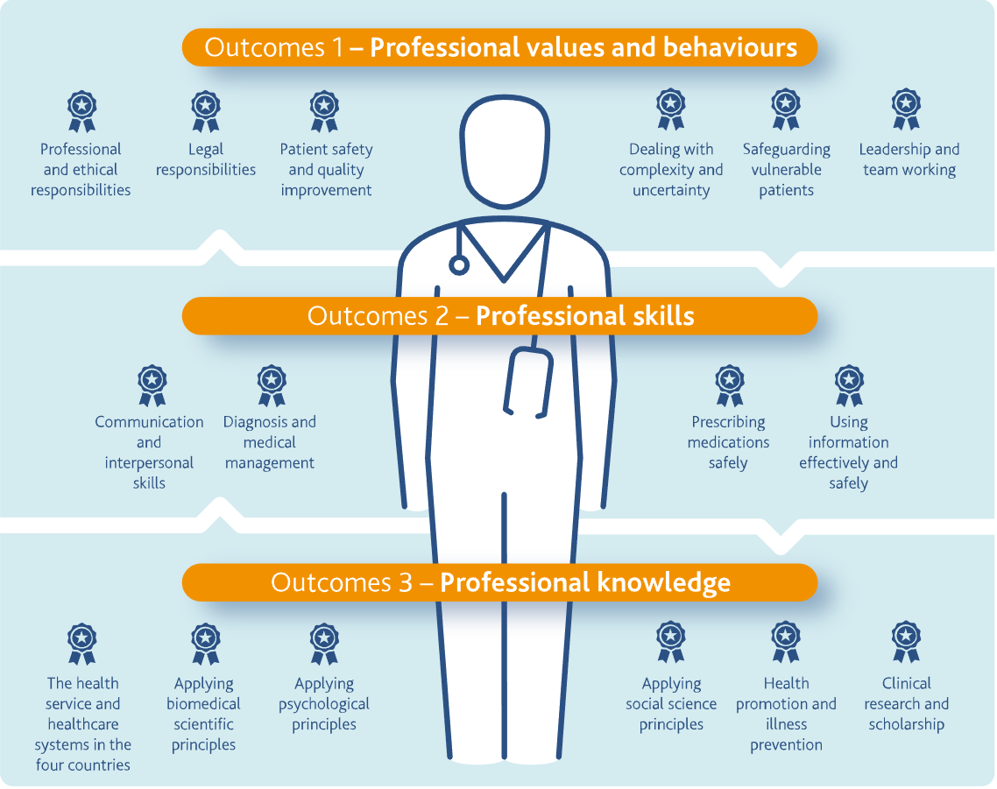
Curriculum
GMC Outcomes for Graduates 2018
Notes:
https://www.gmc-uk.org/-/media/documents/outcomes-for-graduates-2020_pdf-84622587.pdf

Slide 8
Course Structure at SoM UoL
Notes:
https://www.liverpool.ac.uk/media/livacuk/schoolofmedicine/leo/documents/Clinican,fact,sheet,on,curriculum,in,2022-23.pdf

Slide 9
MBChB Programme Structure Year Course focus
Year 1 Core clinical science: the structure and function of the human body under ‘normal’ conditions
Year 2 Pathology and disease: ‘abnormality and illness’ and the interaction with the environment
Year 3 Becoming a practitioner: Core clinical practice
Year 4 Broadening expertise: Specialist and challenging clinical practice
Year 5 Preparing for practice: Emergency and acute clinical medicine
Notes:
Year 1 – focus on normal – teaching delivered by lectures, CBLs, seminar-style teaching, anatomy focused teaching, sociology and psychology, leadership (Altcar), clinical and comm skills
Year 2 – develop pathology – lectures panoptyo, CBLs, CCP, etc also 4 week clinical placement (varied)

Slide 10
Year 3 Placements
Medicine A: Cardiovascular, Respiratory and Dermatology
Medicine B: Gastroenterology, Diabetes and Infectious Diseases
Surgery A: Colorectal, Urology, Breast, Upper GI and Liver
Surgery B: Trauma & Orthopaedics and Vascular
General Practice
Paediatrics
Obstetrics
Notes:
https://canvas.liverpool.ac.uk/courses/61945/pages/course-information

Slide 11
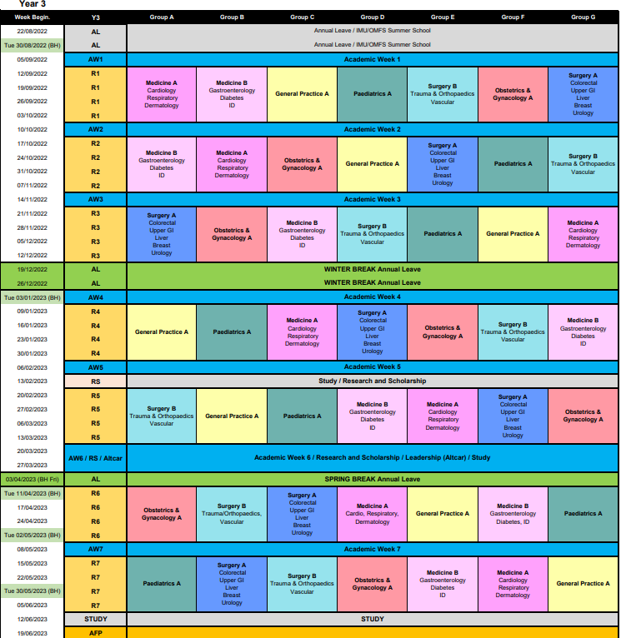

Slide 12
Year 3 Teaching
Cased based Learning (CBL)
Safe Prescribing Sessions
Clinical Skills
Community Clinical Teaching (CCT)
Developing history taking skills and formulating differential diagnosis
Notes:
CBL – specialist teaching in clinical placements
Give examples of topics we teach in CCT

Slide 13
Year 4 Placements
General Practice B
Medicine C: Geriatric Medicine, Renal & Rheumatology
Medicine D: Palliative Care, Oncology & Haemato-oncology
Neurology (including Neurosurgery)
Obstetrics & Gynaecology B
Paediatrics B (including Child & Adolescent Psychiatry)
Psychiatry A
Surgery C: Paediatric Head & Neck, Adult Head & Neck, Ophthalmology and Plastic Surgery
Notes:
E-portfolio requirements for each 4 week placement

Slide 14
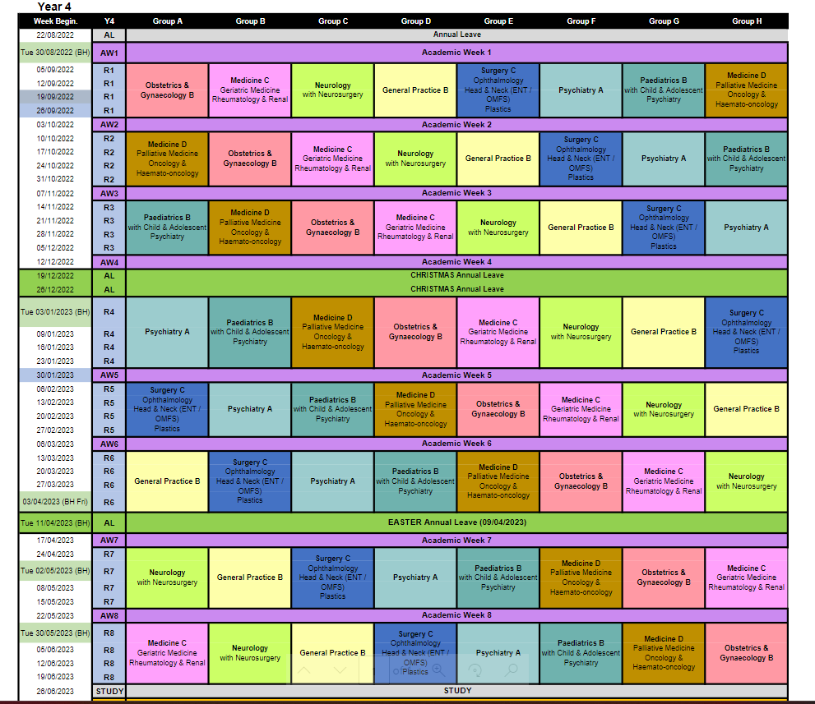

Slide 15
Year 4 Teaching
Development knowledge Year 3 and also Clinical specialities
Cased based learning (CBL)
Clinical Skills
Safe Prescribing
Disability Awareness
Communication for Clinical Practice (CCP)
Community Clinical Teaching (CCT)
Expanding on investigations and management of patients
Notes:
Give examples of topics we teach in CCT

Slide 16
Year 5 Placements
Acute medicine
Acute surgery
Emergency medicine
General Practice
One 4-week composite placement consisting of Critical Care and Anaesthetics (2 weeks), Acute Psychiatry (1 week), FY1 PracTiSCE (Practical Training in a Simulated Clinical Environment) (1 week)
SAMP (6 weeks)
Pre-Foundation Apprenticeship Placement
Notes:
5x 4-week placements
SAMP – Selective in advanced medical practice (student selected clinical Placement
Weekly Teaching CBLS, OSCE assessment and e-portfolio

Slide 17
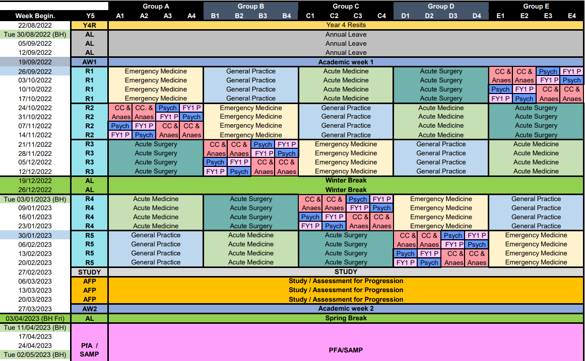

Slide 18
How to develop our knowledge benchmarking?
Experience will help!
Shadow CCT teaching sessions
Familiarise yourself with learning outcomes
Look at LEO website for more information on course curriculum
Get involved with assessment
OSCE team need you!
https://www.liverpool.ac.uk/medicine/osce/booksessions/

Slide 19
What could you do in the future to help more accurately assess your students performance on placement?

Slide 20
Summary of aims
Developed knowledge how to benchmark students
Course structure and how this affects knowledge base of students
Looked at ways of further developing our knowledge of benchmarking our students

Slide 21
Thank you.
Contact your Year Lead if you find any digital content difficult or impossible to use, either directly or with an assistive technology such as a screen reader.

