Slide 1
Introduction to the SPF UK Climate Resilience Programme
Suraje Dessai and Kate Lonsdale
University of Leeds
18 April 2019

Slide 2
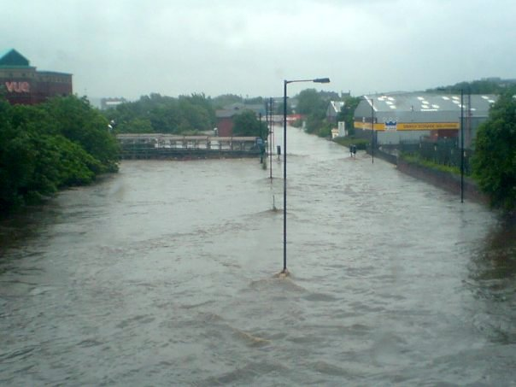
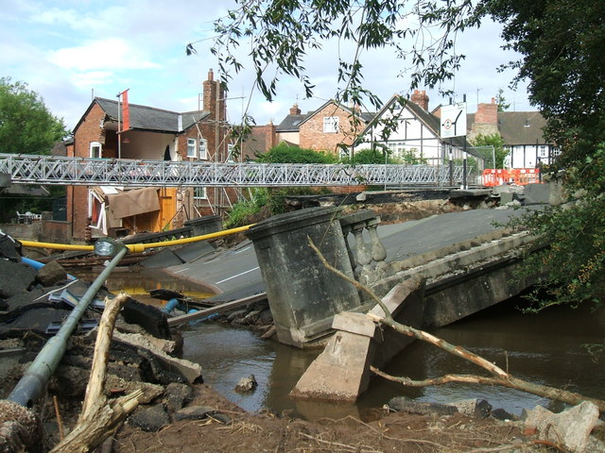
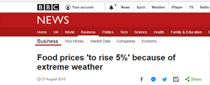
Need and urgency for building resilience
Impacts of extreme weather and climate change permeate through society affecting lives and livelihoods
UK Flooding Events 2007
UK Heatwave 2018
Notes:
UK Flooding events 2007: affected 55,000 homes, killed 13 people and cost the UK economy £3.2 billion.
Pictures: Meadowhall Centre flooding after the River Don burst it banks, collapsed bridge in Ludlow
UK Heatwave 2018: joint hottest summer on record for the UK as a whole – blamed for record A&E attendance – with reports of dehydration, heart failure and kidney problems related to the unusually high temperatures.
A combination of a wet cold winter and summer heatwave in 2018 is being predicted to result in increases in food prices.

Slide 3
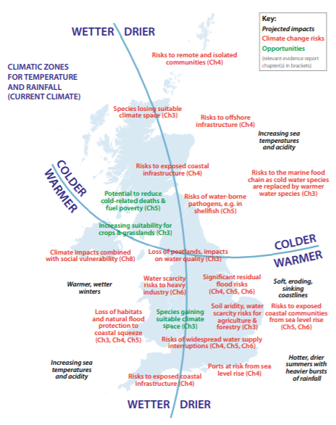
Potential UK impacts summarised in CCRA2

Slide 4
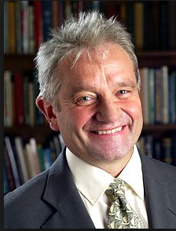
The Strategic Priorities Fund
Building on Sir Paul Nurse’s vision of a ‘common fund’
Drive an increase in high-quality, multi- and interdisciplinary research and innovation
Ensure that UKRI’s investment links up effectively with Government departments’ research priorities and opportunities
Ensure the system is able to respond to strategic priorities and opportunities.

Slide 5
Funding and management
The UK CR programme funded under Wave 1 of SPF
Jointly led by NERC (on behalf of AHRC, ESRC and EPSRC) and Met Office
Workshop held in September 2018 to help draw the community together
Ministerial announcement in October 2018
UKRI
Notes:
Objectives of the workshop
Network researchers from different disciplines
Understand policy/ business requirements
Develop new ideas that fill the gaps and deliver multidisciplinary research

Slide 6
Scope
The UK Climate Resilience Programme will draw together fragmented climate research and expertise to deliver robust, multi- and inter-disciplinary climate risk and adaptation solutions research ensuring the UK is resilient to climate variability and change and powerfully positioned to exploit the opportunities of adaptation and green growth.

Slide 7
Objectives
Climate related risks: The robust characterisation, quantification and communication of climate-related risks.
Effective adaptation strategies: Develop risk-informed resilience and optimise the opportunities from a transition to a low carbon future.
Climate services: Co-produce and pilot end-to-end climate services.

Slide 8
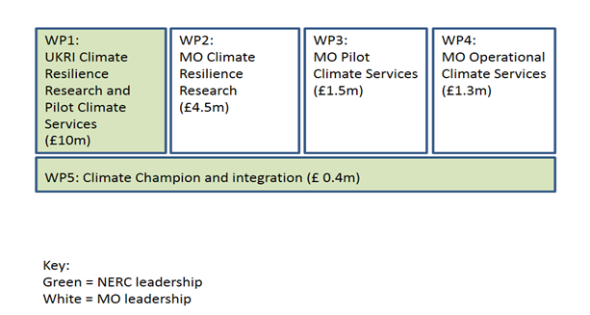
Programme structure

Slide 9
WP1 components resulted from UKRI call in December 2018
A prototype real-time sting jet precursor tool for forecasters
Building UK climate resilience through bridging the qualitative-quantitative data divide
CROP-NET: Monitoring and predicting the effects of climate change on crop yields
Characterising and adapting to climate risks in the UK wine sector
Climate Resilience of Care Settings
Climate Risk Indicators: developing indicators of climate risk using UKCP18 to support risk assessments and enhance resilience
Coastal resilience in the face of sea-level rise: making the most of natural systems
Delivering resilience to climate impacts on UK freshwater quality: towards national-scale cyanobacterial bloom monitoring and forecasting
Designing Resilient and Adaptable Water management - Integrated & Interactive Tools (DRAW-IT)
Erosion Hazards in River Catchments: Making Critical Infrastructure More Climate Resilient
FUTURE-DRAINAGE: Ensemble climate change rainfall estimates for sustainable drainage
Financial risk and the impact of climate change
Forecasting Risk of Environmental Exacerbation of Dissolved Organic Matter - Building Climate Change Resilience (FREEDOM-BCCR)
Impacts and Risk Assessment to better inform Resilience Planning (IMPRES)
Mobilising Citizens for Adaptation: building local flood resilience through cooperative rainwater harvesting (MOCA)
Monitoring and predicting the effects of climate change on crop yields
Smart Systems Approaches for Climate Resilient Livestock Production
Towards a microbial process-based understanding of the resilience of UK peatland systems
Understanding UK Perceptions of Climate Risk and Resilience (RESILRISK)
Unlocking the potential of surface water flood nowcasting for emergency services in a changing climate
http://gotw.nerc.ac.uk/list_them.asp?them=UK+Climate+Resilience

Slide 10
UK Climate Resilience Champions
The Champions will act as thought leader, flag bearer and strategy owner for the UK Climate Resilience research programme.
Funded throughout the duration of the programme to consult with the wider research and user communities to further develop the UK Climate Resilience programme, and scope the subsequent funding calls and activities to address the research questions needed to achieve the programme objectives.
Notes:
Examples of activities:
ensure alignment across the portfolio of research
promote knowledge exchange across the programme and to all relevant communities
ensure linkages to user community including business, practitioners
ensure linkages to governmental policy requirements
ensure linkages to international efforts
raise the profile of the programme in all relevant communities
coordinate monitoring and evaluation activities
provide data management and reporting
provide advice and recommendations to the programme board regarding the scope of subsequent calls
participate in the steering committee

Slide 11
Next steps
Scoping stage to shape next round of calls and programme activities
Further open calls will be announced in 2019. https://nerc.ukri.org/research/funded/programmes/ukclimate/
Stay in touch:
Website in development
Contact us at:
@UKCRP_SPF
champion@leeds.ac.uk

