Slide 1


Mobilising Britain’s historical flood information in support of contemporary flood risk assessments

Slide 2
Bath and the River Avon
Roman settlement near warm springs
~ 1700 become a popular spa town
Most buildings in Bath face away from River
New-found revival along River Avon

Slide 3
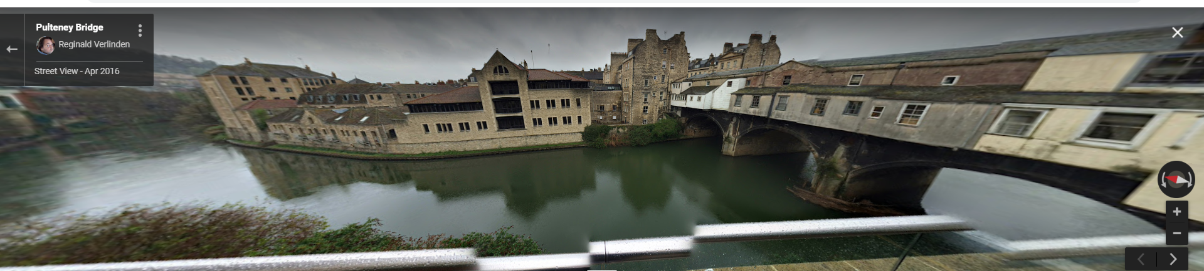
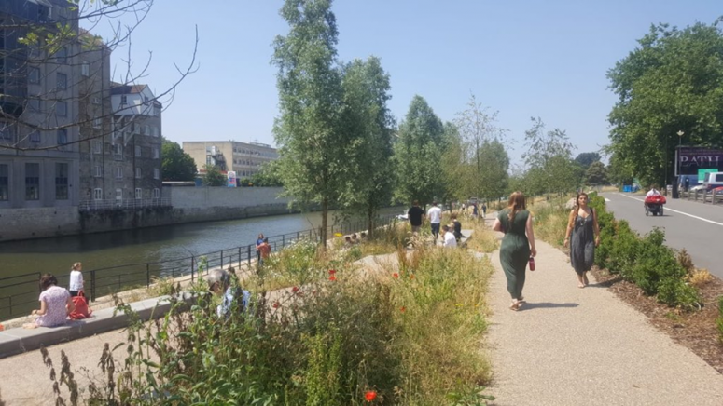
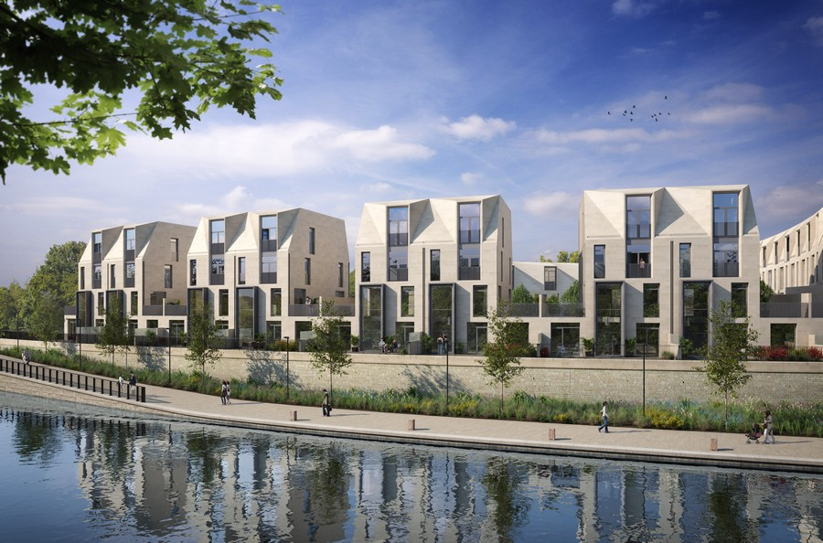

Slide 4
Aims of project
Develop chronology of historical events and changes to river management and infrastructure in Bath (~1800 – 2019)
Develop hydraulic river model representing River Avon and surroundings at time of historical events
Incorporate historical data into contemporary flood frequency analysis (e.g. impact on 100-year flood)

Slide 5
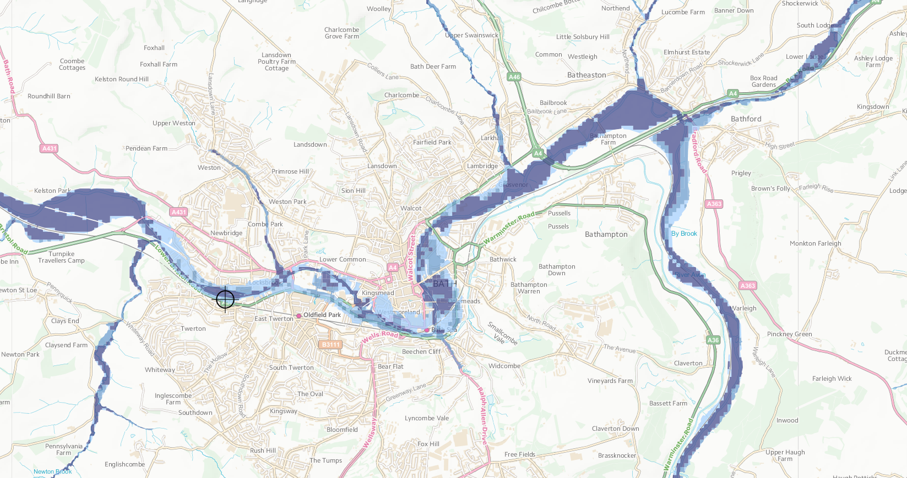
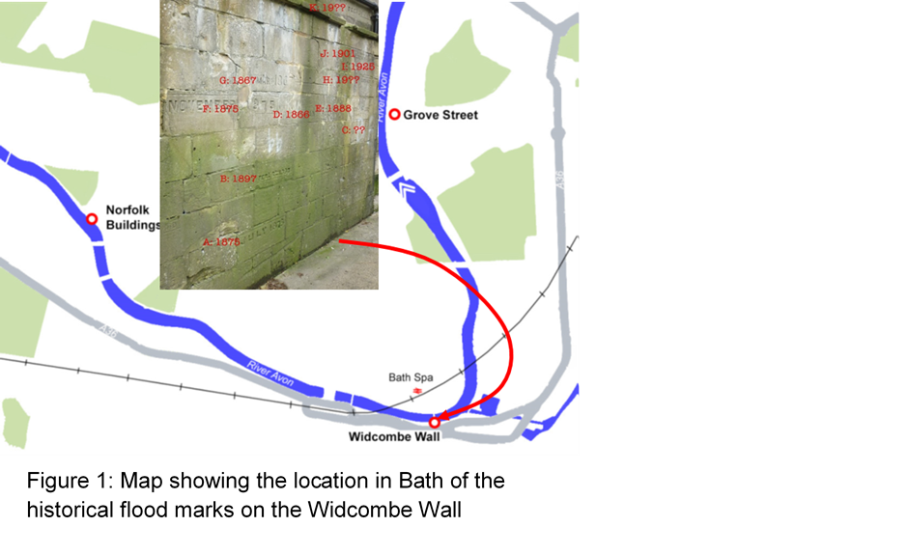

Slide 6
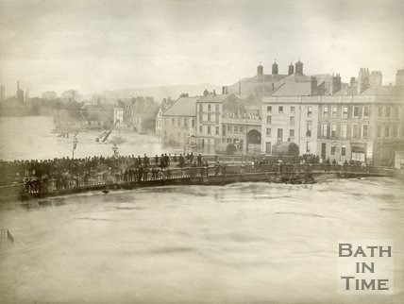
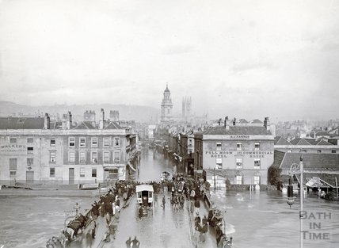
1882
1894

Slide 7
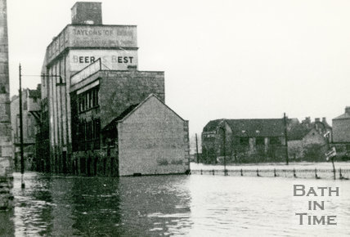
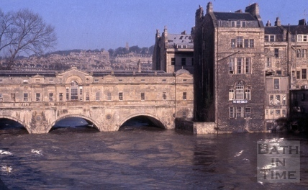
1947
1960

Slide 8
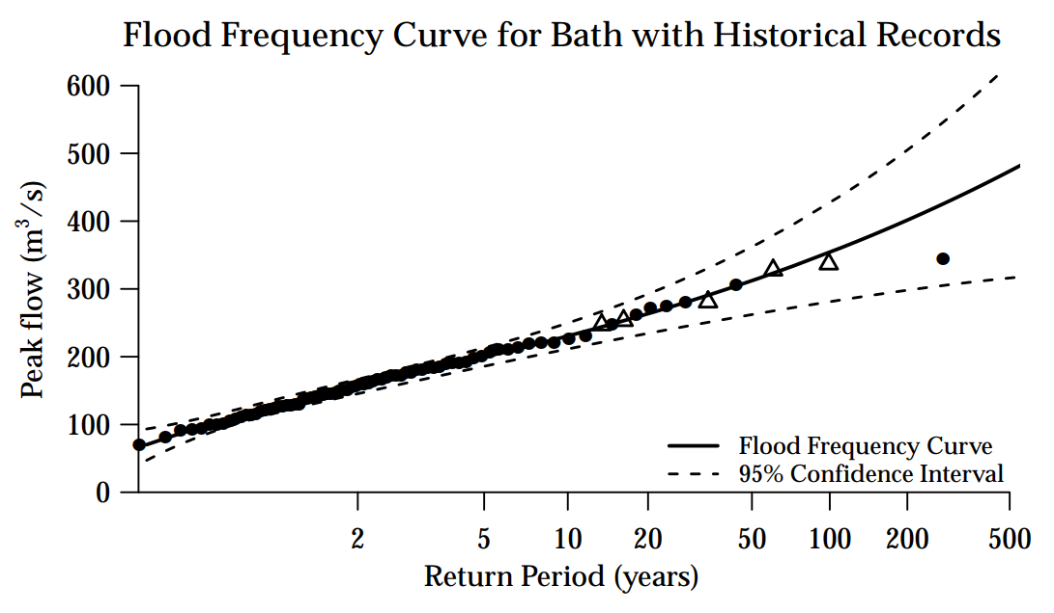

Slide 9
Considered four options to reduce flood risk in Bath
Upstream storage unit
Bypass channel
Raising flood levees in the city
Increase the conveyance of the channel

Slide 10
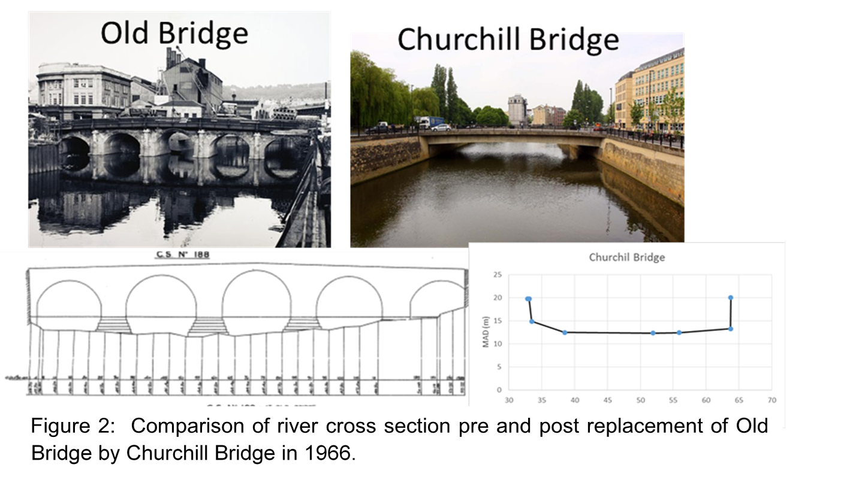

Slide 11
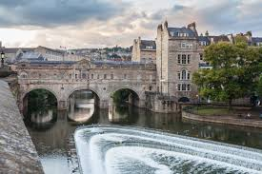

Slide 13
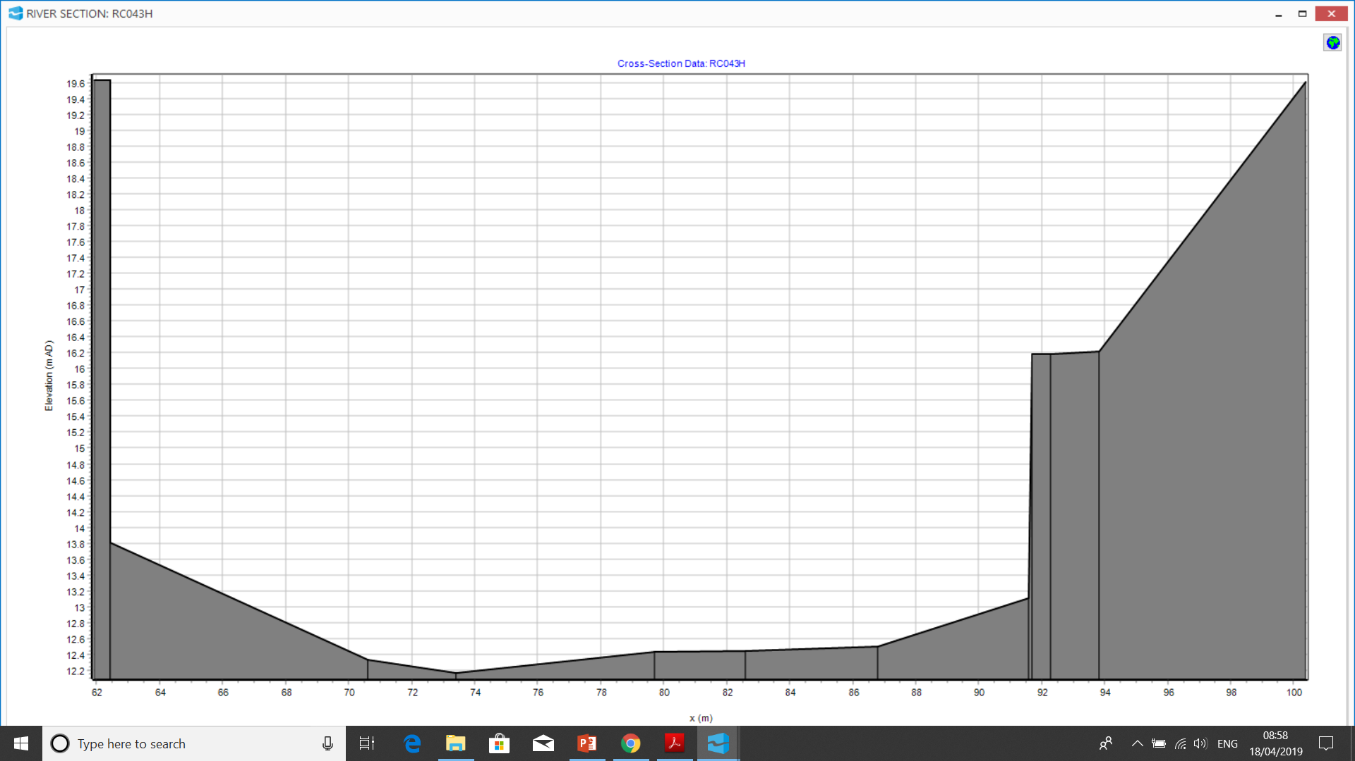
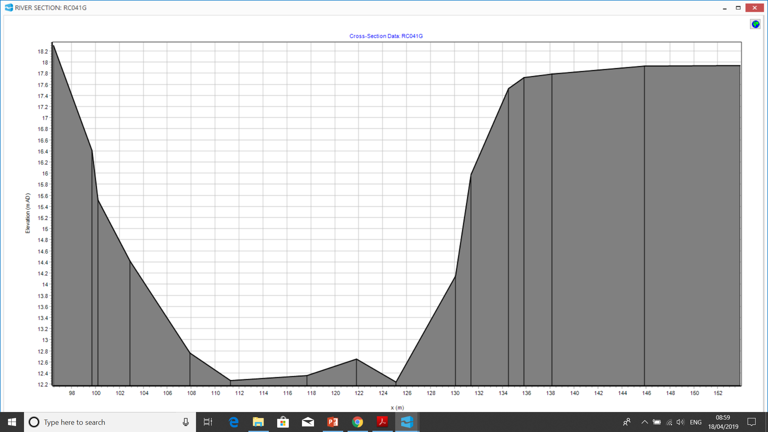
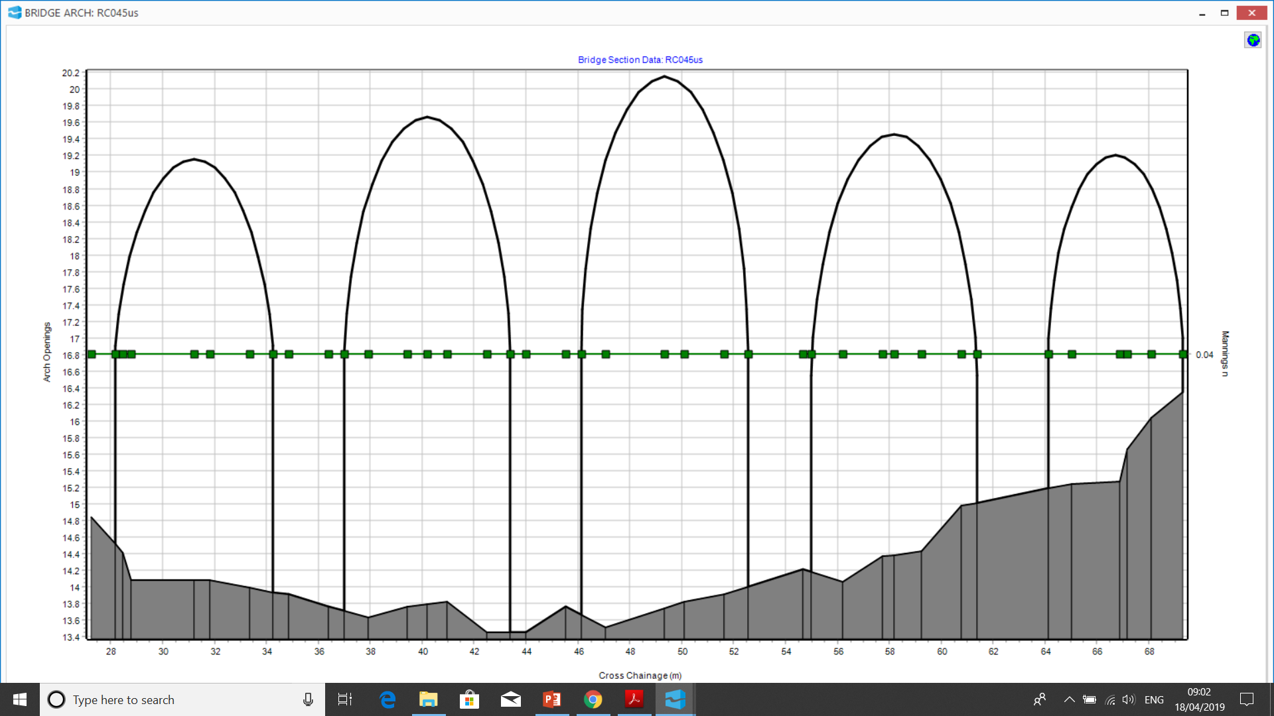

Slide 14
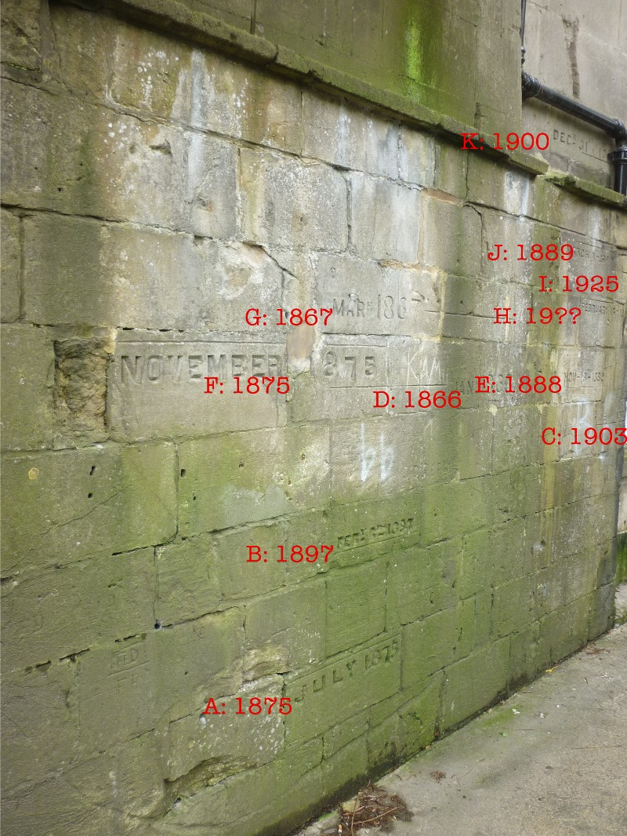

Slide 16
What does the future have in store for Bath?
?? +50%
by 2080

Slide 17
