Slide 1

Leadership in Impact Assessment –
An international symposium
FOTHERGILL
Training & Consulting
The Higher Education Innovation Fund (HEIF)

Slide 2
WELCOME AND HOUSE-KEEPING
Thomas Fischer
-
Josh Fothergill

Slide 3
OPENING THOUGHTS
Umrah Mahadik

Slide 4
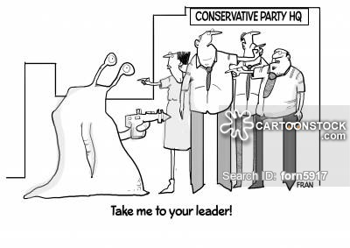
OPENING THOUGHTS
Topical – in a country in which leadership is more urgently needed now than probably over more than the last half century
United Kingdom
Over 450 people viewing the announcement to this event on my personal blog – by far the largest number of views I have received for an announcement like this on my blog…

Slide 5
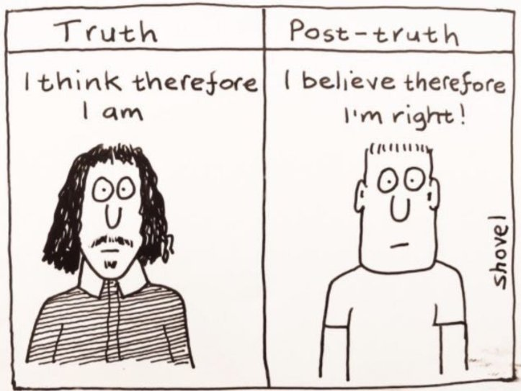
Original Idea
There is uncertainty with regards to the future of IA
IA is under pressure in the current post-factual era, where wishful thinking is frequently stronger than evidence and facts (1+1=3)

Slide 6
Original Idea
‘Leadership’ is of crucial importance for an instrument that aims at transparency and balance
Internationally, leadership is provided through different means and bodies – a few of those representing them are here today...
In the UK, leadership has been provided in different ways:
  EU, UK and governments of devolved administrations (e.g. SEA in Scotland, HIA in Wales, England and NI?)
  Professional bodies; IEMA (formerly IEA)
  Consultancies and universities
  IAIA Ireland-UK branch?

Slide 7
Original Idea
Whilst over 50 HE institutions in the UK offer e.g. EA related degree programmes, less than a handful are active in associated research and outreach, including e.g. organising events like this
  Recent Liverpool EAM Research Centre events
    Leadership in IA
    Implications of Brexit for environmental assessment in the UK
    Reuniting planning and health – the role of impact assessment
    Guidance for more effective SEA
    25 years of the EIA Directive

Slide 8
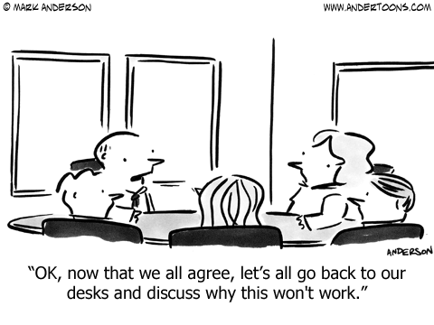
Objectives
To look at and understand different ways to providing IA (and instrument under threat) leadership internationally
To discuss whether we currently have sufficient and / or the right type of leadership and what type of leadership may be needed in particular

Slide 9
Participants…
Private sector / consultancies
Public sector / authorities
Universities
Others

Slide 10
Participants…
UK
Other European
Non-European

Slide 11
Participants…
HIA
SEA, SA and EIA
SIA
TIA
Other

Slide 12

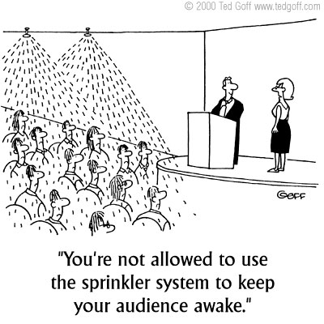
Acknowledgements
Industrial Strategy Higher Education Innovation Fund
Raymond Hung Shiu Fung
Speakers
Colleagues from the EAMRC
You…

Slide 13
Questionnaire
1 ‘Autocratic’ leadership: resulting in detailed instructions on what to do and how to do it (e.g. through detailed legislation and guidance) with little space provided to go above set requirements
2 ‘Transformational’ leadership: continuously pushing thinking and practice outside the comfort zone in order to go beyond established (through e.g. guidelines) practices
3 ‘Democratic’ leadership: considering opinions of different experts / leaders in their fields and on that basis to continuously developing IA further to achieve best practice
4 ‘Laissez faire’ leadership: leaving the decisions on ‘how to do it’ to the ‘community’ and providing minimum guidance; the focus may be on e.g. providing a platform for the community to discuss relevant issues)
5 ‘Transactional’ leadership: setting clear roles and tasks and rewards those that fulfill them best; e.g. through accreditation
6 ‘Bureaucratic’ leadership, going by ‘the books’; listening and considering the input of experts; but rejecting an input if it conflicts with policy or past practices.

Slide 14
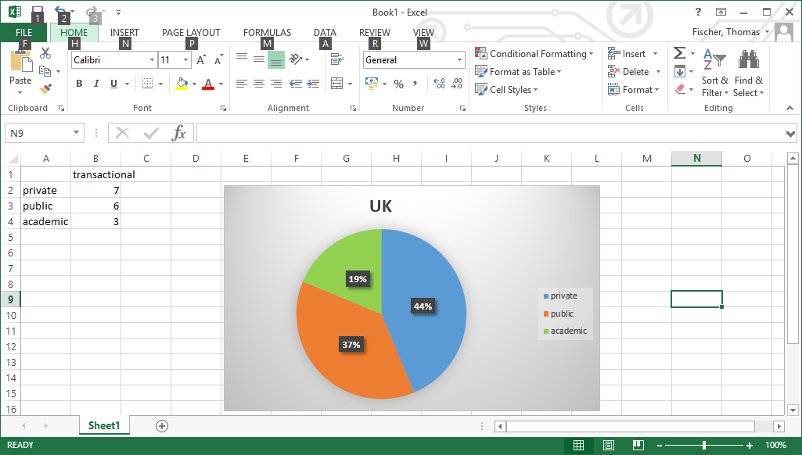
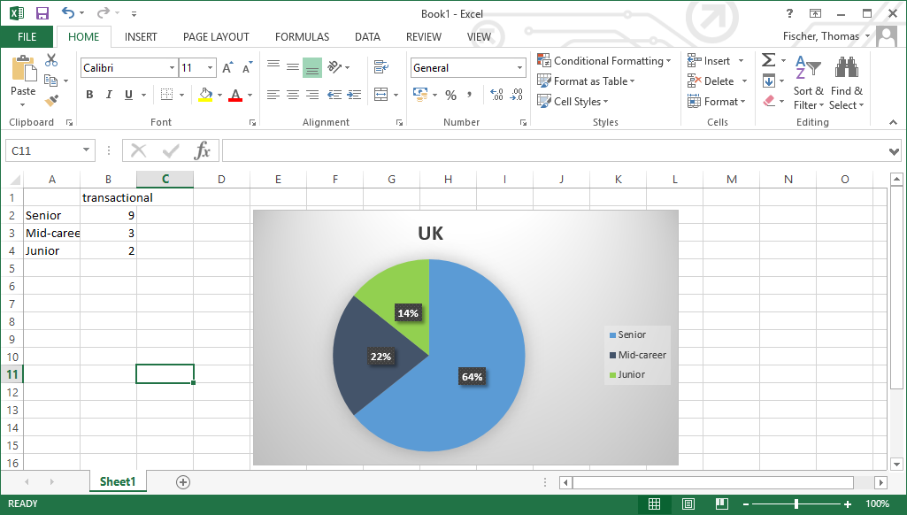
Questionnaire
54 respondents (16 from UK)

Slide 15
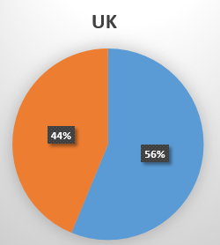
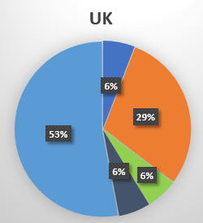
Questionnaire
54 respondents (16 from UK)

Slide 16
Questionnaire
54 respondents (16 from UK)

Slide 17
Questionnaire
54 respondents

Slide 18
Questionnaire
56 respondents
UK
Elsewhere

Slide 19
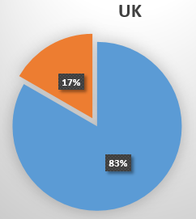
Questionnaire

Slide 20
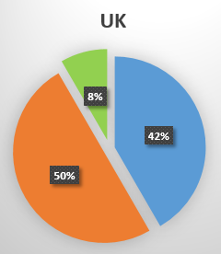
Questionnaire

Slide 21


Slide 22
The day
10:30 REGISTRATION, TEA AND COFFEE
11:00 Welcome, introduction to the day and aims of the symposium; presentation of results of ‘leadership in IA’ survey; Thomas Fischer and Josh Fothergill
11:25 Rob Verheem: EA Leadership provided by the Netherlands’ EA Commission; Q&A
11:45 Liz Green: HIA Leadership provided by Public Health Wales; Q&A
12:05 Charlotta Faith-Ell: IA Leadership provided by a consultancy – the case of Sweden; Q&A
12:25 Francois Retief: IA Leadership provided by an affiliate of an international association – the case of IAIA South Africa; Q&A
12:45 Ellen Schwaller: The Society of Practitioners of HIA – a brief introduction
12:50 comments from the audience
13:00 LUNCH
14:00 Joachim Hartlik: EA Leadership provided by a membership-based organization – the case of Germany; Q&A
14:20 Elaine McCall: EA Leadership by a devolved government – the case of Scotland; Q&A
14:40 Julia Nowacki: IA leadership by a UN organisation – the case of the WHO European region; Q&A
15:00 Mark King: IA leadership by development banks – reflecting on experiences with the World Bank and the EBRD, Q&A
15:20 comments from the audience
15:40 TEA/COFFEE and Group work: what leadership do we have and what is currently missing
(UK and different IA instruments or sectors overall)
16:50 Groups feeding back on main points
17:20 Conclusions of the day (Josh Fothergill and Thomas Fischer)
17:30 CLOSE

