Slide 1
Leadership in HIA and health in EA (?)
Julia Nowacki
WHO European Centre for Environment and Health, Bonn, Germany
Division of Policy and Governance for Health and Well-being World Health Organization Regional Office for Europe

Slide 2
The WHO European Region – environment & health
53 Member States – 900 000 000 population - extending to central Asia

Slide 3
WHO European Centre for Environment and Health (ECEH)
Established in 1991
Part of the WHO Regional Office for Europe
Operates as a scientific centre of excellence of WHO/Europe
Develops policy advice and international guidelines
Provides assistance to Member States on EH

Slide 4
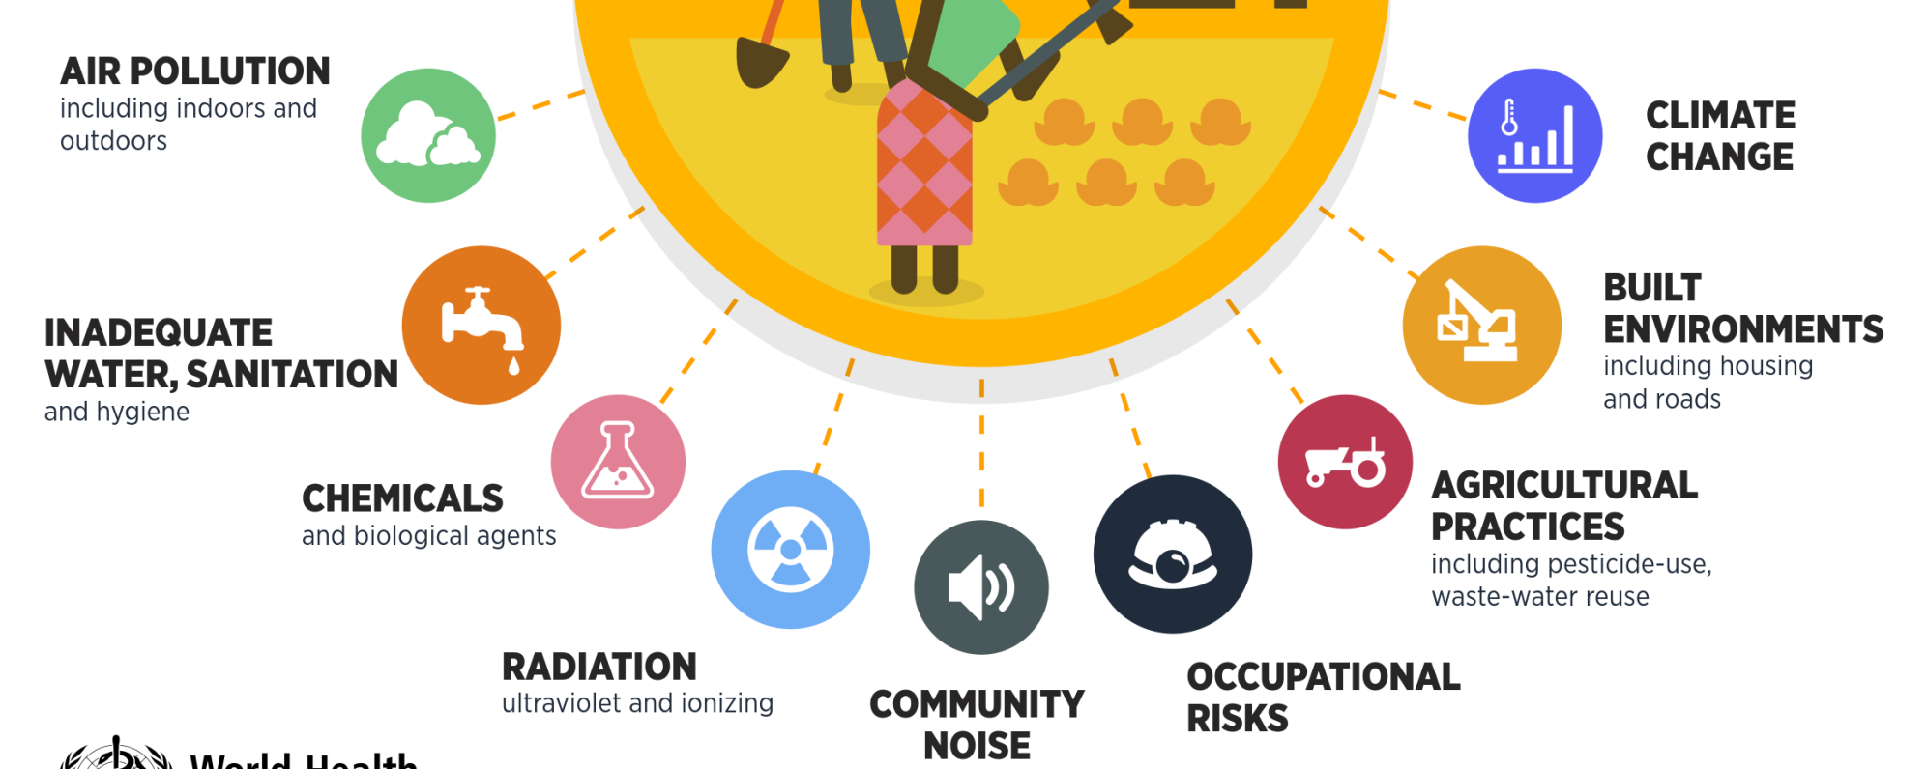
How the environment affects health
Notes:
Many environmental risk factors affect health and well-being – at home, at work, during transport, or in public places.
Adequate environmental, urban and transport policies as well as sustainable agriculture and production, and safe working conditions, can prevent or strongly reduce many of these risk factors. Yet, environmental conditions still account for a significant share of mortality and morbidity.

Slide 5
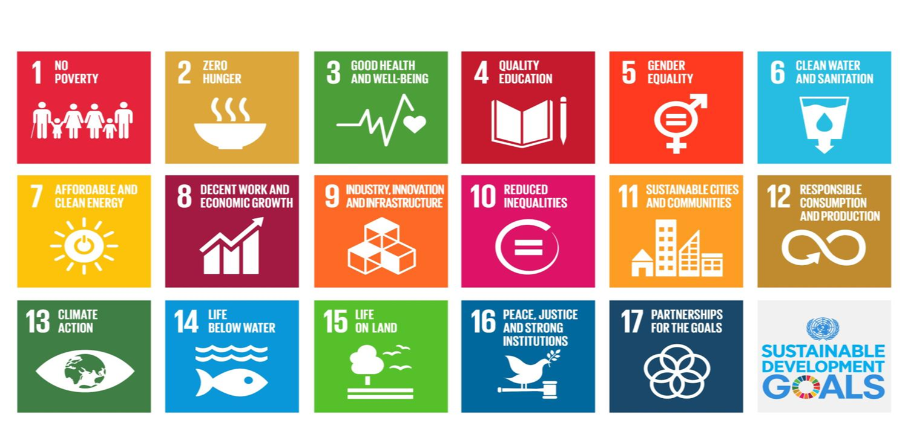
Opportunities for HIA and health in environmental assessments
Policies, plans, programs and projects outside the health sector influence health
Great potential for disease prevention and health promotion
Need to get involved in other sectors already at the decision-making level
Opportunities to get health recognized in other sectors decision-making processes, is supported through divers frameworks
World Health Assembly (WHA) Resolutions (1982, 1992)
Sustainable development goals (SDG)
WHO Health 2020 policy framework with a whole-of-government and whole-of-society approach
European Ministerial Conference on Environment and Health and its process
Legal obligations for assessing health in environmental assessments within the EU and international through UNECE conventions.
Notes:
1982 World Health Assembly Resolution WHA-35.17 introducing a framework for HIA development. This resolution urging WHO MS to:
analyse in detail the possible health hazards and environmental dangers of existing and proposed development projects;
incorporate into project plans and their implementation adequate measures to prevent, to the greatest possible extent, the occurrence of health and environmental hazards;
make adequate provisions for the implementation of necessary preventive measures, in financing relevant development projects.
1987 "Our Common Future" by the World Commission on Environment and Development encouraged WHO to undertake Environmental Health Impact Assessments (EHIA) and extend their use beyond development projects into development policies.
WHA Resolution WHA45.24 on Collaboration within the United Nations system: general matters: health and development, 14 May 1992, 1. URGES Member States to … (3) analyse the health impact of existing and future development projects and implement the necessary protective measures to safeguard, promote and improve the health status of affected populations; additional documents
1993 "Health, Environment and Development: Approaches to drafting country level strategies for human well-being under Agenda 21".
Health 2020 policy framework
Strategic objectives of H2020: stronger equity and better governance for health
Improving health for all and reducing health inequalities
Improving leadership and participatory governance for health
Working together on common policy priorities for health
H2020 priority areas:
Priority area 1. Investing in health through a life-course approach and empowering people
Priority area 2. Tackling Europe’s major health challenges: noncommunicable and communicable diseases
Priority area 3. Strengthening people-centred health systems, public health capacity and emergency preparedness, surveillance and response
Priority area 4. Creating resilient communities and supportive environments
SDGs
UN Sustainable Development Goals 2015-2030, adopted 25- September 2015, new York, to end poverty, fight inequality and injustice, and tackle climate change by 2030

Slide 6
Environment and health: a long standing intersectoral collaboration
Highendfood.files.wordpress.com/2009/01/Frankfurt_skyline.jpg
monocle.com/upload/volumes/01/issue05/m_06helsinki/article_large_06helsinki.jpg
Craigr.com/impages/London%20tower%20bridge.jpg
Sovranaviaggi.com/sito/files/images/budapest1.jpg
Ce.unipr.it/automatic/sagz2006/images/duomoDiParma.gif
Cezchtourism.com/de/t/ostrava
Notes:
Intersectoral action is a political choice and requires political commitment. Implementing intersectoral action for health and well-being, however, is challenging.
Addressing the determinants of health and well-being means addressing complex, challenging issues. Bringing together different sectors means navigating the specificities of different bureaucratic systems, unequal distribution of resources, and even at times conflicts of interest within government. This requires a determined effort.
There is now extensive knowledge and experience about what sustainable institutional and functional processes support successful implementation of intersectoral policies and processes. Our Region has considerable experience in intersectoral action
One area of considerable experience we are discussing today is the Environment and Health Process.
There are many good reasons to look at the work in environment and health area to be inspired and reflect on the lessons learnt on the long way between Frankfurt in 1989, where the first Ministerial Conference on Environment and Health took place, to Oslo, where we will gather for the sixth Conference in 2017. I would like to take this moment to express special gratitude to Germany, Finland, the United Kingdom, Hungary, Italy and Norway for generously providing the hospitality and leadership on that way, making each and every of these conferences a unique milestone in a different way.
Reflecting on the aspects that made the European Environment and Health Process a flagship intersectoral governance mechanism is a very useful exercise when considering the necessity, value and challenges of intersectoral work in other areas and with different sectors.

Slide 7
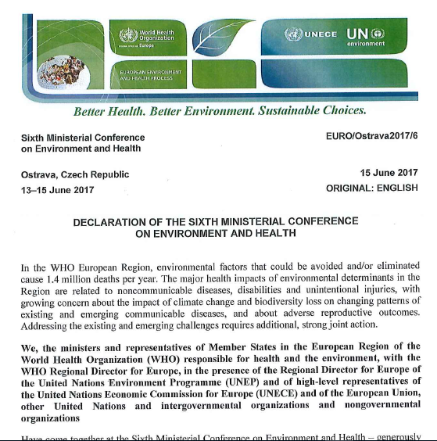
2017 Ostrava Declaration: 7 EH priorities in Europe
Air quality
Drinking-water, sanitation and hygiene
Chemicals
Waste and contaminated sites
Climate change mitigation and adaptation
Action at city and regional level
Environmental sustainability of health systems
“To address these priorities we will … (e) strengthen the knowledge and capacity of health and environment professionals for HIA”

Slide 8
HIA & health in EAs @ WHO
– capacity building, networking, compiling resource & developing tools –

Slide 9
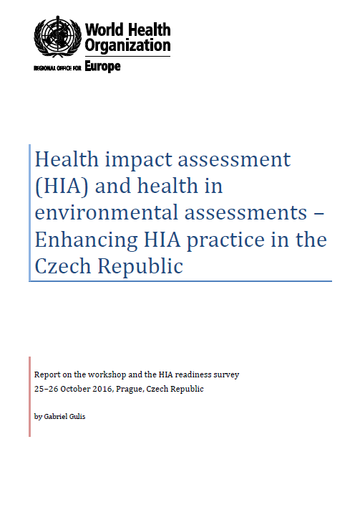
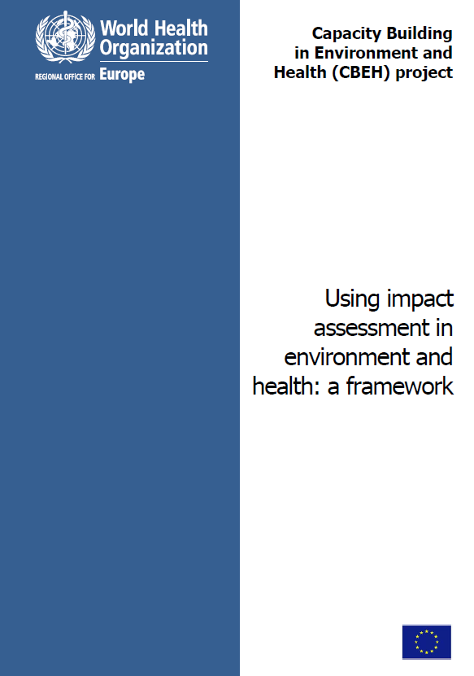
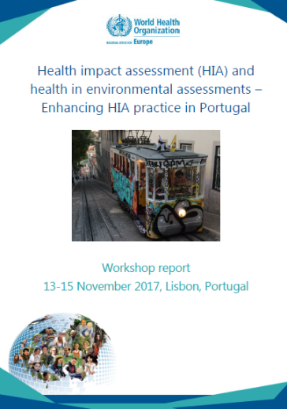
Capacity building activities
Capacity building workshops and policy dialogues
e.g. Czechia, Estonia, Latvia, Lithuania, Moldova, Poland, Portugal, Romania, Slovakia, Slovenia
Surveys on HIA readiness
Capacity Building on Environment and Health (CBEH) Project

Slide 10
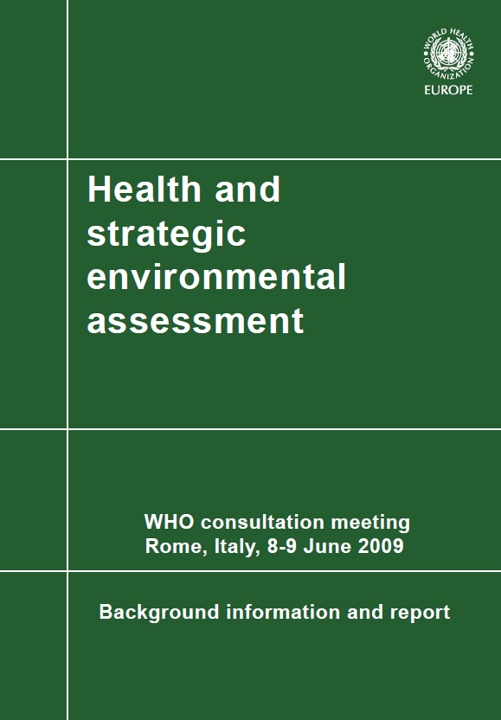
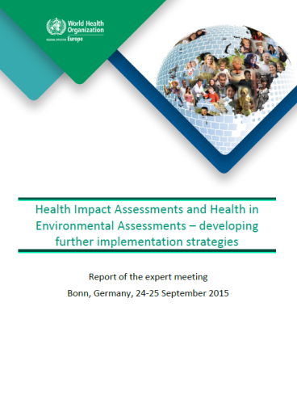
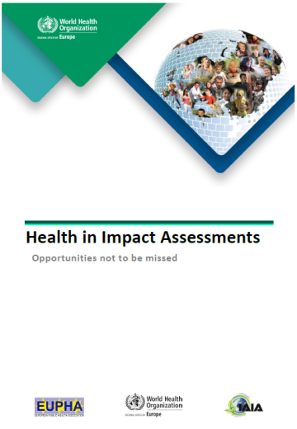
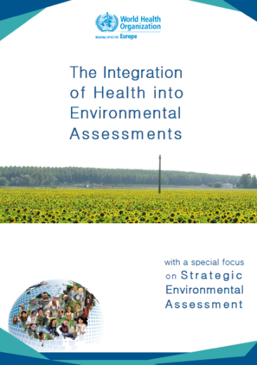
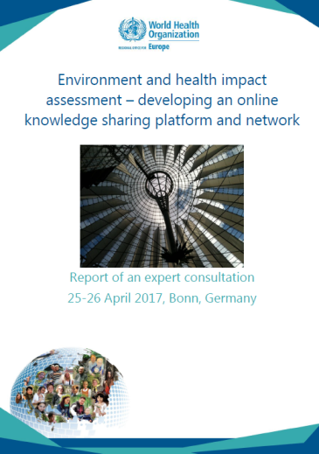
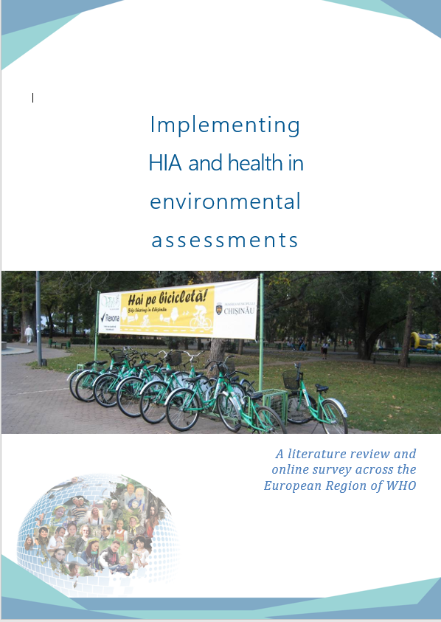
Networking and publications
Forthcoming
March 2019
forthcoming

Slide 11
HIA and health in EA online resources
www.euro.who.int
www.impactshub.com
Resources:
Case studies
Guidelines
Training
Glossary
Web-links (Library)

Slide 13
Case study review

Slide 14
WHO leadership in HIA and health in EA?
‘Transformational’ leadership, i.e. leadership which pushes thinking and practice outside the comfort zone in order to go beyond established (through e.g. guidelines) practices
e.g. bringing together E&H sectors
‘Democratic’ leadership, i.e. leadership which considers opinions of different experts / leaders in their fields and on that basis to continuously developing IA further to achieve best practice
e.g. networking & capacity building
‘Laissez faire’ leadership, i.e. leadership which leaves the decisions on ‘how to do it’ to the ‘community’ and provides minimum guidance; the focus may be on e.g. providing a platform for the community to discuss relevant issues
e.g. Member States need to adjust capacity building and implementation to their system

Slide 15
Thank you for your attention!
Julia Nowacki
WHO European Centre for Environment and Health, Bonn, Germany
Division of Policy and Governance for Health and Well-being World Health Organization Regional Office for Europe

