Slide 1




IA Leadership provided by a consultancy the case of Sweden
Charlotta Faith-Ell, WSP, Mid Sweden University and Estonian Environment Instiute

Slide 2
Basis of my presentation
Three research initiatives:
  SPEAK ( Sustainablity Planning and Environmental Assesment Knowledge)
  Impact Assessment – did it go as planned?
    Case study
    SEA of HSR Sweden
    SEA of HSR Rail Baltic
    Mode 3 approach
  ELEA (Environmental Leadership in Environmental Assessment)

Slide 3
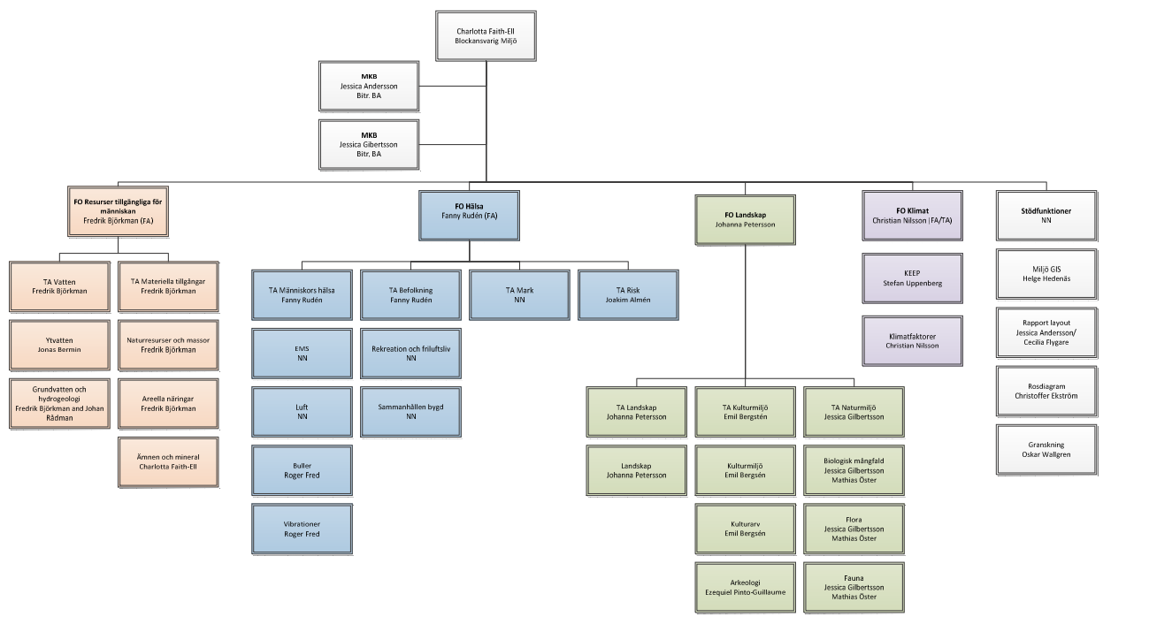
Environmental / Sustainable leadership in SEA
Sometimes mistaken for SEA management

Slide 4
Environmental / Sustainable Leadership in SEA?

Slide 5
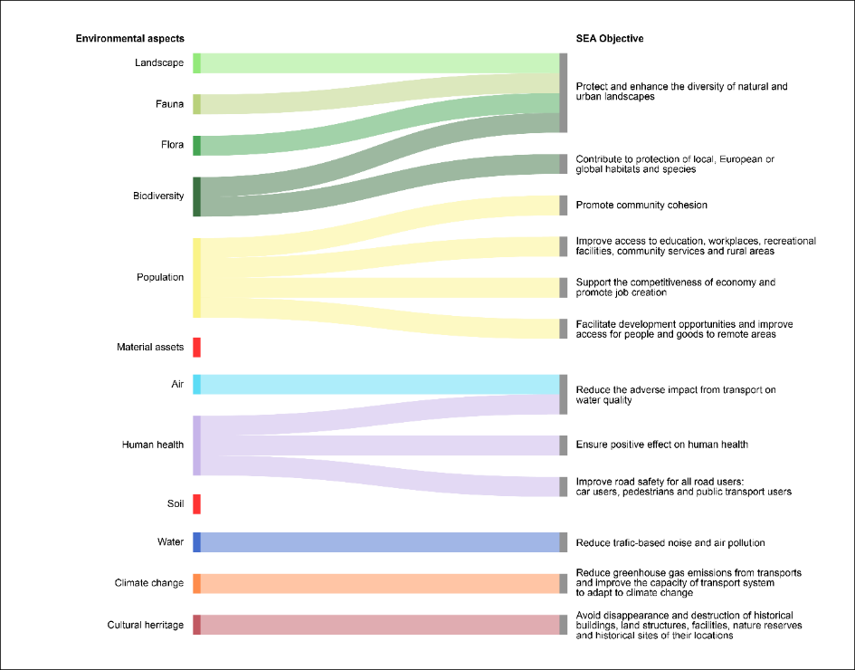
Environmental / Sustainable Leadership in SEA?
Deciding what is important or not – i.e. scoping

Slide 6
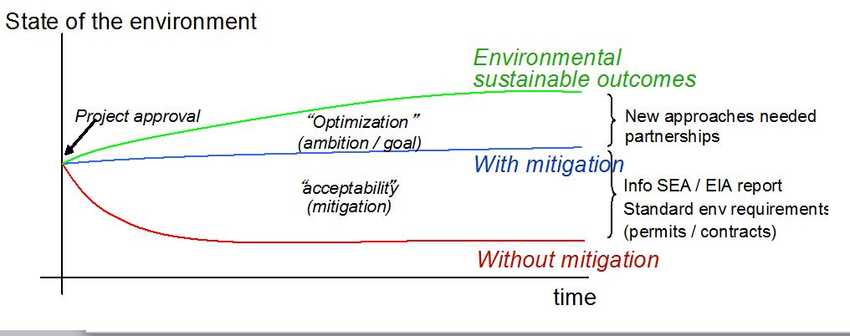
Environmental / Sustainable Leadership in SEA?
Deciding on the level of environmental ambition
(Arts & Faith-Ell, 2010)

Slide 7
Environmental / Sustainable Leadership in SEA?
Deciding on what constitutes fulfilment of an environmental objective

Slide 8
Fulfillment of objective
Contributes to fulfilment
Preferred state of the environment
Potential to contribute to fulfilment
Uncertainties concerning mitigation measures imply that the fulfilment is contradicted
Contradicts fulfilment

Slide 9
Fulfillment of objective
Preferred state of the environment
Contributes to fulfilment
Potential to contribute to fulfilment
Uncertainties concerning mitigation measures imply that the fulfilment is contradicted
Contradicts fulfilment

Slide 10
Fulfillment of objective
Contributes to fulfilment
Preferred state of the environment
Potential to contribute to fulfilment
Uncertainties concerning mitigation measures imply that the fulfilment is contradicted
Contradicts fulfilment

Slide 11
Fulfillment of objective
Contributes to fulfilment
Preferred state of the environment
Potential to contribute to fulfilment
Uncertainties concerning mitigation measures imply that the fulfilment is contradicted
Contradicts fulfilment

Slide 12
Environmental / Sustainable Leadership in SEA?
Environmental characteristics
Negotiating between various environemntal experts on what constitutes sustainability
Regulatory level
Perspectives
Integrated into
& Varied by
Applied at
Shaped by
Varied by &
Viewed from
Significance interpreting importance
Applied
level
Into EIA
process
Significance –interpreting Importance – narrow Definition
Impact characteristics
Significance
Determination
process
Integrated to
& Varied by
Bounded &
Directed by
Broad definition
Institutional arrangements
Applied
through
Approaches & methods
Adapted to
Context
(After Lawrence, 2007)

Slide 13
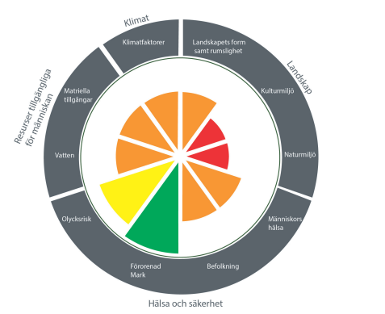
Environmental / Sustainable Leadership in SEA?
Deciding what is important and not – i.e. scoping / sieving
Deciding on the level of environmental ambition
Deciding on what constitutes fulfilment of an environmental objective
Negotiating between various environemntal experts on what constitutes sustainability

Slide 14
Change Leadership
Change leadership is the ability to influence and enthuse others through personal advocacy, vision and drive, and to access resources to build a solid platform for change (Higgs and Rowland, 2000).
Start of plan/project
SEA
Final plan/project

Slide 15
The trade of being a change leader in Impact Assessment
A change leader that has:
a clear understanding of one’s own core environmental values and principles, and how they impact on the role and that of the ESIA process,
a clear understanding of the values and principles of the other teams in the project/plan,
the right sets of skills to generate momentum, or get others on-board in mitigating environmental impact on behalf of yourself, the project and for the common good,
a high level of integrity.
(adapted based on Marshall (2018) and W. Hogg et al. (2018))

Slide 16
Who upholds the Environmental Leadership in SEA?
SPEAK-project
Statistical analysis of SEA of municipal plans – size (inhabitants, area), economy (tax, income), political majority, etc.
(Balfors et al. 2018)

Slide 17
Who upholds the Environmental Leadership in SEA?
SPEAK-project
Statistical analysis of SEA of municipal plans – size (inhabitants, area), economy (tax, income), political majority,etc.
Result: The most important factor for high quality SEA is the SEA team leader!
(Balfors et al. 2018)

Slide 18

A true IA leader
Bengt Eriksson

Slide 19
Thank you!
wsp.com

Slide 20
References
Arts, J. & Faith-Ell, C. (2010). IA in Green Procurement and Partnering Contracts. In: The Role of Impact Assessment in Transitioning Green Economy, 30th Annual Meeting of the International Association for Impact Assessment, 6-11 April 2010, Geneva Switzerland.
Balfors, B. ; Wallström, J. ; Lundberg, K. ; Söderqvist, T. ; Hörnberg, C. ; Högström, J. (2018). Strategic environmental assessment in Swedish municipal planning. Trends and challenges, Environmental Impact Assessment Review, Vol.73, pp.152-163.
Higgs, M. & Rowland, D. (2000). Building change leadership capability: The quest for change competence, Journal of Change Management, Vol. 1, 2, 116–130.
Lawrence, D.P. (2007). Impact significance determination — Back to basics, Environmental Impact Assessment Review, Vol. 27, pp. 755 – 769.
Marshall, R. (2018). 5 Questions on Leadership skills in EIA, LinkedIn, January 10, 2018.

Slide 21




