Slide 1



IN IMPACT ASSESSMENT
International Symposium 21 January 2019
University of Liverpool / Foresight Centre
Leadership provided by a membership-based organization – the case of Germany
Dr. Joachim Hartlik / Chairman of German EIA Association

Slide 2



EIA Association Germany
Organization
& Activities
Member-based NGO
Focus on EIA & SEA topics
EIA Congress
Open working groups
Comments on legislative proposals
Complaints
Products
EIA report
Guidelines & leaflets
EIA Trainings for young academics & job starters
Notes:
Sorry, that‘ just a short commercial Break and some advertisment for my association...
Organization
We are a classical independent NGO, financed by our 500 members (academics, planers, IA consultants, administration staff)
Our committee (9 persons) is attended by an scientific advisory board
EIA and SEA and environmental precaution are central issues – and how to implement them in practice & into decision making processes
our congress (250 – 300 participants) is organised biennial, next one in 2020
Working groups of specific issues are free for non members because they are knowledge- and result oriented
we prepare statements to official drafts and proposals concerning EIA & SEA related acts and administrative regulations (current topicc last week: draft of a regulation for the central EIA portals (EIA Directive 2014/52, Art. 6 § 5)
we do make appeals at the court of justiceof the EU – if we get the impression, that things in transposing EU Directives in national law are running in a bad way. Currently we appeal at the commission about the national building code, because the Construction Ministry underruns the obglitation to enforce EIA‘s & SEA‘s required by EIA and SEA Directive.
Products
our journal „UVP-report“ is published 4 times a year (articles are controlled by double blind peer review)
We publish guidelines and leaflets concerning specific questions in EIA and SEA – especially if there are new challenges or requirements through amendments of the EU Directives
every year we offer a Summerschool or an Tutorial, connected with the EIA congress

Slide 3
depends on ...
Authorization
Knowledge (Theory)
Willingness
Capacity & Ressources
Experience (Practice)
Notes:
Before starting with the view at the different types of leadership we face in our countries, short remarks to some aspects of „Leadership“, we should bear in mind in our discussion.
Authorization
– Leadership needs as a rule an official order or a mission to be respected. If not taken bei the responsible body (e.g. MoE), other bodies should take responsibility by ...
Knowledge
... and ...
Experience
like our EIA Association in Germany.
Capacity
Leadership needs capacities and ressources constantly, so the size of the body or institution should be sufficient.
Willingness
Last but not least the body should have the willingness for Leadership, means to be debatting, tough enough to stand disagreements in discussions and hold a view.
Talking about IA Leadership in Germany now the next minutes, I‘ll focus on EIA & SEA and our Experiences in almost 30 years.

Slide 4
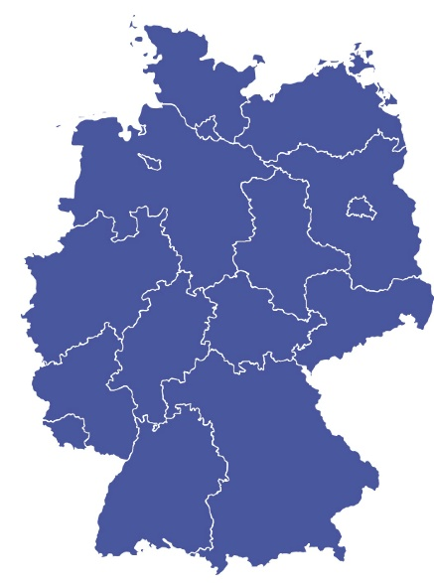
IA Leadership in Germany
1
Autocratic
2
Transformational
3
Democratic
4
Laissez faire
5
Transactional
6
Bureaucratic
Notes:
First of all – YES, we have all types of Leadership, Thomas shortly described in his paper.
And second:
The listed types of leadership are different – from sector to sector, from federl state to federal state.

Slide 5
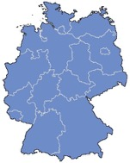
IA Leadership in Germany
1
Autocratic
MoE is responsible (in autocratic manner) for
transposition of EU Directives
national legislation process
implementation regulations
No real sign of leadership or creative drive for IA in MeO
EU court decisions against Germany
great impact of lobbying
EIA only for major projects (Annex I)
Body: Federal Ministry of Environment (MoE)
Scope: IA in general
Notes:
Looking at the first type of Leadership – the Ministry of Environment should be inspected closer. The MoE is responsible for the Implemenation of EIA & SEA in national law by it‘s legislative role.
My proposition: there isn‘t any sign of real willingness for leadership or creative drive in the MoE – neither in the EU nor on national level.
The last 3 times, the EU Directive was amended in greater extent, the ministry failed in proper and timely implementation of changes in German law.
By the way: Rembering the start with EIA in Germany, our government needed up to 1994 implementing the EIA Directive completely into German Law – the transposition deadline was 1988!
The important implementation regulations (UVPVwV) are not adjustet to the major changes in EIA Act the last 23 years at all!
Our main problem in Germany: The EIA Act has become more and more complex – some say, that the regulations are so sophisticated, that law enforcement by the competent authorities without risk of legal complaints seems hardly achievable. So everybody tries to avoid EIA‘s.
Starting with 22 Paragraphs, our EIA Act now comprises 74 Paragraphs.
There are quite a lot of sucessful and substancial decison at the EU court against Germany, so German Government had to adjust the EIA Act and relevant other acts several times.
Commercial associations have a great impact, especially on environmental policy and legislation. E. g.: Only 2 month ago, in Bavaria – our very special federal state in the south east corner of Germany – an advisory circular has been sent to all relevant liencing authorities by an engaged senior official. Message: Please stop the procedure of pre checks or case by case examinations for minor projects which in a rule reject the obligatory EIA. New Motto: „In case of doubt concerning the significance of expected impacts – carry out the EIA!“ Same kind of circular in North Rhine Westfalias Ministry for roads and Transport still exists.
After a couple of weeks, a member of an commercial assocciation noticed that and called directly the bavarian environmental minister. Two hours more, and that circular was history.
All in all: The Ministry of Environment seems to weak und continuously to be under pressure by the other Ministries, who tries to undermine their responsibility for IA, and trying to avoid especially EIA whereever it goes.

Slide 6
IA Leadership in Germany
2
Transformational
EIA Association Germany
  providing information to establish a more comprehensive view to IA
  developing IA in a more precautionary way regarding advanced standards
FGSV (Road and Transportation Research Association)
  providing guidelines & recommendations
  detailed technical specifications for EIA reports, methodologies & maps
&
3
Democratic
Bodies: e.g. Committees, Associations
Scope: IA in general or sectoral area
Notes:
These two types of leadership I decided to bundle because I don‘t see that big differences. But maybe I‘m wrong and didn‘t catch the right sense of Thomas ideas.
With this type of Leadership, the EIA Association could be linked quite good.
As I showed already at the start, we provide infomation four our members and all other actors within IA Processes with useful information, trying to establish a good practice in EIA & SEA.
Other Associations do the same, for example Road and Transportation Research Association. The recommendations and regulations from this body – like our association a charitable organisation – are of much more official character, because there are a lot of different committees and boards and more than 2.500 experts. The Guidelines concerning EIA and SEA in road and transport sector are usually recommended by the transport ministry.
Forschungsgesellschaft für Straßen- und Verkehrswesen (FGSV) =
Different Working Committees, 2.500 members from Adminisitration, Economy, Science

Slide 7
IA Leadership in Germany
4
Laissez faire
No sign of overall IA harmonization
  EIA is dispersed in sectoral laws, separate legislative provisions
No real support of the competent authorities by MoE federal level
Unsatisfying IA practice
  almost no EIA for minor projects (Annex. II of EU-Directive) after ‚case by case‘ examination
  no consideration of cumulative effects because of too much legal barriers
Body: Federal Ministry of Environment
Scope: IA in general
Notes:
As the body preferring this type of leadership, I also identified the MoE. So the Ministry has two faces:
on the one side, the new EIA Act from July 2017 is prepared in an autocratic manner with – comprehensive and substancial comments by the enviromental NGO‘s were more or less ignored. The act itself is characterizised as a detailed instruction of what to do and how to do – with little space for leaving this way.
on the other side, EIA and SEA has to be intgrated in the different licencing procedures which are linked to other sectors like transport, cobstruction, emission control, mining. The competent ministries and authorities are transposing EIA and SEA strictly in their own law with separate implementing provisions. There is no sign of harmonization of all the different regualtions by the MoE.
Unsatysfying – because missing the leadership of MoE – is the support of the competent authorities, trying to enforce the law.

Slide 8
IA Leadership in Germany
5
Transactional
Chamber of Industry & Commerce
  accreditation of EIA experts for different sectors (rare)
Expert Organizations
  e.g. organization of bat experts for wind farms is preparing a quality seal
German EIA Association
  considering a general code of conduct or a seal for expert members
Bodies: Chambers of Industry & Com-merce; Expert Organizations
Scope: IA in general and sectoral areas
Notes:
Transactional leadership is understood as a way, to provide a seal or any kind of accreditation form for experts or institutions, you can expect a good quality of expertise.
In Germany, this way in IA relevant sectors is not popular.
Bymeslf I took the way and decided to apply for EIA expert status at the and chamber for industry and Commerce in Hannover.
Some experts are now organising to establish an own certificate, based on a specific expert rules to be strictly followed.
Also the German EIA Association is thinking about a seal or a code of conduct for its members like the IAIA. But that one is quite smooth and flexible, without specific IA requirements.

Slide 9
IA Leadership in Germany
6
Bureaucratic
EIA integrated in licensing procedures for emtting projects according to federal immission control act
this procedure is a „conditional decision“ – meeting specific requirements and legal environmental limits ➔ permit
no efficient way for integrating other impacts in the decision making process like immissions
Bodies: Immission Control Authorities
Scope: Energy Industry, Emitting Industry
Notes:
For this type of Leadership, I have choosed an example from a specific scope of IA – the immission control sector. The German authorities there have a specific relation to EIA and their own interpretation of what to do in IA.
They have their own EIA implementation regulations – most of the time its just a copy word by word from the regulations of the EI act (because they refuse to look at the EIA Law).
The limited way of this approach is unique and some experts mean that‘s not in line with the EU law because all results of an EIA process and all kinds of environmental effects have to be concered in the decision making process... Maybe another case for an appeal to the EU court of justice.
Regarding this, the EIA procedure in this sector is very bureaucratic and there is usually no space for looking beyond legal standards oand leaving the comfort zone of the immission control law.

Slide 10


The German EIA Association
– Leadership in IA in Germany?
1
First step – identification
Identification of
gaps in the national EIA & SEA regulations
practical problems in legal enforcement
methodological questions
Notes:
As I tried to show, we have different kinds of Leadership in IA in different sectors. How and in which field can a NGO like the German EIA Association take responsibilty and a leading role in IA?
Gaps in national implementation:
We attend the legislative activities of EIA & SEA relevant new bills with a critical eye to ensure full compliance with EU legislation. We don‘t hesitate to report at the EU Commission if EU law seems to be not fulfilled
Practical problems in legal enforcement
Competent authorities more and more get problems by law enforcement because of unmanageable complexity of EIA act – and no implementation regualtions are provided by the MoE. (E.g.: The case by case examination for projects according to Annex 2 Projects of EIA Directive is regulated by 7 single paragraphs resulting in 25 different case groups with different handling!
General methodological questions
E.g. how to operationalize the new environmental factors „population“, „land“ and „vulnerability of projects to climate change“
Are there pracical approaches for EIA Reports?
How to handle with cumulative effects by different projects?

Slide 11




The German EIA Association
– Leadership in IA in Germany?
2
Second step – information & guidance
setting up an expert working group
preparing practical guidance
distribution and expert discussions
Notes:
Setting up an expert working group
Setting up an working group for identified issues, looking for interested experts is the first step.
Preparing practice oriented guidance ...
... Means developing guidelines & leaflets for procedure steps, operationalizing new factors and contents for the EIA report or for methodological approaches
Distribution and expert discussions
Not only publishing the results (papers, website) but also presenting them on meetings, congresses, comissions and so on is important!

Slide 12

Activities of German EIA Association
Done
Current activities
>
Guidelines on good quality in EIA
>
Vulnerable groups in EIA (leaflet)
>
Guidelines on health in EIA
>
Evaluation of health effects (leaflet)
>
Guidance on cultural heritage
>
EIA-Portal - collecting case studies
>
Cumulative effects in SEA (leaflet)
Planned
>
SEA basics (leaflet)
>
Guidelines on climate change in IA
>
New environmental factor „land“
>
Seal/code of conduct for members?
Notes:
You can see in an overview of some of our past, current and planned activities.

Slide 13
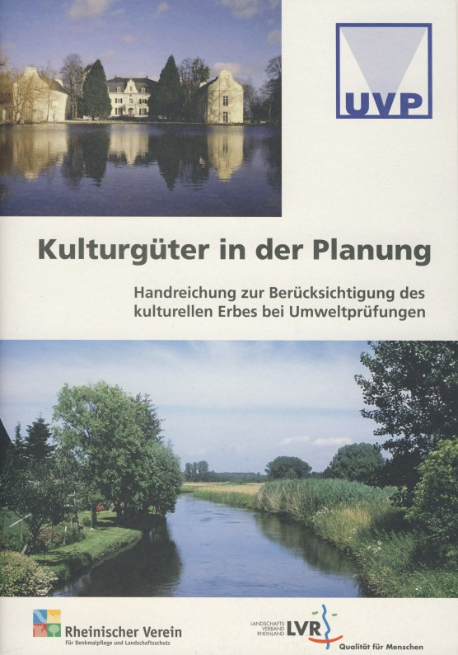
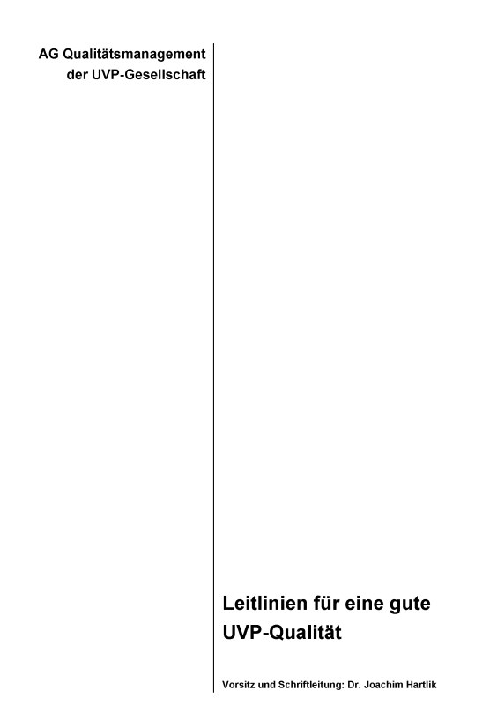
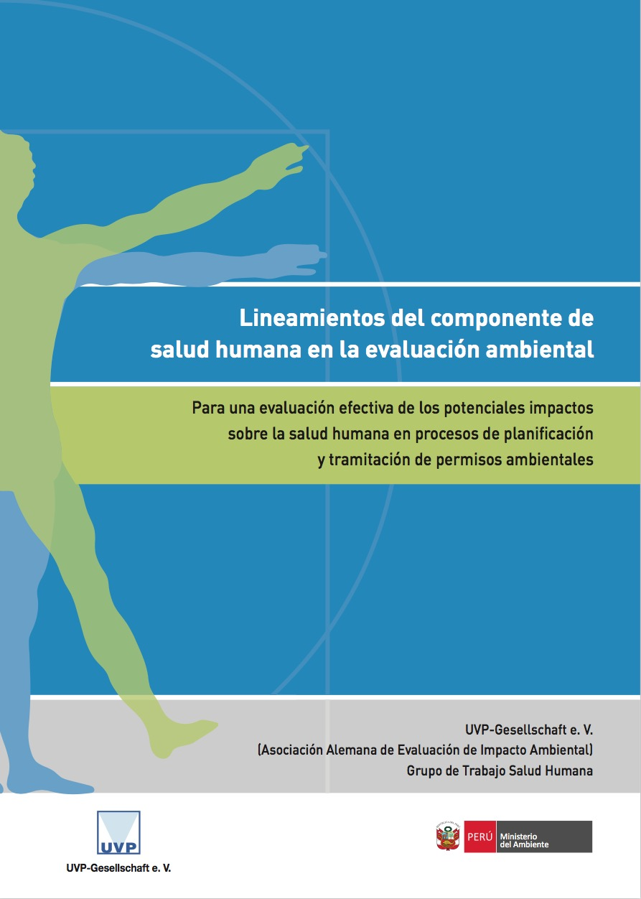

Slide 14

ConclusionS
>
By the Ministry
  setting basic rules and a clear framework for process & contents
  harmonizing IA‘s in different application areas & sectors
>
By Expert Committees & Associations
  specifying quality standards and methods establishing a good practice – sector by sector
  deceloping IA to an instrument of precautional princip considering more ambitious environmental quality standards
Notes:
Ending with some coclusions...
YES, we need Leadership...
IA is not an obstacle but a chance for a better future
In my point of view thats a major reproach to the Environmenatl Ministry and to the Economic Associations as well: Despite the fact, that in 28 years of EIA in Germany no project is ever stopped bei EIA, this intsrument is still perceived as an Evil and a tool to prevent from public or private economic investments.
But in some authorities and under some investors arises a countermovement:
EIA as an opportunity to ensure legal security – and broader acceptance in the public.
Authorities are recommending: in case of doubt > better EIA! No more avoiding IA becuase of minor character of a project.

Slide 15


