Slide 1
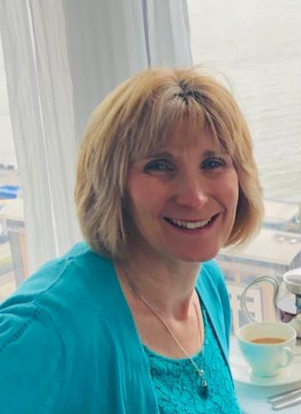
Karen Ryan. B.Sc (Hons) MIScT Rsci (Science Council Registrant champion )
“My secondment opportunities whilst working at the University of Liverpool: From Grade 3 to Grade 5.”
My Background:
University of Liverpool: Core technician (2013-present).
Secondary school science technician (2004-2013)
Senior microbiologist: Medipure (2002-2004).
Research Microbiologist: Unilever (1989 – 2002)
Laboratory technician: Bristol Myers Squibb (1988-1989)
Notes:
Hi, I’m Karen Ryan and I’m a Grade 5 core support technician in IVES in the department of Clinical infection, microbiology and immunology in the Ronald Ross building.
I’ve worked at the university for almost 10 years and my talk today is about my experiences with 3 secondments that have helped me get to where I am today.
Over the last 34 years I have worked in a variety of areas as you can see starting out as a lab tech at 16 and becoming a microbiologist a few years later.
I wanted to work in a lab from a young age and probably from watching Quincy as a child (for those of you old enough to remember the TV show about a pathologist come detective) this planted the seed.
Even when my 2 daughters were younger I worked as a school science technician to give me work life balance, give me time off in the holidays, yet still have a science career.
I always wanted to further my career and return to working in research labs.

Slide 2
2013-2021: Grade 3 core technician at Leahurst.
Running the autoclaves, making agar, waste disposal and responsible for wash up area.
PAT tester.
Maintaining the tissue culture lab.
Writing SOP’s for my areas.
Defrosting freezers.
Maintaining the communal store.
Shadowed team members to upskill and learn PCR and tissue culture techniques.
Occasional microbiology support work for Campylobacter and Salmonella projects; Miles and Misra, serial dilutions, tissue collection.
SAFtPAK trained.
Notes:
I started at the University in 2013 as a grade 3 core technician on the Leahurst campus.
A friend had told me about this post so I applied and was offered the role.
My journey could now begin.
This is a list of my core duties but if I had any spare time while waiting for autoclaves to cool down or agar plates to set then I would shadow colleagues to upskill learning PCR and tissue culture techniques.
I attended training courses and covered for my team in their absence too.
As a microbiologist, I was also, on occasion, given the opportunity to assist with some lab work and utilise my skills.

Slide 3
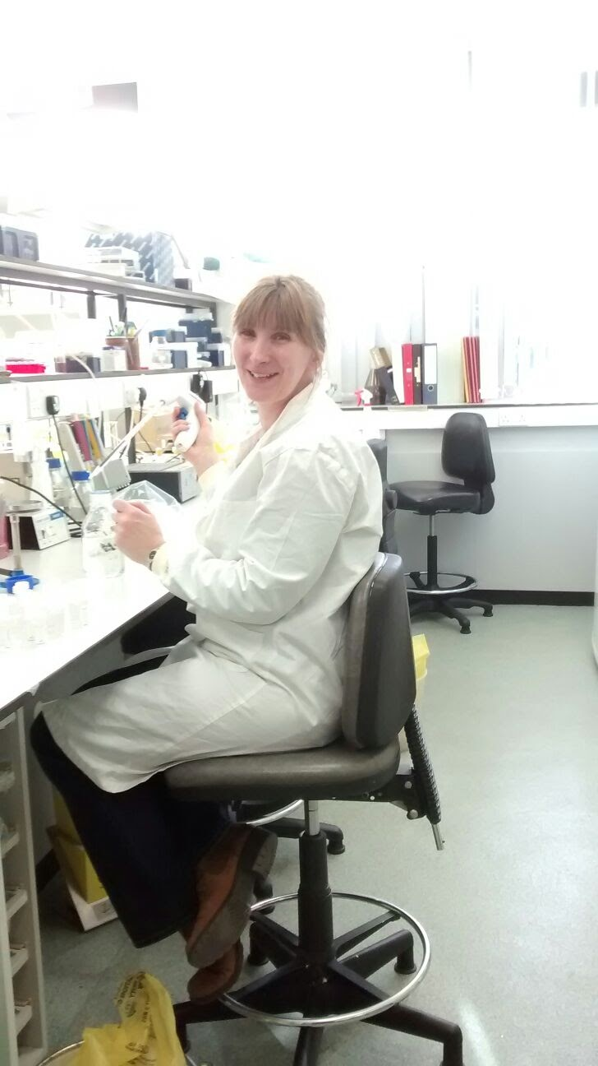
2016: First secondment opportunity: Maternity cover.
Grade 5 core research tech at Leahurst
Maintaining research CL2 and CL3 labs.
Lab inductions, training students.
Setting up experiments for the veterinary students’ public health rotations.
Working with Bio vet and vet students during their lab project work.
Direct attachment work: Campylobacter and Salmonella studies with post docs / PhD students.
Working at CL3 looking for TB in road-kill badgers.
Microbiology lab, Leahurst campus.
Notes:
A member of my team that I had shadowed went on maternity leave and I applied for her maternity cover.
The option of secondment was explored, agreed and my role backfilled.
This post gave me the opportunity to work more in the lab taking on more responsibility and working with students on their honour’s projects.
I looked after CL2 and CL3 labs and assisted with tissue collection from road kill badger carcasses to look for TB at CL3.
I returned to my Grade 3 role and continued to take every opportunity to upskill where possible.

Slide 4
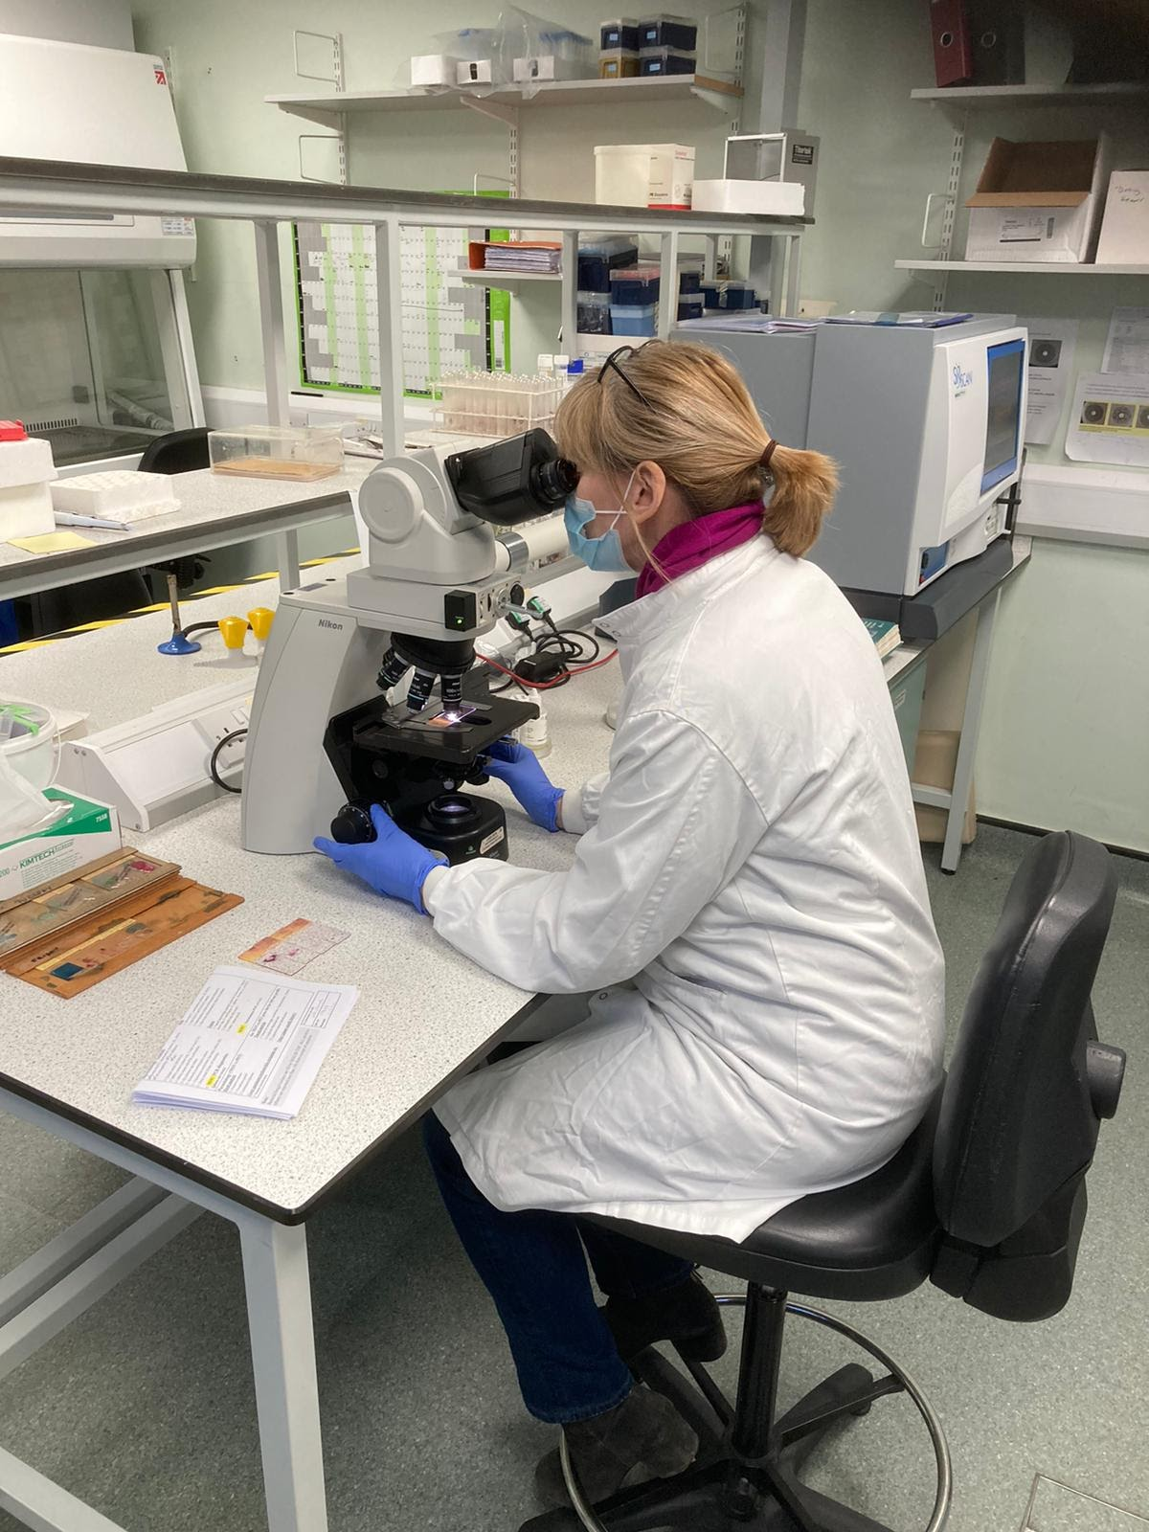
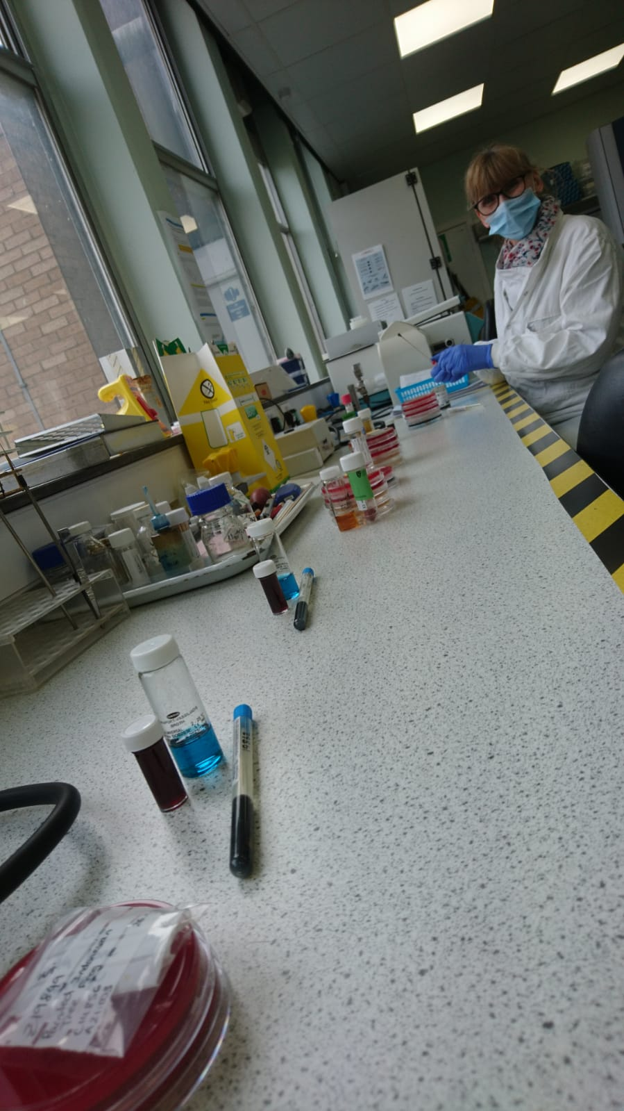
2020: Second Secondment opportunity: Maternity cover.
Grade 5 Research Technician:
Veterinary Microbiology Diagnostic laboratory
– Leahurst campus.
Culturing of isolates from clinical samples;
wound swabs, hair samples, urine, faeces, milk, blood cultures and post mortem samples from the animal hospitals, farm practice, Chester zoo and external veterinary practices.
Identification of isolates using MALDI-Tof spectrophotometer.
Antimicrobial sensitivity testing.
Minimum inhibitory concentration.
Reporting results to clinicians.
Looking at Gram stained slides.
Setting up clinical samples.
Notes:
3 years later, I applied for a maternity cover microbiologist role in the veterinary diagnostic lab at Leahurst.
My grade 3 role was backfilled. Within 6 weeks the Covid pandemic struck and I was working from home then furloughed.
By July I was back in the lab and continued to learn a range of diagnostic techniques, listed here.
We were able to look for and identify infections such as Salmonella in horses, mastitis in cows, urine infections in dogs, skin infections in cats and even snakes from Chester Zoo, to name but a few.
Microbes identified were tested against a range of antibiotic panels and the clinician informed of the results so that they could select the correct course of treatment.
I also cultured bacteria from post mortem animal samples to assist the clinicians with the cause of death in some cases.
The role was demanding but very interesting work.
After this cover I returned to my Grade 3 post for a few months.

Slide 5
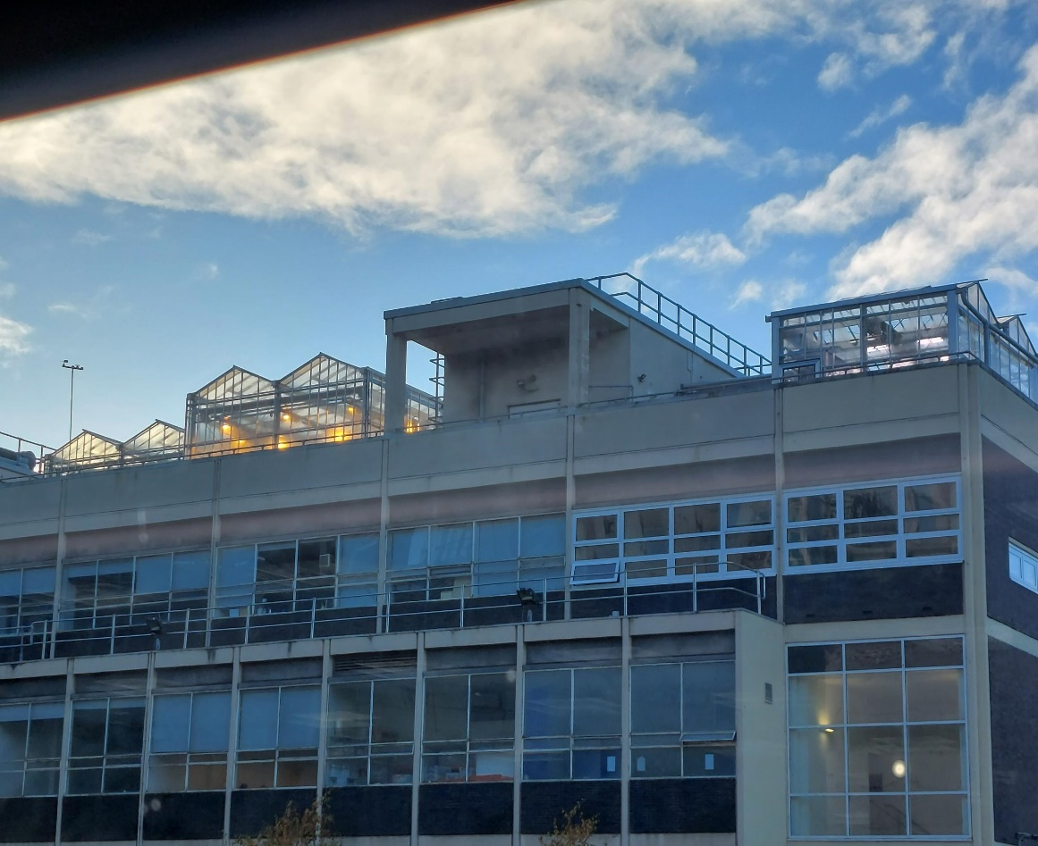
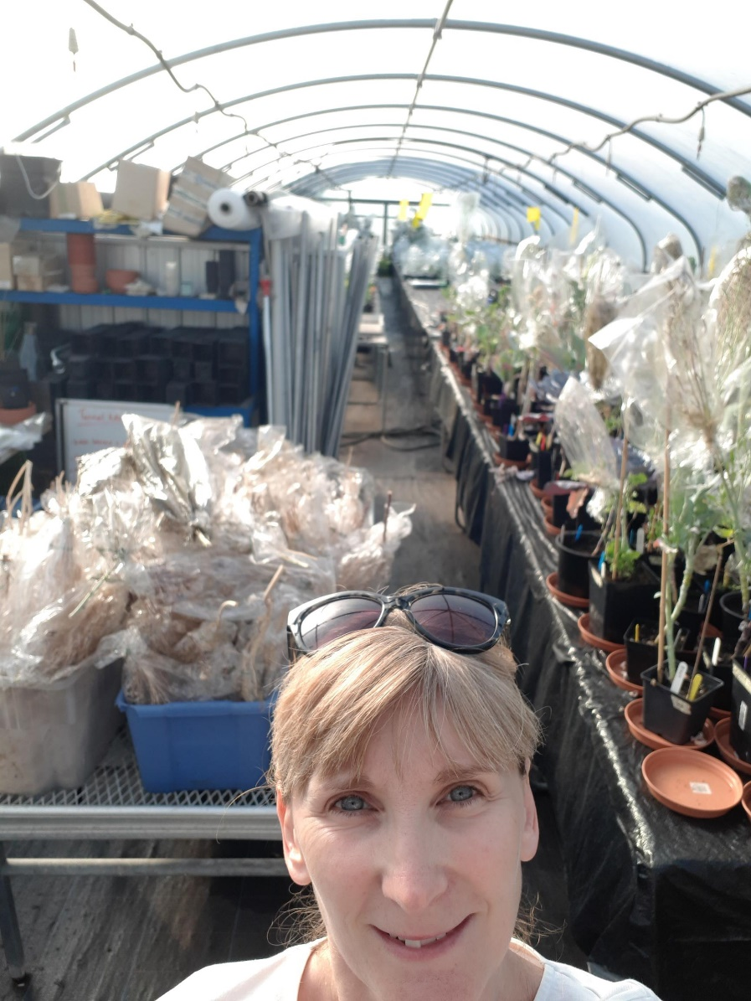
2021: Third Secondment opportunity: Maternity cover.
ISMIB. Grade 5 Plant technician.
Maintaining glass houses, plant growth rooms and polytunnel.
Watering schedules for Kalanchoe plants, brassicas & taking cuttings.
Kale plant trials / root measuring and root washing.
Seed cleaning.
Photographing leaves with students.
Maintaining an aphid colony on barley plants.
Plant tissue culturing.
Maintaining the tissue culture labs.
Glasshouses on the Life Sciences roof
Polytunnel, Woodpark farm, Neston
Notes:
A colleague spotted a maternity cover role in ISMIB for a core technician to look after plant collections and the glass houses.
I’m a keen gardener with a green house at home and I grow veg from seed and grow many types of fruit.
I certainly had the practical skills needed for this role.
I applied and was offered the role.
My institute back filled my role and I was seconded from IVES to ISMIB.
This was a completely different role to anything I had done before and every day was different.
I had handover training before the person went on maternity leave and I was trained how to do plant tissue culture, cleaning seeds and all sorts of things listed here.
I also looked after plants in the polytunnel in Neston on Wood Park farm.

Slide 6
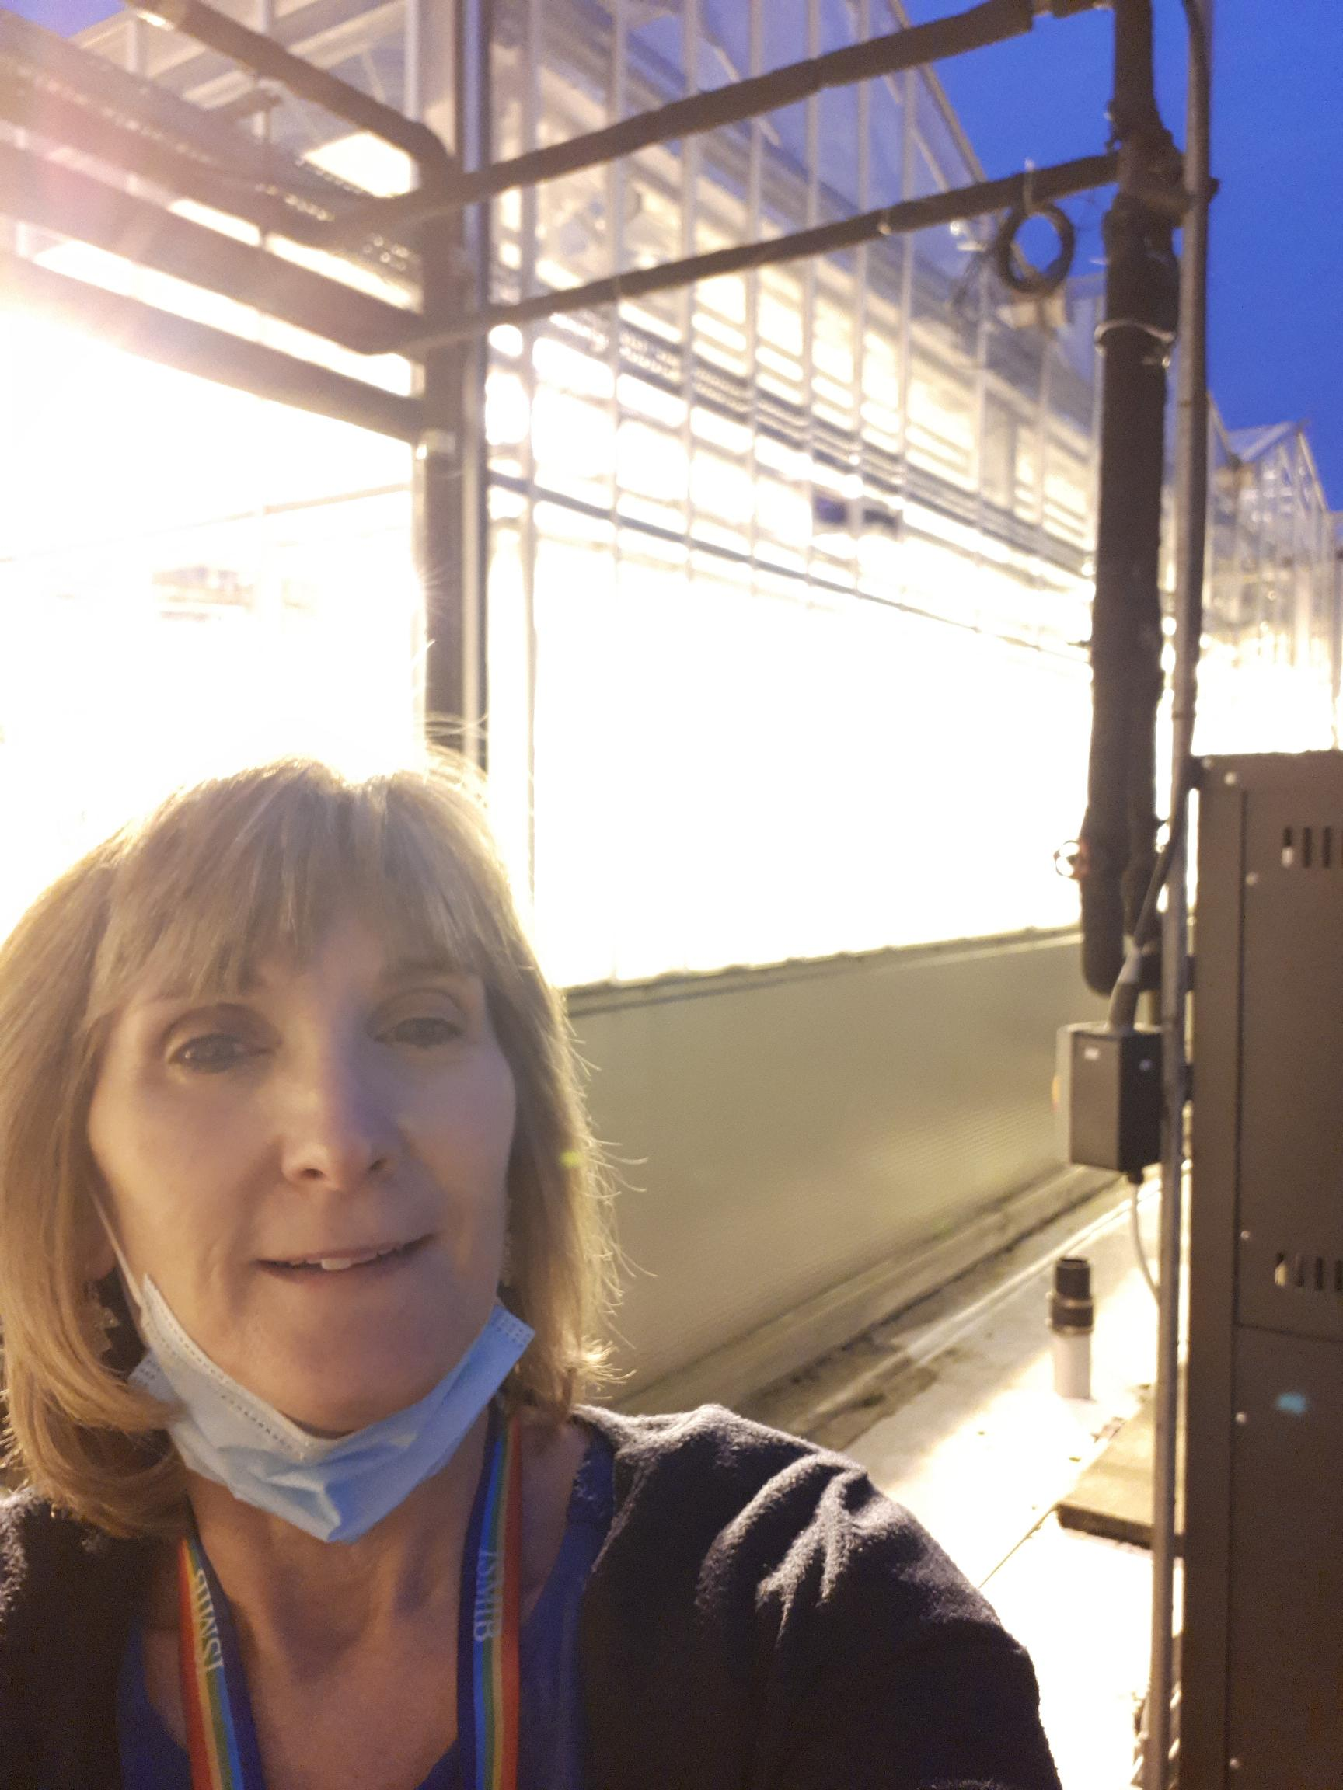
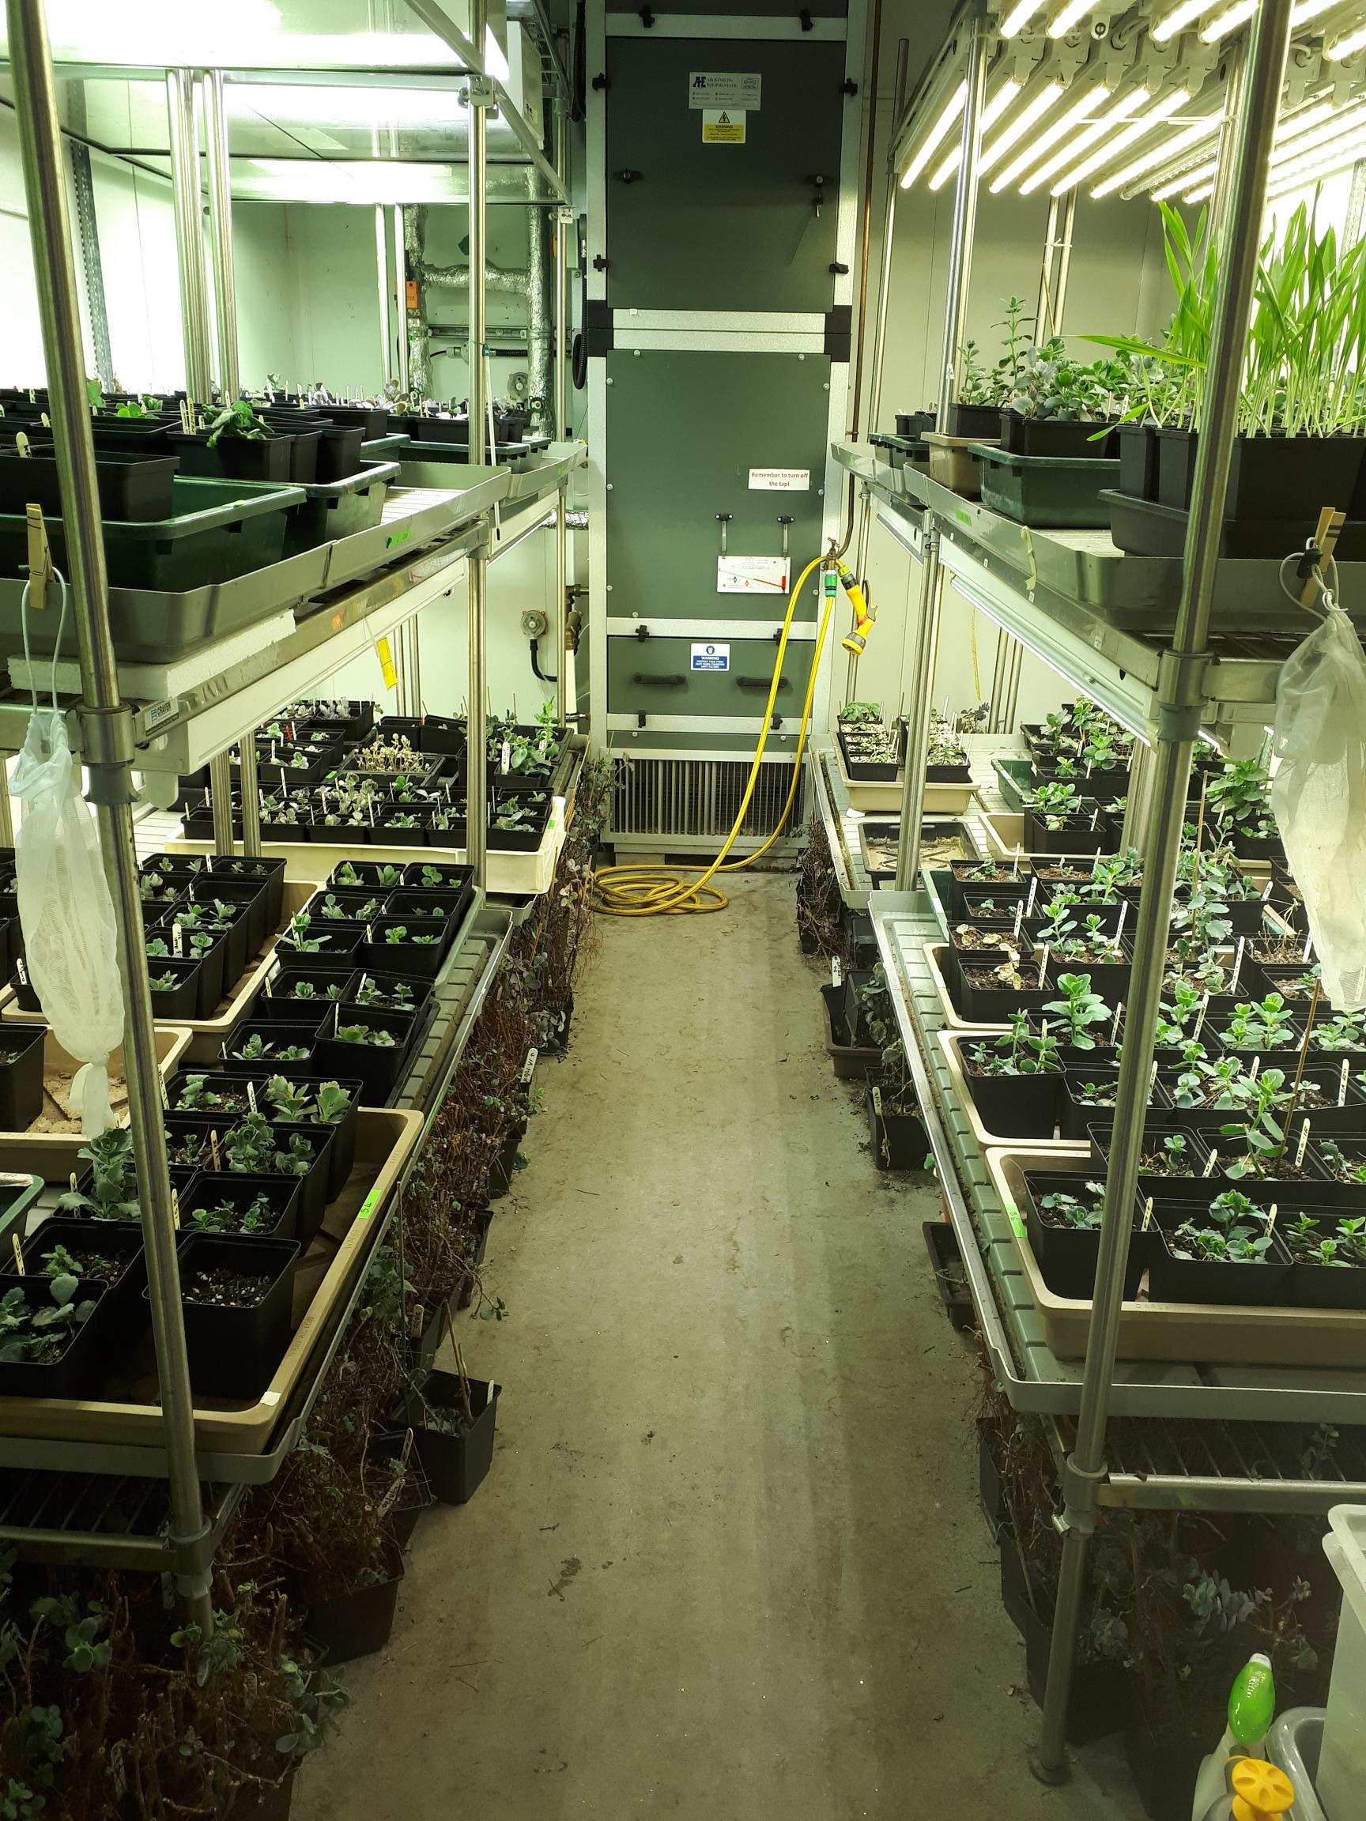
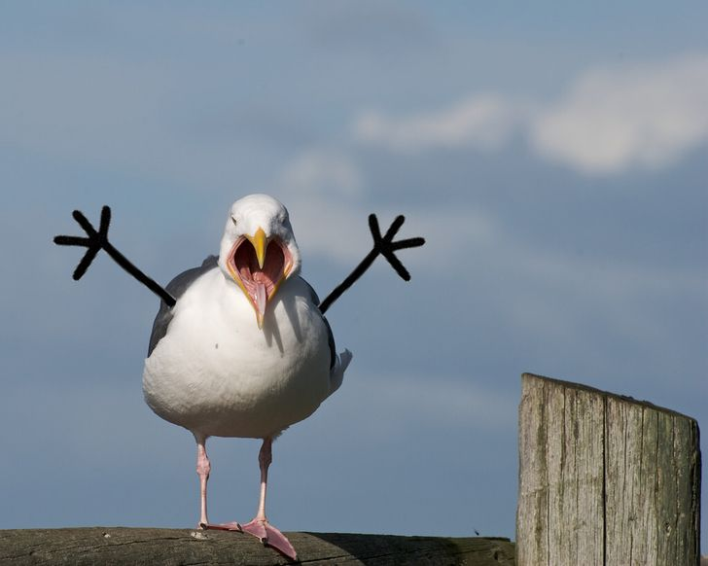
Dodging seagulls on the roof
Early morning trip onto the roof to check the glass houses and boilers.
Plant growth rooms
Notes:
Here’s a few more photos from my time in this role.
I also maintained the plant growth rooms ensuring the lighting and temps were maintained.
Going onto the roof to check the glass houses could be a bit scary as I had to dodge the seagulls that had nested out there and were protecting their chicks.
You needed a good head for heights!

Slide 7
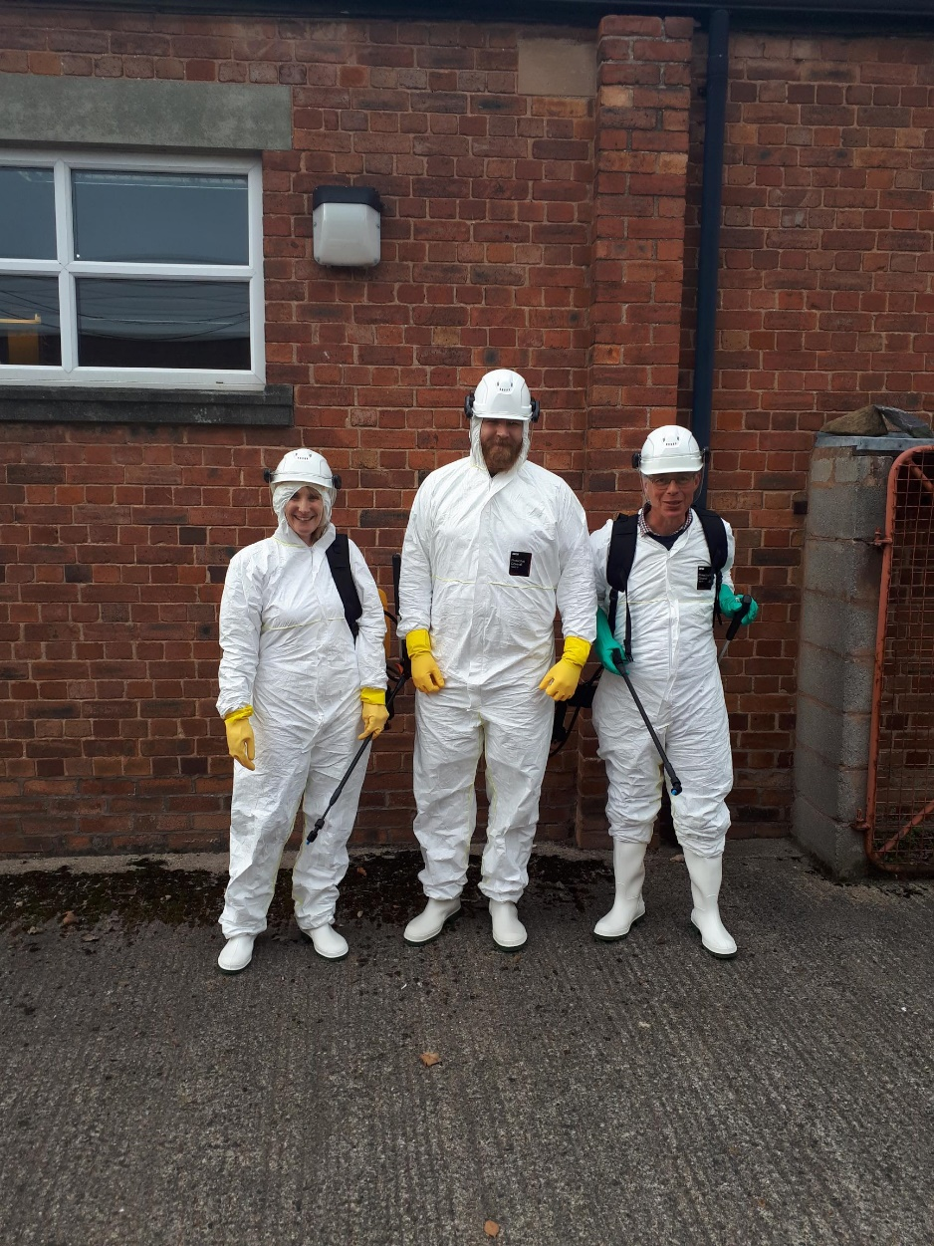
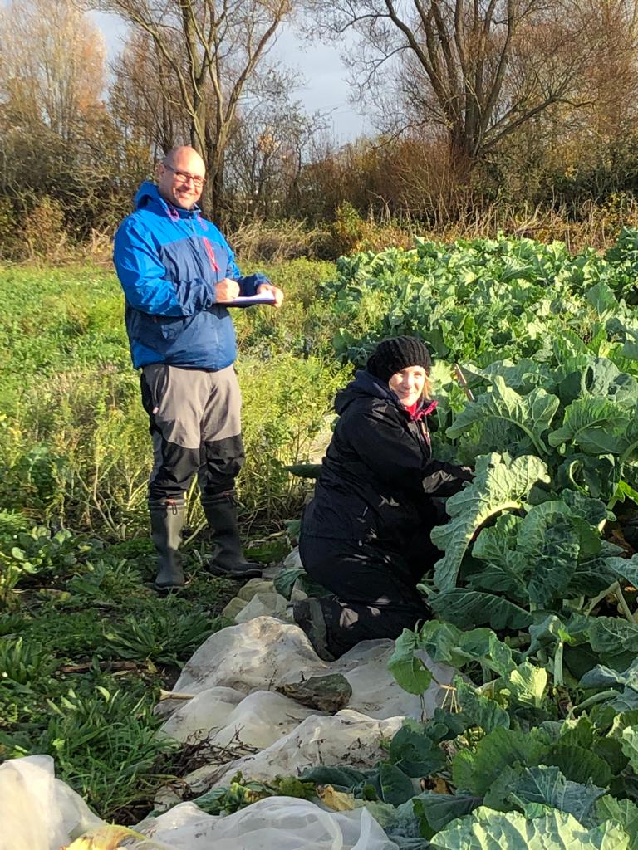
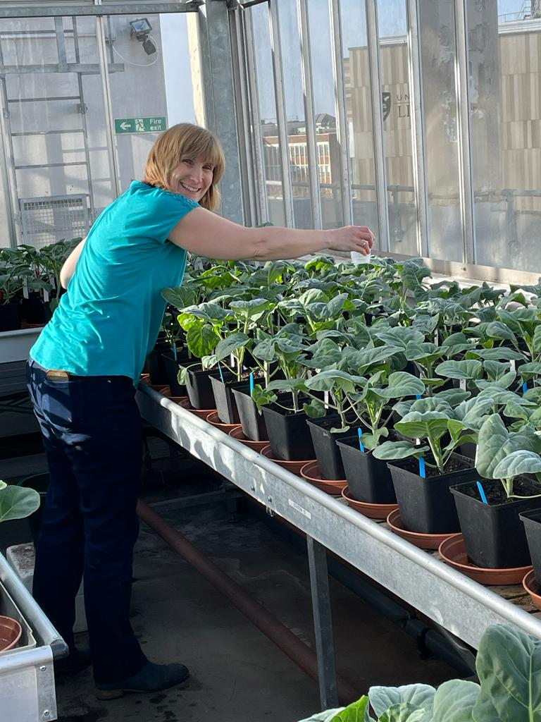
Pesticide spraying course with
Paul Loughnane & Greg Dykes.
Coleg Cymraeg, Northop, North Wales.
Kale plant trial in Ormskirk:
Measuring plant height,
width and leaf colour.
Peter Walley’s team.
Kale salinity trial. Roof
Glasshouses, Life Sciences.
Notes:
Here’s a few more pics.
No, it’s not the ghost busters but the PPE we needed to wear for the pesticide spraying training.
This training was essential because if there was an insect infestation in the glass houses it could ruin valuable plant collections.
To spray these types of pesticides it can only be carried out by a qualified person.
The secondment was due to finish in June this year but I applied for and was offered a permanent Grade 5 role back in IVES based in the Ronald Ross on the core team.

Slide 8
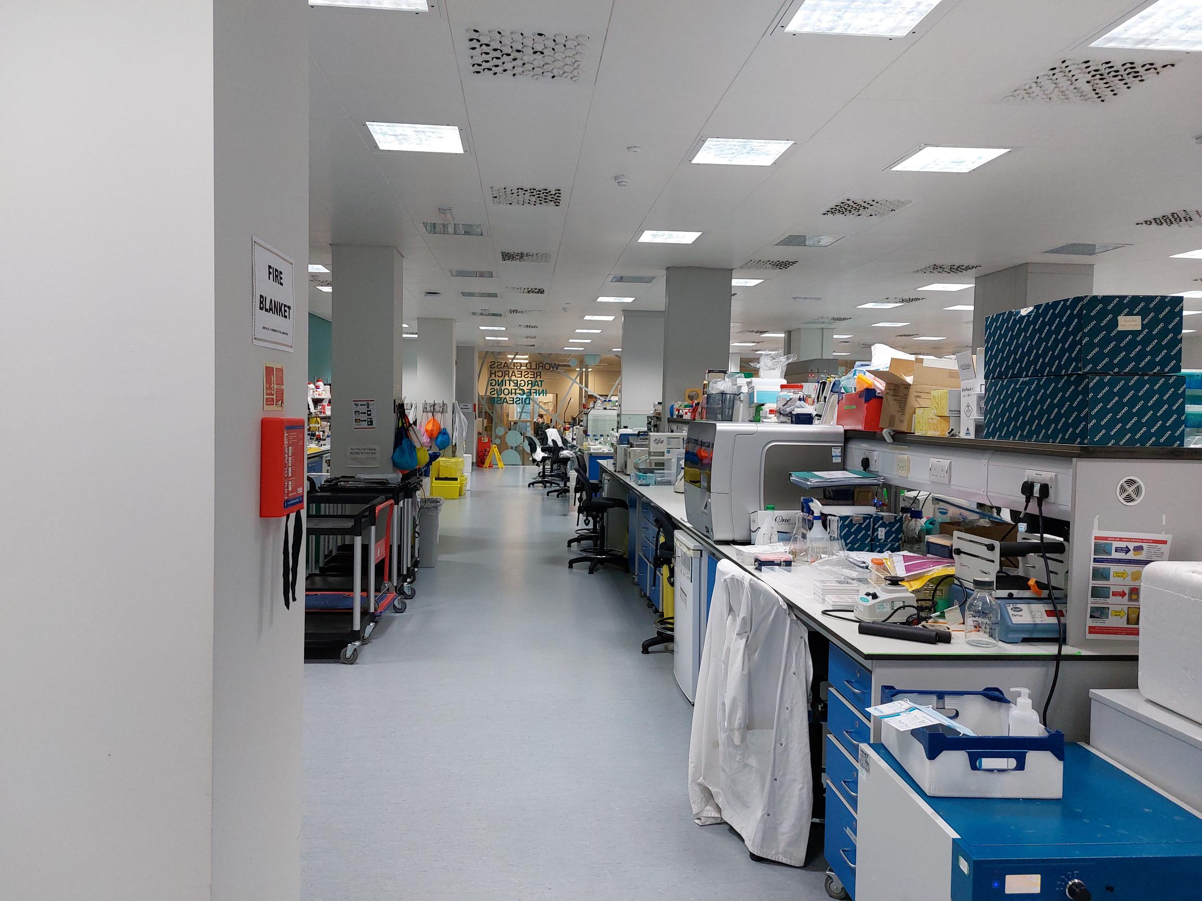
April 2022 – present
Grade 5 Core technician.
Ronald Ross Building,
Clinical Infection, Microbiology & Immunology (CIMI) IIVES:
Maintaining the research labs / tissue culture labs.
Direct Attachment work: ELISA testing for Rotavirus antibodies
in clinical serum / plasma samples.
(Nigel Cunliffe group / Dan Hungerford / Khuzwayo Jere).
Working with Jenna Lowe.
FACS flow cytometer maintenance and CST beads set up.
Student training.
Routine Mycoplasma testing.
SAFtPAK trained:
Checking and signing off biological samples for transport by courier.
CIMI laboratory
Notes:
I’ve been in this role for 8 months and it is going really well.
I provide technical support to CIMI colleagues and I have a direct attachment project that I work on with Jenna Lowe,
using sandwich ELISA testing for rotavirus antibodies in serum and plasma samples.
I maintain and set up the flow cytometer, train students and carry out routine mycoplasma testing.
I’m also SAFtPAK trained and I am starting to sign off on my own for courier transport.
I did this training a few years ago at Grade 3 but this has been the first time that I am able to put it into practice.

Slide 9
Acknowledgements and thanks:
Leahurst Core tech team (IIVES):
Shirley Bonner
Dave Jones
Sue Jopson
Jenny Llewelyn
Ken Sherlock
Veterinary Diagnostic team (VAPP):
Christine Ellis
Iuliana Maciuca
Dorina Timofte
Andy Wattret
Ronald Ross Core tech team (IIVES):
Alison Baker,
Felipe Cia Viciano, Debbie Howarth, Chris Jones, Trevor Jones, Erwan Trochu,
Eve Wilcock.
IC2: Cathy Glover / Jenna Lowe.
Biochemistry and Systems Biology team (ISMIB):
Aron Barrass
Greg Dykes
Alex Holme
Paul Loughnane
Jade Trueman
Technical Supervisors / Managers / Heads of Operations:
Jane Armstrong
Jan Brett
Kevin Cham
Clare Kenny
Adele Maggs
Jo Parker
Notes:
I would like to thank the following teams of people who have helped me since I started at the university and during my secondments.
Many conversations were had with senior management to allow my role to be back filled and for me to be seconded.
All my experiences were positive and I received great feedback during my time in these roles.
It was a privilege to work with such great teams of technicians and my network of contacts has grown considerably.
If I need any technical advice or support, I can draw on my list of contacts made during my time working in different areas and I’ve also made life long friends along the way too.
My journey back into working in research labs is now complete and my secondment experiences have given me such a range of transferable skills and experience boosting my confidence along the way.
If you have any questions please feel free to e-mail me: Kryan@Liverpool.ac.uk.
Thank you.

