Slide 1
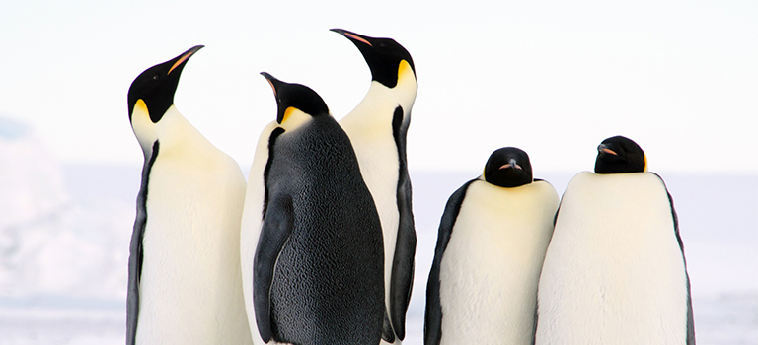
Mastering Research Collaboration
Alys Kay, Researcher Developer
Notes:
Will be a follow up…

Slide 2
To contribute to the Benefits of Collaboration survey go to https://www.qualtrics.manchester.ac.uk/jfe/form/SV_0NcwxW7IUGt4Ssm
Notes:
What is your goal – how is this collaboration going to contribute to your research portfolio? And your skillset

Slide 3
Collaboration Brings Career Advantages
Key to Female Career Progression - 2021
Both men and women more likely to become research leaders,
Scholars frequently publish with same co-authors linked to shortened career.
https://royalsocietypublishing.org/doi/10.1098/rspb.2021.0219
Notes:
Female researchers are markedly more likely to become principal investigators if they publish frequently with a wide range of co-authors, an analysis shows.
According to a paper published by the UK’s Royal Society, both men and women are more likely to become research group leaders if they collaborate widely throughout their career – with those publishing with a more diverse cross-section of co-authors also significantly cutting the time it took to achieve this promotion.
But the positive effect of collaboration is much more noticeable for female advancement in academia, with researchers also noting that scholars who frequently publish with the same co-authors are more likely to face a “shortened career” in academia.
935 uk academics

Slide 4
Working Collaboratively Increases Citation
More co-authors - more citation
Diversity of co-authors - higher h-index for citations
Co-authorship rates have increased dramatically in the last 50 years (in some fields)
1. Larivière, V., Gingras, Y., Sugimoto, C. R. & Tsou, A. Team size matters: collaboration and scientific impact since 1900. J. Assoc. Inf. Sci. Technol. 66, 1323–32 (2015).
2. Parish, A. J., Boyack, K. W. & Ioannidis, J. P. A. Dynamics of co-authorship and productivity across different fields of scientific research. PLOS ONE 13 (2018).
https://f1000research.com/articles/11-95
Notes:
Over the past 50–100 years, academic publications with more co-authors have received more citations. For example, in an analysis of over 28 million papers from the natural, medical, and social sciences and the humanities published between 1900 and 2011, papers with more authors received more citations, particularly if the authors were from different institutions¹.
A study of nearly 250,000 academic researchers who published their first 30 academic papers between 2000 and 2015 found that more collaborative academics – those that published with a greater number of different co-authors during their career – had a higher h-index for citations².
An analysis of over 30,000 papers published in Elsevier’s Scopus database between 2000 and 2009 found that the larger the geographical distance between collaborators, the higher the number of citations³, and research has shown that more ethnically diverse collaborations tend to produce publications with higher citation impact⁴.
The relationship between the level of collaboration and number of citations persists at the national level, according to data presented in the G20 Innovation Report⁵. Countries with the highest rates of collaboration generate more highly-cited papers. The report also showed that the effect of the level of collaboration on citation rates was strongest for countries with the lowest overall scientific output.

Slide 5
Activity: Challenges of Collaboration
Read the scenario about a researcher who was invited to join a research collaboration. Consider what risks and challenges they might face. This is an example from the field of psychology, but the risks and challenges of collaborating could apply to any discipline.
Padlet Activity: https://padlet.com/alyskay/r6mowxd8cfdsa9k3
Notes:
It is no surprise that research collaborations have become so common, given the wide range of benefits that they present. Collaborating is not only advantageous for each participant but it can also benefit the research community and society in general.
The challenges of collaborating
Although collaborative projects can provide many benefits, they are also inevitably associated with challenges that you might not experience with an individual research project.
We have seen that collabation Read the scenario below about a researcher who was invited to join a research collaboration. Consider what risks and challenges they might face. We have included an example from the field of psychology, but the risks and challenges of collaborating could apply to any discipline.

Slide 6
Challenges
Impaired communication
Misappropriation of your ideas, knowledge or IP
More administrative work
A lack of institutional or national financial support
Agreeing how to share credit fairly
Ensuring that all members of the collaboration, especially early career researchers, are credited fairly.
Notes:
Other common challenges might include:
Understanding the nuanced relationships between the other collaborators takes time and can make developing a team dynamic challenging
Estimating and agreeing realistic timelines to complete tasks
Sharing ideas, giving feedback, and reaching a consensus can slow down the speed of research
Mobility restrictions, such as family commitments or disabilities, can make meeting your collaborators or attending workshops difficult
Keeping people engaged with the research and maintaining momentum towards your goal

Slide 7
In Summary:
Collaboration doesn’t always speed up research
The least tangible benefits can be the most rewarding
Notes:
A common misconception is that research collaborations achieve goals faster than academics working alone. However, collaborations take time to set up and to manage and don’t necessarily speed up the process of research. In addition, whether collaborating will help you reach your goals faster is highly dependent on your field.
“The idea that you’ll just work together and the more people you have the faster you’ll work isn't true. More people might slow you down because you need to check-in, you need to dedicate time for calls, for communicating results.” – Mark Hahnel (CEO, Figshare, UK)
THE LEAST TANGIBLE BENEFITS CAN BE THE MOST REWARDING
It is easy to focus on the visible outputs of a collaboration – the papers, the conference talks, the commercialized products. However, the members of our expert panel noted that the other benefits of their projects, such as enjoying their work environment, making friends, or making a difference to people’s lives, were more valuable to them.

Slide 8
Notes:
Collaborating can help you develop transferable skills
Conducting research collaboratively requires skills that aren’t commonly taught in undergraduate or postgraduate courses. Taking the time to learn these skills will help with other areas of your research and can boost your professional development overall.

Slide 9
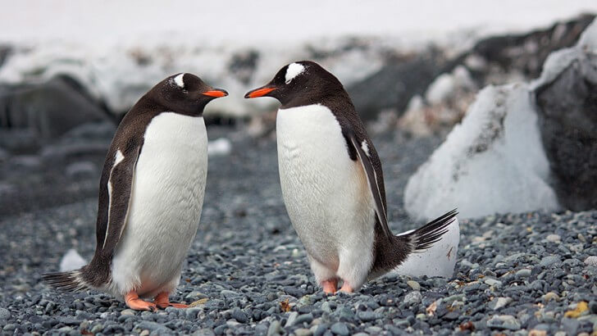
Finding the Right Collaborators

Slide 10
Notes:
The ideal collaborator
The qualities you are looking for in a collaborator will depend on the specifics of your project but there are also some general characteristics and behaviours that make someone a good fit for collaborative research projects.
In the following poll, select the qualities that you think are most important in a collaborator and then see how other researchers who have taken this course answered.

Slide 11
Important Characteristics:
Research Qualities Someone with expertise, skills or resource who understands and shares the projects goals.
Professional Qualities Someone who is flexible, reliable, committed to the project and has high ethical standards.
Social Qualities Someone who is respectful, honest, direct, reasonable, good at communicating, and manages conflict well.
Personal Qualities Someone who is personable, open-minded, genuine, emotionally intelligent and empathetic.
Notes:
research skills are not the only thing to consider when building your team. In fact, we can identify four broad ‘categories’ of characteristics that are important. Click each card to find out more.
Finding colleagues with some of these qualities is important, but try not to be too prescriptive about your ideal collaborator – after all, nobody’s perfect! Consider how their skills could complement those of existing team members and create a collaboration that is more than the sum of its parts. It is easier for example to collaborate with someone who can do something you can’t and vice versa, than someone with an overlapping skill set.
A balance of personality types or ways of working can also make a collaboration stronger and more efficient. For example, in projects with a creative component, you might want a mixture of people who can generate ideas and people who are more focused on executing the ideas and delivering outputs. You’ll also want to consider diversity in other traits.
Top tip: Don’t underestimate the importance of getting on with a potential collaborator on a personal level. Choosing collaborators that you like and with whom you enjoy spending time will make the work enjoyable and can prevent friction. There are few experts who are so unique that you wouldn’t be able to find an alternative collaborator with the same skills.

Slide 12
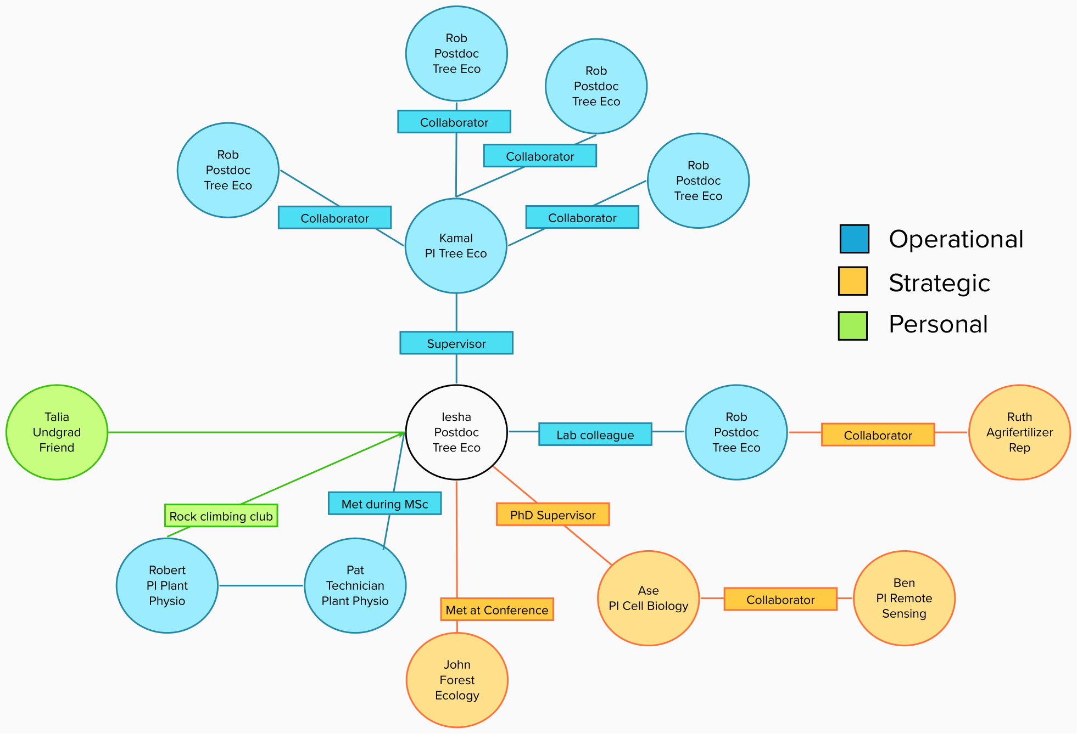
Notes:
Look within your own networks
Try dividing your existing network into three categories: operational, personal, and strategic. Categorizing your contacts can help you to understand how you can benefit from working with them.
1
1
Operational network: The people who you work with on a regular basis – those who help you get your day-to-day work done efficiently and meet your short-term goals. Examples include work colleagues such as people in your department and administrative staff.
2
2
Personal network: The people who you know outside work, from whom you can gain external perspective. Examples include family members, and friends from school, university, hobby groups, and professional organizations.
3
3
Strategic network: The people who understand the direction in which your field or industry is moving and can help you to make relevant long-term plans. This network is a good place to look for a mentor. Examples include your line-manager, the head of your department, a senior contact in industry, or a visiting professor.
Activity: Finding collaborators within your networks
Work through the short scenario activity below to identify who would make the best collaborator from Iesha’s operational, strategic, and personal networks, according to the goals of the project. As with all our scenarios, we’ve picked a specific discipline and project to give the example realism but these considerations apply to any collaborative project.
Draw this and think about who could you useful conversation with about potential collaboration in the future? Which people in your network could go and seek out a conversation about collaboration?

Slide 13
Look Beyond Your Own Networks
Identify central individuals in a wider network
Reach out to visiting academics and to your mentor’s contacts
Look at journals and other publications
Consider peripheral research
Identify regional experts
Follow the money – identify contacts funded with previous grants
Attend innovation bootcamps
Consider your competitors
Notes:
Look beyond your networks
You might need to look beyond your existing network to build the right team for your collaboration, particularly if your idea for a collaborative project is interdisciplinary or relevant to industry.
Click on each of the headings below to explore our tips for finding new potential collaborators.
Once you have identified potential collaborators, do your research: look up their departmental profile or website, find them on social media, and read their publications to become familiar with their work and the goals that drive them. All this information will help you to contact them and make a good case for working together.

Slide 14
Finding Industry Collaborators
Identify Research that is tangential…
Working through conferences
Asking your own academic network
Literature review: who is publishing from industry perspective Contact them (or Academic Liaison, Partnership manager) for brief conversation, identify if mutual benefit.
Let relevant Uni departments know what sort of collaboration you are seeking (knowledge exchange, business engagement, knowledge transfer partnerships, commercialisation)
Notes:
https://www.elsevier.com/research-intelligence/collaboration-between-industry-and-academia
Research that is tangential…
Working through conferences
Working with your own academic network to try and get a name
Due diligence literature search who is publishing from a company perspective, who are the key scientist publishing from those companies – contact that scientist or find a conduit like director of academic liason, a brief conversation, or email exchange very quickly get to point of whether there is likely to be a collaboration of benefit to both parties.
Look for partnerships, international relations,
Most universities have business development groups that support these pathways, and often that is even better
Academic lisason officer
Let any relevant University departments know what sort of collaboration you are seeking – so a conversation with an appropriate contact about all the pathways that are open to you.

Slide 15
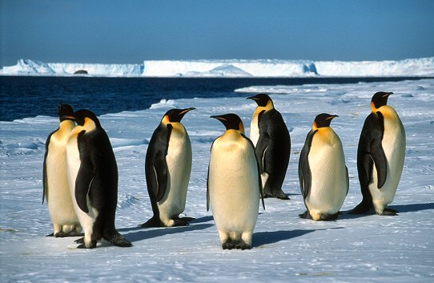
Keeping On Track
Notes:
As a new member of a collaboration, you need to maximize your contribution to the efficient day-to-day running of the project and help keep the overall project on track without hindering it. In this lesson, we’ll discuss how to divide tasks fairly, manage your time and communicate effectively.

Slide 16
Dividing the Work: RACI Chart
Main Task | Sub-task | PI | Postdoc | Lab tech | Stats
Experiment 1
Bench work
A
R
R
I
Data analysis
A
C
I
R
R = Responsible (for completing the task)
A = Accountable (for ensuring that the task is completed correctly)
C = Consulted (in discussions about that task)
I = Informed (about progress, setbacks, and challenges)
Notes:
In any collaboration, the workload should be divided to take advantage of each team member’s strengths while respecting their weaknesses, and taking into account priorities, goals, and other responsibilities.
For example, in a collaboration across disciplines and countries, or with industry, each member of the group will be working towards different endpoints and deadlines of varying timescale and importance. Although a project might be your current top priority, it might not be for other members of the collaboration. Be prepared to compromise and find realistic timelines to complete interdependent tasks.
Coordinating tasks with your colleagues, who have different schedules and obligations, can be challenging. Having an open discussion about the demands on each person’s time and their availability, and being understanding about their other commitments, can ensure you suggest and agree to sensible deadlines. In the unlikely case that you have time to spare, consider offering to perform a task or take on a responsibility for one of your collaborators. This will build goodwill and help to meet project milestones.
In addition, you could take advantage of collaborators being in different countries or continents, as each member of the team can take project outputs to conferences and meetings in their own region, thereby cutting costs and minimizing the carbon footprint of the project.
Create a RACI chart
A useful way to divide labour between collaborators is to establish different levels of responsibility. When you join a new collaboration, check whether they have a RACI chart; if not, it might be a good idea to suggest creating one.
The acronym RACI stands for responsible, accountable, consulted, and informed and the chart will allow you to map out who is responsible and to what level for each task.
To build a RACI chart, you first need to define the roles that are required in your collaboration; for example, project manager, laboratory technician, statistician, and so on. These roles are each associated to one or more tasks and can be performed by one or more people. Discuss with your collaborators who is responsible for completing each task, who is accountable for ensuring that the task is completed correctly, who will be consulted in discussions about those tasks, and who should be informed about progress, setbacks, and challenges. Clear roles and responsibilities ensure that each member of the team owns a piece of work and feels empowered to carry it out. Have a look at the example RACI chart below:

Slide 17
Project Gantt Chart
 | June | July | Aug | Sept | Oct | Nov | Dec
Plan experiment
Do experiment
Acquire the data
Analyse the data
Key
Project 1
Project 1 Milestone
Notes:
Create a project Gantt chart
A Gantt chart is a tool that allows you to visualize the different stages of a project, the time allocated to each stage and the key milestones. The group you are joining might already have a Gantt chart, which you will need to read, understand, and possibly edit. If the collaboration doesn’t already use a Gantt chart to map milestones and deliverables, you could suggest creating one.
Timeframe: Select a timeframe for the project, or for the amount of time you are planning to work on it. Plot that along the top.
Stages, Milestones and deliverables: List the different stages, milestones and deliverables, Break these down into as much detail as possible to cover each task that needs to be completed
Allocate time to tasks: Allocate time to each task, make sure you think about contingency and feedback time.
Top tip: when planning your own contribution to the project, work backwards from the milestones that you want to achieve and organize your time accordingly.
You can use many different tools to produce RACI and Gantt charts, from straightforward spreadsheets to specialized software. Here are a few examples:

Slide 18
Managing Your Own Time
Top tips:
Budget your Time (always have purpose: 40% collab, 60% my res)
Buffers (contingency)
Boundaries (establish and ruthlessly defend)
Bits (maintain a list of tasks that can be done in 10 – 20 mins)
Useful Time Management Tools:
Toggl
Trello
Notes:
Teamweek allows you to create Gantt charts for your project.
It’s free for teams of up to 5 people.
For a more dynamic approach to task management, try Trello.
And then there are services like Slack.
It provides a virtual forum where all communication about a project can take place. You can also integrate many of the services we’ve already mentioned, providing a single project space for your team to work in. The benets of using such a service include:
Increased transparency within the team
Finding information is made easier
Team culture is improved
Team members feel more connected 5.
Finding help If collaborative research is new to you, or if you are uncertain about how things are supposed to work, it’s natural to be apprehensive. Luckily, you are not alone. People have done this before. Have a look around your institution: is there a senior sta member who is charged with mentoring and fostering rst-time collaborative researchers? Is there a successful collaborator in your department that you can chat to before you get started? A massive resource is going to be your administrative support. Research oces are increasingly run and staed along para-academic lines, with dedicated professionals who have dealt with dozens of contracts, research proposals and networks. Here are some of the things that your administrators might be able to help with: Identifying possible collaborators: they have the best seat in the house to see the research being produced by the university Identifying existing networks: they know who has worked with whom in the past. Checking the legal side: what’s the due diligence process at your institution, and what do you need to do to sort out contracts? How much to charge for your time: the costing function for sta time is often managed centrally. Finally, do look at the experiences, both positive and negative, reported by other researchers through their blogs and social media proles. There’s a lot of people out there working together, learning together and producing excellent work together. Why not join them? There are plenty of people writing about these new tools and how they can help researchers. Take a look at the digital academic hashtag on Twitter or Professor Andy Miah’s A-Z of Social Media for Academics. And don’t forget that we share practical advice on our own blog, get started with our tips for undertaking collaborative projects.

Slide 19
Communicating Effectively
Situation 1:
Henry and Maria, two early career bio-informatics researchers, from different institutions, are planning an ambitious collaboration in clinical machine learning. At the start of the project they clearly defined tasks and set milestones. However, Henry has not been keeping to the agreed timeline and Maria is worried they will not meet key deadlines.
Every time Maria asks Henry about progress, emails are ignored. Henry feels bad about the situation and is overwhelmed by work. He feels embarrassed to admit that he is behind. What should he do?
Notes:
Scenario

Slide 20
Communicating Effectively
Situation 2:
Maria and Henry have a video call and try to resolve the situation. Henry apologises, explains how far behind he is and suggests a realistic new deadline. How should Maria respond?
Notes:
Communicate with your collaborators efficiently
Communication is key to the smooth, efficient operation of any collaboration, but it can also be challenging to get right. As you get started in a new collaboration, you’ll need to consider how you can best communicate with your new colleagues to maximize efficiency, striking a careful balance between providing regular updates and not overloading your colleagues.
Give regular updates
Click to flip
It is important to send your collaborators regular progress updates and share new data or results as they arise.
Click to flip
Be responsive
If the leader of the collaboration requests an update, try to make sure you give a timely response. If you are unable to give an update in the time frame requested, make sure you communicate this and explain why. Failing to respond might mean your input isn’t taken into consideration in an important decision and could be considered rude or disrespectful by your collaborators.
Don’t overload your collaborators
Replying in a timely manner is important but try not to pester your collaborators when they aren’t responding to messages or meeting deadlines. Be conscious that they might be juggling other commitments and that there could be other demands on their time.
Communicate delays
It is equally important to communicate delays or that a task has become unachievable as soon as possible. Although this might feel like a failure to you, it’s a common situation that happens for various reasons (technical difficulties, changes in resources, unexpected additional workload, and so on). Knowing about a delay, as early as possible, will be useful for the leader of the collaboration and will enable them to adapt the timeline or task-list accordingly.
Attend meetings
With lots of responsibilities to juggle, it can be easy to miss meetings about collaborative projects and rely on the minutes to catch up. However, being present in meetings is important to develop and maintain rapport and trust, to share data and ideas, maintain enthusiasm, and to help the project make progress. If the leaders of your collaboration don’t organize regular meetings, consider encouraging them to do so.
Appreciate differences
As we discussed in the previous lesson (“Working in a new research team”), your collaboration will run more efficiently if you are able to respect differences between you and your collaborators. Face-to-face communication can help build a respectful relationship that is appreciative of differences.
Top tip: Even when you are under pressure, it’s important to remain polite and respectful towards your collaborators. Sometimes the frustrations of academic research can lead to strong emotions, but try to avoid sending an email in anger or frustration. Try drafting what you want to say and coming back to it when you have calmed down.

Slide 21
Communicating Effectively
Top Tips:
Keep in touch, regular progress update, share new results
Be responsive, try to give timely response, if not explain why
Don’t overland collaborators, try not to pester
Communicate delays, as soon as possible
Attend meetings, being present is important to maintain trust
Respect difference, face-to-face can help build stronger relationships
Notes:
Communicate with your collaborators efficiently
Communication is key to the smooth, efficient operation of any collaboration, but it can also be challenging to get right. As you get started in a new collaboration, you’ll need to consider how you can best communicate with your new colleagues to maximize efficiency, striking a careful balance between providing regular updates and not overloading your colleagues.
Give regular updates
Click to flip
It is important to send your collaborators regular progress updates and share new data or results as they arise.
Click to flip
Be responsive
If the leader of the collaboration requests an update, try to make sure you give a timely response. If you are unable to give an update in the time frame requested, make sure you communicate this and explain why. Failing to respond might mean your input isn’t taken into consideration in an important decision and could be considered rude or disrespectful by your collaborators.
Don’t overload your collaborators
Replying in a timely manner is important but try not to pester your collaborators when they aren’t responding to messages or meeting deadlines. Be conscious that they might be juggling other commitments and that there could be other demands on their time.
Communicate delays
It is equally important to communicate delays or that a task has become unachievable as soon as possible. Although this might feel like a failure to you, it’s a common situation that happens for various reasons (technical difficulties, changes in resources, unexpected additional workload, and so on). Knowing about a delay, as early as possible, will be useful for the leader of the collaboration and will enable them to adapt the timeline or task-list accordingly.
Attend meetings
With lots of responsibilities to juggle, it can be easy to miss meetings about collaborative projects and rely on the minutes to catch up. However, being present in meetings is important to develop and maintain rapport and trust, to share data and ideas, maintain enthusiasm, and to help the project make progress. If the leaders of your collaboration don’t organize regular meetings, consider encouraging them to do so.
Appreciate differences
As we discussed in the previous lesson (“Working in a new research team”), your collaboration will run more efficiently if you are able to respect differences between you and your collaborators. Face-to-face communication can help build a respectful relationship that is appreciative of differences.
Top tip: Even when you are under pressure, it’s important to remain polite and respectful towards your collaborators. Sometimes the frustrations of academic research can lead to strong emotions, but try to avoid sending an email in anger or frustration. Try drafting what you want to say and coming back to it when you have calmed down.

Slide 22
Improving Online Collaboration
Challenges
More difficult to have certain kinds of conversation
Fewer chances for spontaneous contact and discussion
Mismatches of technology and purpose
Solutions
Establish a clear process for how things get done
Pick the best tools for your goals
Be flexible about availability and think about coverage
Notes:
Online collaboration presents unique challenges, but is becoming more and more common in research and all other work environmetns. You might rarely see people in person.
Challenges:
More difiicult to have certain kinds of conversations – cannot read the room – seeing nodding heads.
Fewer changes for spontaneous informal contact
Everyone doesn’t use technology in the same way – e.g. you might use a project management software basecamp, you could end up with people not talking to each other…
Solutions
Establish a clear process for how work and discussion get done, People need to know where to look for files, and content and so on. – Then if there is issues or questions they need to know where to talk about them. There are lots of tools out there that allow you to there are a lot of communication tools out there that allow teams to hold meetings. Whether you go for video based tools like zoom or google hangout. Or more text heavy ones like slack. Or hipchat.
But just having a space for discussion isn’t enough you need to set some more rules, helping people how to determin where to put stuff…Show elearning slack channel…
Pick the best tools for your goal
Consider splitting up meetings – recording meetings – Take minutes and post in centrally located sport

Slide 23
Reflections and Actions
In small groups spend a few moments discussing Mastering Research Collaboration.
What are the 2-3 things that you personally will take away from this workshop?
Notes:
You have invested time coming here, what will you do differently as a result of this information – what bits might you do further reading on

