Slide 1
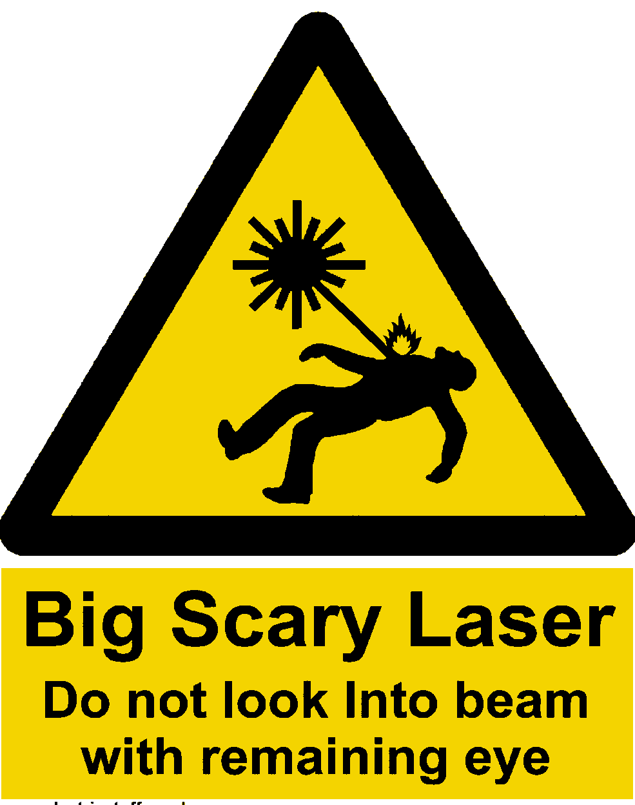
Laser Safety
October
2018
Liverpool University

Slide 2
Contents
Basics
Health & Safety Legislation
Laser Classification
Laser safety Labelling
Laser Safety Procedures at Liverpool
Practical Laser Safety
Hazard Evaluation & Risk Assessment

Slide 3
The lasing medium
A lasing medium is a material which has an atomic or molecular structure which produces a coherent beam of light when sufficient energy is supplied. The energy supplied (usually electrical energy) is converted into laser light and heat.
The medium can be a solid (e.g. ruby), a liquid (e.g. organic dye) or a gas (e.g. carbon dioxide).
The performance of a laser is largely governed by the choice of material used as the lasing medium.

Slide 4
Simple diagram of a laser tube
Mirrors
Lasing medium
Beam
Energy input e.g. high voltage
Notes:
Without going too deeply into the design of a laser, it briefly consists of a laser tube, which may be a solid material, a liquid or a gas, and some form of energy input. Typically the energy input is in the form of an electrical supply, and the atomic or molecular structure of the material in the laser tube converts the energy input into an output in the form of a laser beam.
The beam passes along the length of the tube and is reflected back down the tube by mirrors placed at each end. However, one of the mirrors is only partially reflecting and so a proportion of the beam is allowed to escape. This represents the useful laser beam.
It is important to realise that lasers are not very efficient, and only a small proportion of the energy input is converted to a laser beam. Most of the rest appears as heat and this must be dissipated in some way in order to avoid damage to the laser itself.

Slide 5
Design of a laser
Tube containing lasing medium
Mirrors at either end
Power supply
“Pumping” - electrical or light
Cooling system
Delivery system
Notes:
Inside the laser tube, the lasing medium determines the wavelength of the beam produced, and there have been many materials tried since the laser was invented in 1960.
The energy input, known as pumping, often consists of a high voltage electrical supply, but can also be in the form of a flash lamp (similar to a photographer's flashgun).
Cooling may be provided by a fan, or a water system if a large amount of heat must be dealt with.
Finally, we must have some method of getting the laser beam to the area of interest - in medical applications, to the treatment site of the patient. Alternatives for delivery systems will be discussed later.

Slide 6
Units
Wavelength or colour – nanometres
1 nm = 1/1 000 000 000 m
Power - Watts
Energy - Joules
Pulse length - seconds
ms millisecond 1/1 000 s
μs microsecond 1/1 000 000 s
ns nanosecond 1/1 000 000 000 s
ps picosecond 1/1 000 000 000 000 s
fs femtosecond 1/1 000 000 000 000 000 s
Notes:
Wavelength or colour is measured in nanometres (abbreviated to nm). One nm is a billionth (10⁻⁹) of a metre.
Power is measured in Watts, the same units as are used to specify the brightness of a domestic light bulb (e.g. 100W) or an electric fire (e.g. 3 kW), or milliwatts, mW, one thousandth of a Watt.
The energy of a pulse of laser radiation is measured in Joules or milliJoules (J or mJ). A one Watt laser beam operating for one second delivers one Joule of energy.
Power × time = Energy
Watts × seconds = Joules

Slide 7
Types of laser emission
Continuous wave (CW)
Free running (ms, µs)
Triggered pulse: ns, ps, fs
Beam delivery
Direct beam
Hollow wave guide
Articulated arm
Optical fibre
Notes:
Lasers can be designed to emit a beam continuously or in a series of pulses.
Continuous output lasers are known as CW (continuous wave) lasers.
A pulsed laser beam can be described as free-running, where the pulse are only milli- or midro-seconds long (thousandths or millionths of a second). Because the interval between pulses allows heat to be dissipated, the power within each pulse can be higher than for a CW laser.

Slide 8
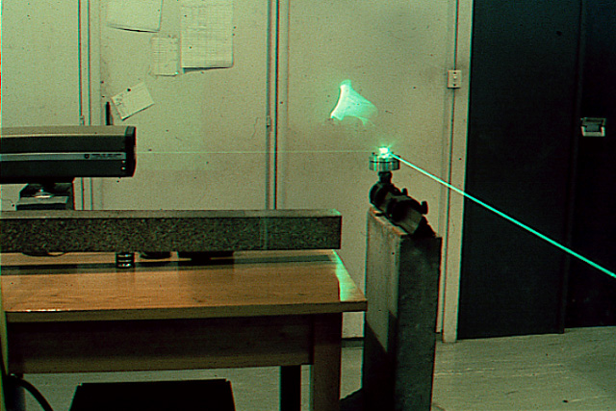
Direct beam
Notes:
In the simplest applications, for example in physiotherapy, a low powered visible laser beam is directed at the patients skin. In this case it is sufficient to place the end of the laser tube in contact with the skin.
A simple lens system can be incorporated if it is necessary to focus the beam. If such a lens is used, the beam effects will be concentrated at the focus, i.e. a greater effect will be produced over a smaller area. This may be compared with using a magnifying glass to focus the sun’s rays and burn a mark onto a piece of wood.
Beyond the focus, the beam will diverge and any effects will be reduced.

Slide 9
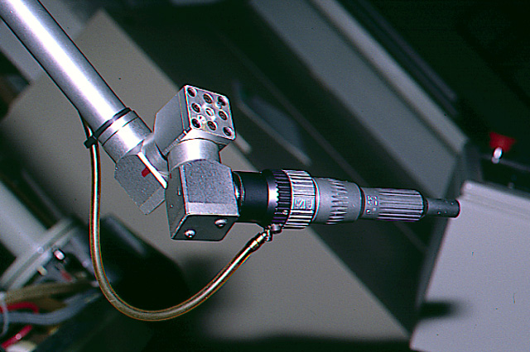
Articulated arm
Notes:
The end of the articulated arm may have a lens incorporated in it to focus the beam. It is often shaped like a pen so that the operator can manually direct the beam towards the target. In this picture the small tube may carry compressed air to blow debris away from the treatment site.

Slide 10
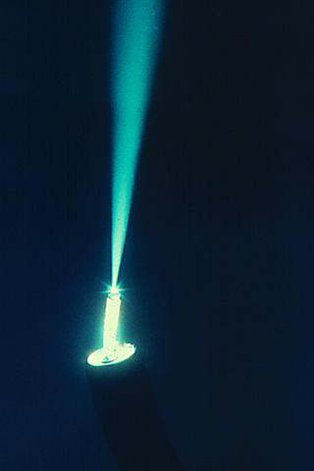
Diverging beam from a fibre

Slide 11
Focusing a laser beam
The beam from the end of a fibre will diverge
A laser beam can be focused by a lens to give a very high power over a small area - compare with magnifying the sun’s rays
Can lead to very hazardous situations.
Notes:
Although, as stated earlier, the laser beam is parallel when it is emitted from the laser itself, some forms of delivery system such an the optical fibre will change this.
If the divergent beam from the end of a fibre is not re-focused, any effects will be reduced as the distance from the end increases.

Slide 12
When a laser beam is focused, there will be a greater effect where the power is concentrated over a small area:
For a continuous beam:
POWER DENSITY = Power/Area
i.e Watts per square metre: W.m⁻²
Or for a laser pulse:
ENERGY DENSITY = Energy/Area
i.e Joules per square metre: J.m⁻²

Slide 13
Device malfunctions - what can go wrong?
Shutter jammed open.
Broken fibre.
Unprotected exposure switch.
Laser light leakage.
Wrong output – too high or low.
Failure to terminate.
Aim beam not co-incident with main beam
Problems with experimental set-up.
Notes:
Medical laser equipment incorporates a shutter which should only open, and allow the beam to be emitted, when the user requests it by means of an exposure switch. It has been known for the shutter to jam open so that the beam is emitted before it is required.
A broken optical fibre would emit a laser beam at the break rather than at the end of the fibre. Although rare, this has occurred and has resulted in igniting the clothing of staff.
The foot switch should be fitted with a shroud so that it is not possible to accidentally step on it and operate the laser.
The covers of the laser unit should be fitted with interlocks to prevent access while the laser is running. Users must not disable these interlocks.

Slide 14
Interactions of light on tissue
Depend on:
Tissue type
Wavelength
Power/energy density
Duration of pulse
Pulse repetition rate
Medical & ethnic history of person
Etc…
Notes:
There are many different effects of laser radiation in tissue. The effect depends on a number of factors. The choice of laser and the settings used are governed by the effect required for a particular patient.

Slide 15
The four main effects
Thermal
heating up to ~ 800ºC
Mechanical
shock waves by high energy densities.
Photoablation
bond breaking e.g. UV (Excimer) lasers
Photochemical
chemical reaction but no heating e.g. PDT.
Notes:
The main effects can be divided in to four types.

Slide 16
THERMAL EFFECTS
Divergence ~ 15º
300ºC Carbonisation
100ºC
70ºC
50ºC
< 50ºC
So it is important to keep the aperture at the right distance from the tissue, in order to get the desired power density and the intended effect

Slide 17
Harmful effects of exposure to laser
Eye
Skin
Cornea
Lens
Retina
Burns
Photochemical
Photo-allergic
Pregnancy - NO HAZARD FOR STAFF
Notes:
The hazards from the laser beam itself can be divided in to hazards to the eye and to the skin.
There is no particular hazard to pregnant staff. Any laser beam reaching a fetus would have to burn through the mothers abdomen first. This would probably be noticed before the fetus was harmed !!!

Slide 18
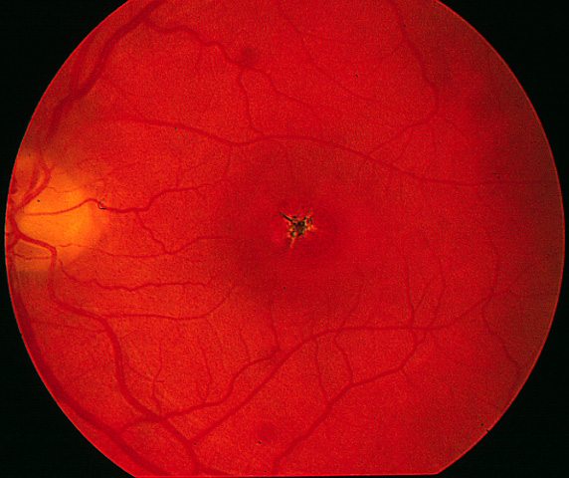
Accidental laser burn to the retina
IGNORANCE
COMPLACENCY
Notes:
This is a picture of a retinal burn caused by a laser. The macula, which is the most sensitive part of the eye and is used for central vision, has been burned. This has resulted in clinical blindness.

Slide 19
Laser Safety - Legislation
Legal Responsibilities – for employer & employee
Health & Safety at Work Act
Work Equipment Regulations
Management Regulations – risk assessments
Control of Artificial Optical Radiation at Work Regulations 2010 (AOR Regulations)
Mandatory Rules for University Staff and Students
Guidance
British Standard – BS EN 60825-1 (2014)

Slide 20
Health & Safety Law
Health & Safety at Work Act 1974
The act places duties on both employers and employees
It is criminal law and can be enforced against persons and organisations.
The act can be summed up as;
Employers duty: ‘To safeguard so far as reasonably practicable the health, safety and welfare of employees and others affected by the work’.
Employees duty: ‘To take reasonable care for the safety of themselves and others; to cooperate; not to be reckless’

Slide 21
Provision and Use of Work Equipment Regulations (PUWER)
All equipment must be suitable
Maintained in an efficient state
Maintenance recorded
Restricted to trained users
Users must have information and training
Access prevented to dangerous parts
Adequate controls and lock-offs
Suitable environment

Slide 22
Management Regulations (Risk Assessment)
1999 Management Regulations (HSAW)
Regulation 3. ‘Every employer shall make a sufficient assessment of the risk at work to’:
Employees
Others affected
Records kept of:
Risk assessment
Safe Methods of Work (Local Rules)
Review and update as necessary

Slide 23
British Standard for Laser Safety (Web: http://www.hpa.org.uk/radiation/)
EN60825-1:2007- Safety of Laser Products
Equipment classification, requirements and user’s guide
EN60825-2:2004 - Safety of Laser Products
Safety of optical fiber communication equipment
PD IEC TR 60825-14:2004 - Safety of Laser Products
A User’s Guide

Slide 24
Objectives of ‘BS’ Laser Safety Standards
To protect persons from laser radiation by indicating safe working level of laser radiation
To introduce a system of classification of lasers & laser products according to degree of hazard
To lay down requirements for both user & manufacturer to establish procedures & supply information so that precautions can be taken
To ensure warning of laser hazards by signs, labels & instructions
To minimise accessible radiation, and control radiation by protective features and control measures
To protect persons from other (non radiation) hazards associated with lasers

Slide 25
BS EN 60825-1 Safety Standard
EN 60825-1 provides tables of Accessible Emission Limit (AEL) for each class of laser:
Maximum output for given wavelength & emission duration
Laser products include: product or assembly of components which contain laser or laser systems
e.g. compact disc player is a laser product because it contains a laser system
NB: Light emitting diodes (LEDs) are implied by laser in BS

Slide 26
Laser Classification
To classify a laser, need to know:
Laser wavelength
Maximum power (or pulse energy)
Exposure duration
Viewing conditions
Each laser class has a set of safety control measures that manufacturers and users must obey
Classification of laser determined by:
Accessible Emission Limit (AEL)
Maximum level of laser radiation that the laser can emit over its full range of capability during operation at any time after its manufacture

Slide 27
Laser Classification
Class 1 Safe under reasonably foreseeable operation
Class 1M Generally safe – some precautions may be required
Class 2 Visible light at low power, blink limits risk
Class 2M UV or IR light at low power, generally safe - some precautions may be required
Class 3R Safe for viewing with unaided eye, (i.e. not by telescope etc)
Class 3B Viewing beam hazardous, diffuse reflections safe
Class 4 Hazardous under all conditions, eyes and skin
VIDEO CLIP No.6 – Laser Classification

Slide 28
Class 1(Safe)
HANDOUT
Safe under reasonably foreseeable conditions of operation, including the use of optical instruments for intrabeam viewing
Class 1 AEL < 1 mW
May contain high power laser with higher classification
Effective engineering controls used to restrict routine exposure to Class 1 AEL
Compact disc player
laser printers
CD ROM players

Slide 29
Class 1M
HANDOUT
New class for new EN60825-2 regulations to deal with fibre comms & LEDs
302.5 nm to 4 μm
Generally “safe” as Class 1
Safe except for diverging or large area beams when collecting/focussing optics used

Slide 30
Class 2 (Low Power)
HANDOUT
Max output - 1mW
Visible only: 400 nm to 700 nm
Blink response of eye affords protection
OK even for use with optical instruments
E.g:
Supermarket scanner
HeNe laser in teaching lab
Laser diode in teaching lab
Class 2M
OK unless collecting or focusing optics used

Slide 31
Class 3R (Low/Medium Power)
HANDOUT
Max output – 5mW and irradiance < 25 Wm⁻²
Visible: blink response of eye protects
Non-visible: above 4 μm treat as Class 1
Direct intrabeam viewing using optical aids (binoculars, telescopes, microscopes) is hazardous
E.g:
Surveying equipment
Some laser pointer pens
Some HeNe and laser diodes in teaching & research labs

Slide 32
Class 3B (Medium Power)
HANDOUT
Max output - 0.5W (500 mW)
Visible/non-visible
Direct intrabeam viewing is always hazardous
Viewing diffuse reflections is normally safe provided:
Eye is not closer than 13 cm from diffusing surface
Exposure duration is less than 10 seconds
E.g. Research laboratory HeNe laser

Slide 33
Class 4 (High power)
HANDOUT
Hazardous: direct or reflected beam, diffuse reflections viewing results in injury
Environmental damage (fire), skin burns as well as eye injuries

Slide 34
Labelling of Laser Products
HANDOUT
Labels for laser user & laser servicer
Correct labels should be provided by manufacturer
Meaning of labels should be described in manual
If size or design of laser makes labeling impractical (e.g. laser diode), labels should be included with user information or placed on package
Knowledge of labelling procedures required by:
persons making up laser products e.g. laser diodes
persons designing laser enclosures. e.g. technicians, researchers

Slide 35
Types of Labels
HANDOUT
Labels are black against yellow background
Class 1& 1M: any colour, not always displayed
Radiation output & Standards information:
Above Class 1:
Maximum power output, pulse duration, emitted wavelength
Laser aperture
Labelled on Class 3B or 4 laser.
Access panels, Safety interlocked panels
Should be labeled if access to laser radiation in excess of the AEL for Class 1 is possible on their removal or over-riding
Laser starburst warning label
Displayed by all laser products of Class 2 and above

Slide 36
Laser Safety University Code of Practice
Appointed Laser Protection Adviser – Pete Cole
All lasers (above Class 2) – registered
All conform to EN 60825-1, 2
Risk assessment & Local Rules completed at workplace
Supervisor responsible for safe working practices
All laser users must attend risk assessment & safe method of work briefing
TEA / COFFEE BREAK

Slide 37
Practical Laser Safety
There is a hierarchy of controls to ensure safe use of lasers:
Risk Assessment and Safe Method of Work
(1) Engineering controls
(2) Administrative controls
(3) Personal protective equipment (PPE)

Slide 38
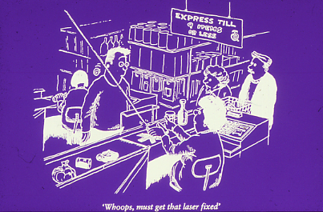
Engineering Controls
Never bodges and no temporary fixes.
It compromises safety

Slide 39
Engineering Controls
Exposure to laser radiation is restricted primarily by:
Housings or enclosures
Beam stops
Interlocks
Warning lights
These can be:
Addressed at design & manufacture stage
Incorporated when laser is installed at site by user

Slide 40
Engineering Controls
Controls should not be over restrictive and hamper ease of working
Engineering controls may not provide adequate protection in cases such as:
Phases of research when laser system is being commissioned or aligned
Manufacture or research into laser design
Servicing of laser equipment

Slide 41
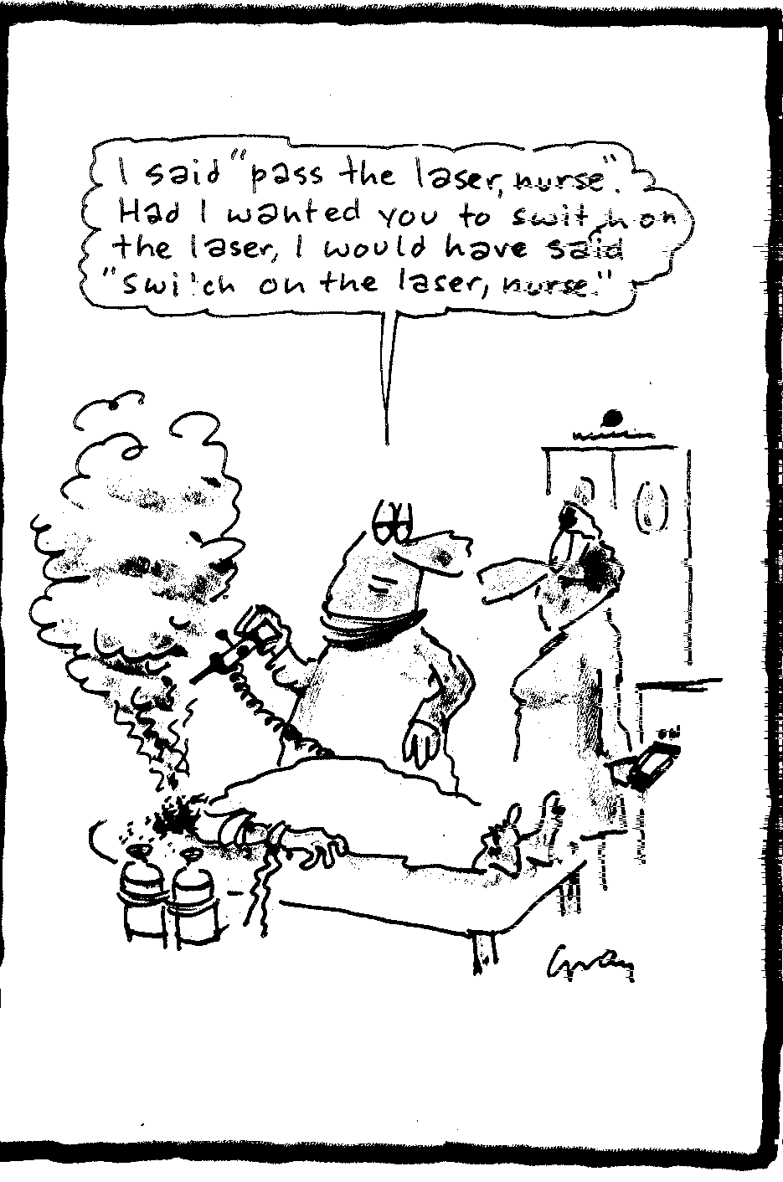
Administrative
Controls
Clear instructions
Clearly understood
LOCAL RULES

Slide 42
Administrative Controls
1. Warning Signs & Notices Prominently displayed – clear and unambiguous
If laser performance or function is modified by user, re-classification and/or re-labelling may be required
There should be labels at entrances to lab or workshop containing Class 3B or 4 laser.
All safety signs should comply with Health & Safety (Safety Signs & Signals) regulations 1996
2. Key Control
Class 3B & 4 laser keys removed when not in use
Key security is responsibility of laser user
Kept secure in key cabinet to which authorised users only have access
Key location, use, means of obtaining are detailed in the Local Rules

Slide 43
Administrative Controls
3. Maintenance & Service Manuals - should be easily accessible to laser users
4. Education & Training
Only trained persons are allowed to use Class 3B and 4 lasers
5. Marking of Protective Devices
Users should always check markings on laser safety eyewear
6. Laser Controlled Area – where exposure > MPE
Restricted to authorised persons
By physical means: walls, doors, locks, number pads
VIDEO CLIP No.8 – Control Measures

Slide 44
Personal Protective Equipment
Laser safety goggles
Fire resistant clothing and gloves
Used when:
Risk of injury or harm can not be suitably minimised by engineering controls etc
Protection is required against hazards associated with lasers (noise, chemical etc)
PPE is required for Class 3B and 4
Protective clothing when exposure to radiation exceeding maximum permissible for skin (MPE)
PPE will be required for the following procedures:
Alignment
Open beam experiments
Maintenance or servicing laser systems
Employers are obliged to provide employees with PPE

Slide 45
Protective Eyewear
Purpose: to reduce level of incident laser radiation upon cornea, to below MPE (Maximum Permissible Exposure)
Filter: Sufficient Optical Density (OD) to attenuate incident radiation to MPE
Legal requirement to comply with British Standards:
BS EN 207: Filters & equipment used for personal eye protection against laser radiation
BS EN 208: Personal eye-protectors used for adjustment work on lasers and laser systems
Eye protection filters and equipment must be marked with:
Wavelength (or wavelength range) in nm against which protection is afforded
Scale Number at which wavelengths (or at least Optical Density)
The manufacturers identification mark
Appropriate CE mark

Slide 46
Common Causes of Incidents or Accidents
Eye protection not used when required
Badly aligned optics
Altering beam path (e.g., adding optical components without regard to beam path
Inserting reflective objects into beam path
Bypassing interlock (particularly during servicing and alignment)
Inappropriately turning on power supply or firing of laser
Exposure of unprotected third party personnel
Equipment breakdown
Covers not replaced after service/alignment
Lack of operator training
Not anticipating associated hazards
Worth Noting:
Majority of accidents are caused by associated hazards

Slide 47
General Safety Practices Whilst Working
Wear appropriate protective eyewear – when required
Use minimum power/energy required for project
Reduce laser output with shutters/attenuators, if possible
Terminate laser beam with beam stop
Use diffuse reflective screens, remote viewing systems, low power HeNe laser etc, during alignments, if possible
Remove unnecessary objects from vicinity of laser
Keep beam path away from eye level
Don’t put your body parts (particularly your eye balls) in the beam!!

Slide 48
Control all Hazards – not just laser related
Laser radiation hazards:
Complete containment not always possible for some applications e.g. alignment, servicing
Enclosing as much beam path as poss, interlocks, shutters
Mechanical or electrical hazards:
Engineered out of process
Enclosed by guarding or shields - interlocked
Environmental hazards:
Ventilation or extraction systems
Heating, lighting
Chemical hazards:
Ventilation, extraction, monitoring, substitution of material
Use of PPE – gloves, safety eyewear
VIDEO CLIP No.7 – Non-Beam Hazards

Slide 49
Hazard Evaluation and Risk Assessment
Majority of accidents in workplace are caused by:
Inadequate training
Fatigue
Error
Failure to plan and carry out work safely
MH&SaW Regs 1999 and AOR Regs 2010
Employers have a duty to carry out full risk assessments
Laser users must use equipment in accordance with safety training or procedures
Hazard: Potential to cause harm
Risk factor: Product of likelihood of hazard occurring and outcome or harm that arises as a result

Slide 50
Risk Assessment
Carried out by competent person (LSO or laser supervisor or trained person)
Identify significant risks
Identify & prioritize measures that need to be taken
5 steps:
1. Look for hazards
2. Decide who might be harmed and how
3. Evaluate, control, or reduce the risks i.e. decide whether existing precautions are adequate or identify how to control or reduce hazards
4. Record findings
5. Review assessment from time to time and revise

Slide 51
Risk Assessment: 1. Associated laser risks: HeNe (Class 3R) external optics alignment
Assessment number: Assessment date: 18/03.02
Assessed by: David Jones Review date: Next L. S. L.
Research Group: N/A
Location :J.A. 3.24
STEP 1
STEP 2
STEP 3
List significant hazards
List groups of people at risk
List existing controls
Are controls OK?
Risk of hazard?
Actions required
Electrocution
S
High voltage terminals properly shielded.
Persons attempting any repair must be competent.
Yes
Low
None
Flooding
S
All water fittings to be of sufficient standard.
No electrical power sockets to be on floor.
Yes
Low
None
Spillages / ingestion of contaminants.
S,O
No eating or drinking in the Lecture Theatre
Yes
Low
None
Handling of liquid nitrogen
No Liquid Nitrogen Required
N/A
N/A
N/A
Inadequate lighting
S,O
Prompt reporting and replacement of failed lighting.
Yes
Low
None
Trip hazards
S,O
All trailing cables to be securely anchored at a safe level (ground or above head height) and covered by cable strips where crossing pathways
Yes
Low
None
Fire
S,O
Knowledge of fire exits and assembly points
Yes
Low
None
Handling of heavy or awkward objects
S
Proper manual handling practice to be adhered to.
Use of suitable lifting equipment and appropriate numbers of personnel.
Yes
Low
None
S = staff, C = contractor, V = visitor, P = public, O = other

Slide 52
Risk Assessment: 2. Specific laser risks: HeNe (Class 3R) external optics alignment
Assessment number: Assessment date: 18/03/02
Assessed by: David Jones Review date: N. L. S. L.
Research Group: N/A
Location : J. A. 3.24
STEP 1
STEP 2
STEP 3
List significant hazards
List groups of people at risk
List existing controls
Is the control OK?
Risk of hazard?
Actions required
Personal injury due to lack of care / improper use
S,O
• Training of all laser users.
• Propagation of best practice for laser use.
• Procedure for authorising capable users.
Yes
Low
In Progress
Uncontrolled access
S,C,V,P,O
• Shield laser beam from path to door – switch off laser if external persons enter room
Yes
Low
None
Eye damage
S,O
1. Care – do not look along laser path.
2. Appropriate eye protection to be worn.
3. Consideration of the implications of each aligning step before commencement.
4. Reflections to be minimised and contained with no highly reflecting objects in path of beam.
1. Yes
2. No
3. Yes
4. Yes
Medium
Obtain appropriate eye protection glasses
OR
Limit laser output power to below 1mW during alignment
Accidental diversion of laser beam
S,O
1. Lasers securely fixed to optical table
2. Beam steering elements held securely in position.
3. No beam cover on periscope.
1. Yes
2. Yes
3. No
Medium
Fit suitable cover on periscope
S = staff, C = contractor, V = visitor, P = public, O = other

Slide 53
Local Rules
Drawn up by, or in consultation with, the Laser Protection Adviser
To be read by all staff concerned
Sign and date to say they have read and understood them and agree to follow them
The potential hazards
Controlled and safe access
Authorised user's responsibilities
Methods of safe working
Safety checks
Normal operating procedures
Personal protective equipment
Prevention of use by unauthorised persons
Adverse incident procedures
List of authorised operators
Notes:
All staff working with a medical laser should be familiar with the Local Rules.

Slide 54
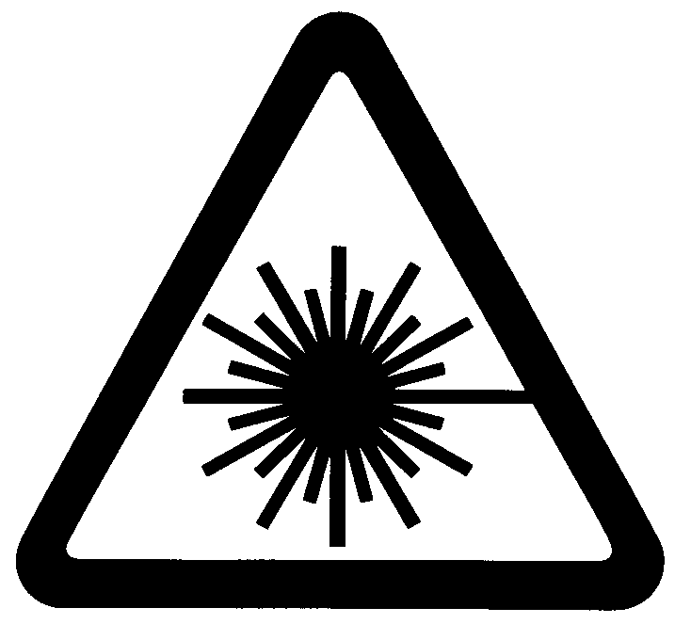
Other protection
Windows and doors
Fire extinguisher
Warning signs and lights
Interlocks
Reflective surfaces
LASER CONTROLLED AREA
Invisible Laser Beam
DO NOT ENTER
Notes:
The LPA will advise on other protection measures necessary. This may include shielding to windows and doors, to protect persons outside the laser room. It will certainly include the requirement for warning signs and/or lights.
The LPA will also advise on whether interlocks should be used, and consider whether reflective surfaces should be covered or removed.

Slide 55
Types of reflection
Specular
Reflection
Diffuse
Reflection
Notes:
It is important to realise that a laser beam can be reflected, just like any other source of light, and that the reflected beam may be just as hazardous as the main beam.
A specular, or mirror-like, reflection will preserve the narrowness of the beam. This type of reflection is likely from all shiny surfaces, such as glass or stainless steel.
A matt or roughened surface will tend to diffuse the reflection and this will reduce the hazard because the beam is spread out over a larger area. For this reason some safety advisers recommend matt paint for the walls of a laser room.

Slide 56
Specular and diffuse reflections
Notes:
This picture illustrates the difference between specular and diffuse reflections.
The calm stretch of water reflects the setting sun in an almost specular pattern, while the ripples on the other areas of water diffuse the reflection.

Slide 57
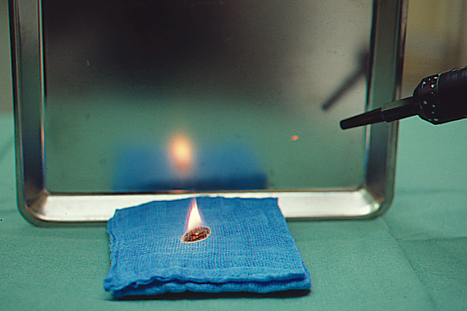
Specular reflection
Notes:
It is important to realise that metallic surfaces can reflect a laser beam, particularly a CO₂ laser beam, very well. Here a CO₂ beam is reflected off a stainless steel surface and is still quite capable of igniting a cloth.

Slide 58
Beware of reflections from:
Mirrors
Jewellery
Reflective surfaces in the room e.g. taps, pedal bins, trolleys, light fittings etc.
All metallic surfaces (shiny or not)
Remember: a reflection from a curved surface could re-focus the beam

Slide 59
Eye protection: safety glasses
Marked for use with correct laser/IPL
Marked with OD or Scale ‘L’ and wavelength(s)
All persons in the controlled area must use at all times unless agreed by LPA
CE marking + compliant with BS EN 207
Must use correct ones
If more than one type is needed, keep glasses in separate marked boxes
Designed to protect from brief accidental exposures
Do NOT assume they will protect from deliberate, prolonged direct exposures
Notes:
By far the most important safety precaution to take is to wear suitable safety glasses. A British and European Standard defines how these work and how they should be marked.
They should be marked with the wavelength against which they are designed to protect, and their optical density (OD). OD is a measure of the efficiency of protection, and the higher the number the better. More recently OD has been replaced by the Scale Number which means more or less the same thing.

Slide 60
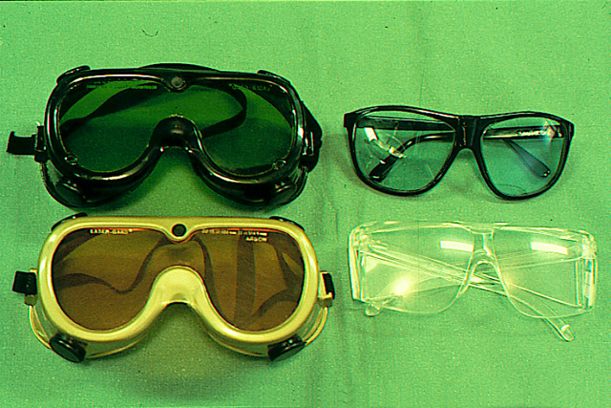
VIDEO CLIP No.9 – Eyewear
Notes:
Safety glasses come in a range of designs. The goggles on the left are efficient, but tend to alarm patients. They are also inconvenient for theatre use since they have no side vision panels and users tend to bump into things.
The spectacle type at the bottom right is usually the most convenient, since they fit over most corrective spectacles and are fairly comfortable to wear.

Slide 61
Other hazards
Fire or explosion
Cryogens
Biological – dye
Plume
Slips & trips
Manual handling
Electrical
Notes:
It is very easy to start a fire with most medical lasers. Flammable materials such as paper, drapes and clothing should, as far as possible, be removed from the target area. Flammable gases and liquids should not be used. Fire extinguishers must be provided for all laser rooms.
Some lasers (e.g. excimer) use cryogenic (very cold) liquids. These present a hazard in themselves and manufacturers safety instructions should be followed.
Dye lasers usually contain an organic dye which in some cases is believed to be carcinogenic. Any spillages of these liquids should be left alone and the service engineer or other expert contacted.

Slide 62
Accident procedure
Switch off laser.
Immediate first aid.
Eye examination if necessary.
Inform local Laser Safety Officer.
Inform Laser Protection Adviser.
Incident report form.
Accident book.
Report to HSE, etc.

Slide 63
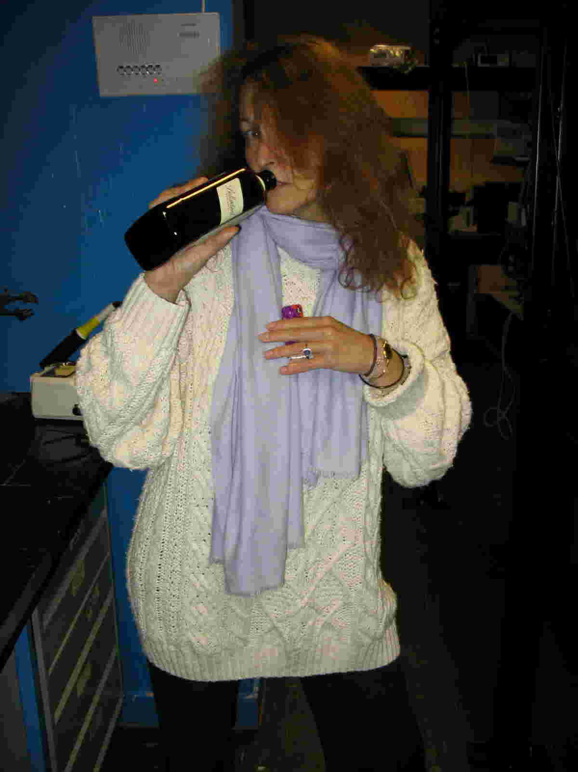
Practical Laser Safety!?

Slide 64
Practical Laser Safety - No!
Tie long hair back
Don’t drink or eat
In laser lab
Especially; avoid alcohol!
Remove watches and jewellery
(including wedding rings)
Avoid baggy jumpers and scarves
(correct temp. in lab is essential)

Slide 65
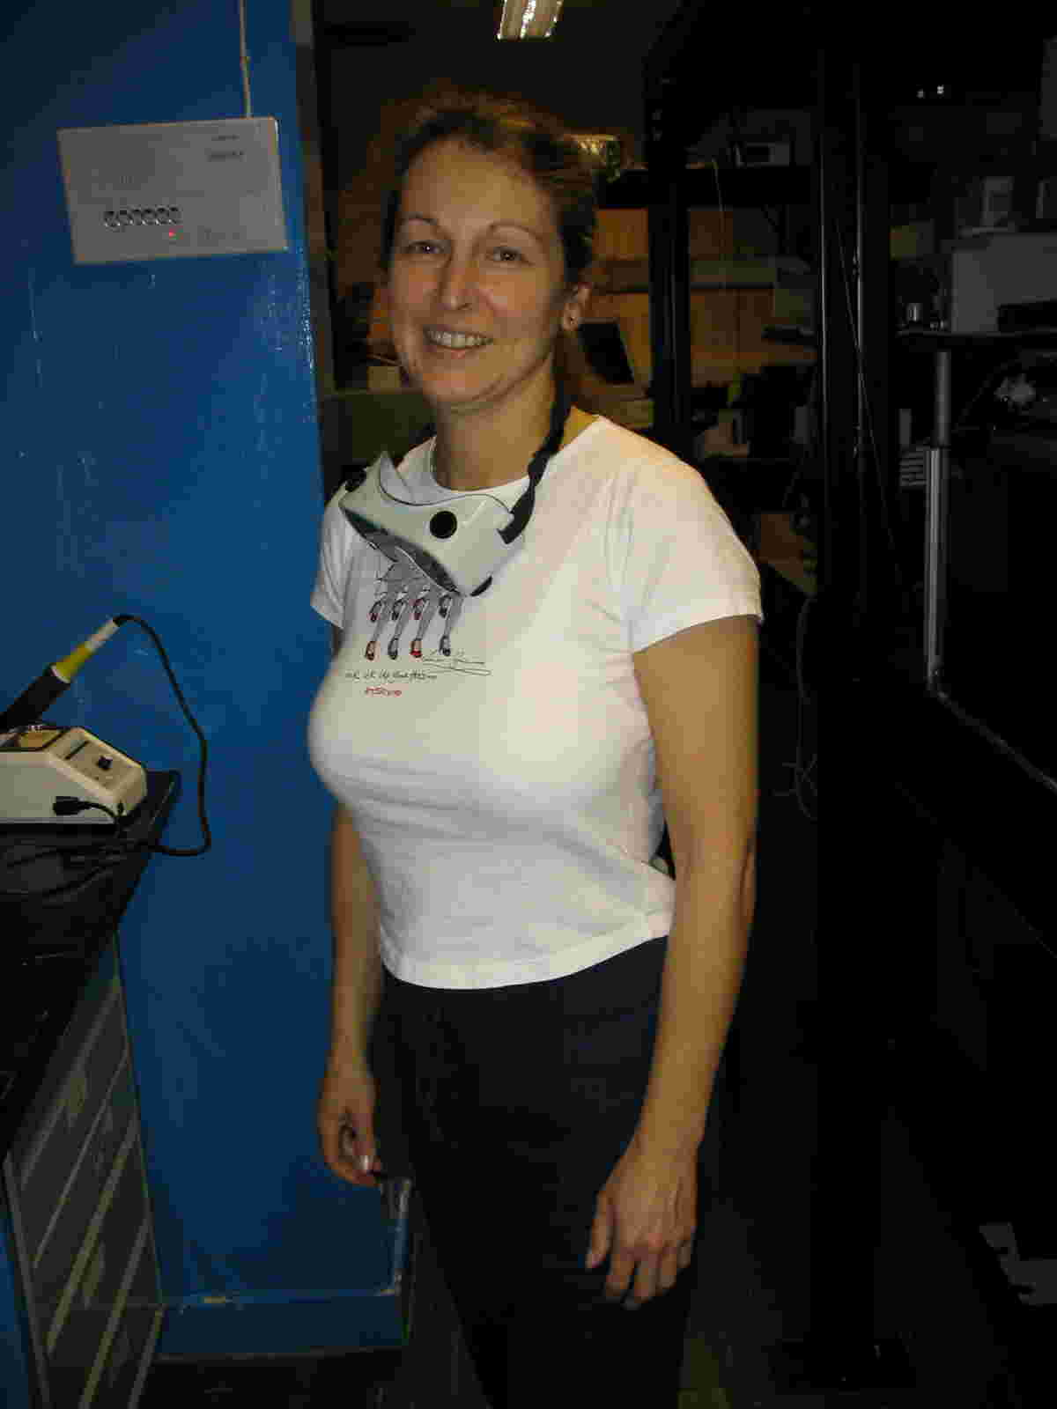
Practical Laser Safety? - Yes!
Hair restrained out of way
Appropriate safety goggle
Clear arms
and clothing unlikely to snag optics or cross beam paths
No watch or jewellery

Slide 66
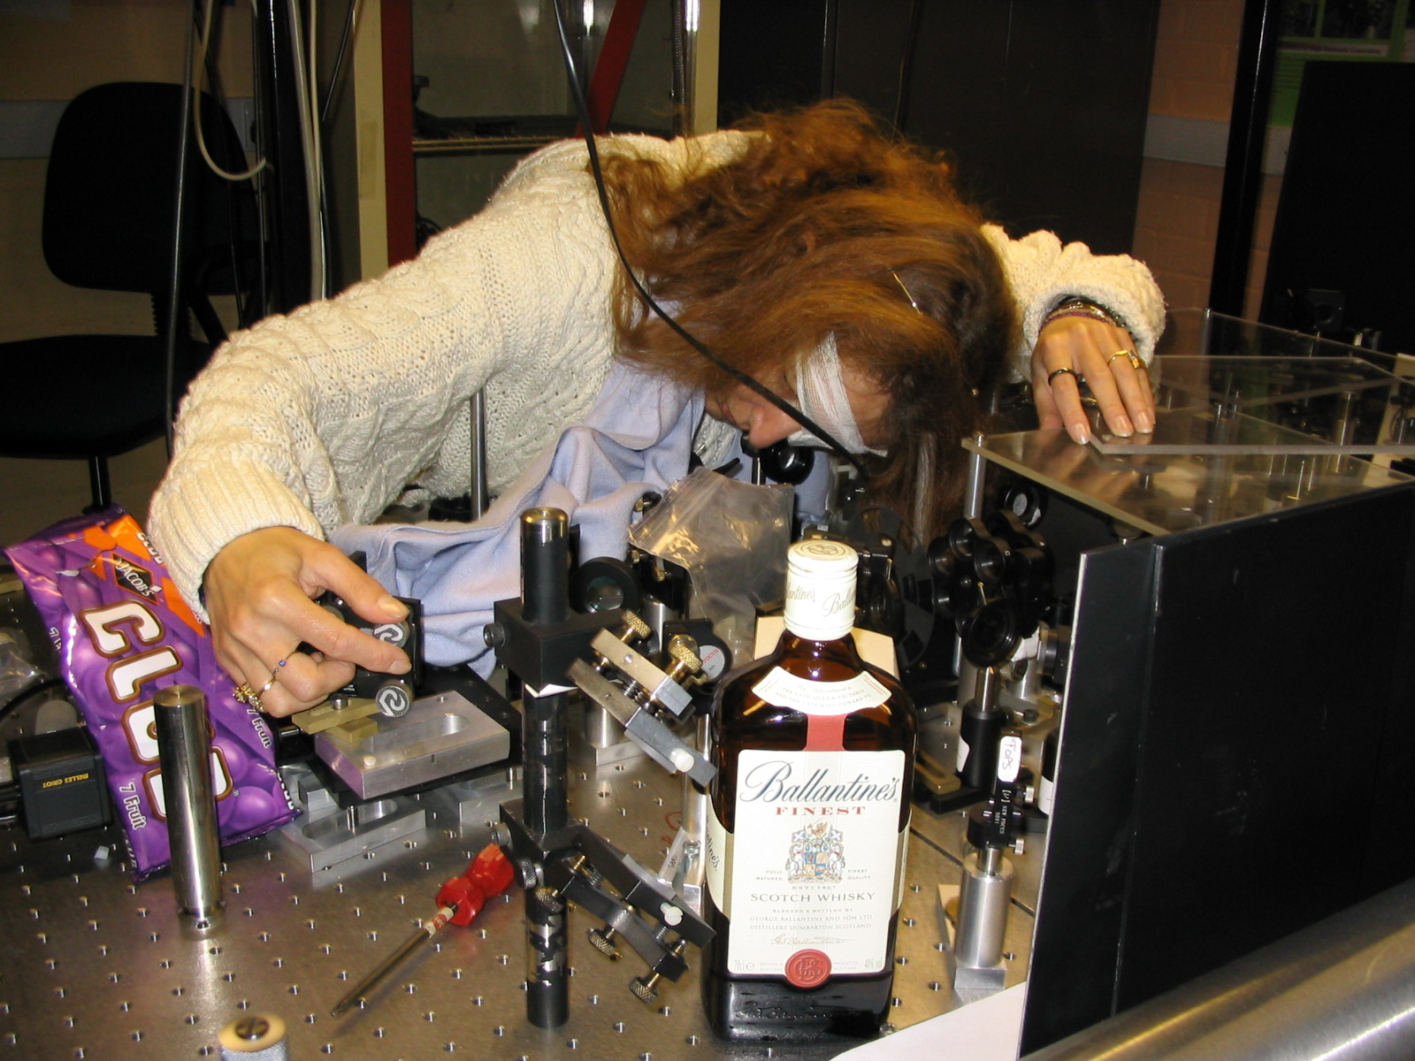
Practical Laser Safety?!

Slide 67
Practical Laser Safety – Definitely No!
Eyes at beam height - no safety goggles
Cable hanging down
Loose covers
Hair unrestrained
Loose clothing in beam
path
No laser screens
Jewellery
Periscope not enclosed
Unsecured optic
post
Tools on table
Area poorly lit
Food and drink in lab

Slide 68
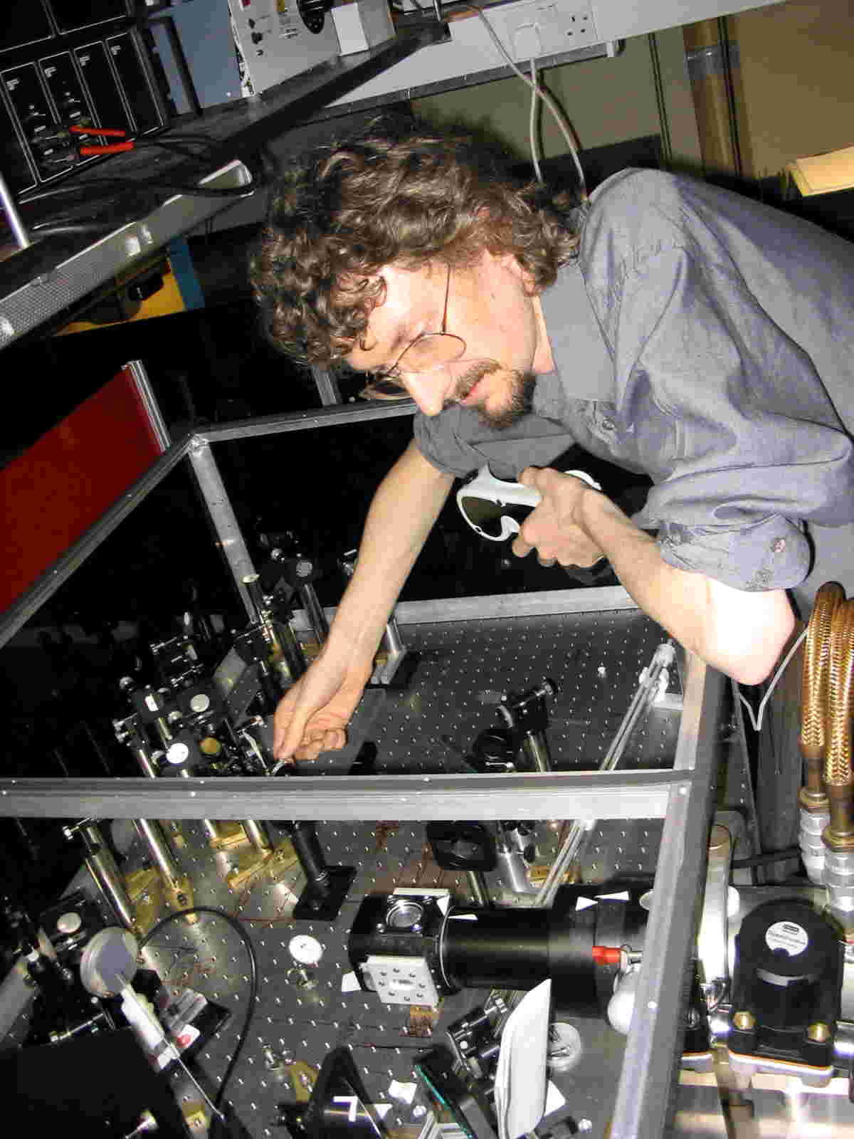
Practical Laser Safety - Yes!
Eyes well above beam height
and safety goggles available
Laser screens
No jewellery or watch
Clear arms
Uncluttered optical set-up and no tools on table
Properly secured optics
General area well lit

Slide 69
5 safety ‘bench’ rules
(1) Ensure all optics (lens, mirrors, etc) are securely fastened
in the correct optical mount
(2) Ensure all optical mounts (posts etc) are securely fastened
to the optical table - not loose
Always keep laser beams parallel to table surface
and preferably at one common height
(4) Always place beam stops as close as is practical to optics in set-up
(5) Never leave components or tools in optical set up
Note:
All components fastened securely to table - including the laser!
Laser beam parallel to table
Beam stop
Note:
Beam containment walls around optical table
(safety belt!)
Never leave objects
on optical table

Slide 70
Beam alignment strategies
Visible main laser:
(1) Use neutral density filter to reduce laser power to below 1 mW
(2) Use low power ancillary laser (< 1 mW) for initial alignment of optics
Infrared laser or UV laser:
ALWAYS use low power ancillary laser (< 1 mW) for initial alignment
Variable or removable neutral density filter
Main laser
Dicroic or flip mirror
HeNe alignment laser - use this laser for initial alignment of optics
HeNe
Beam containment walls
All lasers:
ALWAYS - start at lowest power setting and first check for stray beams

Slide 71
Changing beam height
(1) NEVER incline laser beams – always use periscopes
(2) NEVER work with laser beams above the table beam stops

Slide 72
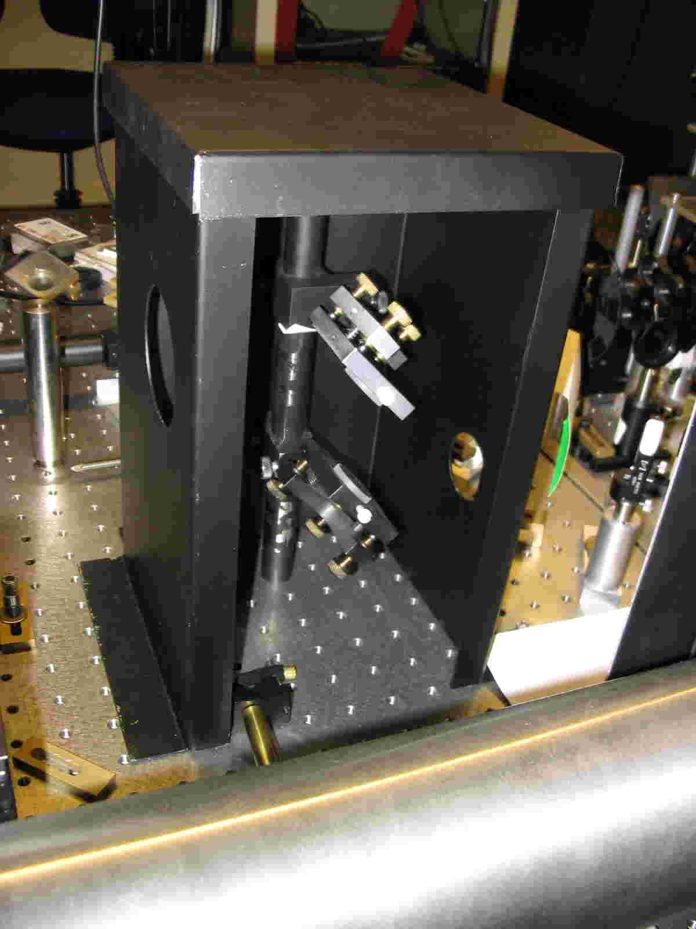
Changing beam height
Use periscope to change beam height - NEVER incline laser beams
Always enclose periscope

Slide 73
Periscopes - initial alignment strategy
(No laser required)
MUST HAVE - no laser lab should be without at least one
(1) Make a height rule
(2) Mark the in and out beam height on the rule
(3) Position centre of mirrors at correct height
(1) Position eye in line with rule and lower mirror
(2) Adjust bottom mirror until image of top
mirror is centred on bottom mirror
(1) Position eye in line with lower mirror
(2) Adjust top mirror until image of mark on rule
is centred on bottom mirror
SIMPLE - and much easer and safer that using a laser

Slide 74
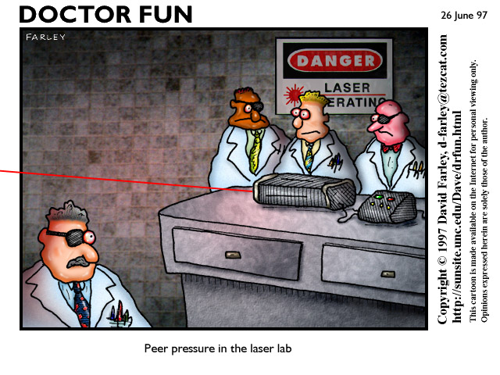

Slide 75
The End – Thank God
5 safety ‘bench’ rules
(1) Ensure all optics (lens, mirrors, etc) are securely fastened
in the correct optical mount
(2) Ensure all optical mounts (posts etc) are securely fastened
to the optical table - not loose
Always keep laser beams parallel to table surface and preferably
at one common height
(4) Always place beam stops as close as is practical to optics in set-up
(5) Never leave components or tools in optical set up
and
ALWAYS - start at lowest power setting and first check for stray beams

