Slide 1
Epidemic dynamics on networks
Kieran Sharkey
University of Liverpool
NeST workshop, June 2014

Slide 2
Overview
Introduction to epidemics on networks
Description of moment-closure representation
Description of “Message-passing” representation
Comparison of methods

Slide 3
Some example network slides removed here due to potential data confidentiality issues.

Slide 4
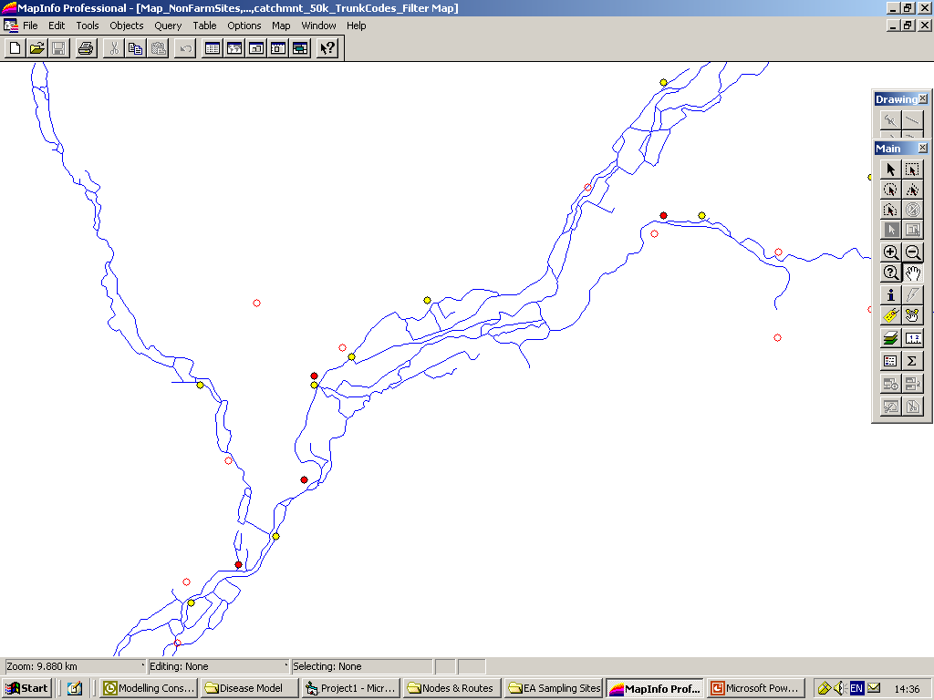
Route 2: Water flow (down stream)
Modelling aquatic infectious disease
Jonkers et al. (2010) Epidemics

Slide 5
Route 2: Water flow (down stream)
Jonkers et al. (2010) Epidemics

Slide 6
States of individual
nodes could be:
Susceptible
Infectious
Removed

Slide 7
The SIR compartmental model
States of individual
nodes could be:
Susceptible
Infectious
Removed
S
Infection
I
All processes Poisson
Removal
R

Slide 8
Contact Networks
1 2 3 4
0 0 0 0
0 0 1 0
0 1 0 0
1 1 0 0
2
1
2
3
4
3
1
4

Slide 9
Transmission Networks
1 2 3 4
0 0 0 0
0 0 T₂₃ 0
0 T₃₂ 0 0
T₄₁T₄₂ 0 0
2
T₂₃
1
2
3
4
T₃₂
3
1
T₄₂
T₄₁
4

Slide 10

Moment closure & BBGKY hierarchy
Probability that node i is Susceptible
i
$$T_{ij}$$
j
Sharkey, K.J. (2008) J. Math Biol., Sharkey, K.J. (2011) Theor. Popul. Biol.

Slide 11
Moment closure & BBGKY hierarchy
i
j
i
j
i
j
i
j
k
k
Sharkey, K.J. (2008) J. Math Biol., Sharkey, K.J. (2011) Theor. Popul. Biol.

Slide 12
Moment closure & BBGKY hierarchy
Hierarchy provably exact at all orders
To close at second order can assume:
Sharkey, K.J. (2008) J. Math Biol., Sharkey, K.J. (2011) Theor. Popul. Biol.

Slide 13
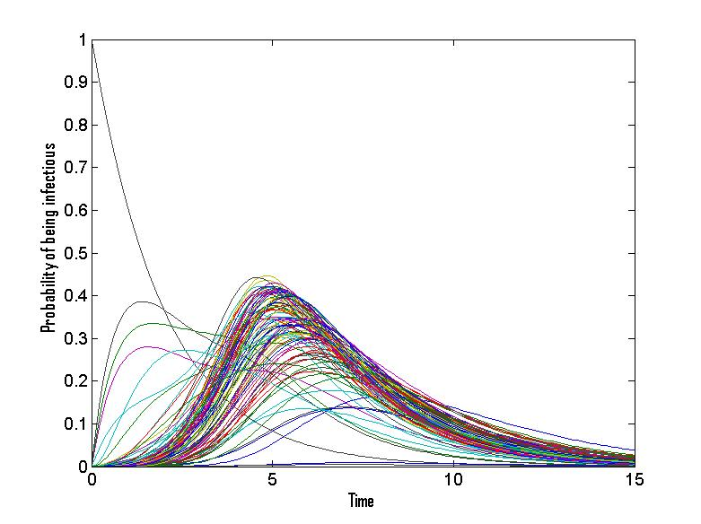
Random Network of 100 nodes
Sharkey, K.J. (2008) J. Math Biol., Sharkey, K.J. (2011) Theor. Popul. Biol.

Slide 14
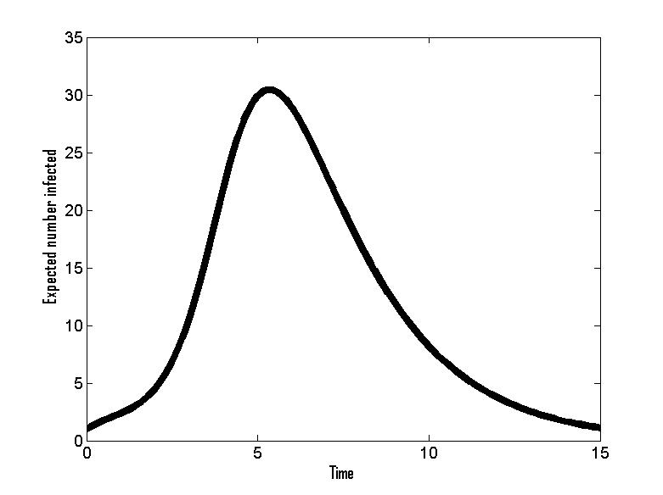
Random Network of 100 nodes
Sharkey, K.J. (2008) J. Math Biol., Sharkey, K.J. (2011) Theor. Popul. Biol.

Slide 15
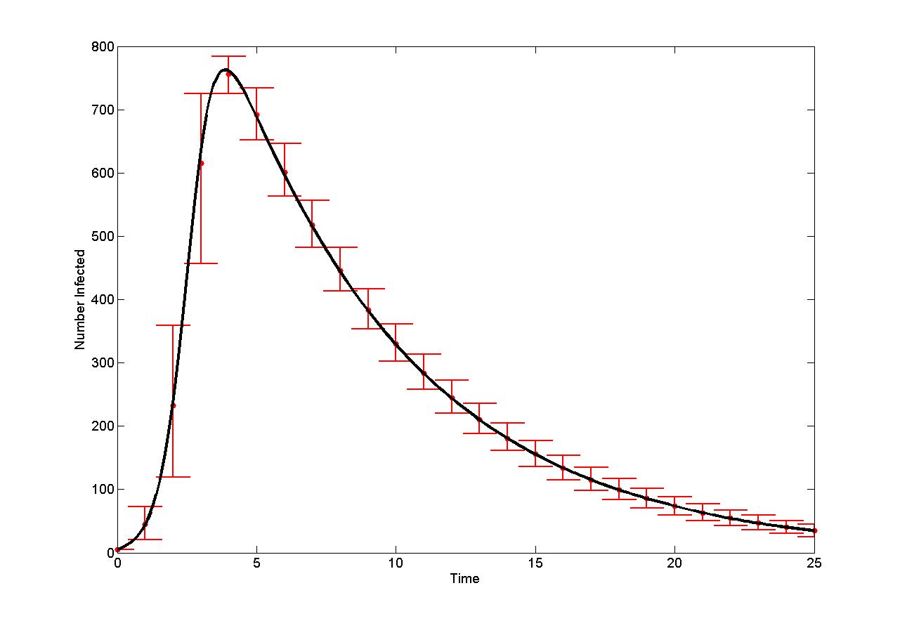
Random K-Regular Network
Sharkey, K.J. (2008) J. Math Biol., Sharkey, K.J. (2011) Theor. Popul. Biol.

Slide 16
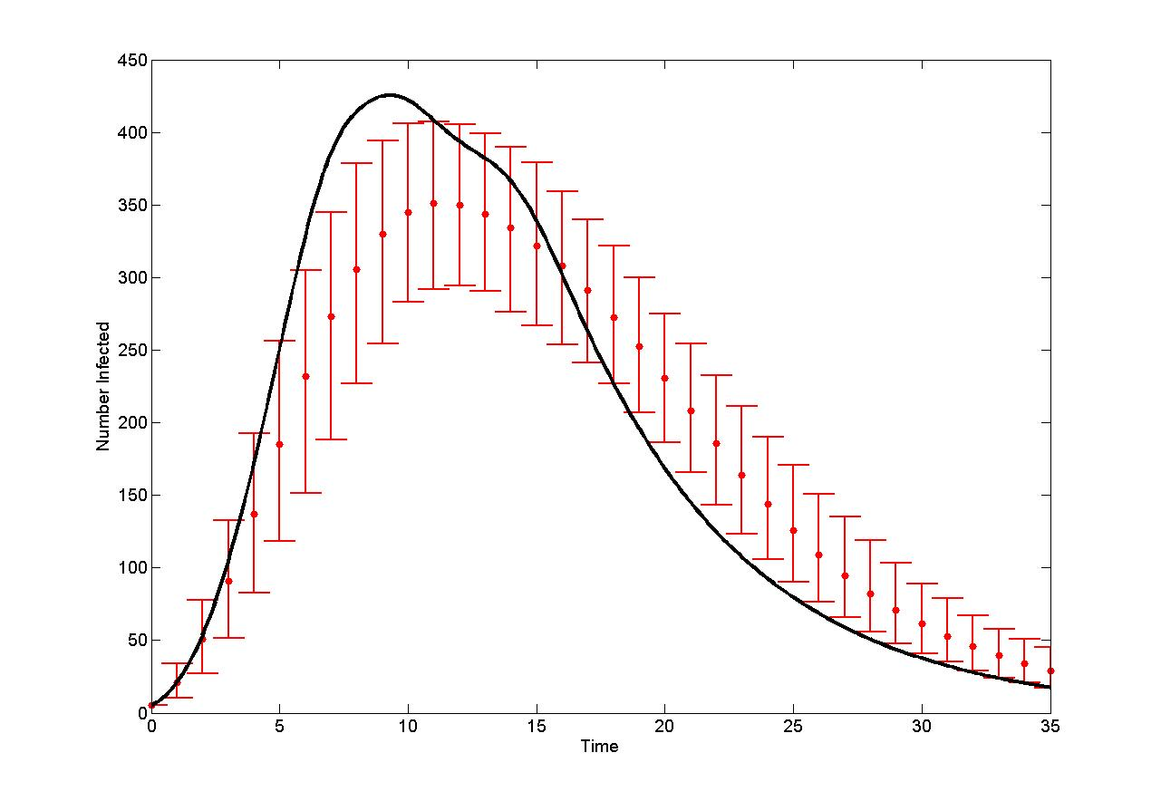
Locally connected Network
Sharkey, K.J. (2008) J. Math Biol., Sharkey, K.J. (2011) Theor. Popul. Biol.

Slide 17
Example: Tree graph
For any tree, these equations are exact
Sharkey, Kiss, Wilkinson, Simon. B. Math. Biol . (2013)

Slide 18
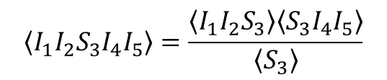
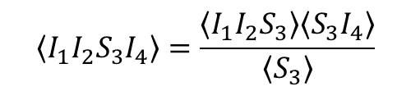
Extensions to Networks with Clustering
1
2
$$\left\langle I_{1}I_{2}S_{3}I_{4}\right\rangle =\frac{\left\langle I_{1}I_{2}S_{3}\right\rangle \left\langle S_{3}I_{4}\right\rangle }{\left\langle S_{3}\right\rangle }$$
3
4
1
2
$$\left\langle I_{1}I_{2}S_{3}I_{4}I_{5}\right\rangle =\frac{\left\langle I_{1}I_{2}S_{3}\right\rangle \left\langle S_{3}I_{4}I_{5}\right\rangle }{\left\langle S_{3}\right\rangle }$$
3
5
4
Kiss, Morris, Selley, Simon, Wilkinson (2013) arXiv preprint arXiv:1307.7737

Slide 19
Application to SIS dynamics
Closure:
Nagy, Simon Cent. Eur. J. Math. 11(4) (2013)

Slide 20
Moment-closure model
Exact on tree networks
Can be extended to exact models on clustered networks
Can be extended to other dynamics (e.g. SIS)
Problem: Limited to Poisson processes

Slide 21
Karrer and Newman Message-Passing
Karrer B and Newman MEJ, Phys Rev E 84, 036106 (2010)

Slide 22
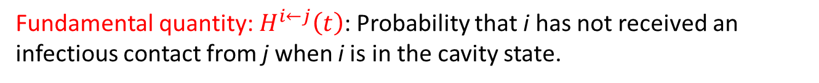
Karrer and Newman Message-Passing
j
i
Cavity state
Fundamental quantity: $H^{i←j}\left(t\right)$: Probability that i has not received an infectious contact from j when i is in the cavity state.
Karrer B and Newman MEJ, Phys Rev E 84, 036106 (2010)

Slide 23
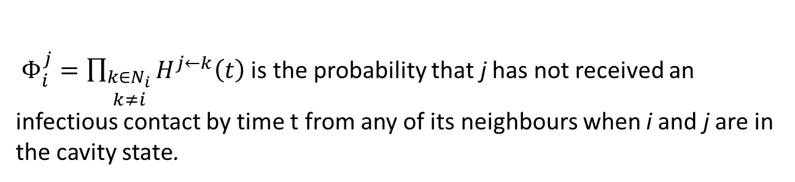
Karrer and Newman Message-Passing
j
i
Cavity state
Fundamental quantity: $H^{i←j}\left(t\right)$: Probability that i has not received an infectious contact from j when i is in the cavity state.
$Φ_{i}^{j}=\prod_{\begin{aligned}k∈N_{i} \\ k≠i\end{aligned}}{H^{j←k}\left(t\right)}$ is the probability that j has not received an infectious contact by time t from any of its neighbours when i and j are in the cavity state.
Karrer B and Newman MEJ, Phys Rev E 84, 036106 (2010)

Slide 24
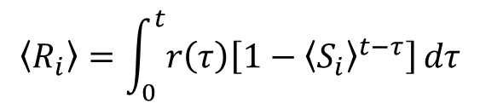
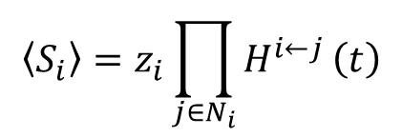
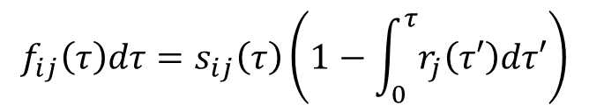
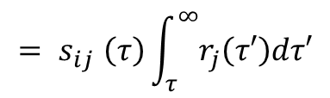
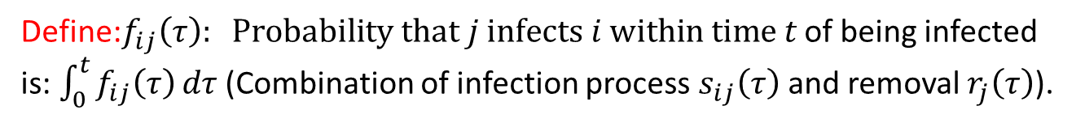

Karrer and Newman Message Passing
Define:$f_{ij}\left(τ\right): Probability that j infects i within time t$ of being infected is: $\int_{0}^{t}{f_{ij}\left(τ\right)}dτ$ (Combination of infection process $s_{ij}\left(τ\right)$ and removal $r_{j}\left(τ\right)$).
$$f_{ij}\left(τ\right)dτ=s_{ij}\left(τ\right)\left(1−\int_{0}^{τ}{r_{j}\left(τ′\right)dτ′}\right)$$
1 if j initially susceptible
$${= s}_{ij}\left(τ\right)\int_{τ}^{∞}{r_{j}\left(τ′\right)dτ′}$$
Message passing equation: $H^{i←j}(t)=1−\int_{0}^{t}{f_{ij}\left(τ\right)\left[1−z_{j}Φ_{i}^{j}\left(t−τ\right)\right]dτ}$
$$\left\langle S_{i}\right\rangle =z_{i}\prod_{j∈N_{i}}{H^{i←j}}\left(t\right)$$
$$\left\langle R_{i}\right\rangle =\int_{0}^{t}{r\left(τ\right)\left[1−{\left\langle S_{i}\right\rangle }^{t−τ}\right]}dτ$$
$$\left\langle I_{i}\right\rangle =1−\left\langle S_{i}\right\rangle −\left\langle R_{i}\right\rangle$$
Fundamental quantity: $H^{i←j}\left(t\right)$: Probability that i has not received an infectious contact from j when i is in the cavity state.
$Φ_{i}^{j}=\prod_{\begin{aligned}k∈N_{i} \\ k≠i\end{aligned}}{H^{j←k}\left(t\right)}$ is the probability that j has not received an infectious contact by time t from any of its neighbours when i and j are in the cavity state.
Karrer B and Newman MEJ, Phys Rev E 84, 036106 (2010)

Slide 25
Karrer and Newman Message-Passing
Applies to arbitrary transmission and removal processes
Not obvious to see how to extend it to other scenarios including
generating exact models with clustering and dynamics such as SIS
Useful to relate the two formalisms to each other
Karrer B and Newman MEJ, Phys Rev E 84, 036106 (2010)

Slide 26
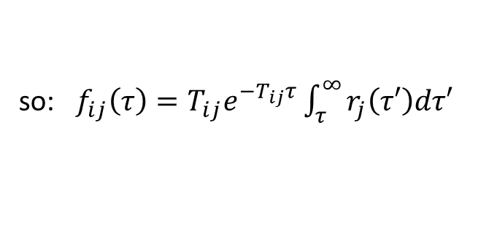

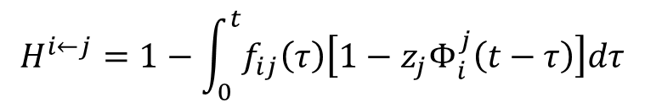
Relationship to moment-closure equations
$$H^{i←j}=1−\int_{0}^{t}{f_{ij}\left(τ\right)\left[1−z_{j}Φ_{i}^{j}\left(t−τ\right)\right]dτ}$$
When the contact processes are Poisson, we have: $s_{ij}\left(τ\right)=T_{ij}e^{−T_{ij}τ}$
so: $f_{ij}\left(τ\right)=T_{ij}e^{−T_{ij}τ}\int_{τ}^{∞}{r_{j}\left(τ′\right)dτ′}$
$$\frac{dH^{i←j}\left(t\right) }{dt}=−T_{ij}\left[H^{i←j}\left(t\right)−z_{j}Φ_{i}^{j}\left(t\right)−\int_{0}^{t}{r_{j}\left(τ\right)e^{−T_{ij}τ}\left(1−z_{i}Φ_{i}^{j}\left(t−τ\right)\right)dτ}\right]$$
$$\left\langle S_{i}S_{j}\right\rangle =z_{i}z_{j}Φ_{j}^{i}\left(t\right)Φ_{i}^{j}\left(t\right)$$
$$\left\langle S_{i}I_{j}\right\rangle =z_{i}Φ_{j}^{i}\left(t\right)\left[1−z_{j}Φ_{i}^{j}\left(t\right)−\int_{0}^{t}{\left(f_{ij}\left(τ\right)+g_{ij}\left(τ\right)\right)}×\left(1−z_{j}\right)Φ_{i}^{j}\left(t−τ\right)dτ\right]$$
Wilkinson RR and Sharkey KJ, Phys Rev E 89, 022808 9 (2014)

Slide 27
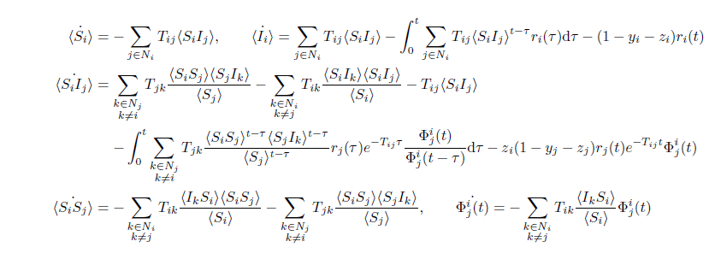
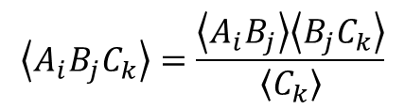
Relationship to moment-closure equations
When the removal processes are also Poisson: $r_{i}\left(τ\right)=g_{i}e^{−g_{i}τ}$
$$\left\langle A_{i}B_{j}C_{k}\right\rangle =\frac{\left\langle A_{i}B_{j}\right\rangle \left\langle B_{j}C_{k}\right\rangle }{\left\langle C_{k}\right\rangle }$$
Wilkinson RR and Sharkey KJ, Phys Rev E 89, 022808 9 (2014)

Slide 28
Relationship to moment-closure equations
When the removal process is fixed, Let $r_{i}\left(τ\right)=δ\left(τ−d_{i}\right)$
Wilkinson RR and Sharkey KJ, Phys Rev E 89, 022808 9 (2014)

Slide 29
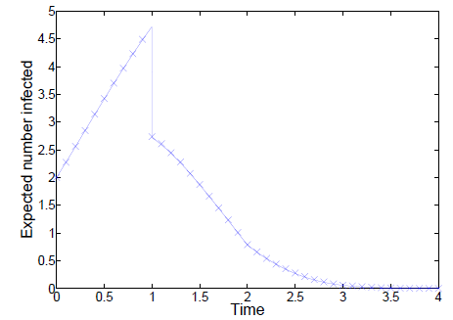
SIR with Delay
Wilkinson RR and Sharkey KJ, Phys Rev E 89, 022808 9 (2014)

Slide 30
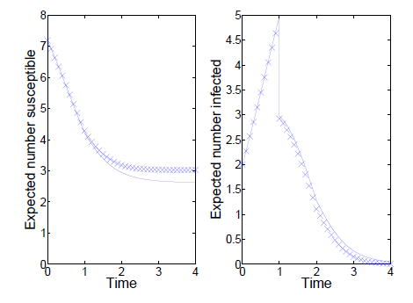
SIR with Delay
Wilkinson RR and Sharkey KJ, Phys Rev E 89, 022808 9 (2014)

Slide 31
Summary part 1
Pair-based moment closure:
Exact correspondence with stochastic simulation for tree networks.
Extensions to:
Exact models in networks with clustering
Non-SIR dynamics (eg SIS).
Limited to Poisson processes
Message passing:
Exact on trees for arbitrary transmission and removal processes
Not clear how to extend to models with clustering or other dynamics

Slide 32
Summary part 2
Linking the models enabled:
Extension of the pair-based moment-closure models to include arbitrary removal processes.
Proof that the pair-based SIR models provide a rigorous lower bound on the expected Susceptible time series.
Extension of message passing models to include:
a)Heterogeneous initial conditions
b)Heterogeneous transmission and removal processes

Slide 33
Acknowledgements
Robert Wilkinson (University of Liverpool, UK)
Istvan Kiss (University of Sussex, UK)
Peter Simon (Eotvos Lorand University, Hungary)

