Slide 1
Clinical Assessment of Children with Suspected Central Nervous System Infections
Tom Solomon, Penny Lewthwaite,
Rachel Kneen, Sri Hari, Mong How Ooi
Viral Brain Infections Group University of Liverpool, UK
www.liv.ac.uk/braininfections

Slide 2
Introduction
This teaching tool has been developed at the request of clinicians and health care workers in areas where Japanese encephalitis (JE) is endemic
It has been produced with the financial support of the JE Program, PATH, Seattle
Two versions exist:
A smaller file with no video clips which is available for download
A larger file with video clips which is available on CD ROM
The tool is freely available, but when using it, please acknowledge the University of Liverpool, UK and PATH, (or give other credits as indicated)

Slide 3
Other resources
There are many other excellent resources available to aid health care workers in assessing sick children, and examining the nervous system
Health care workers are advised to refer to them for a detailed consideration of the topics
This tool is an additional resource, that addresses specifically some of the issues relating to children with suspected Japanese encephalitis

Slide 4
History – General questions
For the sick child, ABCD first
Airways, Breathing, Circulation, Disability
Ask about:
Fever, history of fever
Note that even if a child is not febrile at this time, a history of fever is important
Cough, coryza
Diarrhoea, vomiting
Food and fluid intake
Urine output
Immunization history

Slide 5
History – relating to JE epidemiology
Is this an area where JE occurs?
Is this the JE season?
In much of the tropics the season begins soon after the rainy season
However in many areas there is low level transmission even out of season
Have other children been developing a similar illness?
Does the child live in a rural area, where JE is more likely?
Note that JE also occurs on the edges of some cities in Asia

Slide 6
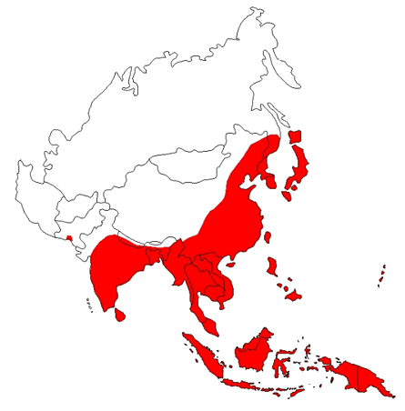
The current geographical distribution of Japanese encephalitis
.
http://www.cdc.gov/NCIDOD/DVBID/jencephalitis/map.htm
Return

Slide 7
Are there epidemiological features to suggest that this is NOT JE?
Are animals becoming sick?
In most of Asia where JE is endemic, the virus does not cause disease in birds or swine (though it may cause abortions in pregnant swine)
Are many adults affected?
In most of Asia where JE occurs it causes less disease in adults than children (or no disease in adults at all), because most individuals have been exposed to the virus and developed immunity during childhood

Slide 8
History – relating to neurological disease
Ask about:
Stiff neck
Photophobia (fear of light), phonophobia (fear of noise)
Confusion / irritability / restlessness / mutism
Altered behaviour
Sometimes mistakenly attributed to psychiatric illness
High pitch cry
Limb weakness
Has the child stopped walking, or stopped using one hand

Slide 9
History of seizures or abnormal movements
Ask about abnormal movements of eyes, face, limbs
When taking a history, distinguishing convulsions from spasms, tremors and rigors is difficult.
Actions speak loader than words!
Get the parent to mimic exactly what the child did. They are more likely to do this of the health care worker sets an example
The distinction is important because
Seizures may need anticonvulsant drugs
Characteristic spasms and tremors are seen in some types of viral encephalitis (eg.g JE), and so may point towards the diagnosis

Slide 10
Paediatric examination in practice
Observation is the key.
A full formal neurological examination is time consuming and will not be tolerated by small children, however you can do much of the examination by just observing
Click Here for revision of a more detailed neurological examination, which may be possible in older children who are fully cooperative

Slide 11
More detailed examination of cranial nerves I-VII
I Olfactory
is the sense of smell normal?
II Optic
Is visual acuity normal?
Do the pupils react to light and to accommodation?
Are the visual fields normal to confrontation?
Are the optic fundi normal?
III Occulomotor; IV Trochlear; VI Abducens
Are the eye movements normal?
Is one pupil dilated (IIIrd nerve lesion)?
V Trigeminal
Is sensation normal on the face (and cornea), and is jaw power normal?
VII Facial
Is there facial weakness?

Slide 12
More detailed examination of cranial nerves VII-XII
VII Vestibulocochlear
is hearing reduced?
IX Glossopharyngeal
Is sensation in the pharynx normal (tested by eliciting the gag reflex)?
X Vagus
Do both sides of the palate move when the patient says “Ahh”? (And during the gag reflex?)
XI Accessory
Do the shoulders lift? Is power of head turning normal?
XII Hypoglossal
Does the tongue look and protrude normally

Slide 13
Detailed peripheral nervous system examination
Tone
Reflexes
Power
Sensation
Joint position; pin prick; vibration; light touch; temperature
Coordination, including finger nose, dysdiodochokinesis, heel shin and gait

Slide 14
Assess power in the limbs
If the child can cooperate, assess power of flexion and extension at each joint, using the MRC Grading:
Grade 5 – normal
Grade 4 – reduced
Grade 3 – only just strong enough to overcome gravity
Grade 2 – not strong enough to overcome gravity
Grade 1 – a flicker of movement
Grade 0 – no movement at all
Return

Slide 15
Examination - General
Observe the child’s behaviour and actions, even whilst taking the history.
Look for:
Skin turgor
Capillary refill time
Rash, petechiae/non-blanching
Bruising
Positive tourniquet test
Examine the ear nose and throat

Slide 16
The tourniquet test for dengue
Inflate the BP cuff to half way between systolic and diastolic for 5 minutes.
20 or more petechiae per 2.5 cm2 is a positive test for dengue
- sensitivity 40% specificity 95% - Cao et al (2002)
- Photos Solomon, T. (2003) In Manson's Tropical Diseases, 2003
Return

Slide 17
Remember:
The examination is not complete without an examination of other systems,
including skin,
respiratory,
cardiovascular
gastrointestinal systems.

Slide 18
Assess the breathing rate and pattern, and listen to the chest
An abnormal rate and pattern may indicate
Aspiration pneumonia, which is common in JE
Metabolic acidosis, which is common in any sick dehydrated child
Brain stem damage, which is common in JE

Slide 19
Neurological examination
Observe, as much as you can, before disturbing the child
Begin to examine with minimal disturbance
Examining the uncooperative child can be difficult
Look for:-
Bulging fontanelle
Neck stiffness
Test for Kernig sign
With the child lying on their back, and the hip and knee flexed, extend the knee
The test is positive if this causes back pain Reduced spontaneous movements of one or more limb
Abnormal limb posture

Slide 20
Abnormal limb posture - a sign of focal brain damage causing hemiparesis or monoparesis
Photo: T Solomon
Photo: T Solomon
Return

Slide 21
Assess the coma score
The Glasgow coma score is the most widely used score
A modified coma score exists for children <5 years old
A simple AVPU score allows a very rapid initial assessment, and is better than nothing

Slide 22
Glasgow Coma Score and the James Modification for children < 5 years*
 | Children > 5 years | Children < 5 years
Eye opening
4 | Spontaneous | Spontaneous
3 | To voice | To voice
2 | To pain | To pain
1 | None | None
Verbal
5 | Orientated | Alert, babbles, coos, words or normal sentences
4 | Confused | Less than usual ability, irritable cry
3 | Inappropriate words | Cries to pain
2 | Incomprehensible sounds | Moans to pain
1 | No response to pain | No response to pain
Motor
6 | Obeys commands | Normal spontaneous movements
5 | Localises to supraocular pain | Localises to supraocular pain or withdraws to touch in infant <9/12
4 | Withdraws from nailbed pressure | Withdraws from nailbed pressure
3 | Flexion from nailbed pressure | Flexion from nailbed pressure
2 | Extension to supraocular pain | Extension to supraocular pain
1 | No response to supraocular pain | No response to supraocular pain
.
*References are given at the end
Return

Slide 23
The AVPU rapid assessment of consciousness level
A ALERT
V responds to VOICE
P responds to PAIN
U UNRESPONSIVE
Return

Slide 24
Abnormal movements and seizures
Abnormal movements
of face or mouth (orofacial dyskinesias common in JE)
Limb tremors (common in JE)
Seizures
Generalised tonic clonic seizures
Subtle motor seizures
These may indicate a child is in electrical status epilepticus

Slide 25
Examine the eyes
Assess the pupillary reactions to light
Poorly reactive or asymmetrical pupils may indicate brain stem damage
Test the oculocephalic reflex (doll’s eye reflex)
Normally the eyes remain central when the head is rolled to left and right
Abnormality of this reflex may indicate brainstem damage
Examine the optic discs for papilloedema
Not often seen in JE

Slide 26
Other signs of brainstem damage
Check gag reflex
lost in deep coma, or brainstem damage
Look for facial asymmetry
in response to pain, if necessary
Look for
Opisthotonus
Flexor (“decorticate”) posturing
Extensor (“decerebrate”) posturing

Slide 27
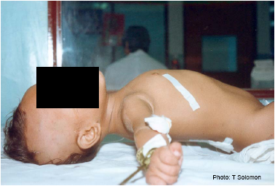
Opisthotonus in JE
Return

Slide 28
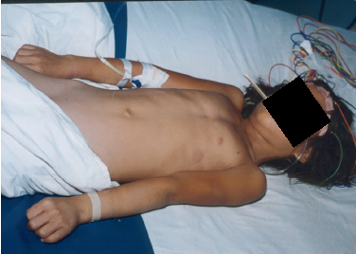
Extensor posturing in JE
Return

Slide 29
Assessing tone in the arms
Examine tone in the arms
Gently bend the arm at the wrist and elbow joints, use circular movement
Is there cog-wheel rigidity?

Slide 30
Examining tone in the legs
Gently roll the leg from side to side
Does the foot gently rock? (normal)
Does it flop about too much? (flaccid tone)
Or is it stiff (increased tone)
Hold the leg behind the knee, and quickly pull the knee off the bed.
Does the whole leg lift up (increased tone)
Or does the heel remain on the bed? (normal)
Test for flaccid tone with the “frog’s legs test”
Do the legs flop out because of reduced tone?
Test for ankle clonus:
with the knee flexed, quickly flex the ankle and hold the pressure on
If there more than 5 beats this is a positive test for ankle clonus

Slide 31
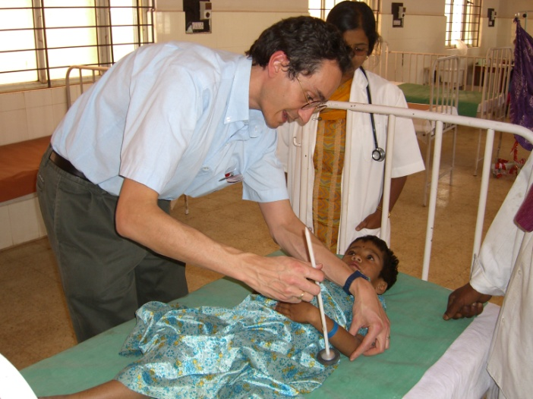
Examining the reflexes
First demonstrate the use of the tendon hammer on yourself or an assistant, so that the child is not frightened.
Test upper limbs
biceps, triceps, supinator
Test lower limbs,
knee jerk, ankle jerk
Are the deep tendon reflexes:
Normal
Increased (upper motor neuron damage)
Decreased/absent (lower motor neuron damage)
Test plantar (Babinski) reflexes
Are they flexor (down, normal), or extensor (up, abnormal)

Slide 32
Further PNS examination
Examine limb movement
Observe: is there spontaneous movement of all 4 limbs?
If not, do all limbs withdraw from pain?
Test Abdominal reflexes
often absent in JE if the spinal cord is involved
Is the bladder distended?
Due to bladder muscle paralysis, common in JE

Slide 33
The “frog’s leg” test for flaccid Leg weakness
The health care worker draws up the knees with the legs bent; when they are released they flop out into a frog’s legs position, because they are flaccid (floppy)
Return

Slide 34
Gait
If the child is able to walk,
observe the gait, and also ask them to try heel toe walking

Slide 35
References
General
Advanced Paediatric Life Support – the Practical Approach. 2nd edn. Advanced Life Support Group. BMJ Books, 1997
Gunn VL, Nechyba C, eds. The Harriet Lane Handbook: a manual for pediatric house officers.16th ed. St.Louis, MO: Mosby-Year Book, Inc.; 2002.
Solomon, T. and R. Kneen (2004). Neurological Presentations. Lecture Notes on Tropical Medicine. N. Beeching and G. Gill. Oxford, Blackwell Science.
Glasgow Coma Scale
Teasdale G, Jennett B. Assessment of coma and impaired consciousness. A practical scale. Lancet 1974;2:81-4.
James modification of Coma Scale for children < 5 years
James, H. and D. Trauner (1985). The Glasgow Coma Scale. Brain insults in infant and children. Pathophysiology and management. H. James, N. Anas and R. Perkin. Orlando, Grune and Stratton: 179–82.

Slide 36
Acknowledgements
We are grateful to the children, their parents and guardians for granting permission for the videos and photos used in this teaching tool
We also thank the Director Dr K Naseeruddin, the Head of Paediatrics Dr Veera Shankar, and the Head of Medical Microbiology Dr R Ravikumar, of Vijayanagar Institute for Medical Science (VIMS), Bellary, India, for their support
This teaching tool was funded by the JE program at PATH.
The Medical Research Council of the United Kingdom, and the Wellcome Trust of Great Britain funded some of the work shown here.
Please send comments and suggestions to tsolomon@liv.ac.uk or via www.liv.ac.uk/braininfections

