Slide 1


Slide 2


PGR Training and Funding Opportunities
Hayley Meloy
Faculty PGR Development Officer
Faculty PGR Induction 2019

Slide 3
Development Needs Analysis
Two key purposes:
For individual students to identify their personal training requirements and develop a bespoke training plan, in liaison with their supervisors, which should then also be discussed at the Annual Progress Review Independent Progress Assessment Panel.
To identify gaps in training provision across cohorts. Departmental Directors of PGR read the DNAs for all PGRs within their Department, to analyse trends and identify gaps in provision. This information is passed up the School Director of PGR, who will be able to assess whether certain training needs are specific to individual departments, or whether there are trends across the School or Faculty. Relevant training can then either be (a) more widely publicised, if already existing, or (b) newly developed to address the identified gaps.

Slide 4
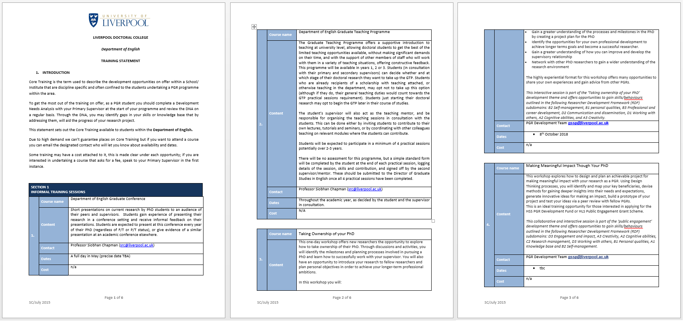
Departmental Training Statements
Each Department has its own PGR Departmental Training Statement, which can be found here: https://www.liverpool.ac.uk/intranet/doctoral-college/development/catalogue/humanities-and-social-sciences/

Slide 5



engage@liverpool
engage@liverpool is a cross-faculty research and methods initiative at the University of Liverpool.
Series of Methodological Training Events
Short Course (5 Credit) Research Methods Modules
Biennial Digital Research Methods Festival
Check out the engage@liverpool website www.liverpool.ac.uk/engage
Follow us on twitter: @livuniengage
Sign up to the engage mailing list by sending "subscribe engagelist" to LISTSERV@LISTSERV.LIV.AC.UK
Visit our YouTube channel: https://www.youtube.com/user/engageatliverpool

Slide 6

Methods North West
Methods North West is a cross-institutional initiative which brings together engage@liverpool, methods@manchester, methods@lancaster and links@keele
Publicises events taking place across the consortium ‘ampersands’, accessible to students from any institution
Funds innovative methodological and thematic collaborative events
Runs the Methods X Programme, which consists of five interdisciplinary and cross-institutional methodological themes for PGRs to engage with:
  New Forms of Data / Digital Methods
  Quantitative Methods
  Ethnography
  Archives, Collections and Documents of Life
  Interview-based Qualitative Research

Slide 7
Funding for Events
There is funding available for PGRs to develop their own training events, workshops and conferences. These schemes include:
Faculty PGR Development Fund
https://www.liverpool.ac.uk/humanities-and-social-sciences/postgraduate-research/pgrdevfund/
engage@liverpool Methodological Innovation and Development Award Scheme (MIDAS)
https://www.liverpool.ac.uk/engage/funding-opportunities/methodological-innovation-development-awards/
Methods North West Collaborative Innovation Grants
http://www.methodsnorthwest.ac.uk/news/

Slide 8

Faculty PGR Bulletin and Twitter
You will automatically receive a fortnightly Faculty PGR Bulletin, which details funding opportunities, events and news relevant to PGRs across the Faculty. PGRs are very welcome to submit items for inclusion in this bulletin, just send an email to hsspgr@liv.ac.uk
You can also receive updates on Twitter by following @LivUniHSS_PGR

Slide 9

ANY QUESTIONS?

