Slide 1
Machine translation literacy and language education: teaching, learning and using languages in the digital age.
Online workshop: Digitales Lernen und die Bewertung sprachlicher Leistungen im DaF-Unterricht in Großbritannien. Centre for Teaching Excellence in Language Learning, University of Liverpool, 20 January 2023.
Thomas Jochum-Critchley (University of York)

Slide 2
Introduction
Language learning is
communicative & social
plurilingual
open ended
embodied & multimodal
transformative & political

Slide 3
Overview
Teaching, learning & using languages in the digital age
Machine Translation (MT) & language education
MT literacy for language education
Notes:
Before giving you an overview what awaits you in this talk, I’d like to issue a word of caution / warning, just to set expectations right:
Aims of this talk
Give ideas for exploration
Articulate questions / challenges
otentially even change your perspective on the issues discussed
BUT NOT – providing definite answers/recipes.
This doesn’t seem to be adequate anyway, especially in this topic which is very much in flux with new perspectives, developments and issues arising constantly. One of which you might have also noticed is the advanced in “text production” based on Artificial Intelligence or machine learning. I will comeback to this briefly when talking about MT.

Slide 4
The digital age
Ubiquitous presence of digital technologies & devices
Hyperconnectivity” (Wellmann, Quan-Haase)
Instantaneous access to information/data
Vast data collection about human interaction & behaviour
Virtually unlimited data processing capabilities
trans(?)/formative influence on people’s lives
➔ reconfiguration of spaces, places & bodies
Notes:
Important“: Eurocentric view? We must not forget the digital divisions
Computer mediated & increasingly generated communication
digital age – not only since COVID – longer process; but COVID accelerated developments, and permeated changes much more broadly across society
but: still Eurocentric? - digital divides are increasing

Slide 5
Language use in the digital age
New communicative practices / situations
Speaking to bots, texting, listening to automated messages, listening to music with lyrics scrolling, using emojis, listening to Google maps, speaking to Alexa or other voice assistants, reading automated subtitles, …
New types of language (Storrer, A., 2018; 2020)
“interactive writing” Hybridisation of speaking & writing
New technologies
Speech recognition, machine translation, text improvement & production, text to speech technology …
New types of interaction
Human – computer interaction
Notes:
digital age
“Interaktionsorientiertes Schreiben” / “mündlich geprägtes Schreiben”

Slide 6
Language proficiency
“Language is holistically unobservable except through manifest observations: that is, through instances of people’s language performances, captured through various observational techniques.” (Winke & Brunfaut, 1)
Notes:
Proficiency is only observable through performance.
Always two involved / language performance in language use never only the individual is at stake, it’s always a social act

Slide 7
Language proficiency
“Nowadays, a relatively complex and multidimensional conceptualization of language proficiency tends to underlie the teaching, learning, and assessment of foreign languages, one which acknowledges that there are different communicative skills, communicative strategies, and a variety of linguistic competences (for example vocabulary, grammar, socio-pragmatic).” (Harsch, 251)
Notes:
Language proficiency – narrower vs wider conception
But here still very much centred around skills, strategies and linguistic competences

Slide 8
Language proficiency
Knowledge & skills / procedural & declarative knowledge
SLA Research: CALF + Communicative adequacy
CEFR: “Overall Language Proficiency”
→Linguistic
→Sociolinguistic
→Pragmatic
Reception
Production
Interaction
Mediation
Reception
Production
Interaction
Mediation

Slide 9
Language proficiency levels
“Providing a systematic approach to the definition of language proficiency levels, the framework serves as a reference for language teaching in Europe and is also referred to in professional contexts in which language competence needs to be assessed.” (Benites, Lehr, 2022: 48)
BUT: (Implicitly) Based on human performance alone!
What about
Notes:
Surprising absence of technology in the CEFR; no mention of digital capabilities in contributing to performance

Slide 10
Language proficiency levels
General proficiency
Proficiency profile
Council of Europe, 2018, 34 & 39
Notes:
linear / encompassing levels of proficiency; also of partial proficiencies
profile – shows some variation across different skills – but general

Slide 11
Teaching – learning - using languages
“linear” relationship
teaching - teacher
learning - learner
using - user
“complex” relationship
teaching
using
learning
Notes:
Language teaching – developing language proficiency
Roles/agency: dominant opposition: teacher=competent user – learner=deficient user + exclusion of other users
Teacher: knowledge source: model of (spoken) language; privileged access to language material
Learner
Spaces/places – dominant opposition: classroom-home+exclusion of public/social spaces
Classroom: focus of interaction – teacher/learner; learner/learner; organizes learning process; spatially, temporally, socially
“Home” – learner: homework; teacher: marking; both: class preparation
Language acquisition – or rather language development is a complex and dynamic process. The language learner is not merely acquiring a new language system, mainly by interacting with the teacher and materials, but developing communicative resources as language user in its own right.
Language use is no longer bound to the classroom or the interaction with materials provided by the teacher. Connectivity opens up many ways to connect and communicate outside the classroom / the formal learning situation. It also allows the interaction with resources and apps that have no direct link to the formal learning environment.

Slide 12
Teaching – learning – using languages
Language learner as language user
Balanced curriculum (Nation)
Incremental / cumulative nature of language development
Principle of authentic language use
BUT: what about → Human – computer interaction → Human – computer co-creation
Notes:
Nation = more narrow sense of language teaching / language acquisition:
We are all more or less in the business of supporting the development of learners’ language proficiency
Meaningful input/output - language use
Attention to form - language awareness
Fluency - language automaticity
We could / should add sociocultural knowledge, pragmatics; and also knowledge and use of tools and technologies

Slide 13
Other developments
Multilingual turn in SLA (Stephen May, 2014)
critique of monolingual theories, pedagogies and practices
emphasizing diversity / plurality of learning
languages as resources for meaning making
“plurilingual communicative competence” (CEFR)
Translational turn
“it is possible to view all language use as a process of translation” (Pennycook, 2008, zit nach Hellmich 2022)
“translation as the nature of language itself, its meaning making potential” (Vinall, Hellmich, 2022)

Slide 14
Language education in the digital age
The What
New forms and uses of languages
Plurilingual approach; inclusion of all repertoires
Languages as communicative & meaning making resource rather than: “transactional tool”
The How
Use of authentic situations & relevant language
Use of digital tools (language learning apps, VLEs & platforms, etc.)
Inclusion of tools based on AI (machine translation, text editors, text production, chatbots …?
➔ Tool specific differentiation of language development?
Notes:
What we teach: new emergent language phenomena especially in internet speech: hybrid spoken and written language; the form is written but the function is closer to spoken language; internet communication; texting; etc. increase of multimodality, use of emojis and other symbols; important aspects: speed is more important than accuracy; relationships and identity very important; at the same time: communication/meaning is very context sensitive
We will not learn languages to use it to perform routine situations such as in transactional situations:
asking for directions; buying something on the market; completing an application form OR writing an essay for a teacher to get a grade

Slide 15
Machine Translation (MT)
“Machine translation is the automatic translation of a text from one language to another language without human intervention.”
Notes:
What is machine translation?
vs.
CAT Computer assisted translation – human intervention is needed to produce the finished translation
vs. dictionnaries, glossaries, word lists and other tools that are used in translation but
Where does it come from?
How is it used?

Slide 16
Infographic: https://syncedreview.com/2020/05/20/neural-network-ai-is-the-future-of-the-translation-industry/
Notes:
After war efforts: machine translation as application for computer development; enthusiastic, translation as variant of code breaking; encoding and decoding still used, in the terminology
Warren weaver memorandum 1949 – computer for code breaking
Also name “machine” comes from this time where computers were huge “machines”
1966 of the ALPAC report (Automatic Language Processing Advisory Committee, 1966).
METEO – weather forecast – very specialist domain with some successes

Slide 17
Neural Machine Translation
Data driven: enourmous training data
Neural networks: multiple computational layers
Machine learning / Deep learning
Algorithmic bias
Human – Computer Interaction (HCI) vs. AI

Slide 18
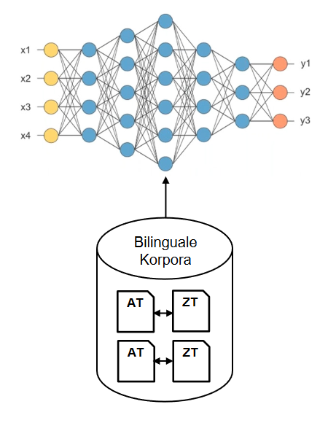
Neural Machine Translation
Input layer
Neural networks with multiple computational layers
Output layer

Slide 19
Machine translation platforms
Reverso
Microsoft
Amazon
Baidu
Papago
Yandex
Systran

Slide 20
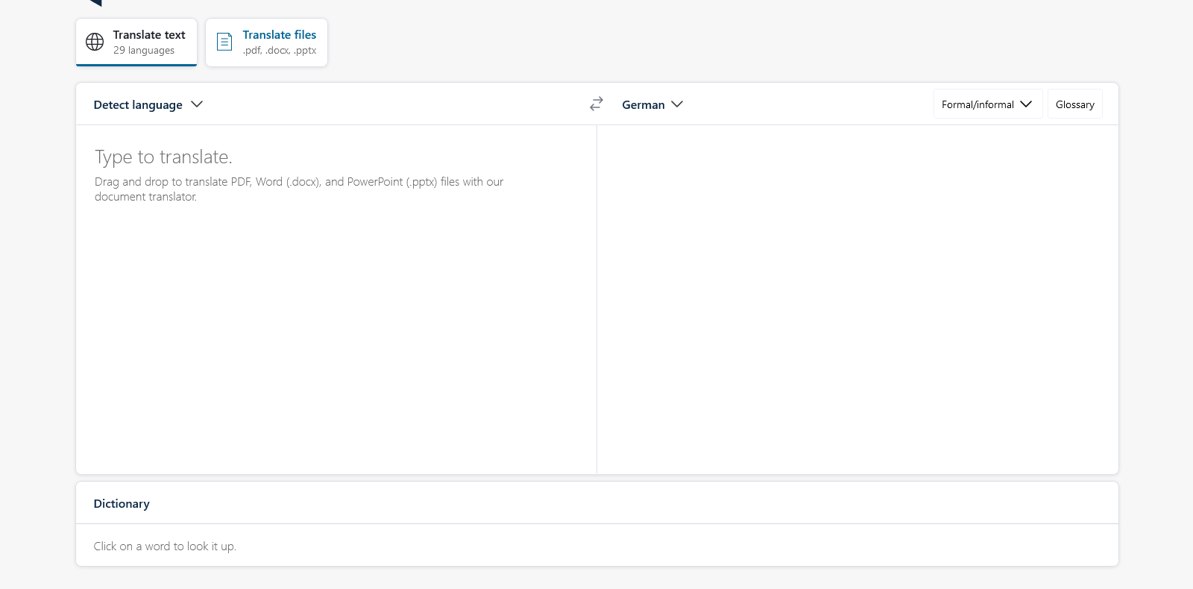

Slide 21
Situation: You have returned from your year abroad in Hamburg and want to catch up with Klaus, a student you have met I Hamburg.
Task: Write a letter where you talk about your course, and what you are doing at the moment. Invite your friend to visit and make some suggestions for what you could do.

Slide 22
© https://twitter.com/Kevin_Hendzel/ status/1099365861851361285/photo/1
Notes:
One thing we must not forget: MT operates on a fundamental different level than human translation / human language processing.
MT has no concept of meaning as such; MT is based on the computation of language as series of units. MT (and AI more generally) operates on the basis of processing large amounts of data, and pattern recognition;
Human language use refers to shared knowledge of the world and (shared) experience. Computers have no access to this type of processing language

Slide 23
MT and Artificial Intelligence
MT as subfield of AI – common processes
natural language processing / production
neural machine learning / “deep learning”
Large language modules: “A language model is a probability distribution over words or word sequences.” Mór Kapronczay (2022)
Newest developments in AI
ChatGPT – text production
Elicit – research assistant
DALL E2 – image creation

Slide 24
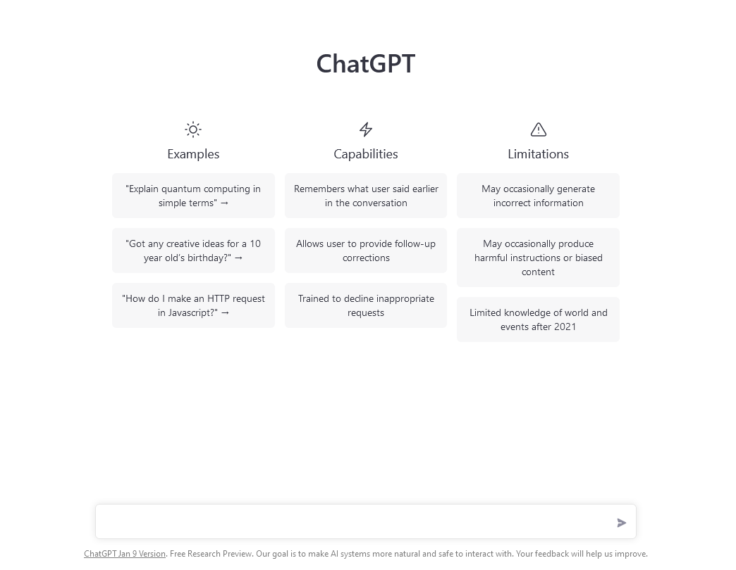
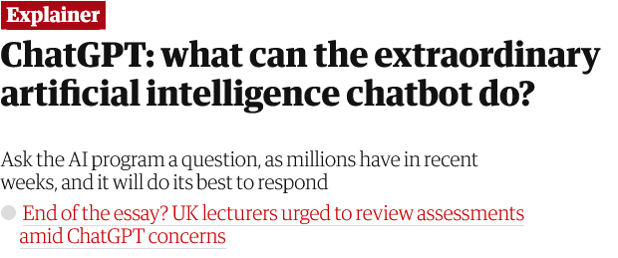
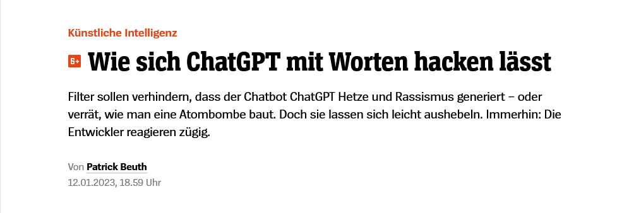
Text production (with conversation)
ChatGPT3
Released 22/11/2022

Slide 25
AI- text production

Slide 26
MT and language education
2006 MT “released into the wild” (Bowker, 2022)
Google Translate as free online MT tool available
MT not reserved to professionals
Access for general public & language learners
Limited but improving quality; better for shorter sentences
2016 Google’s Neural Machine Translation tool released

Slide 27
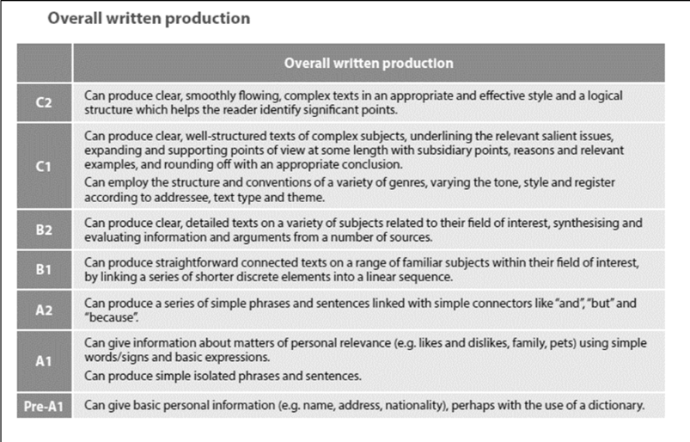
“Language Proficiency” of NMT
Levels Pre A1 - B2 can be achieved by Neural Machine Translation
Levels C1 – C2 need human intervention. (Benites, Lehr, 2022: 59)

Slide 28
MT and language education
Jolley & Maimone (2022) Thirty years of MT and language education. A review of the literature.
How do language learners use MT tools?
What do instructors and learners think about MT tools?
How might MT use affect language learning?
How should instructors respond to MT use by learners?
Notes:
Jolley & Maimone 2022 – most comprehensive and up to date overview; must read. 5 domains of literature/research/scholarship, there of which are
MT and CAT systems
MT in translation training
MT and language learning and teaching
MT use and perceptions
MT and dishonesty
But rather than the domains/arease what seems relevant for us today is the main questions they ask, i.e.

Slide 29
Thirty years of MT and LE/1
How do language learners use MT tools?
Vast majority of language learners use MT
Frequent use of MT for learning AND general purposes
Single word or short phrases dominate input (Jolley, Maimone,2015; Organ 2020, Hellmich & Vinall, 2021)

Slide 30
Thirty years of MT and LE/2
What do instructors and learners think about MT tools?
Teachers’ attitudes:
“friend” vs “foe” (Groves, Mundt, 2016); ban vs. integration
General unease with technology (Hellmich, Vinall, 2021)
Unethical use (cheating) vs “it depends”
Students generally more accepting (Jolley, Maimone, 2015; Organ, 2018)
Notes:
This led to suggestions of banning MT (Socket / Ducar) or creating tasks that focus on work that cannot be assisted by MT

Slide 31
Thirty years of MT and LE/3
How might MT use affect language learning?
“[…] facilitates the production of longer and more accurate texts which tend to be graded more favourably.” (33)
“relatively negative view of the use of MT for the development of L2 writing proficiency.” (34)
Limited evidence of positive impact of MT use for language development.

Slide 32
MT and language education
Hellmich (2021) Machine Translation in Foreign Language Writing: Student Use to Guide Pedagogical Practice.
26 French learners, Beginner levels (A1 & A2)
Computer tracking, retrospective recall & interview
Findings:
Either too little or too much input
Successful MT users
Notes:
26 French learners, Beginner levels (A1 & A2)
Computer tracking study: 3 components: screen recording, retrospective recall, post-interview

Slide 33
Machine translation literacy
“MT literacy is defined as users’ capacity to understand how MT systems work and can be used, to evaluate the MT-friendliness of a text, and to modify MT output.” (Bowker & Buitrago Ciro, 2019: 88)
“Using machine translation is easy, but using it critically requires some thought. Therefore [...], machine translation literacy is mainly about developing cognitive competencies, rather than techno-procedural skills.“ (Bowker, 2021: 132)
Aimed at wide range of audience
Supporting globally operating communities
Background: Translation needs, especially for the academic communicty
Adaptation to language education

Slide 34
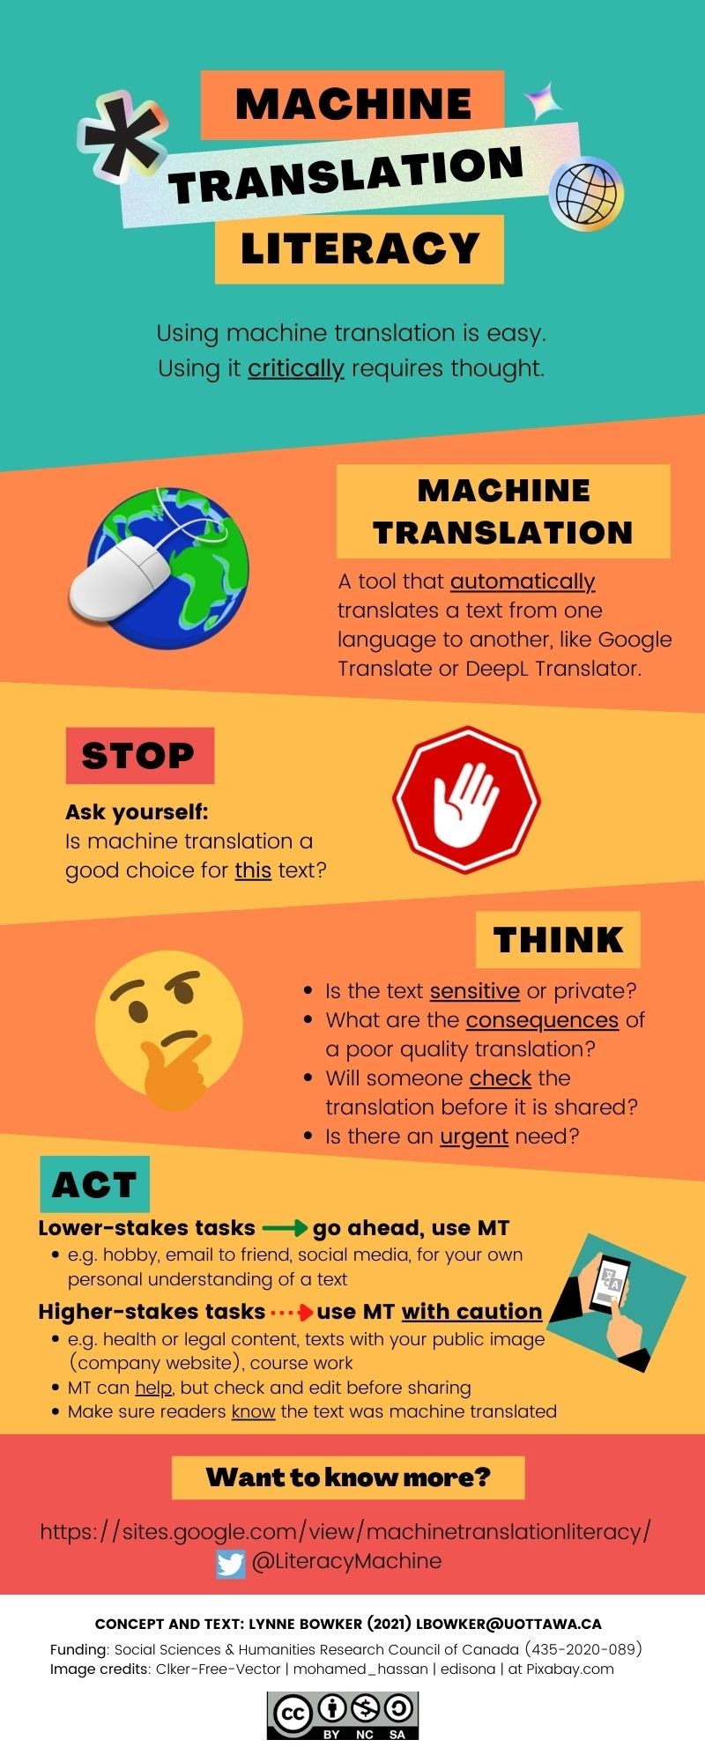
Machine translation literacy
Question: What does an educated use of MT look like?
Awareness of MT
Knowing the risks
Transparency
More than one tool
Garbage in garbage out

Slide 35
MT literacy for language education
Knowledge about Machine Translation
Underlying principles; affordances
Role of training data; algorithmic bias
Available tools; strength and weaknesses
Egagement with MT for
writing / producing language
developing language awareness
Role of input – pre-editing
Role of output – post editing
Notes:
How does MT work – parallel corpora; data driven; algorithmic bias; strengths and limitations

Slide 36
Mt literacy for language education
Effective and ethical use of MT
Differentiation: beginner vs. intermediate/advanced
Beginners: focus on input → not too much, not too little → pre-editing: input – output relation
Advanced: focus on input & output → post editing tasks → comparison of different tools

Slide 37
Pre-editing / input tasks
Showing differences of output.
Modifying input to create output at comprehensible level.

Slide 38
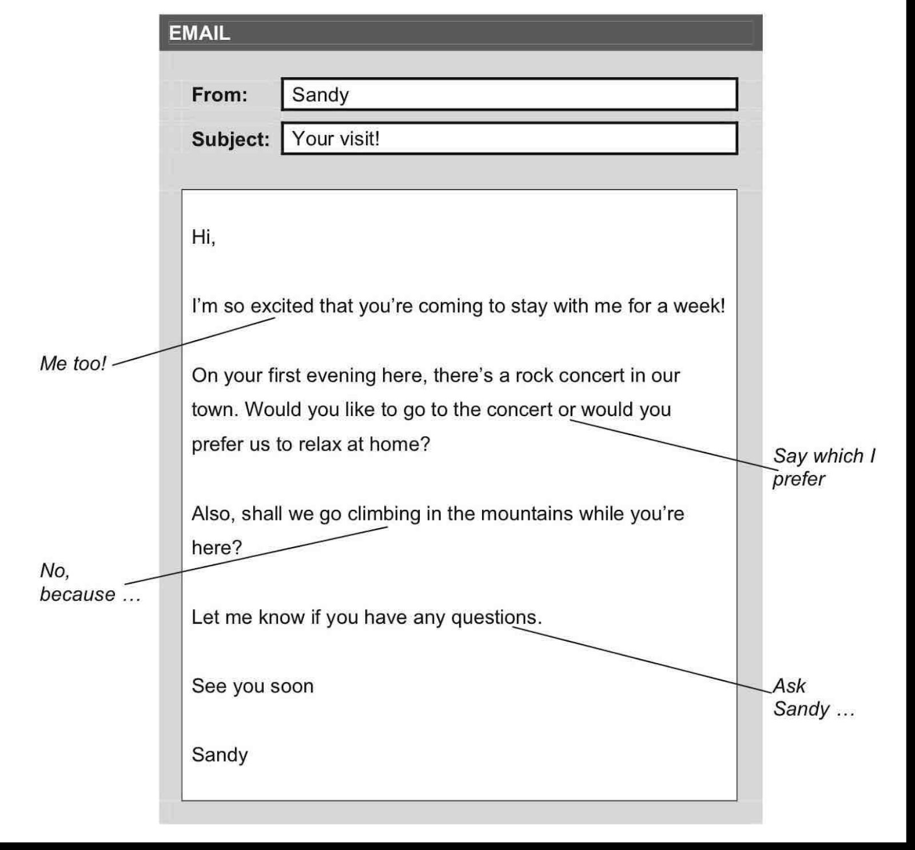
Post-editing
Task: Write a response in German to a personal email you have received from a friend and use the notes you have made. Use the machine translated version and create an improved version.
Source: https://kseacademy.com/cambridge/b1-preliminary-pet/writing/email-english/

Slide 39
Google Translate (30/3/2022)
Hallo Sandy,
Vielen Dank für das Zurückschreiben. Ich freue mich auch sehr über Ihren Besuch!
An meinem ersten Abend möchte ich zu Hause entspannen. Ich werde wahrscheinlich sehr müde von der Reise sein, also muss ich mich ausruhen und mich für die anderen Tage fertig machen. Ist das in Ordnung?
Was das Klettern betrifft, fürchte ich, ich kann es nicht. Ich habe vergessen, es dir zu sagen, aber ich habe letzte Woche mein Knie verletzt, deshalb kann ich jetzt keinen Sport machen.
Wie wäre es mit einem Besuch einiger Kunstgalerien in Ihrer Stadt? Wenn du willst, könnten wir gehen. Du weißt, ich liebe Kunst! Was denken Sie?
Nun, ich muss jetzt gehen, aber bitte lassen Sie mich wissen, was Sie denken.
Sich kümmern,
Luis
DeepL (30/3/2022)
Hallo Sandy,
vielen Dank für deine Antwort. Ich freue mich auch sehr darauf, dich zu besuchen!
An meinem ersten Abend möchte ich mich zu Hause entspannen. Ich werde wahrscheinlich sehr müde von der Reise sein, also muss ich mich ausruhen und mich auf die anderen Tage vorbereiten. Ist das in Ordnung?
Was das Klettern angeht, so kann ich leider nicht. Ich habe vergessen, es dir zu sagen, aber ich habe mich letzte Woche am Knie verletzt, so dass ich jetzt keinen Sport treiben kann.
Wie wäre es mit einem Besuch in einer der Kunstgalerien in deiner Stadt? Wenn du willst, können wir hingehen. Du weißt, dass ich Kunst liebe! Was hältst du davon?
Nun, ich muss jetzt gehen, aber lass mich bitte wissen, was du denkst.
Mach's gut,
Luis

Slide 40
Pragmatic rules, cultural norms

Slide 41
Strategies for language pedagogy
Stronger focus on reflection/analysis of language
pre-editing and post editing tasks
noticing, attention and awareness; crosslinguistic contrasts
Differentiation of tasks
writing tasks with MT use / asynchronous communication
speaking tasks without MT use / synchronous communication
Authentic and context sensitive tasks
Developing metalinguistic awareness

Slide 42
Conclusion
Language proficiency is co-constructed
Re-evaluation of learning outcomes
Integration of Machine Translation (and AI)
Need for resources for MT literacy
Further research into relationship of MT use and language develoment
Notes:
Resources for MT literacy in language education

Slide 43
References
Title & background image: Max Cooper (2019).Repetition (Official Video By Kevin McGloughlin) [Still, 2’20”]
Bowker, l., Ciro, C.B. (2019). Machine Translation and Global Research: Towards Improved Machine Translation Literacy in the Scholarly Community. Emerald Publishing House.
Bowker, L. (2021). Promoting Linguistic Diversity and Inclusion: Incorporating Machine Translation Literacy into Information Literacy Instruction for Undergraduate Students. The International Journal of Information, Diversity, & Inclusion 5 (3), 127-151. https://doi.org/10.33137/ijidi.v5i3.36159
Bowker, L. (2022). Interview. https://slator.com/the-machine-translation-literacy-project-with-lynne-bowker/
Delorme Benites, A., Lehr, C. (2022). Neural machine translation and language teaching -possible implications for the CEFR. Bulletin Suisse de Linguistique Appliquee 114, 47-66. https://www.researchgate.net/journal/Bulletin-Suisse-de-Linguistique-Appliquee-1023-2044
Ducar C., Schocket, D. (2018). Machine translation and the L2 classroom: Pedagogical solutions for making peace with Google translate. Foreign Language Annals 51, 779–795. https://doi.org/10.1111/flan.12366
Harsch, C. (2017). Proficiency. ELT Journal, Vol 71/2, 250-253. https://doi.org/10.1093/elt/ccw067
Hellmich, E. (2021). Machine Translation in Foreign Language Writing: Student Use to Guide Pedagogical Practice. Alsic [online], 24 (1). https://doi.org/10.4000/alsic.5705
Jolley J., Maimone, L. (2015). Free Online Machine Translation: Use and Perceptions by Spanish Students and Instructors. In A. J. Moeller (Ed.), Learn Languages, Explore Cultures, Transform Lives .Central States Conference on the Teaching of Foreign Languages, 181-200

Slide 44
References
Jolley J., Maimone, L. (2022). Thirty Years of Machine Translation in Language Teaching and Learning: A Review of the Literature. L2 Journal, 14 (1), 26-44
Kapronczay, M. (2022). A Beginner’s Guide to Language Models. builtin, 13/12/2022. https://builtin.com/data-science/beginners-guide-language-models
Murray, S. (2022). Talking About Large Language Models. https://arxiv.org/pdf/2212.03551.pdf
Quan-Haase, Anabel & Wellman, Barry. (2005). Local Virtuality in an Organization: Implications for Community of Practice. https://doi.org/10.1007/1-4020-3591-8_12
Storrer, A. (2018). Interaktionsorientiertes Schreiben im Internet. Arnulf Deppermann und Silke Reineke (eds.). Sprache im kommunikativen, interaktiven und kulturellen Kontext. De Gruyter, 219-244
Storrer, A. (2020). Über die Auswirkungen des Internets auf unsere Sprache. Hubert Burda, H., Döpfner, M., Hombach, B., Rüttgers, J. (eds). Gedanken zur Zukunft des Internets. Essen: Klartext Verlag, 219-224
Urlaub, P., Dessein, E. (2022). Machine translation and foreign language education. Front. Artif. Intell. 5:936111. https://doi.org/10.3389/frai.2022.936111
Vinall, K., Hellmich, E. (2022). Do You Speak Translate?: Reflections on the Nature and Role of Translation. L2 Journal, Volume 14 (1), 4-25
Winke, P., Brunfaut T. (2020). Perspectives on ‘Knowing’ a Second Language. What Are We Seeking to Measure. Routledge Handbook of Second Language Acquisition and Language Testing. London, New York, 1-8

