Slide 1
SDS-PAGE and Western Blotting

Slide 2
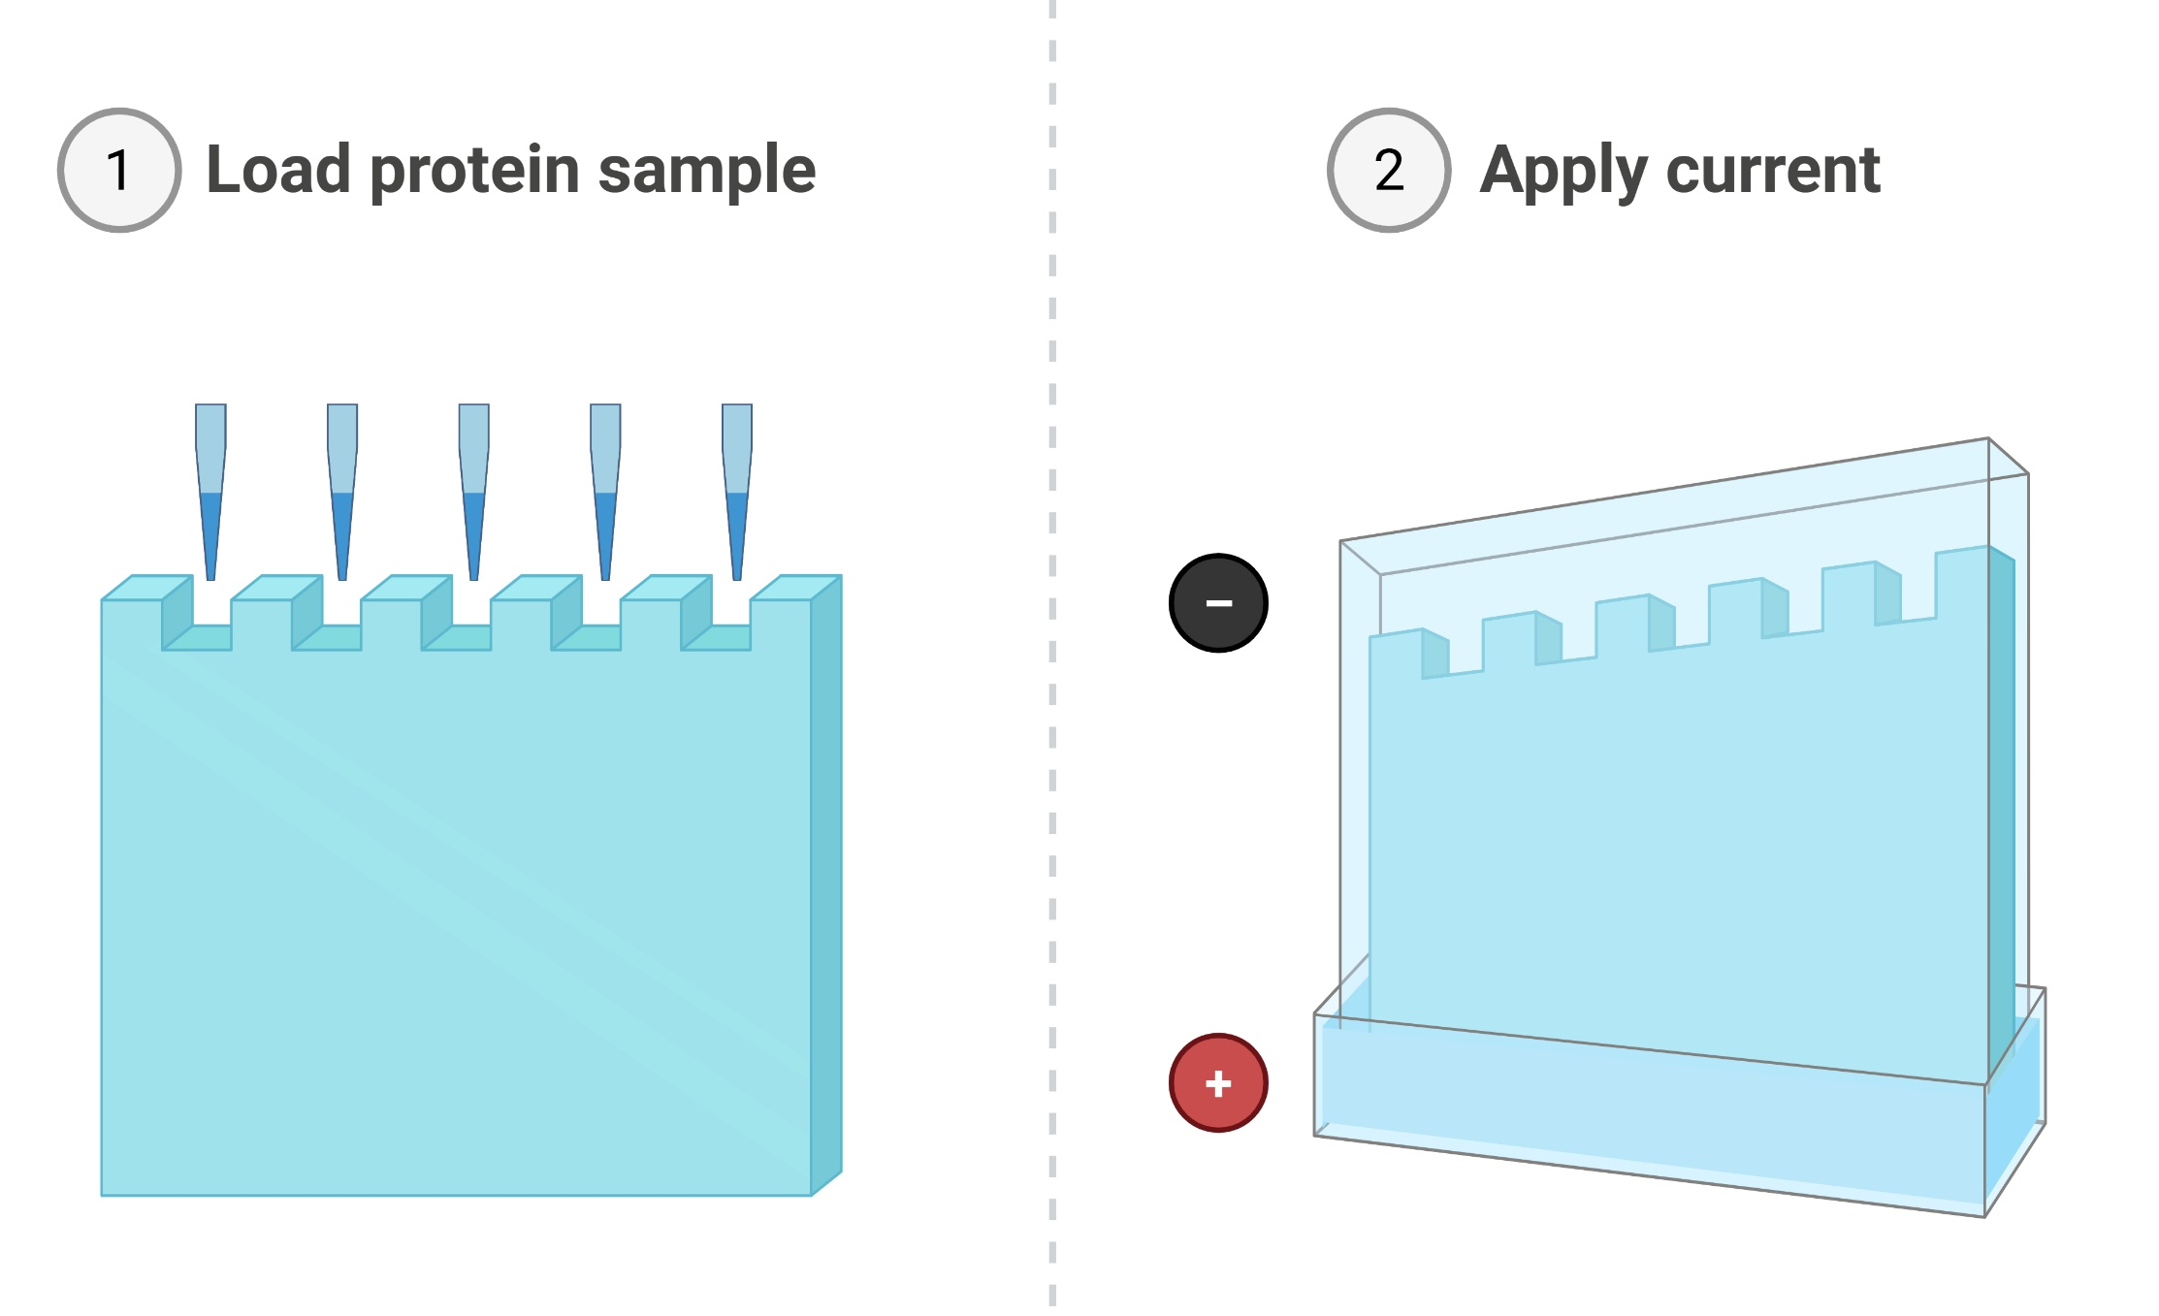
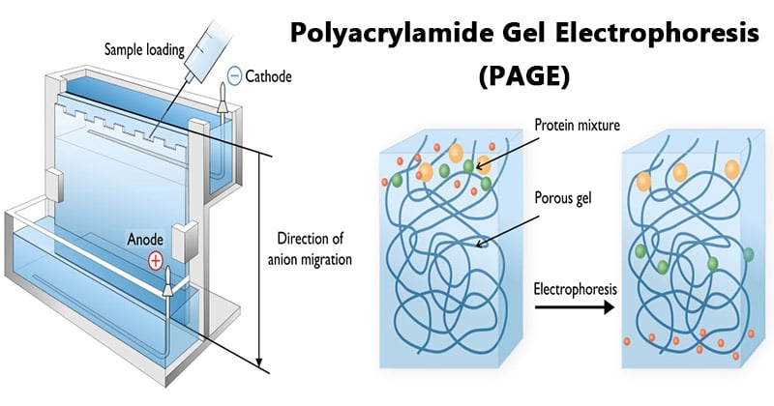
SDS Poly-Acrylamide Gel Electrophoresis
Proteins move through an acrylamide gel based on their size and charge.
Charge is determined by amino acid sequence and 3D tertiary structure.
To separate based on their size only, we need to destroy the tertiary structure by reducing the protein to a linear polypeptide, and mask the net charge of the protein.
Notes:
SDS-PAGE (sodium dodecyl sulfate-polyacrylamide gel electrophoresis) is commonly used in the lab for the separation of proteins based on their molecular weight.
The first thing to know about how PAGE works is that it separates proteins according to their molecular weight, based on their differential rates of migration through a gel under the influence of an applied electrical field.
The movement of any charged species through an electric field is determined by its net charge, its molecular radius, and the magnitude of the applied field. But the problem with natively folded proteins is that neither their net charge nor their molecular radius is molecular weight dependent.
Instead, their net charge is determined by amino acid composition, i.e. the sum of the positive and negative amino acids in the protein and molecular radius by the protein’s tertiary structure.
So in their native state, different proteins with the same molecular weight would migrate at different speeds in an electrical field depending on their charge and 3D shape.
To separate proteins in an electrical field based on their molecular weight only, we need to destroy the tertiary structure by reducing the protein to a linear molecule, and somehow mask the intrinsic net charge of the protein. That’s where SDS comes in.

Slide 3
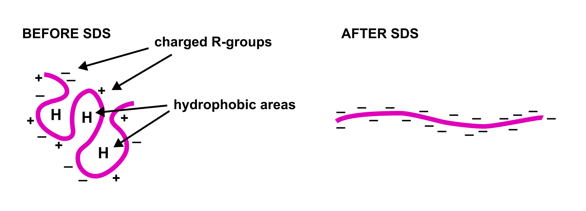
SDS Poly-Acrylamide Gel Electrophoresis
SDS (sodium dodecyl sulphate) is an anionic (negative) detergent
DTT (dithiothreitol) is a reducing agents, which breaks cysteine bonds in tertiary structures.
Boiling samples with SDS and DTT denatures the proteins and makes them negatively charged, proportionally to their size.
Notes:
SDS is a detergent that is added to samples to disrupts the tertiary structure of proteins. This brings the complex folded proteins down to simple linear molecules.
SDS also coats the protein with a uniform negative charge, which masks the intrinsic charges on the R-groups.
SDS binds uniformly to the linear proteins (around 1.4g SDS/ 1g protein), meaning that the charge of the protein is now approximately proportional to its molecular weight.
Since the SDS-coated proteins have the same charge-to-mass ratio, there will be no differential migration based on charge. - the SDS coats proteins in a negative charge so that they are only separated according to size, and not charge.
Reducing agents like DTT can also be added to break cysteine bonds in tertiary structures.

Slide 4
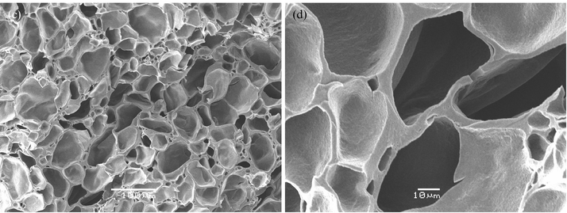
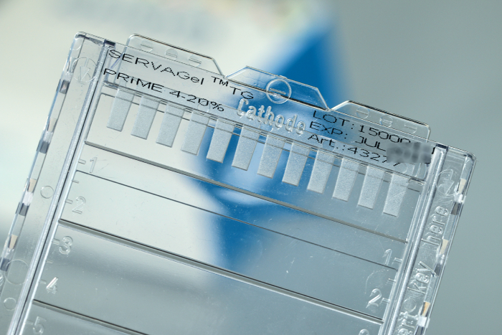
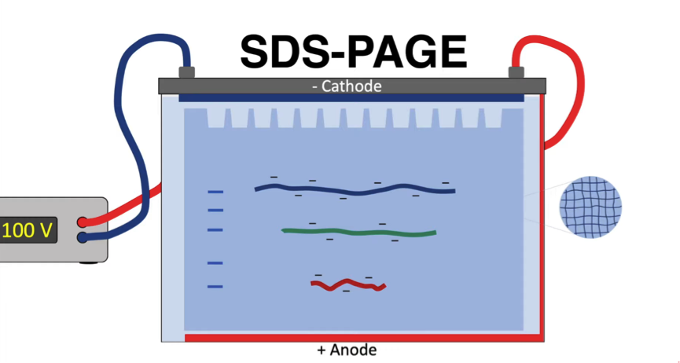
The Gel Matrix
Acrylamide (%) | Mw Range (KDa)
7 | 50–500
10 | 20–300
12 | 10–200
15 | 3–100
Notes:
Now that your proteins are nice and linear, it’s time to run them out on your polyacrylamide gel using electricity. In an applied electrical field, the SDS-treated proteins will now move toward the positive anode at different rates depending on their molecular weight.
Describe a gel – thin 2mm jelly texture, but actually more like a mesh the proteins travel through. Once the proteins are in the running gel, they separate because higher molecular weight proteins move more slowly through the porous acrylamide gel than lower molecular weight proteins. The size of the pores in the gel can be altered depending on the size of the proteins you want to separate by changing the acrylamide concentration.

Slide 5
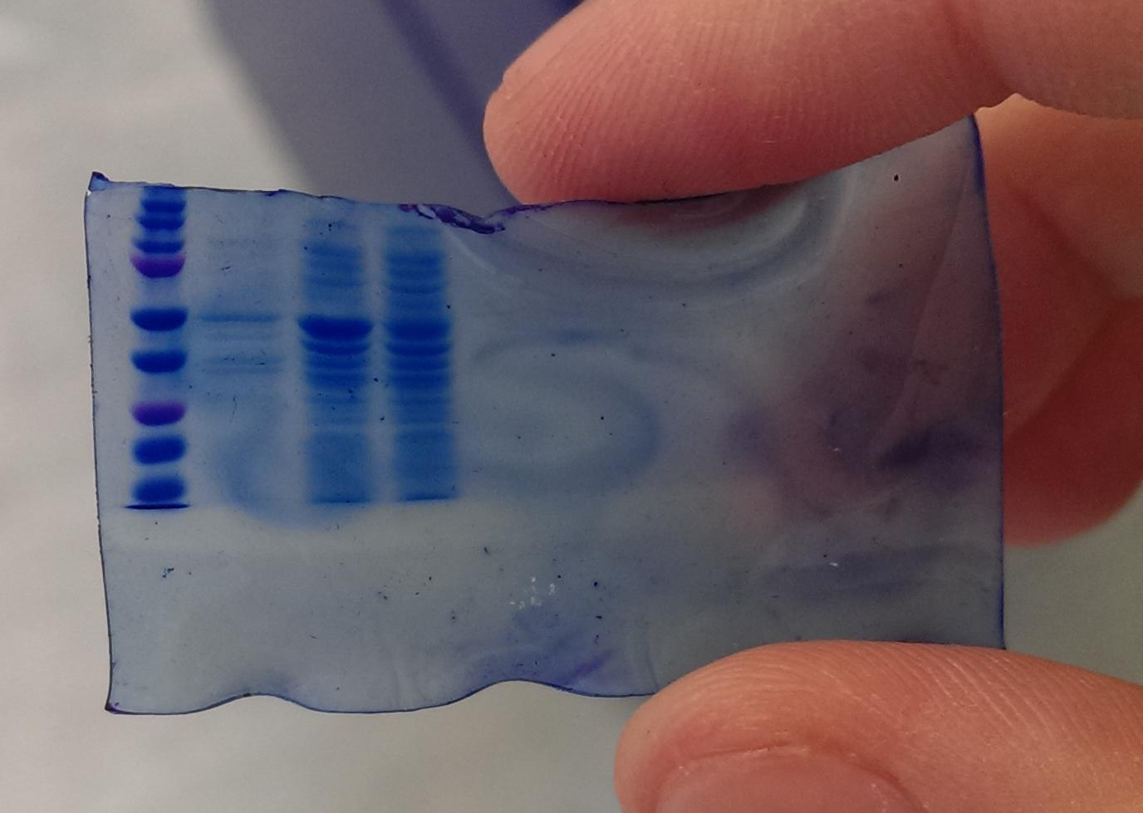
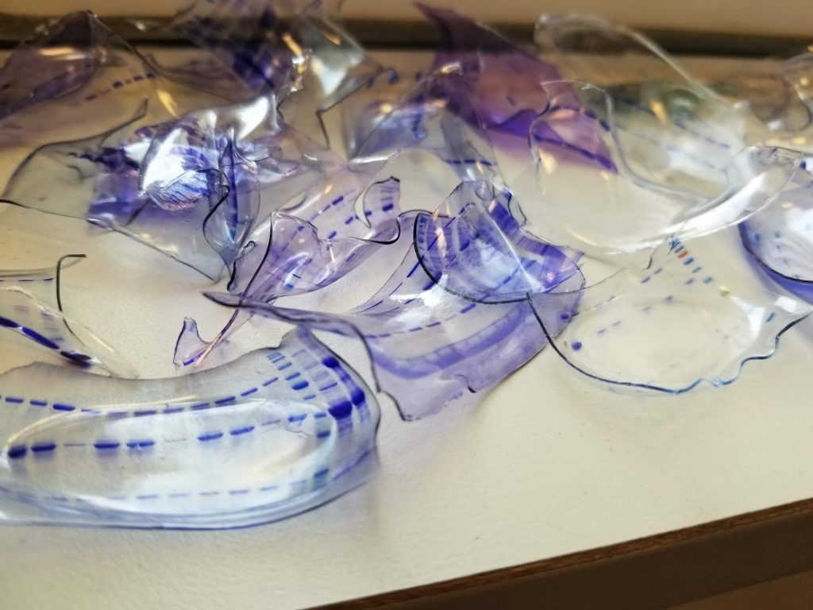
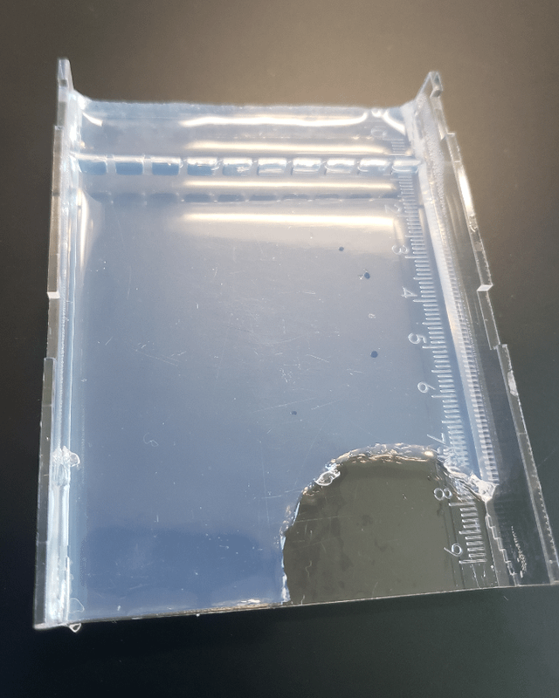
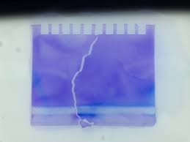
Transferring from Gel to Membrane
(don’t bite gels..)
Notes:
Gels are great for separating proteins out, If but are flimsy, rip easily and dry up and shrink unless they are kept in proper buffers…

Slide 6
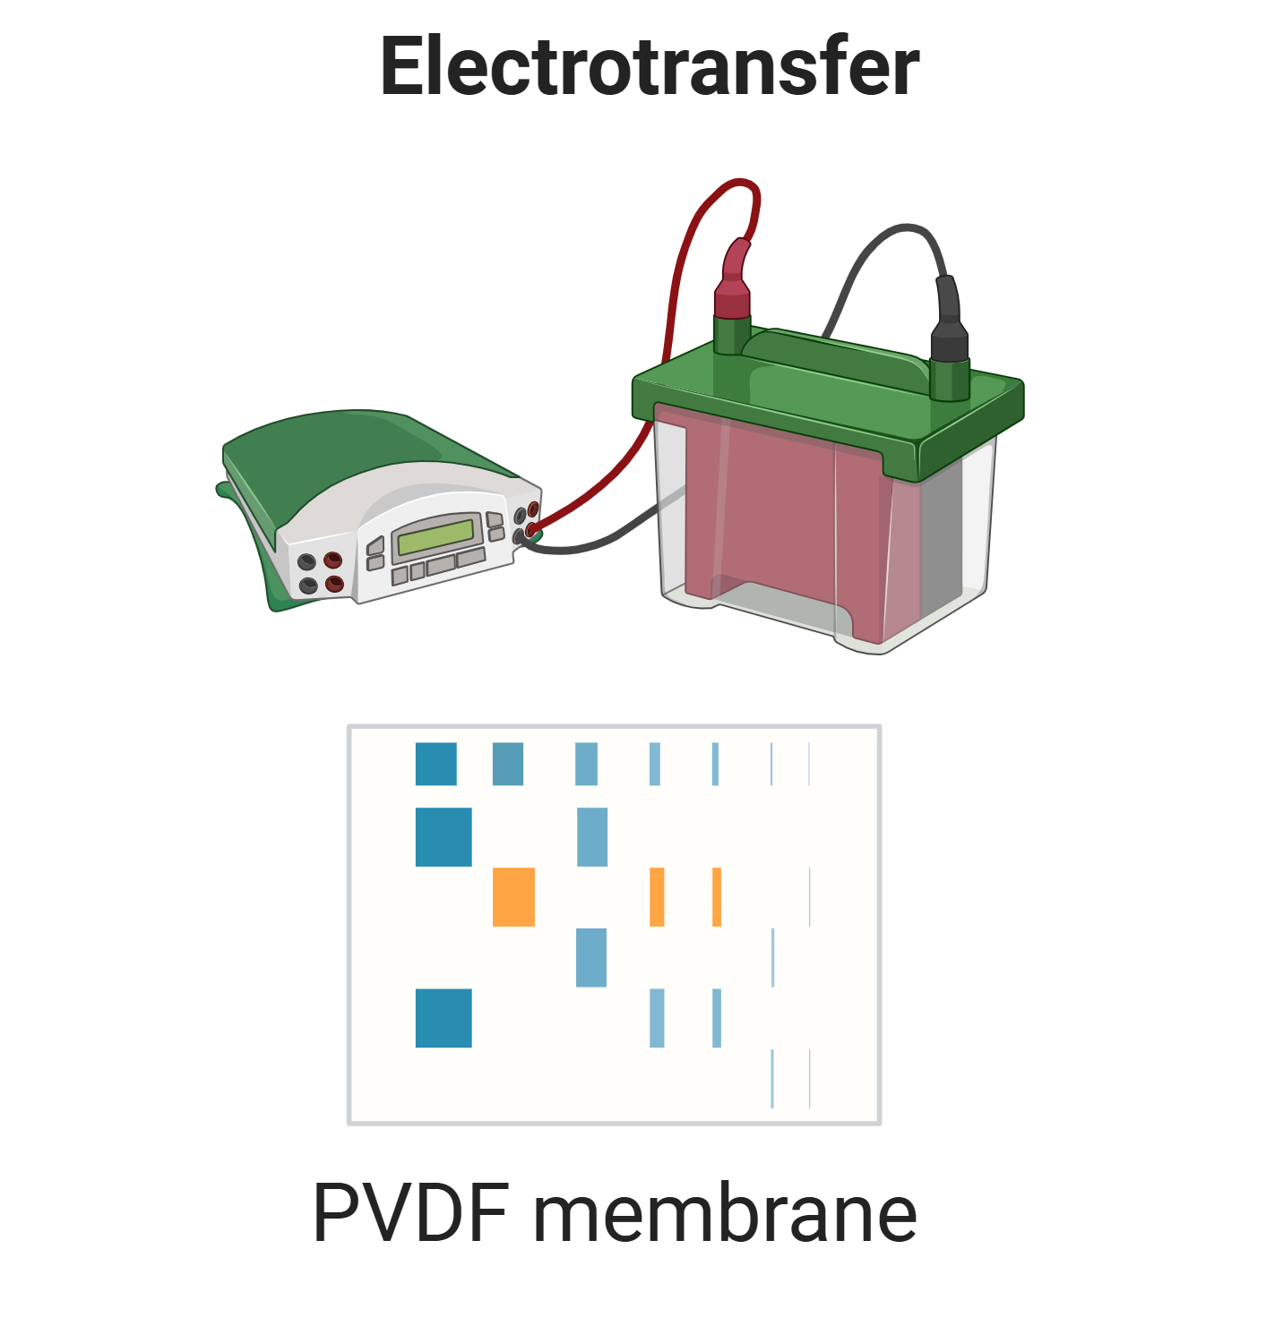
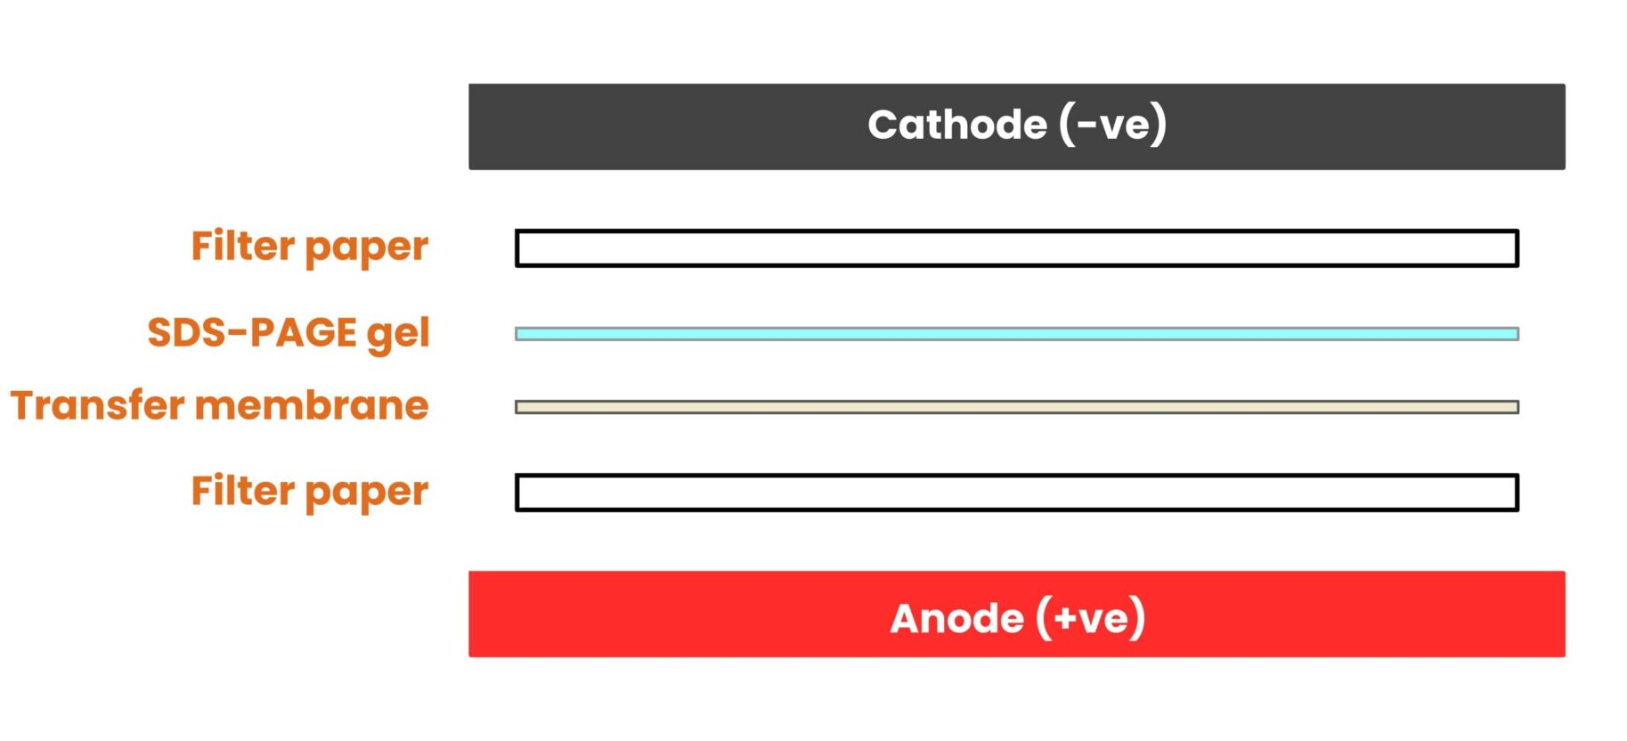
Transferring from Gel to Membrane
Direction of current: negative proteins move towards anode
Notes:
To solve this and to allow for downstream analysis of our separated proteins, we transfer the gel to a more usuable membrane for imaging.
A Stack consisting of the new membrane, the gel, and filter papers is made and a current applied again – the negatively charged proteins migrate from the gel onto the membrane towards the positive anode.
This is the first step of western blotting.

Slide 7
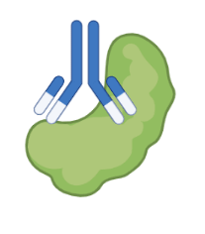
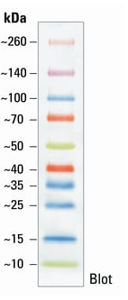
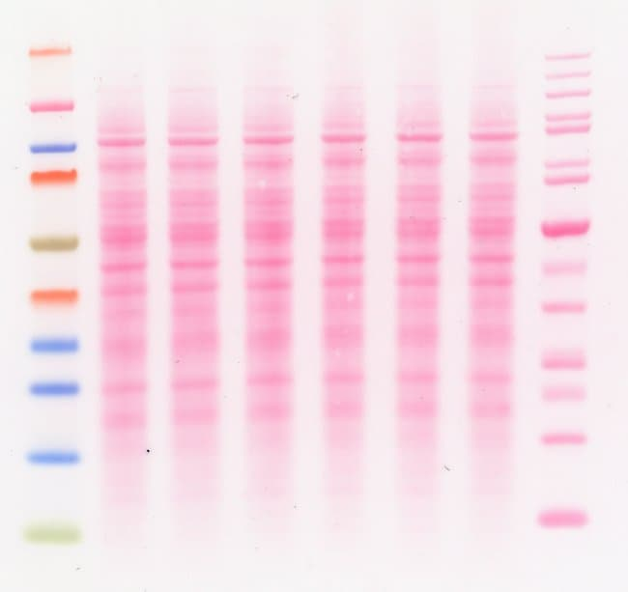
Probing for a Target Protein
Western Blot membrane stained with ponceau red to show all proteins separated out
Bound Antibody
Ladder of known proteins of different sizes, colour coded
Target Protein
Notes:
Now we have all our nicely separated proteins transferred into the membrane, we can use an antibody to detect whatever specific protein we are interested in.
This first antibody we incubate the membrane with is called the ‘primary antibody’ and is made to target a specific part of the protein we are interested in.

Slide 8
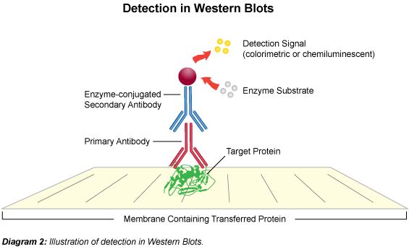
Detecting our Target Protein
Notes:
Once the primary is left overnight to bind, we need to DETECT where it is on the membrane. We do this using another antibody, called the ‘secondary antibody’, that targets the primary antibody itself, based on what species was used (ie, mouse on mouse, rabbit on rabbit, etc).

Slide 9
Detecting our Target Protein
Notes:
This secondary antibody includes either a fluorescent tag that we can visualise, or often an enzyme attached that breaks down a substrate we incubate the membrane in into a coloured product, which stains the membrane and can be seen with the naked eye.

Slide 10
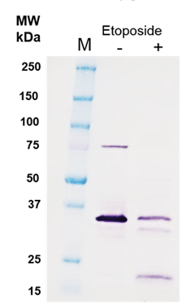
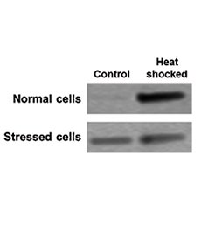
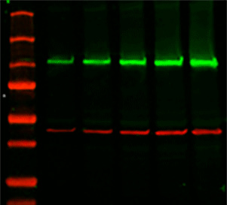
Detecting our Target Protein
Fluorescent secondary detection
Enzyme-linked colorimetric secondary detection

Slide 11
Example:
Tissue Samples
Healthy
Diseased
Primary antibody targeting a 40kDa protein of interest
Healthy vs Disease Tissue samples
Can see loss of this protein in age
= possible drug target?
A B C
A B C
40kDa ---
Notes:
Can link this to why its important to know and load same conc of total protein

