Slide 1
Protein Quantification Assays

Slide 2
Why is protein quantification important?
Protein Concentration
Drug development and dosing
Enzyme kinetics and rate constants
Biomarker development
Food and drug industry applications
House-keeping proteins
Data cross-comparison and validation
Notes:
Accurate protein quantification is critical if, for example, you’re trying to determine a binding constant, measure enzyme kinetics, or if you’re preparing samples for a western blot. Even if you’re doing something more qualitative, having a good idea of how much protein you have will enable you to compare results from one experiment to the next and from one protein to the next.
Also refer to protoemics and western blot sds/page presentations
There are several ways to measure protein concentration, and each of them has its own advantages and disadvantages. It can be difficult to decide on the best method for your protein and the solution it is in (particularly if you’re working with detergents!).
Then go into how there are lots of types and then say here I will mention 3 of the mostr common ways.

Slide 3
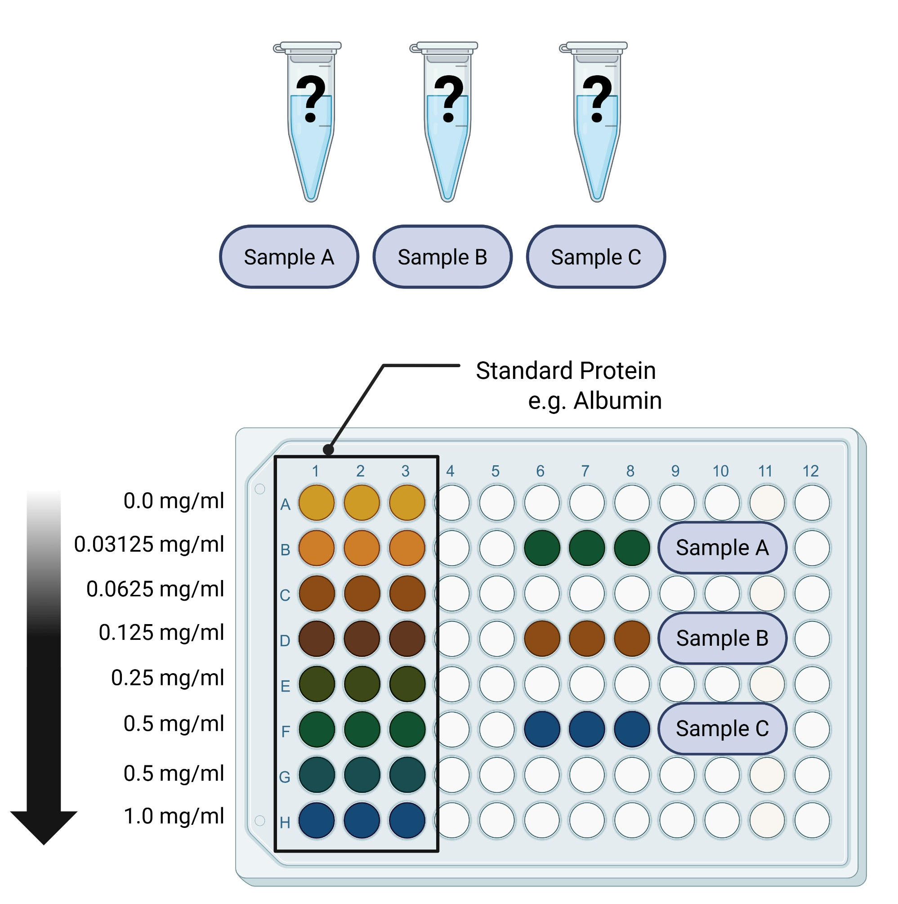
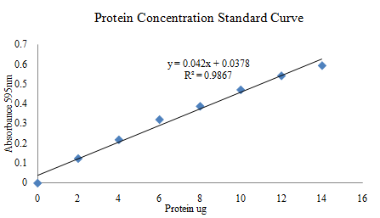
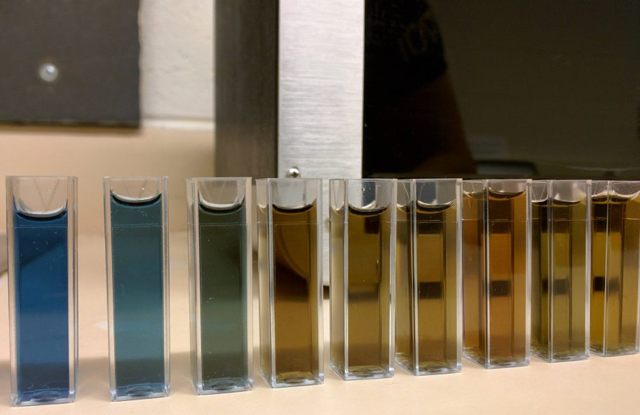
1. The Bradford Assay
Bradford reagent is added; absorbance measured at 595nm and compared to known standards.
Quick (5 mins), easy, and stable for 1 hour.
Not affected by reducing agents like DTT
Depends on protein sequence and accurate standard dilutions
Bradford MM. (1976) A rapid and sensitive method for the quantitation of microgram quantities of protein utilizing the principle of protein-dye binding. Anal Biochem. 72:248-54.
Notes:
There are good reasons that the paper first describing the Bradford Assay has been cited thousands of times! (2) The Bradford assay is a simple colorimetric assay for protein quantification.
It’s based on the interaction between Coomassie brilliant blue and the arginine and aromatic residues in your protein. When the dye binds to these residues, its colour changes, and the maximum absorption shifts from 470 nm to 595 nm.
In general, you measure the absorbance of a series of known concentrations of a standard protein [e.g., bovine serum albumin (BSA) or bovine γ-globulin (BGG)] to create a standard curve, and use this standard curve to calculate protein concentration based on its absorbance. – coins analogy
NEGATIVE: the Bradford assay depends on the sequence of your protein. If your protein doesn’t contain a decent number of arginine and/or aromatic residues, then the dye will not bind to the protein as efficiently, resulting in an underestimation of your protein concentration.

Slide 4
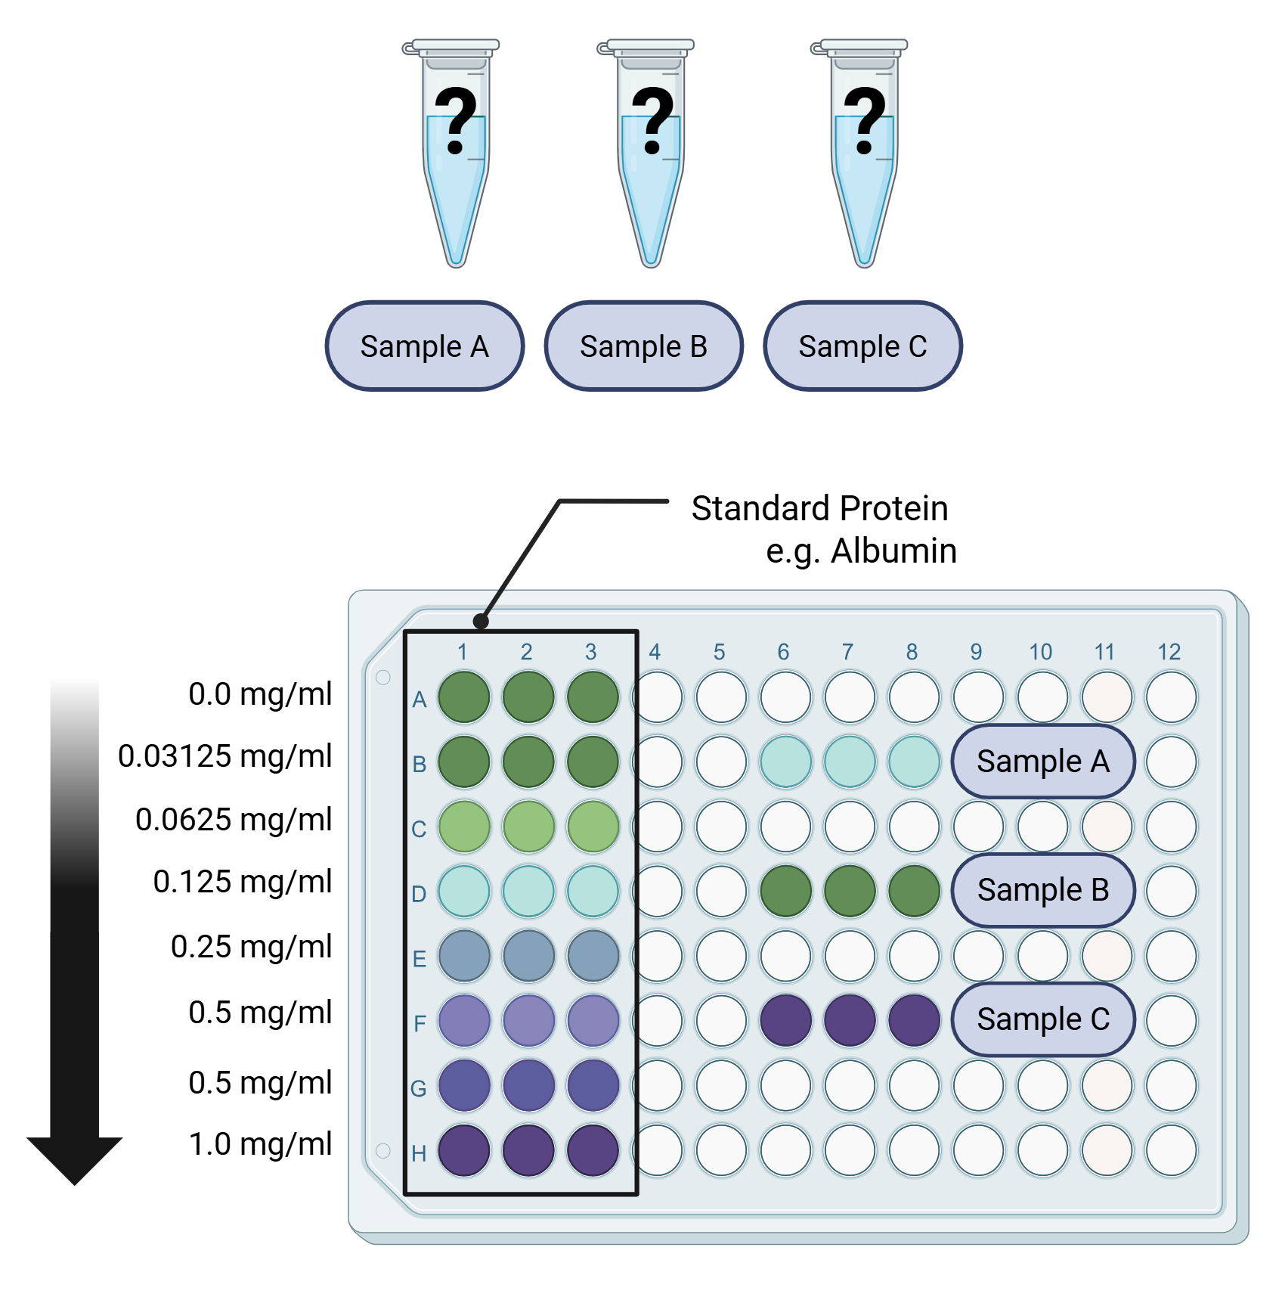
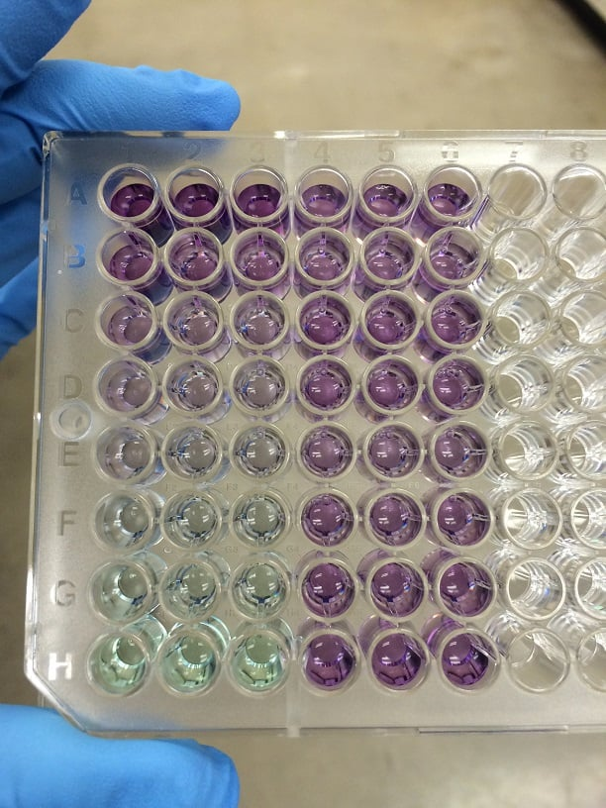
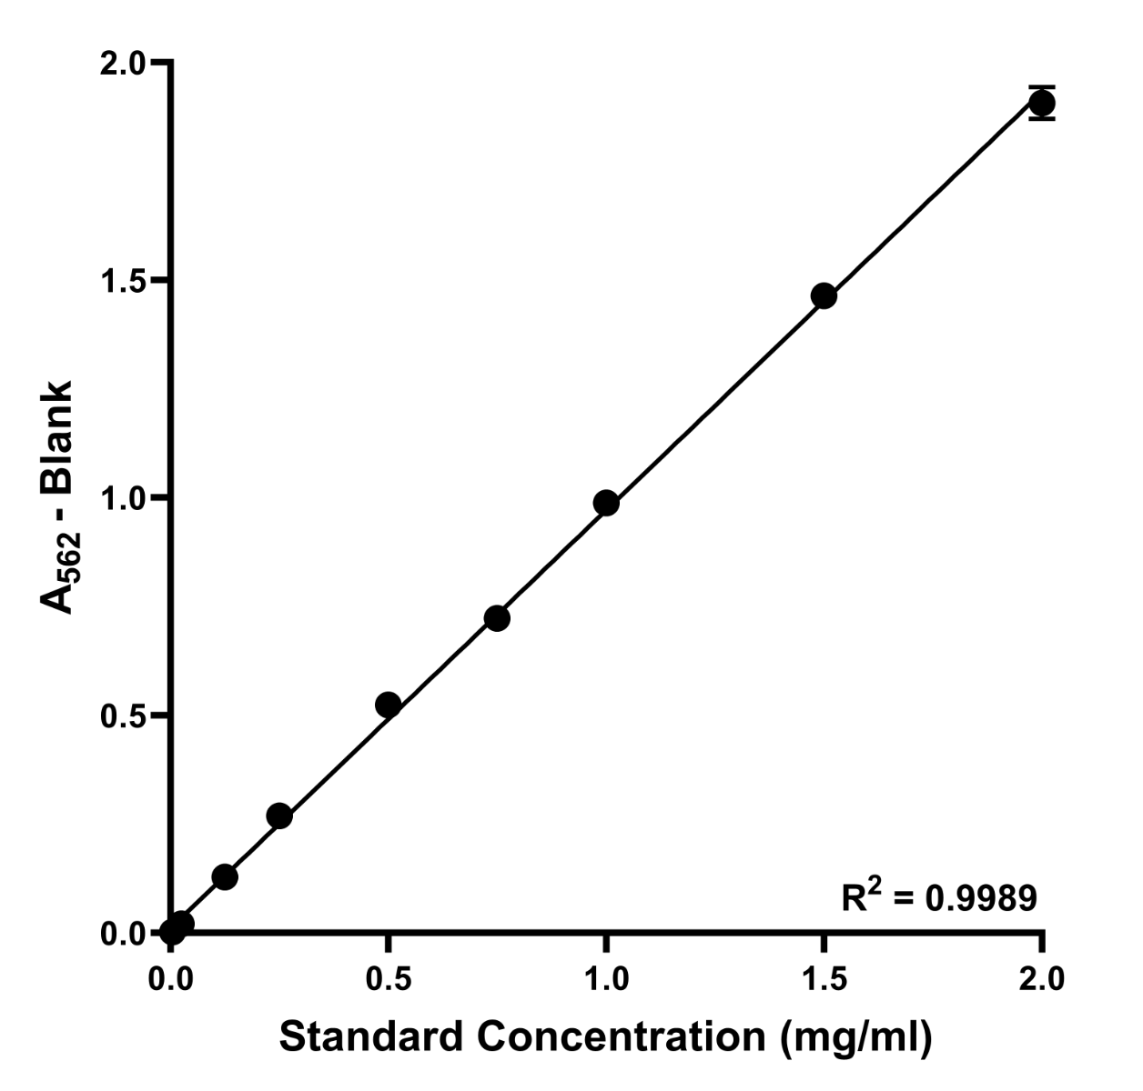
2. The Bicinchoninic Acid (BCA) Assay
Two-step reaction; absorbance measured at 595nm and compared to known standards.
Less affected by protein sequence differences, but also depends on accurate standard dilutions.
Smith PK, et al. (1985) Measurement of protein using bicinchoninic acid. Anal Biochem. 150(1):76-85.
Notes:
Originally developed in 1985, the BCA assay is another colorimetric assay. (3) This two-step assay first makes use of the biuret reaction, in which the protein backbone chelates Cu²⁺ ions and reduces them to Cu⁺ ions. In the second step, the Cu⁺ ions react with BCA to form a purple-colored product that absorbs at 562 nm.
Conveniently, the color intensity is proportional to the amount of protein and, like the Bradford assay, each sample’s intensity must also be compared to a standard curve based on a series of known protein standards.
Because the peptide backbone is involved in the reaction, the BCA assay is less affected by differences in the amino acid composition. However, the reaction is influenced by cysteine, tyrosine, and tryptophan residues. In addition, BCA reagents are not sensitive to detergents and denaturents, so it’s okay to have those in your buffer.
NEGATIVE: The reaction takes some time to proceed. Usually, the samples are incubated at 37°C for 15–30 min. Just enough time to grab a coffee. Also, as in the Bradford assay, you determine your protein concentration by creating a standard curve from a known, standard protein. So again, the same pitfalls apply. While slower than the Bradford assay, the BCA assay is a great option if your protein samples contain >5% detergents.

Slide 5
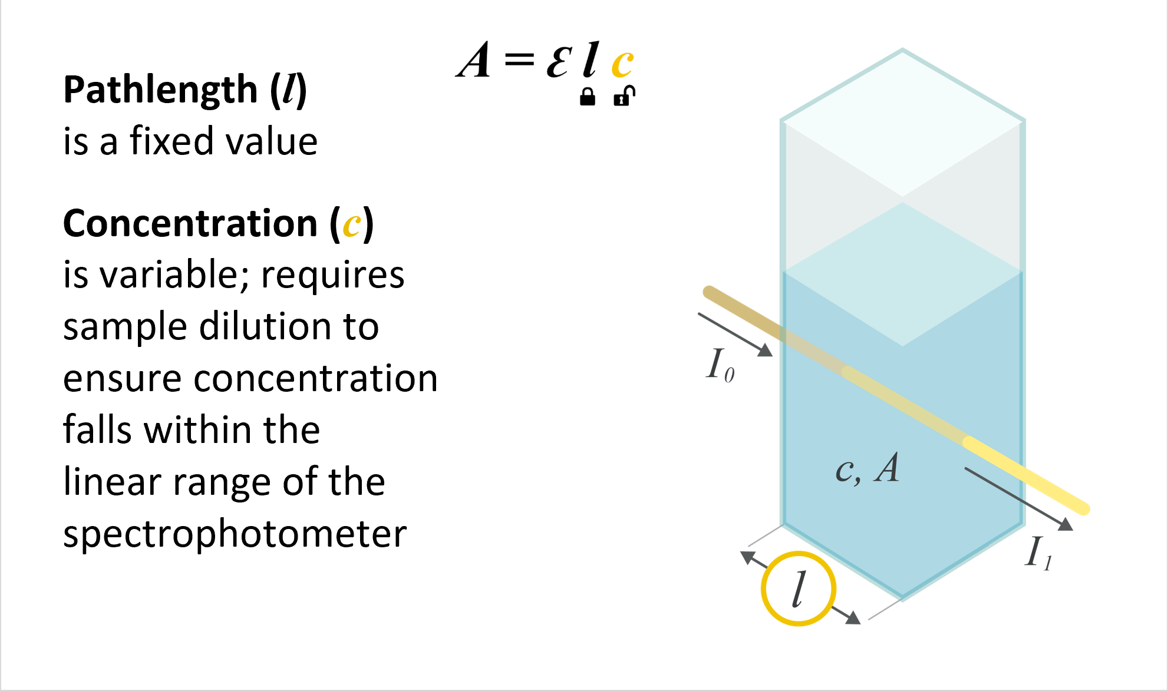
3. UV-Vis Absorbance at 280 nm
Quick with no reagents needed
May not know the experimental extinction of your protein
Other molecules interfere with this method, eg RNA and DNA
A = ε l c
A = absorbance at 280 nm (what you measure)
ε = the molar extinction coefficient (known value)
l = path length of the spectrometer (fixed value)
c = concentration of protein (what we want to work out)
Liu PF, et al. (2009) Revisiting absorbance at 230nm as a protein unfolding probe. Anal Biochem. 389(2):165-70.
Notes:
First two work for protein mixtures – i.e cell lysates, blood sample, tissue – and single protein solutions – i.e an unknown concentration sample of one specific enzyme
UV-Vis absorbance works for single protein solutions of which we know the molar extinction coefficient.
Simple but often unreliable, this protein quantification method estimates the amount of protein by measuring the characteristic absorption of the aromatic residues, tyrosine, and tryptophan, at 280 nm on a UV-Vis spectrometer.
Once you know the absorbance of your protein at 280 nm (A₂₈₀), as well as its extinction coefficient, you can use the Beer–Lambert law to calculate protein concentration:
A = ε l c
If you’re working with purified protein samples and if you measure the complete UV-vis spectrum of your protein sample rather than just the A₂₈₀, you can also see if there are any soluble aggregates/contaminants in your sample by looking for absorbance at 230 nm/elsewhere.
NEGATIVE: Every protein has a different number of tyrosine and tryptophan residues and, annoyingly, you may not know the experimental extinction of your protein. Alcohols, certain buffer ions, and nucleic acids all absorb at 280 nm, thereby making this measurement non-specific for protein if any of these other molecules are present.

Slide 6
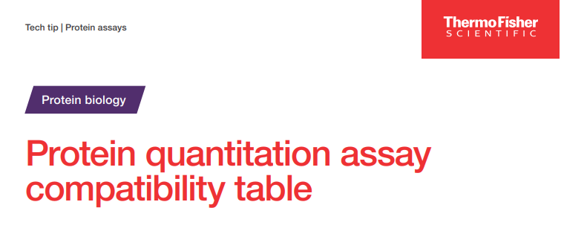
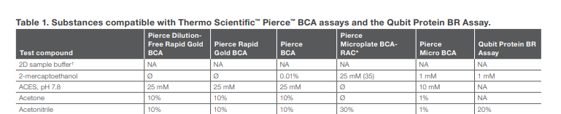
Choosing the Correct Assay
Things to consider
  What solution is my sample in ?
  How much sample do I have available ?
  Do I have a mixture of proteins ?
In some circumstances multiple assays will do the job
If you’re unlucky then none of the assays will work!

