Slide 1
Natural Coastal Resources - Wales
Natural Coastal Resources - Wales
A Future Vision for the Coast
Monday 13th January 2014
Louise Pennington
Senior Coastal Advisor, Flood Risk Strategy team
Natural Resources Wales

Slide 2
Natural Coastal Resources - Wales
The significance of coastal resources in Wales
Flood defence (Cardiff)
Cliff erosion (Dunraven Bay)
Beach morphology (Rhossili Bay)
Industrial resilience (Milford Haven)
Tourism (Solva)
Harbours (Fishguard, New Quay, Aberaeron)
Dune stability (Ynyslas)
Infrastructure (Dovey, Mawddach)
Heritage (Porthdinllaen)
Ports (Holyhead)
Piers (Llandudno)

Slide 3
Natural Coastal Resources - Wales
Our vision for coastal resources in Wales
‘to ensure that the natural resources of Wales are sustainably maintained, enhanced and used, now and in the future.’
How does this vision influence long-term strategic thinking?
How is such thinking incorporated into short-term planning priorities?

Slide 4
Natural Coastal Resources - Wales
Shoreline Management Planning
‘a (non-statutory) document that provides a large scale assessment of the risks associated with coastal processes and presents a policy framework to reduce these risks to people and the developed, historic and natural environment in a sustainable manner’
National Assembly for Wales, 2005
Coastal Group led.
Largely Welsh Government funded.

Slide 5
Natural Coastal Resources - Wales
National Habitat Creation Programme
Aim to establish new habitats, especially saltmarsh, in advance of losses to protected Natura 2000 sites arising from coastal squeeze.
Review projections and resulting requirements.
Requires significant funding and policy review.

Slide 6
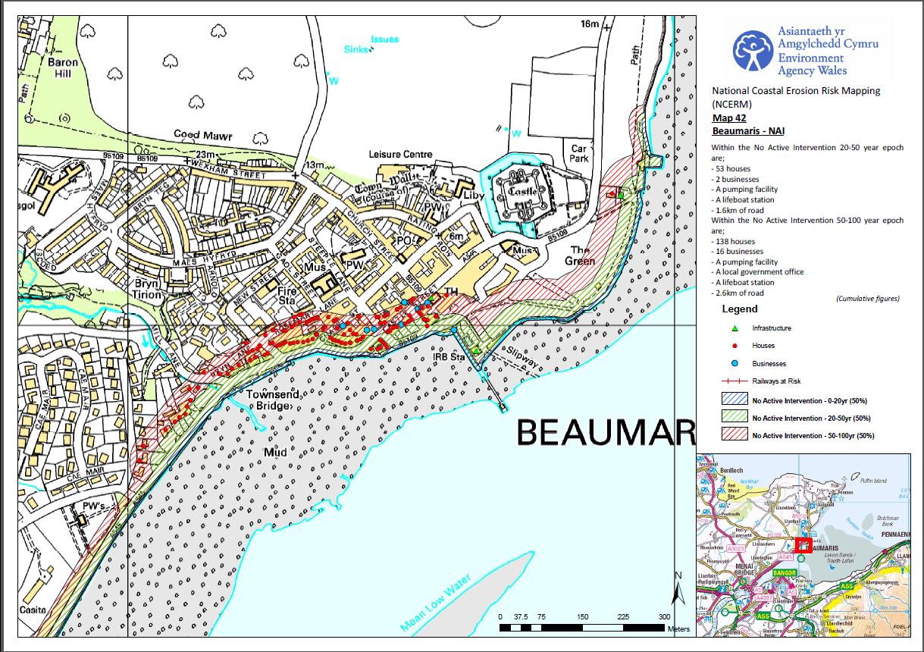
Natural Coastal Resources - Wales
Coastal Erosion Mapping at the Community Scale

Slide 7
Natural Coastal Resources - Wales
Current priorities
National FCERM Strategy objectives:
Reducing the consequences for individuals, communities, businesses and the environment from flooding and coastal erosion.
Raising awareness of, and engaging people in the response to, flood and coastal erosion risk.
Providing an effective and sustained response to flood and coastal erosion events.
Prioritising investment in the most at risk communities.

Slide 8
Natural Coastal Resources - Wales
Projections of future coastal change
Sea level rise (20cm by 2050, 44cm by 2095)
Increased wave heights (generated by greater water depths)
Greater storm frequency (20-fold increase by 2100)
Increased coastal erosion (to 4m above normal sea level)
Fluctuating rainfall (14% winter increase, 16% summer decrease)
Increasing river flows (exacerbating flood risks to estuarine areas)

Slide 9
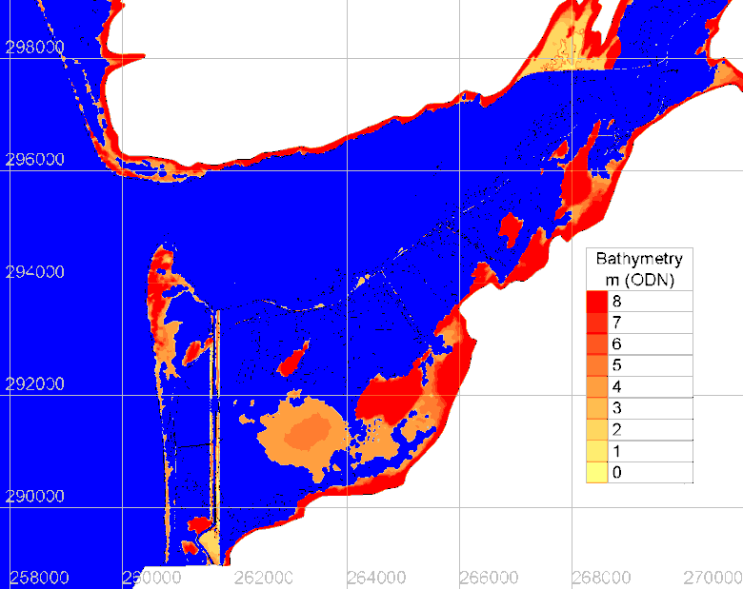
Natural Coastal Resources - Wales
Evidence and uncertainty
Established working groups.
Existing data gathering.
Develop trends.
Model future scenarios to reflect uncertainty.

Slide 10
Natural Coastal Resources - Wales
Limitations on long-term, sustainable management of coastal resources
Funding availability.
Prioritisation.
ECONOMIC
SOCIAL
ENVIRONMENTAL
Dynamic.
‘Change’ rather than ‘damage’.
SUSTAINABILITY
Political and other pressures.
Resources.

Slide 11
Natural Coastal Resources - Wales
Thank you for listening
Louise.Pennington@naturalresourceswales.gov.uk
07768 132025

