Slide 1
Developing language teaching materials: the Devil in the (broader) detail of classroom implementation conditions.
Pauline Foster
St. Mary’s University

Slide 2
Ælfric’s colloquy (10th C)
 | OE | Latin
T | Canst þu ænig þing? | Scis tu aliquid?
P | Ænne cræft ic cann. | Unam artem scio
T | Hwylcne? | Qualem?
P | Hunta ic eom. | Venator sum
T | Hwæs? | Cuius?
P | Cincges | Regis.

Slide 3
Focus on grammar (14th century)
“... The advantage is that they learn their grammar in less time than children were wont to do; the disadvantage is that now children of the grammar school know no more French than their left heel.”
John of Trevisa 1385

Slide 4
Applied Linguistics is not yet 50 years old
Pit Corder's (1967) The Significance of Learners' Errors.
Larry Selinker's (1972) Interlanguage
BAAL 1967
AAAL 1977

Slide 5
A few things that might have surprised Ælfric.
Largely not behaviourally conditioned.
Largely not analogous to building a wall.
Errors are not the surface evidence of poor learning as much as the surface evidence of a developing system.
Ultimate attainment is related to age of onset, motivation and the power law of practice.

Slide 6
A few things he probably never thought about:
First language acquisition cannot be ‘re-activated’ by an adult immersion setting.
Attention to L2 form is necessary for acquisition, is usually beaten to the post by attention to L2 meaning, is manipulable to some degree by external agencies….etc.

Slide 7
Blind alleys?
http://tinyurl.com/m4jmegh
A Child’s Guide to Language
BBC Horizon documentary 1983

Slide 8
Poles apart?
<<<<<<<<<<< | >>>>>>>>>
Real World | Ivory Tower
Chalkface | Academe
Practice | Theory
Classroom | Laboratory
People | Numbers
Holistic | Reductive
Spontaneous | Contrived
Authentic | Inauthentic
‘Good’ ☺ | ‘Bad’

Slide 9
Pedagogic implications?
Reviewers and editors have often expected research papers to include a section with this heading.
Research funding decisions could be swayed by the promise of practical applications.
Ron Sheen says it’s our “implicit mandate to improve language teaching.” (2006)
Notes:
Pica Young and Doughty 1987 ‘provide guidelines for restructuring interaction in the classroom to serve learners’ needs for comprehensible input.’

Slide 10
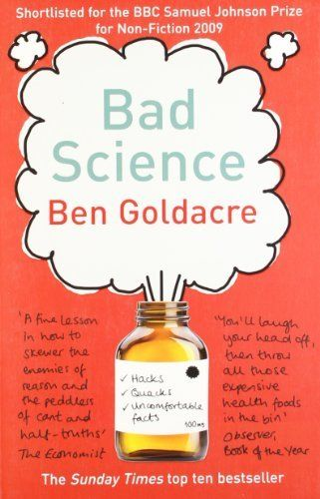
Recommended reading

Slide 11
and this…

Slide 12
Why research is useful
Because without it, we have only opinion, anecdote, intuition, gut-feeling and unthinking adherence to the prevailing zeitgeist.
None of these is reliable.

Slide 13
Task-based learning and teaching
A body of research which is building a picture of how learner language responds to different task designs and implementation conditions.
The corner of this I inhabit as a researcher looks at CAF and lexical outcomes.

Slide 14
6
Pre-task planning is associated with greater complexity and fluency, and sometimes greater accuracy.
Greater familiarity of information in a task is associated with higher fluency and accuracy.
More structure in a task is associated with greater accuracy.
More transformations required, or more information integration required in a task is associated with greater complexity.

Slide 15
Interactive tasks support complexity and accuracy, and greater involvement in an interactive task supports greater complexity still.
Post-task attention manipulation conditions generate greater accuracy, and sometimes complexity, especially with interactive tasks.
Higher level task performance cannot be sustained for long.

Slide 16
Pre-task planning is associated with greater complexity and fluency, and sometimes greater accuracy.
Pre-task planning can take many forms, including whole-task repetition.

Slide 17
repetition increases fluency and complexity;
in conjunction with feedback it results in improved accuracy as well.
Bygate (1999)
Sheppard (2006)
Ahmadian and Tavakoli, (2011).
Ahmadian (2011)

Slide 18
However…..
Would such pedagogic practice be on the wrong end of the ‘authentic –inauthentic, spontaneous – contrived’ divide?

Slide 19
One way street
Research findings | →→→→→→→ | Teaching practice

Slide 20
five-way network

Slide 21
Best practice?
Peer explanations give more learning possibilities than teacher explanations.
Target language explanations lead to more secure learning than mother tongue explanations.
Minimise teacher talk, maximise learner interaction.
Inferring vocabulary meanings from context leads to deeper and more integrated learning than giving them explicitly.
Teaching must cater for all VAKT styles

Slide 22
From the British Council website
The inspectors.... check that the teachers are using up-to-date teaching methods and materials, that the students know what they are supposed to be learning and...that they are actively participating in the class, and that learning is really taking place.

Slide 23
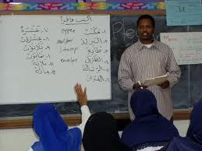
Planning? Repetition?

Slide 24
five-way network

Slide 25
Thank you!

