Slide 1
TRANSITION FROM A COMMERCIAL COURSE BOOK TO IN-HOUSE TEXTBOOK
MATSDA 2014
Reyhan Salataci Ok
Sabancı University
Istanbul, Turkey
rsalataci@sabanciuniv.edu

Slide 2
OUTLINE
Context of teaching
Comparison of two coursebooks
Feedback from teachers and students
Concerns
Solutions

Slide 3
Context of Teaching
English-medium private university
A challenging proficiency exam
One-year English preparatory school
Four levels (Elementary-Pre-Intermediate, Intermediate and Upper Intermediate)-16 weeks
Theme-based programme
Two different coursebooks

Slide 4
The purpose of starting with a commercial coursebook
Commercial textbooks (Language Leader by Pearson) to lay linguistic foundation of students for 8 weeks.
Increasing the number of the courses offered (Elementary-Intermediate-Advanced → Elementary-Pre-Intermediate – Intermediate -Upper Intermediate)
Easier to follow for both teachers and students (shorter and more up-to-date texts and exercises)

Slide 5
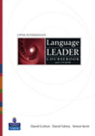
Commercial coursebook (Language Leader - LL)
Route 1 (Elementary) R2 (Pre-intermediate) R3 (Intermediate) R4 (Upp-Intermedi.)
Notes:
Route 1

Slide 6
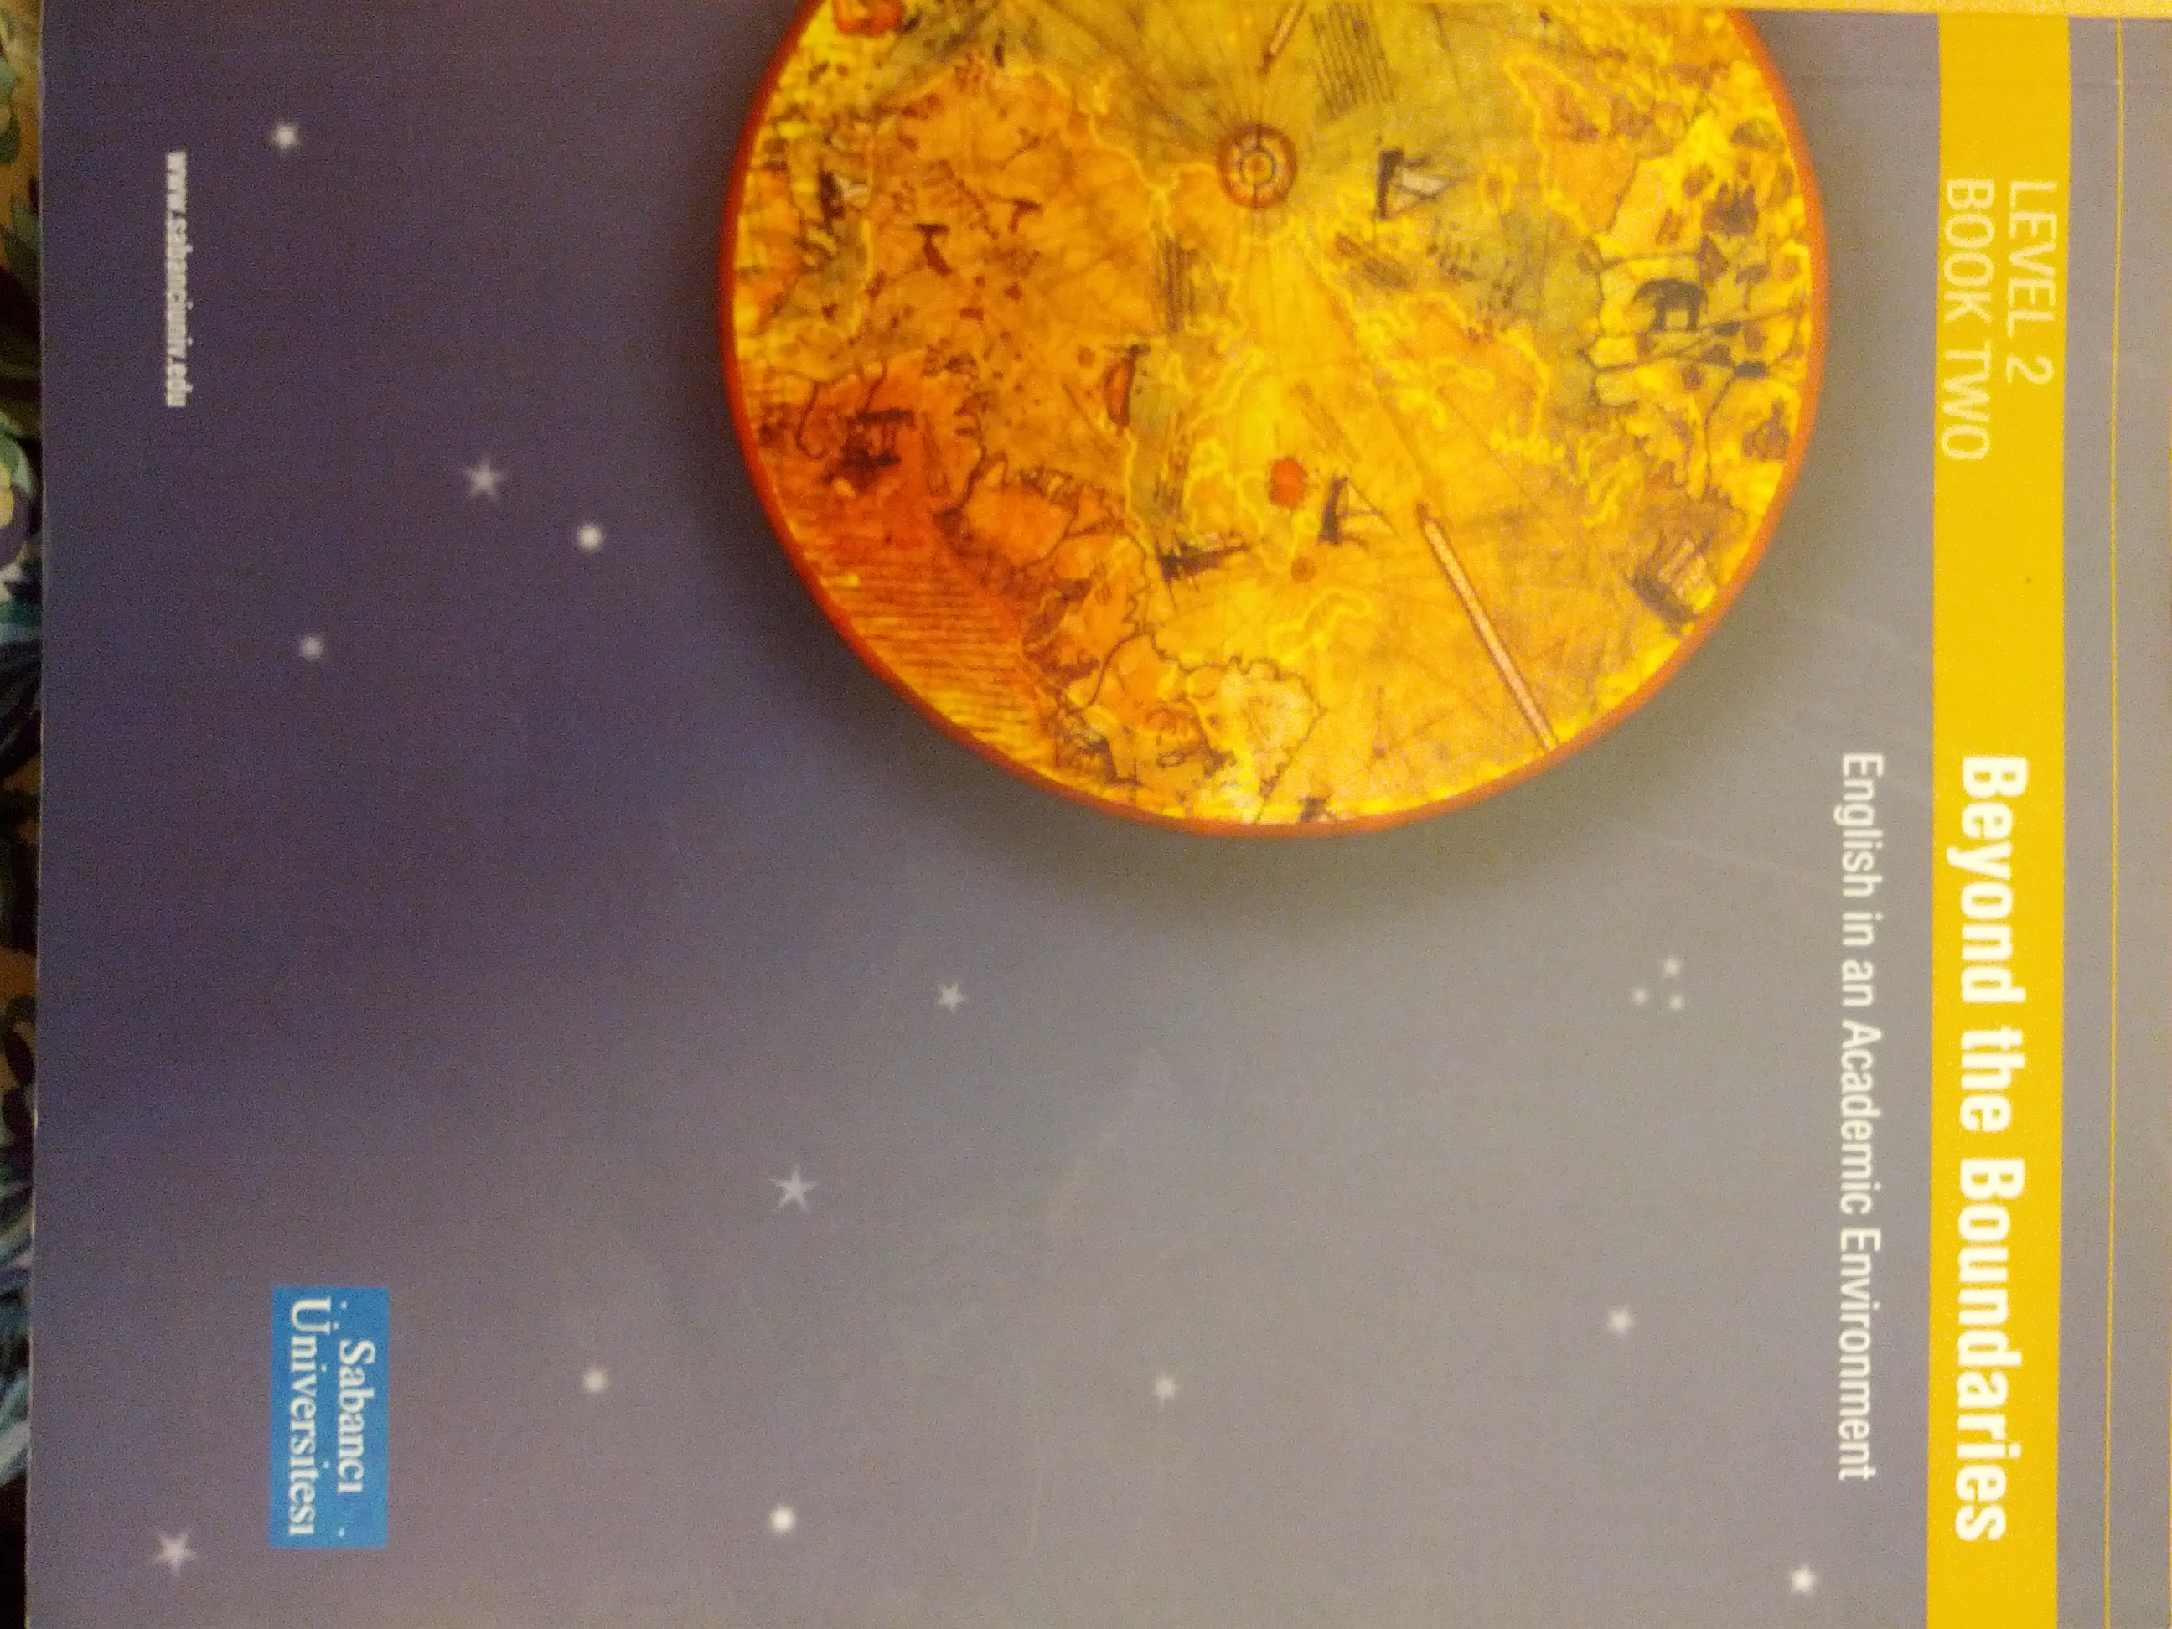
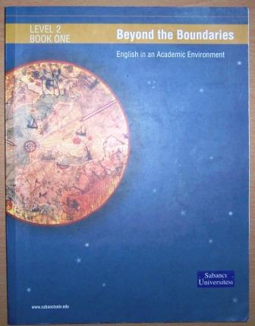
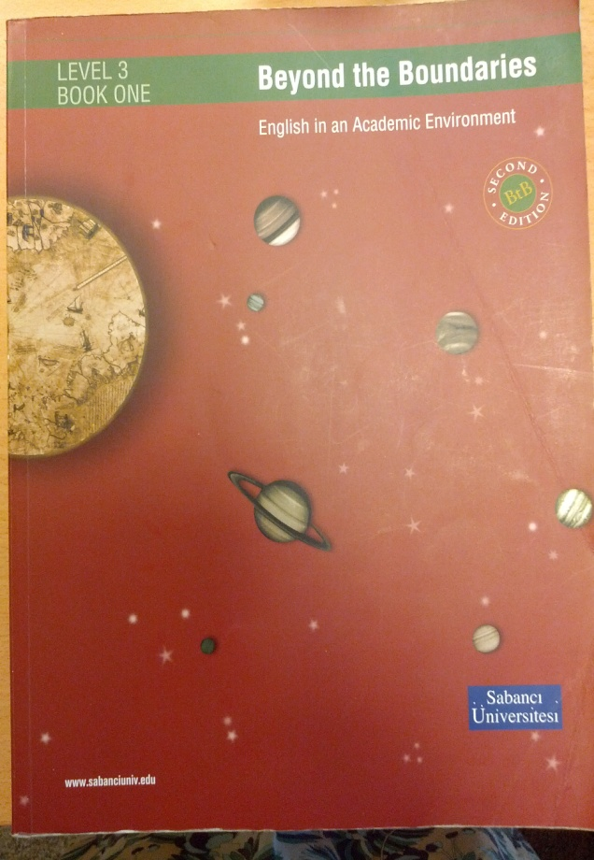
In-house Textbook (Beyond the Boundaries – BtheB)

Slide 7
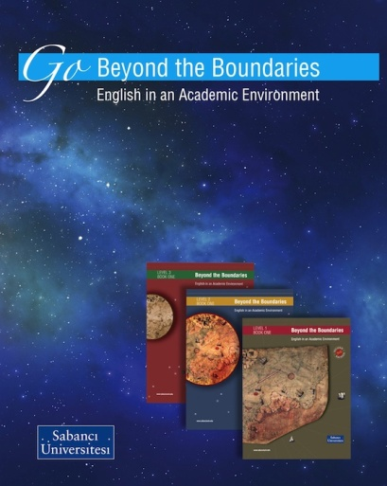
Starting in-house textbook (Beyond the Boundaries)
Used in the second 8 weeks of the course.
Written by a group of teachers at Sabancı University, School of Languages.
Printed in 2003 and edited and reprinted in 2010.
Three levels with two books at each level:
beyon_the_boundaries_booklet.pdf

Slide 8
Comparison between two coursebooks
LANGUAGE LEADER | BEYOND the BOUNDARIES
-Improving language proficiency | -Content-based, thematic approach
-1 book – 12 units | -2 books-10 units
-From easy to difficult (increasing length) | -No level of difficulty
-For teachers: Teacher-friendly (soft copy and online resource bank) | -For teachers: Just a key for exercises
-Building language skills in general | -Address academic needs of university students

Slide 9
Opinions after a semester
First trial in Route 1 (Elementary) for two years→ positive feedback
Using two books at all routes in Fall 2013
First reactions:
“When we finished Language Leader and began Beyond the Boundaries, our teacher has changed, too. Our fun teacher has turned into very serious person overnight. It was the end of the entertainment in class.”

Slide 10
Students’ opinions about LL and BtheB
Survey results from 37 R1 students
37 R2 students
36 R3 students

Slide 11
Difficulty level of two books

Slide 12
Some comments from students
«It could have been more difficult if we had started with BtheB.»
«LL is easy with good grammar exercises.»
«LL is childish not suitable for our age group.»
«BtheB is very difficult and some subjects are boring.»
«The topics in BtheB need updating.»

Slide 13
How much have they learned from the coursebooks?

Slide 14
Comparing two books

Slide 15
Some comments from students
«I think I have learned more academic type of vocabulary in BtheB.»
«I don’t think BtheB has helped me with the speaking skill.»
«It was difficult to cope with the long texts.»

Slide 16
Metaphors (Student responses)
When we finished LL and started BtheB, I felt like/as if…
-bored and in trouble.
-desperate.
-I don’t know anything.
-I hit hard against a wall.
-one of the Turks who who managed to
went to space!
-I made progress.

Slide 17
Metaphors (Student Responses)
Finishing LL and starting BtheB is like…
-migrating from a village to a megacity.
- jumping from a cliff.
-being lost in a jungle.
-stop using Nokia 3310 and start using
Iphone5.
-reaching nirvana.
-being slapped in the face.
-academic English has just started.

Slide 18
Teachers’ Responses (Metaphors)
When I finished Language Leader and I started Beyond the Boundaries, I felt like ....
-a large stone hit the students.
-we are in a new world which is more serious.
-pleased to begin more academic topics and skills.
- my students will be challenged.

Slide 19
Suggestions (Teacher Responses)
How to make the transition smoother?
Finding ways of making BtheB more appealing.
As we do LL, we can gradually introduce and incorporate texts and tasks that are similar to those in BtheB.
Using LL in Route 2 is good as some of its topics and grammar usually harmonise with the requirements of a low level EAP course, but let’s abandon LL on Route 4.
Choosing specific number of units from LL and expanding those units with outside materials to do further content and skills work.

Slide 20
THANK YOU FOR LISTENING.
ANY QUESTIONS?

