Slide 1
The Classroom Interface: Curriculum, Materials and Theory
Gaele Macfarlane, Hatice Çelebi, Sarah Kılınç
Koc University, Istanbul, ELC

Slide 2
The Classroom Interface: Curriculum, Materials and Theory
Today’s Outline
Who are we ?
Literature Review
Course Evaluation
Course Design
Research Methodology & Analysis
Results & Conclusions
The Future

Slide 3
The Classroom Interface: Curriculum, Materials and Theory

Slide 4
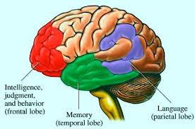
The Classroom Interface: Curriculum, Materials and Theory
Student Profile
Pre-intermediate
18 to 20
Study Habits
LYS
Learner Training /Memorization
Grammar/Productive Skills
Receptive/ Emergence

Slide 5
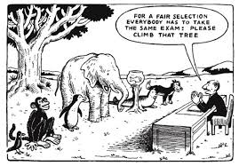
The Classroom Interface: Curriculum, Materials and Theory
Assessment
Michigan Placement Test
4 levels
TOEFL PBT 550 or IELT’s 6.5
537/6

Slide 6
The Classroom Interface: Curriculum, Materials and Theory
Our hypothesis:
“Enhanced guided practice of students’ productive skills through projects in and outside the classroom will improve their performance on tests and increase scores even when the test is designed to evaluate receptive skills.”

Slide 7
The Classroom Interface: Curriculum, Materials and Theory
Literature Review
An on-going critical examination, reflection and experimentation of new alternatives.

Slide 8
The Classroom Interface: Curriculum, Materials and Theory
1) Language experience needs to be contextualized and comprehensible. (Krashen, 1999)
2) The learner needs to be motivated, relaxed, positive and engage. (Arnold 1999, Tomlinson 1998a, 2003)
3) The language and discourse features for potential acquisition need to be salient, meaningful and frequently encountered. (Maley 1998, 2011; Tomlinson 1998b)
4) Deep and multi-dimensional processing of the language. (Tomlinson, 2001b)

Slide 9
The Classroom Interface: Curriculum, Materials and Theory
Rich authentic use for the learners, and the principles of experiential learning (Kolb, 1984) - personal responses to the meaning of the text is ensured
Keller (2010) - motivation, attention, relevance, confidence, and satisfaction
Generic ELT materials

Slide 10
The Classroom Interface: Curriculum, Materials and Theory
Opportunity to research
2012-13
ETS grant project
Pre-test/Post-test - 150 A2 level students
SKILLS INTEGRATION
NEW COURSES

Slide 11
The Classroom Interface: Curriculum, Materials and Theory
Our hypothesis:
“Enhanced guided practice of students’ productive skills through projects in and outside the classroom will improve their performance on tests and increase scores even when the test is designed to evaluate receptive skills.”

Slide 12
The Classroom Interface: Curriculum, Materials and Theory
New Curriculum
2012 Koc University ELC
15 hours of integrated skills 5 hours grammar 5 hours of a APP
325 hours semester
20 students
Our APP plan

Slide 13
The Classroom Interface: Curriculum, Materials and Theory

Slide 14
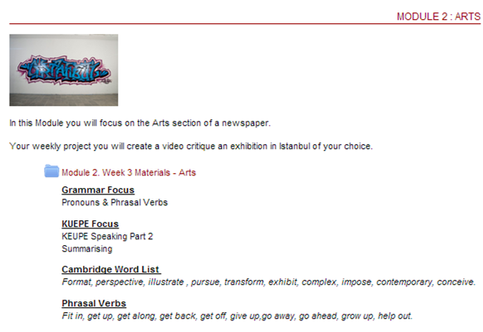
The Classroom Interface: Curriculum, Materials and Theory
Course Description

Slide 15
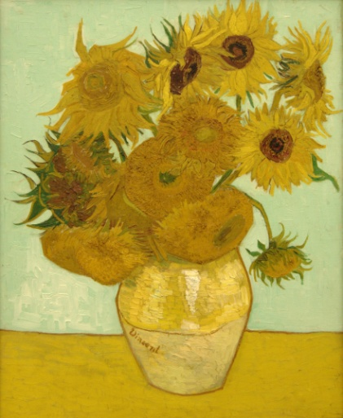
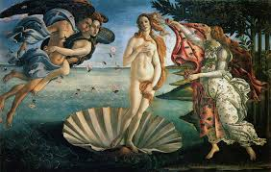
The Classroom Interface: Curriculum, Materials and Theory
Step 1: Describe the Artwork
Materials, shapes, lines are used?
Step 2: Analyze & Interpret
Dominant shapes, forms and lines colors?
Symbols used to convey meaning?
Step 3: Judge and Evaluate
Artist successful in communicating his/her message?
Artwork mean to you, why?
Useful Vocabulary - medium, subject matter, color, lines, shapes, scale, perspective composition

Slide 16
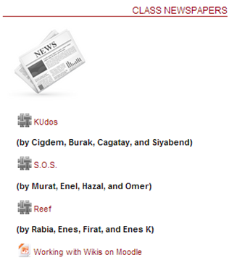
The Classroom Interface: Curriculum, Materials and Theory
Course Description

Slide 17
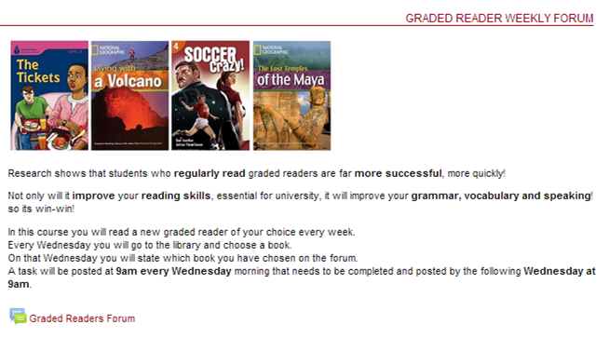
The Classroom Interface: Curriculum, Materials and Theory
Course Description

Slide 18
The Classroom Interface: Curriculum, Materials and Theory
Methodology
Exam Delivery
Exam 1 - 145 students (18-20)
50/50 male female
No English proficiency exam
Exam 2 -101 students

Slide 19
The Classroom Interface: Curriculum, Materials and Theory
Analysis
ETS
Paired-samples T test SPSS Version 13.0.
145 students
44 not included - statistical outliers (1 or more sections blank)
Language skills

Slide 20
The Classroom Interface: Curriculum, Materials and Theory

Slide 21
The Classroom Interface: Curriculum, Materials and Theory
In February
Average score 449
No 550
5 over 500
Range: 363 – 533 (170)
55 scored lower than 450
In May
Average score 492
10 -550
8 537 – 547
45 over 500
Range 353 – 593 (240)
14 scored lower than 450

Slide 22
The Classroom Interface: Curriculum, Materials and Theory
Student promotion comparison with previous years

Slide 23
The Classroom Interface: Curriculum, Materials and Theory
Discussion
Structure section - largest score & range increase
Reading
“Enhanced guided-practice on students’ productive skills through projects in and outside the classroom will improve their performance on an ideal test situation even when the test is designed to evaluate receptive skills”

Slide 24
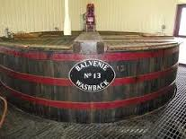
The Classroom Interface: Curriculum, Materials and Theory
2013 - 2014
KUEPE Reading
Writing
Speaking
Listening
Language in use

Slide 25
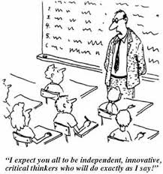
The Classroom Interface: Curriculum, Materials and Theory
Plans for the future
Reviewing topics
Tasks – practise input
Speed Reading

Slide 26
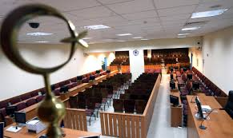
The Classroom Interface: Curriculum, Materials and Theory
The Court Case

Slide 27
The Classroom Interface: Curriculum, Materials and Theory

Slide 28
The Classroom Interface: Curriculum, Materials and Theory
References
Arnold, J. (ed.) (1999). Affect in language learning. Cambridge: Cambridge University Press.
Byrd, P. (1995). Materials writers guide. Rowley MA: Newbury House.
Byrd, P. (2001). Textbooks: Evaluation for selection and analysis for implementation. In M. Celce- Murcia (ed.), Teaching English as a second or foreign language. (3rd edn). Boston, MA: Heinle & Heinle, 415–427.
Cunningsworth, A. (1984). Evaluating and selecting EFL teaching materials. London: Heinemann Educational Books.
Edge, J. & S. Wharton (1998). Autonomy and development: Living in the materials world. In B. Tomlinson (ed.), 295–310.
Hidalgo, A. C., D. Hall & G. M. Jacobs (eds.) (1995). Getting started: Materials writers on materials writing. Singapore: SEAMEO Language Centre.
Johnson, K. (2003). Designing language teaching tasks. Basingstoke: Palgrave Macmillan.
Jolly, D. & R. Bolitho (2011). A framework for materials writing. In B. Tomlinson (ed.), 107–134.
Keller, J. M. (2010). Motivational design for learning and performance: The ARCS model approach. New York, NY: Springer.

Slide 29
The Classroom Interface: Curriculum, Materials and Theory
Kolb D. A. (1984). Experiential Learning experience as a source of learning and development, New Jersey: Prentice Hall.
Krashen, S. 1999. Condemned without a Trial: Bogus Arguments Against Bilingual Education. Portsmouth, NH: Heinemann Publishing Company.
Longman dictionary of contemporary English (4th ed.). (2003). Harlow, England: Longman
Maley, A. (1998). Squaring the circle – reconciling materials as constraint with materials as empowerment. In B. Tomlinson (ed.), 279–294.
Maley, A. (2011). Squaring the circle – reconciling materials as constraint with materials as empowerment. In B. Tomlinson (ed.), 379–402.
McGrath, Ian. (2001). Materials Evaluation and Design for Language Teaching. Edinburgh: Edinburgh University Press, 2001.
Mukundan, J. & Ahour, T. (2010). A review of textbook evaluation checklists across four decades (1970-2008). In Tomlinson, B., Masuhara, H. (Eds.). Research for materials development in language learning: Evidence for best practice (pp. 336-352). London: Continuum.
Prowse, P. (1998). How writers write: Testimony from authors. In B. Tomlinson (ed.), 130–145.
Sheldon, LE. (1987). Introduction in ELT Textbooks and Materials: Problems in Evaluation and Development.

Slide 30
The Classroom Interface: Curriculum, Materials and Theory
Tomlinson, B. (Ed.). (1996). Materials development in language teaching. Cambridge: Cambridge University Press.
Tomlinson, B. (ed.) (1998a). Materials development in language teaching. Cambridge: Cambridge University Press.
Tomlinson, B. (1998b). Introduction. In B. Tomlinson (ed.), 1–24.
Tomlinson, B. (2011). Principled procedures in materials development. In B. Tomlinson (ed.), 1–31.
Tomlinson, B. et al. (2001a). ELT Courses for Adults. ELT Journal, 55(1) 80-101.
Tomlinson, B. (2001b). Connecting the mind: A multi-dimensional approach to teaching language through literature. The English Teacher 4.2, 104–115.
Tomlinson, B. (2003). Humanizing the coursebook. In B. Tomlinson (ed.), 162–173.
Tomlinson, B.(2008) ‘Language acquisition and language learning materials.’ In B. Tomlinson (ed.) English Language Teaching Materials. London: Continuum, 3-14.

