Slide 1
Key Issues in Marking
Stuart McGugan
Educational Development Unit
University of Liverpool

Slide 2
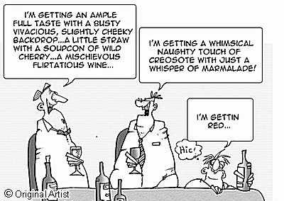

Slide 3
A key goal of marking is to make reliable judgements i.e. as assessors we are reaching the same conclusions about student performance
Consistency & fairness
Different markers/the same marker

Slide 4
Elton and Johnston (2002) argue that the focus on reliable assessment practices arise out of a positivist paradigm with its belief in the possibility of objectivity, scientific measurement and certainty
However.........
Elton, L. & Johnston, B. (2002) Assessment in Universities: a critical review of research, LTSN generic Centre

Slide 5
In some cases, such as problem sheets, the design of the assessment takes
longer than the marking, and usually the scheme is fairly self-evident. The
learning being tested is usually convergent, which means that correct answers
are clear, and the only real problems concern half-correct answers: if
someone has got the answer to a maths problem wrong, do you give credit
for the fact that they only went wrong in the latter stages of the working?
Whatever the decision, it is fairly easy to be consistent and hence reliable in
its application.
This is less true in the case of essay-type questions. In fact, one of their
problems is that they are so easy to set—most experienced teachers can
think of an essay question off-the-cuff in fifteen seconds—that we often have
little clear idea of what we will get back.
James Atherton Marking [online] http://www.learningandteaching.info/teaching/marking.htm

Slide 6
Grade variability of 2 Essays by 50 academics
Classification (5 point scale) | Essay 1 (female author) | Essay 2 (male author) | Total
1st | 0 | 0 | 0
1st/2.1 borderline | 0 | 0 | 0
2.1 | 6 | 5 | 11
2.1/2.2 borderline | 4 | 1 | 5
2.2 (Original assessor) | 24 | 25 | 49
2.2/3rd borderline | 2 | 2 | 4
3rd | 10 | 10 | 20
Fail | 4 | 7 | 11
Total | 50 | 50 | 100
Read, B et al (2005) Gender, bias, assessment and feedback. Assessment and Evaluation in Higher Education 30(3):241-260

Slide 7
Grade variability of 2 Essays by 50 academics
Classification (2 point scale) | Essay 1 (female author) | Essay 2 (male author) | Total
PASS | 46 | 43 | 89
FAIL | 4 | 7 | 11
Total | 50 | 50 | 100
Read, B et al (2005) Gender, bias, assessment and feedback. Assessment and Evaluation in Higher Education 30(3):241-260

Slide 8
Checks and balances
Sample performance more than once using a range of methods
Anonymous performance
Double marking (judgment of student performance)
Moderation – internal and external (judgement of marking)
‘Reasonable’ adjustments (e.g. scaling, profiling)
Criterion based assessment

Slide 9
Approaching your practice
Engage with the assessment criteria
Mark against assessment criteria (guides feedback)
Plan time (blocks)
Do not ‘agonise’
Alert to possible biases – e.g. handwriting, tiredness
Mark individual questions/sections rather than complete performance
Remark the last few students again at the start of a marking session
Self moderate when finished checking for errors/consistency

Slide 10
Professional judgment comes from repeated engagement in the appropriate activities in the company of those with expertise
(Sue Bloxton, Conference Presentation, 2008)

