Slide 1
School of Histories, Languages and Cultures
Generic feedback on exams
17 Oct 2012
Stuart McGugan, Education Development Division
Tünde Varga-Atkins, eLearning Unit

Slide 2
Helping students succeed on their programmes
Make sense of what they are doing
Address misconceptions/errors
Feedback
Influence students’ views of knowledge
Motivate students
Give direction as to what to do next

Slide 3
Feedback on examinations
We will publish overall feedback on each examination, in the form of a commentary on the strengths and weaknesses of the answers given by the class as a whole (the University refers to this as ‘generic feedback’).
Module convenors will publish this feedback on each module’s VITAL pages.

Slide 4
Feedback on examinations
Students may also consult staff individually by appointment for feedback after module marks have been released in Spider.
Students may see their marked examination script, but cannot remove it from the room. Individual feedback will not be available by email.

Slide 5
Suggestions
General comments - quantitative

Slide 6
General Comments - Qualitative
What sorts of answers scored well/badly
Question types: e.g. Compare and contrast...
What kinds of comparisons scored well/badly....
Collect during marking process/insights into markers thinking
Can you provide exemplars of student writing?
External examiners comments?
How exam technique can enhance results
Can you encourage students to think about this feedback in their next assignment?

Slide 7
Can you write a paragraph or so explaining how you have taken general feedback provided on exams into consideration when undertaking this assignment.

Slide 8
Question specific comments
Model answers.
‘Essay’ style answers:
what the marker was looking for;
e.g. particular lines of argument, bodies of literature, relevant concepts elegance of solutions to problems;
Practicalities (writing/reviewing/time).
Revision resource – incoming cohort.
Value for tutor when reviewing individual paper.

Slide 9
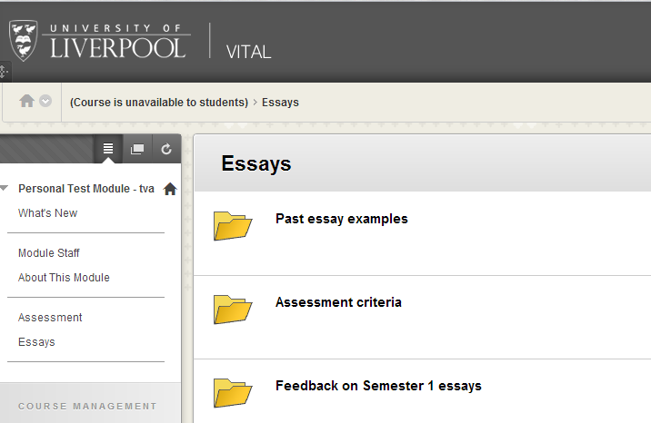
Some online tools for posting generic feedback
e.g. documents
tracked documents

Slide 10
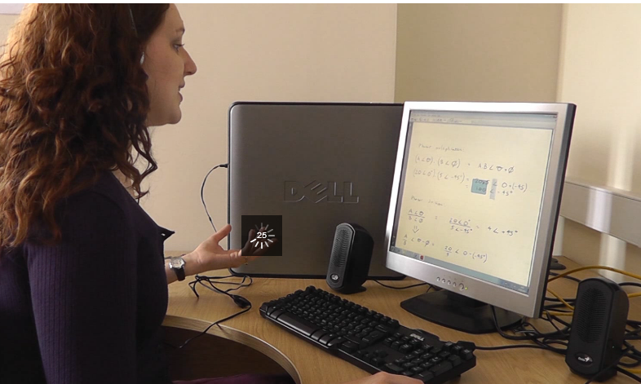
Feedback in multimedia format
podcasts (audio of generic feedback)
see case study by Prof Harrington (Law)
screencasts (video of screen+ audio e.g. narrating example essays, model answers or generic feedback)
see case study by Leah Ridgway (EEE)

Slide 11
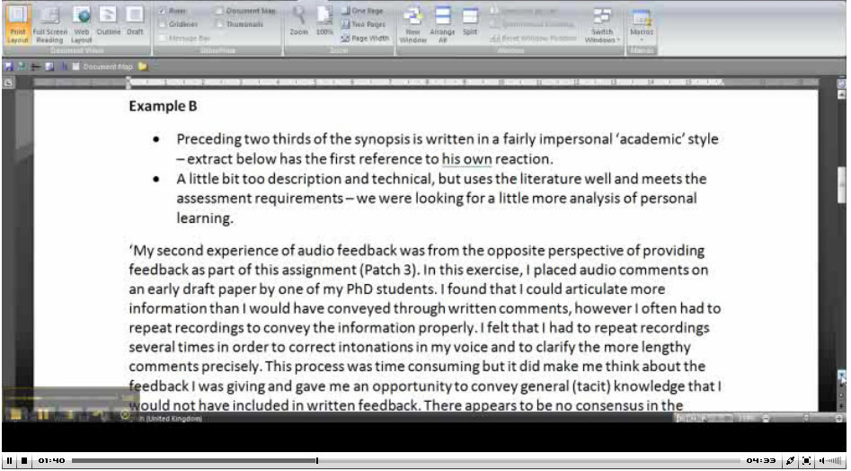
Screencast: narrated prior sample assignments…
see case study by Janet Strivens (PGCert)

Slide 12
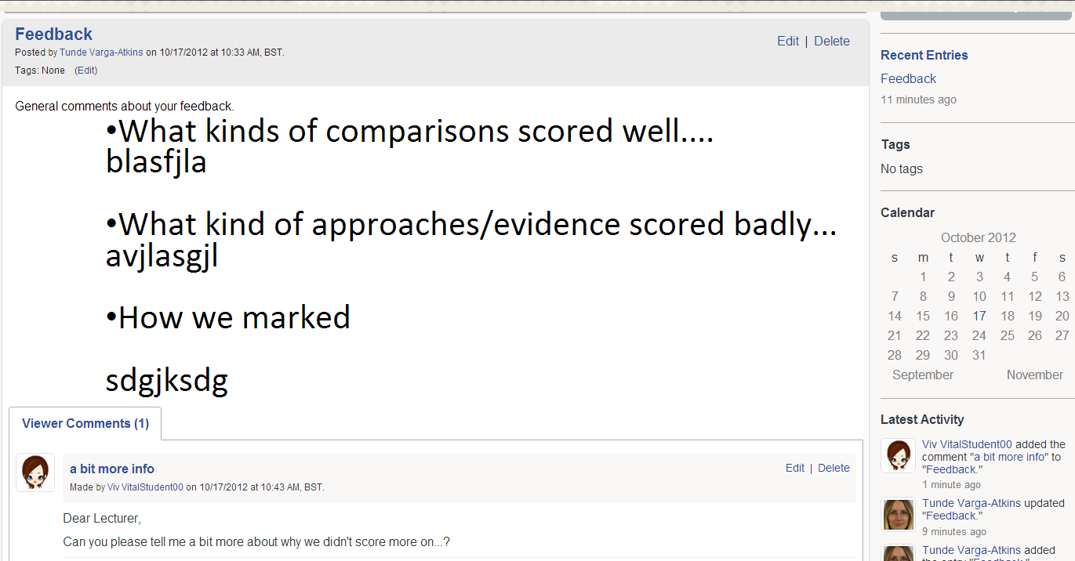
Tools for feedback dialogue:
Discussion boards or comment function of Blogs/Wikis

Slide 13
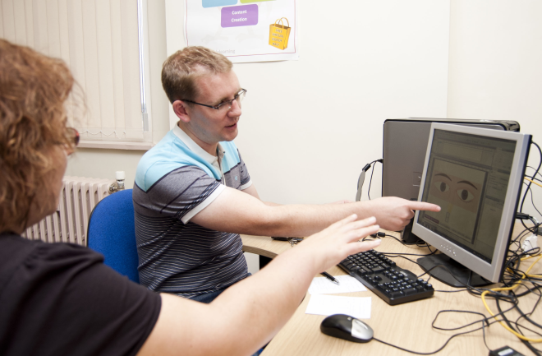
Further support: consultancy
Educational Development
eLearning Unit: Studio Wednesdays 1.30-5pm, 126 Mount Pleasant, 3rd floor.
S.McGugan@liv.ac.uk
elearning@liv.ac.uk

